Slide 1
Chemical Notation
species
superscript
this element or compound
total charge on the species
+
2
H3O
coefficient
how many of this species present
subscript
how many of that element in the species
No number means 1

Slide 2
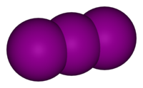
Examples
3I⁻
I₃⁻
three iodide ions
one tri-iodide ion
I⁻
I₃⁻
I⁻
I⁻
three iodine atoms bonded to each other
these atoms are not bonded to each other

