Slide 1
Organic Chemistry
Numbering Systems

Slide 2
Numbering
The length of the main carbon chain
1 meth
2 eth
3 prop
4 but
5 pent
6 hex
7 hept
8 oct
CH₄
CH₃ CH₃
CH₃ CH₂ CH₃
CH₃ CH₂ CH₂ CH₃
CH₃ CH₂ CH₂ CH₂ CH₃
CH₃ CH₂ CH₂ CH₂ CH₂ CH₃
CH₃ CH₂ CH₂ CH₂ CH₂ CH₂ CH₃
CH₃ CH₂ CH₂ CH₂ CH₂ CH₂ CH₂ CH₃

Slide 3
Numbering
The position of a group
2-methyl pentane
3-methyl pentane
2-methyl pentane

Slide 4
Numbering
The position of a group
pentan-1-ol
pentan-2-ol
pentan-3-ol

Slide 5
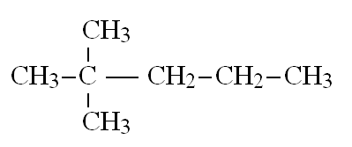
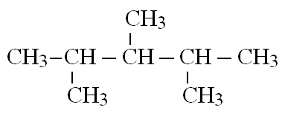
Numbering
2 | 3 | 4
di | tri | tetra
More than one of the same group
2,2-dimethyl pentane
2,3,4-trimethyl pentane

Slide 6
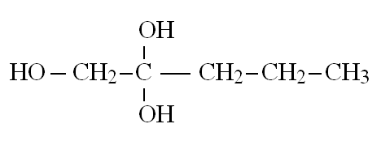
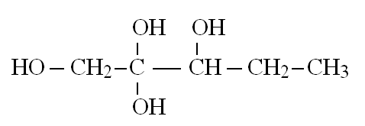
Numbering
2 | 3 | 4
di | tri | tetra
More than one of the same group
pentan-1,1-diol
pentan-1,2,2-triol
pentan-1,2,2,3-tetraol

