Slide 1
Organic Chemistry
Functional Groups

Slide 2
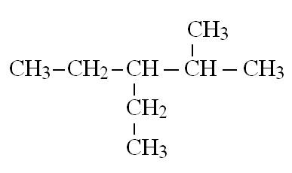
Groups
Group name: alkyl
Found in: alkanes
2-methyl 3-ethyl pentane

Slide 3
Groups
Group name: alkene
Found in: alkenes
but-1-ene
( could also be written: CH₂CHCH₂CH₃ )
If a molecule has at least one alkene group, it is unsaturated

Slide 4
Groups
Group name: hydroxyl
Found in: alcohols
butane-1,2-diol

Slide 5
Groups
Group name: carbonyl
Found in: aldehydes (if at end of chain), ketones (if not)
propanal
pentan-3-one
( could also be written: HCOCH₂CH₃ )
( could also be written: CH₃CH₂COCH₂CH₃ )

Slide 6
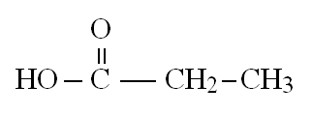
Groups
Group name: carboxyl
Found in: carboxylic acids
propanoic acid
( could also be written: HOOCCH₂CH₃ )

Slide 7
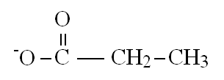
Groups
A carboxylic acid can lose its proton (H+) to become a
carboxylate anion
propanoate ion
A carboxylate anion and a positive ion forms a
carboxylate salt
sodium propanoate

Slide 8
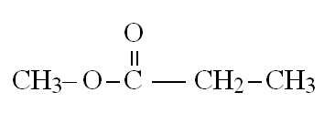
Groups
Group name: ester
Found in: esters
methyl propanoate
( could also be written: CH₃OOCCH₂CH₃ )
Notice how each side of the ester is named:
methyl
propanoate

Slide 9
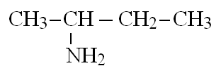
Groups
Group name: amine
Found in: amines
butan-2-amine
( could also be written: CH₃CH(NH₂)CH₂CH₃ )

Slide 10
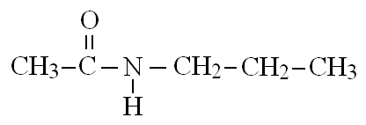
Groups
Group name: amide
Found in: amides
don’t need to name these
( could also be written: CH₃CONHCH₂CH₂CH₃ )

