Slide 1
Year 8 English: Vocab
Term 3, Week 4

Slide 2
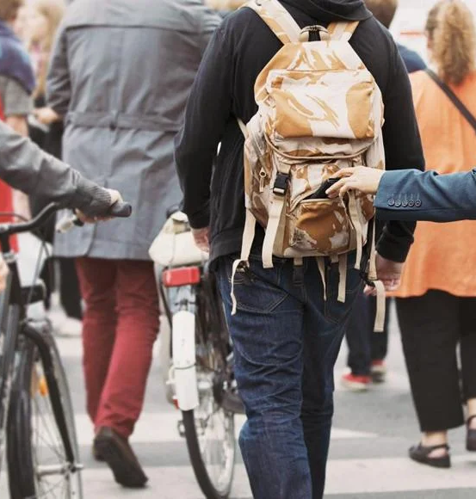
Notorious
Part of Speech: adjective
Meaning: famous for something bad
Tourists should avoid this area as it is notorious for crime and pickpocketing.

Slide 3
Covert
Part of Speech: adjective
Meaning: hidden or disguised; secret
The spy went to great lengths to ensure his enemies would not discover his covert plans.

Slide 4
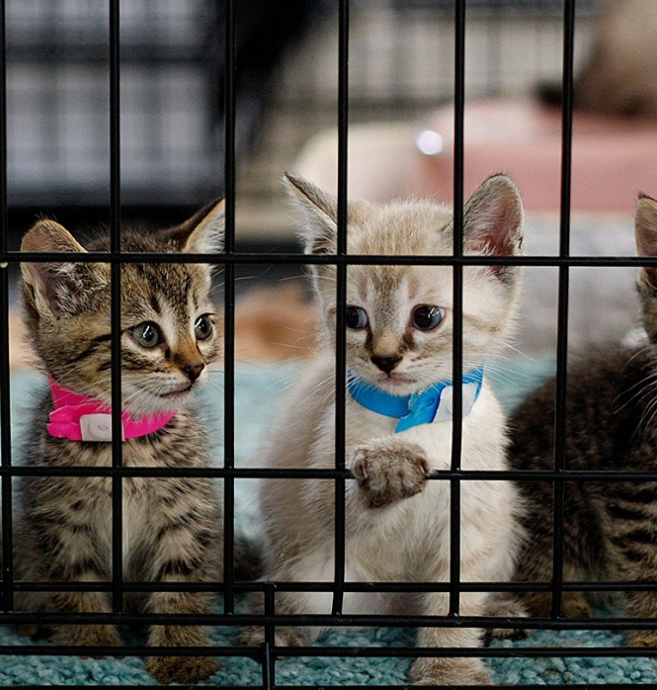
Defray
Part of Speech: verb
Meaning: provide the money to cover costs or expenses
All we ask is a donation to help defray the costs of running the animal shelter.

Slide 5
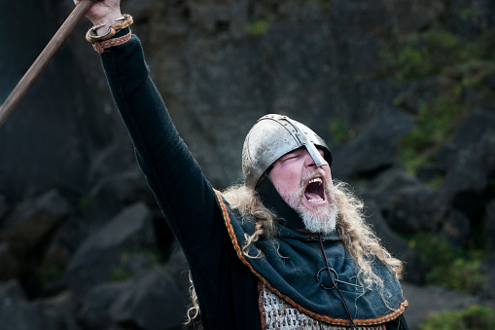
Vanquished
Part of Speech: adjective
Meaning: defeated; utterly wiped out
I will not rest until every foe is vanquished!

Slide 6
Camaraderie
Part of Speech: noun
Meaning: friendly warmth and loyalty between people who work together or spend a lot of time together
The cheerful camaraderie between the workers helped the business to thrive.

Slide 7
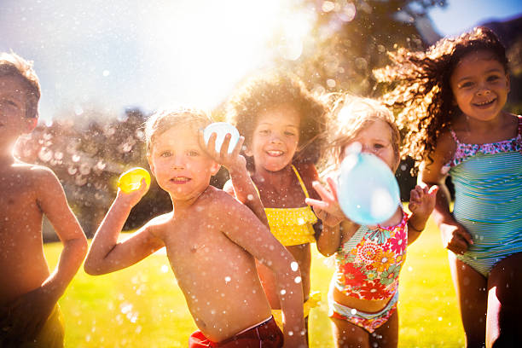
Waylaid
Part of Speech: verb
Meaning: ambushed; attacked unexpectedly by someone who has been lying in wait
On the way to the park we were waylaid by a bunch of kids with water balloons.

Slide 8
Scabbard
Part of Speech: noun
Meaning: a sheath for a dagger or sword
He pulled his sword out of the scabbard and bravely approached the dragon.

Slide 9
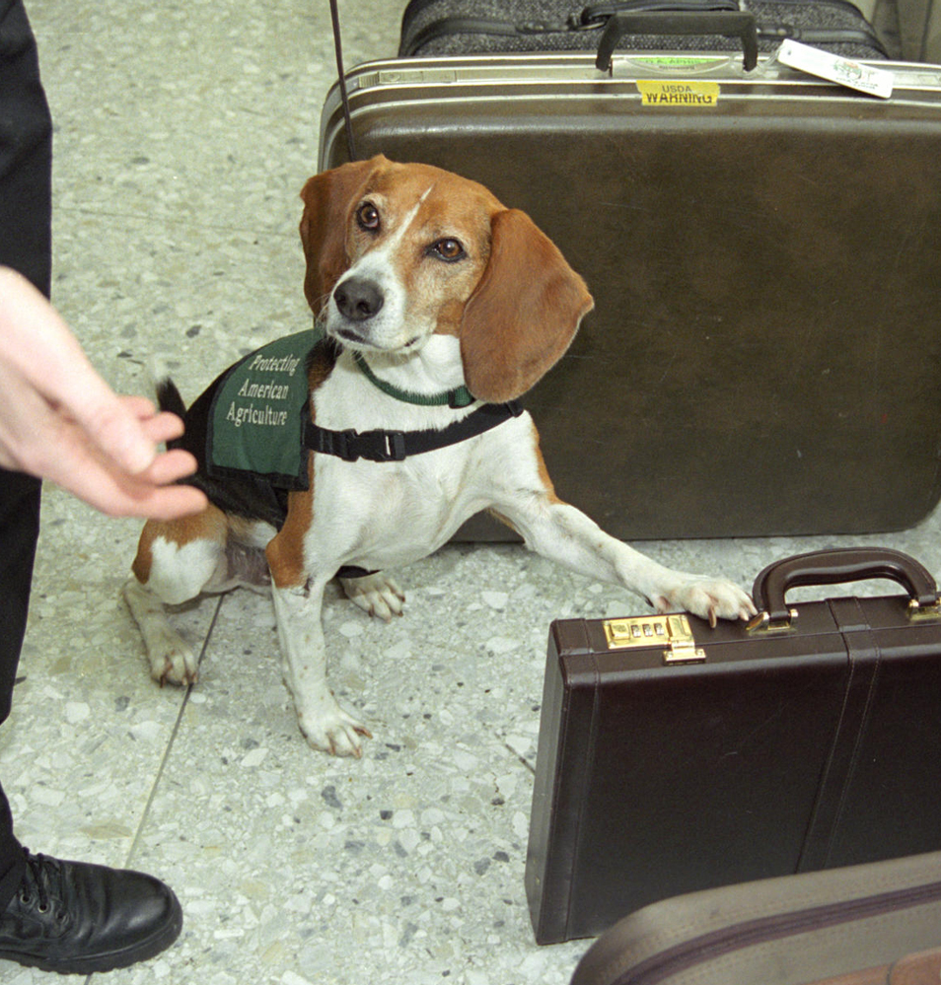
Contraband
Part of Speech: noun
Meaning: goods that have been taken between countries illegally
At the airport, bags are inspected for any contraband items.

Slide 10
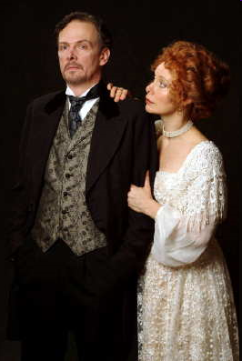
Placate
Part of Speech: verb
Meaning: to stop from being angry; to appease
Helena tried her hardest to placate her husband’s wrath.

Slide 11
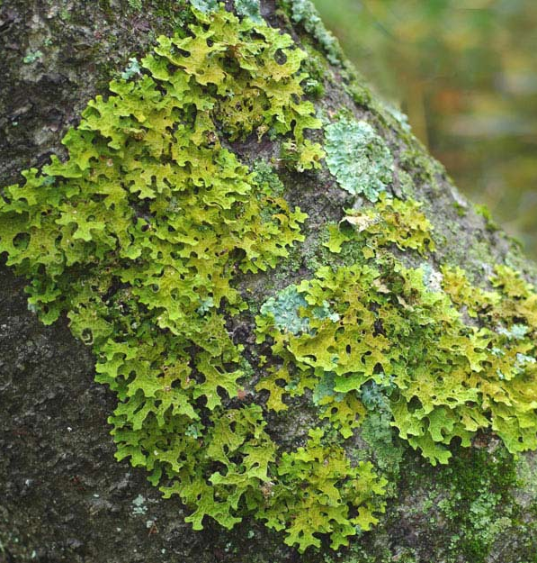
Lichen (LIE-kun)
Part of Speech: noun
Meaning: a type of flat plant-like organism which grows over rocks or wood
Lichen had spread over the fallen tree trunk.

