Slide 1
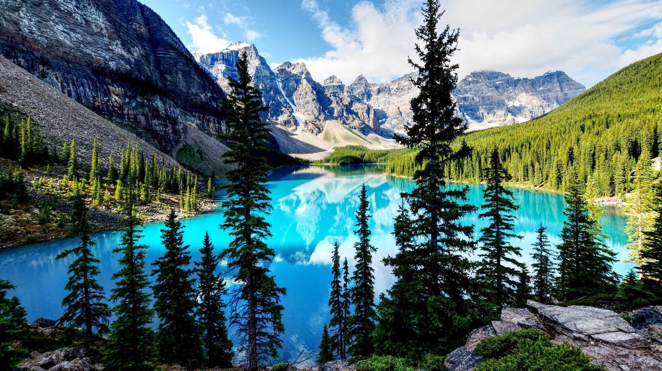
Poetry 4
Meaning, Tone & Mood

Slide 2
Meaning

Slide 3
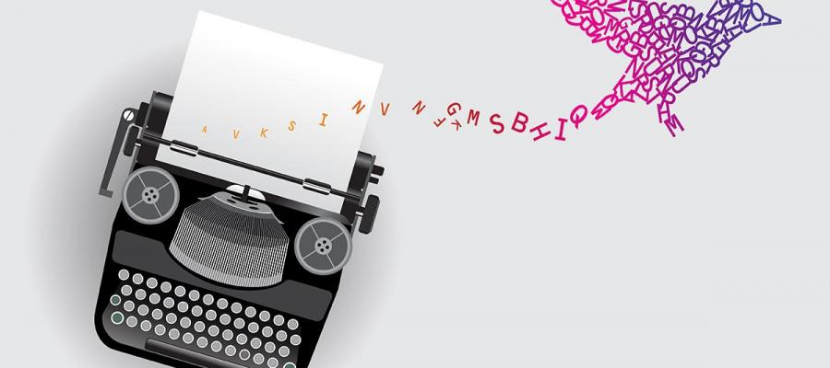
Meaning in poems
Poetry doesn’t always have ‘one true meaning’. It’s open to interpretation.
How YOU feel when you read it
What YOU think it means
WHY you think it means that
Different readers might see different meanings in it.
Even if the author says they meant something else, the reader’s interpretation is still valid.

Slide 4
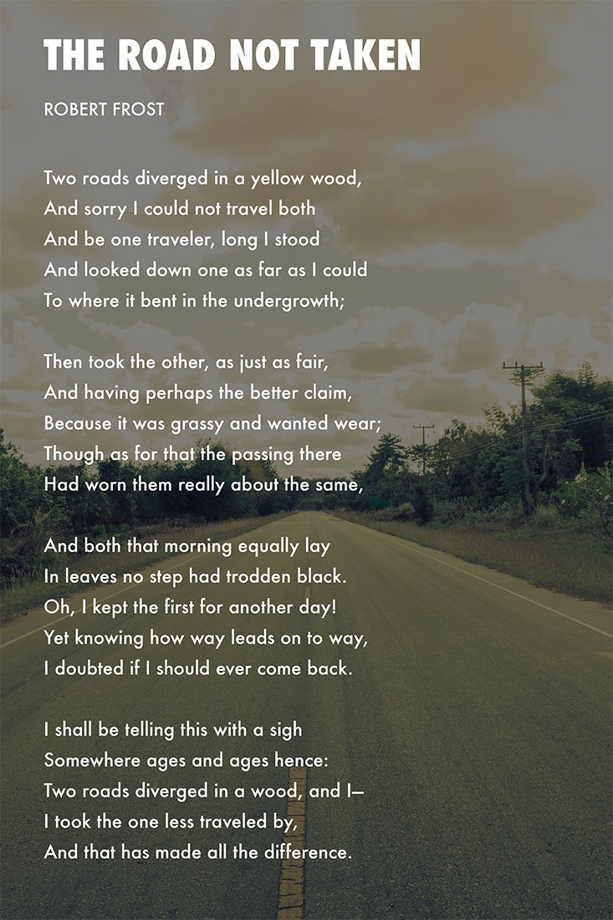
Literal meaning: someone walking comes to a fork in the road, decides to go one way, says that doing so ‘made all the difference’.
Reader 1: it’s about individualism, being different to everyone else
Reader 2: it’s about making choices and decisions in life
Reader 3: it’s about a big mistake the poet made that he regrets

Slide 5
Looking for meaning
Questions to ask:
Does the title have any significance?
What is the poem about? What happens in it?
Is it literal? Could it be a metaphor for something?
Look at the last few lines – sometimes contain a takeaway message
Find out about the poet – who they are & why they wrote this
Look for clues in the words, sounds and techniques used

Slide 6
Point of View

Slide 7
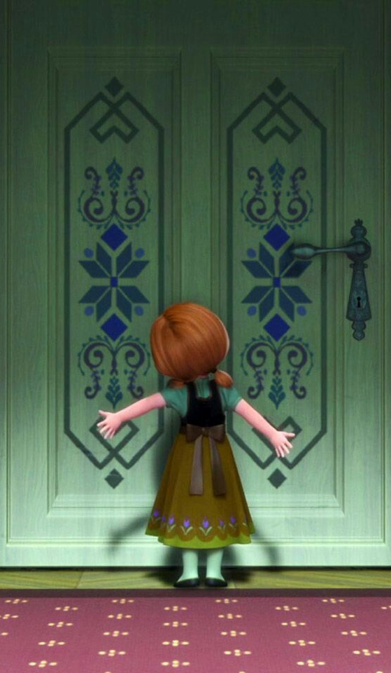
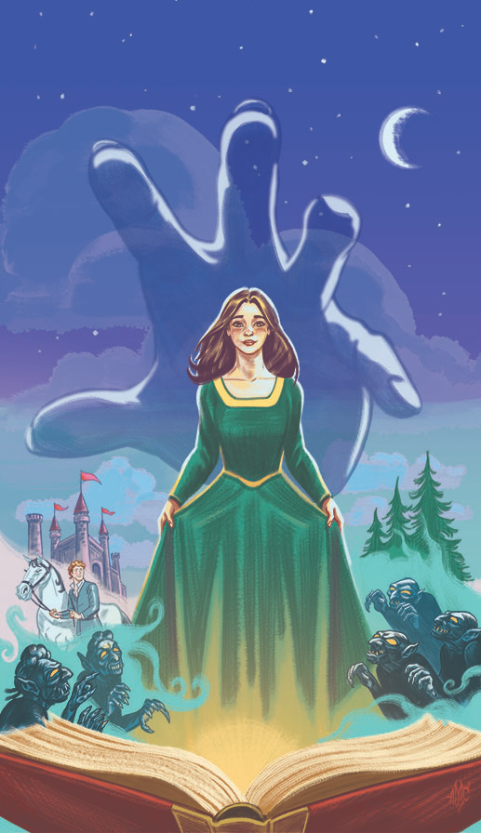
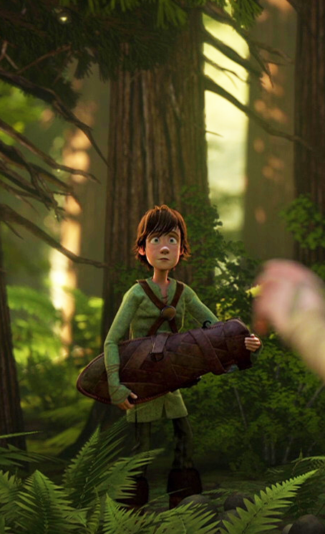
1st Person
I, me, my, we, us
If someone told me to hop on one foot all day, I'd have to do it. If you commanded me to cut off my own head, I'd have to do it. I am in danger at every moment.
3rd Person
He, him, his, she, her, hers, it, they, them, their
Hiccup saw the dragon crash to the ground somewhere in the forest, so he took his dagger and went to look for it.
2nd Person
You, your, yours
You want to build a snowman, but your sister does not want to play with you.

Slide 8
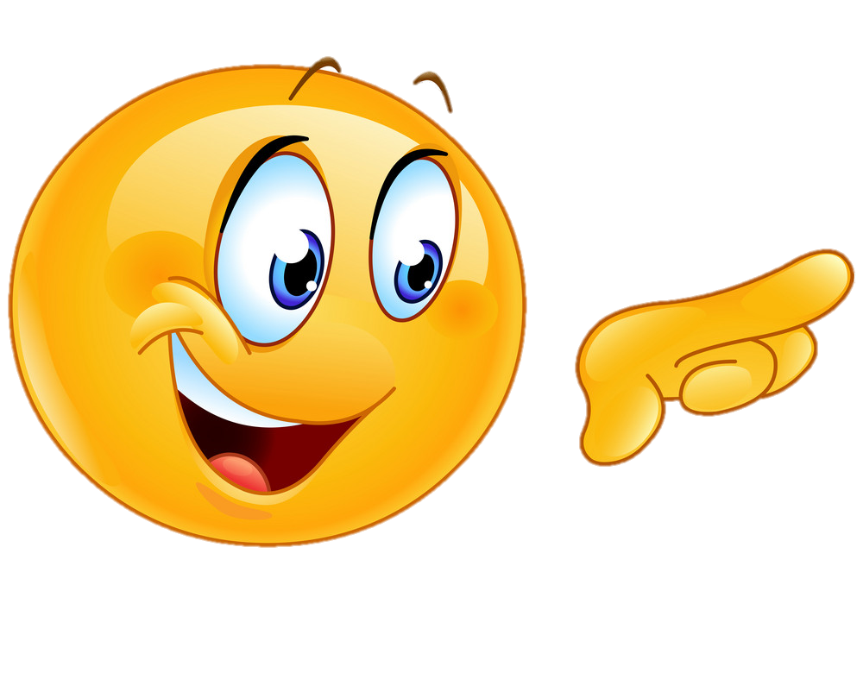
Effect of POV in poetry
First person – personal. Feel like we’re hearing the poet speaking to us about their thoughts.
Second person – inclusive. The poem speaks to you directly, suggests it’s YOUR thoughts or experiences.
Third person – more distant, less personal. Good for narrative poetry (telling a story). Allows poet to use multiple characters or perspectives.

Slide 9
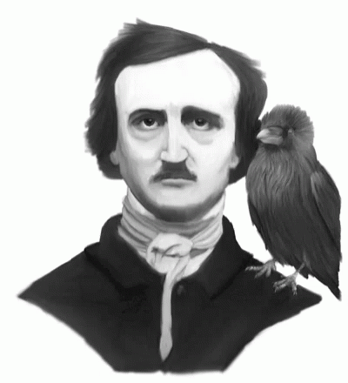
The Raven by Edgar Allan Poe
First person
Once upon a midnight dreary, while I pondered, weak and weary,
Over many a quaint and curious volume of forgotten lore—
While I nodded, nearly napping, suddenly there came a tapping,
As of some one gently rapping, rapping at my chamber door.
“’Tis some visitor,” I muttered, “tapping at my chamber door—
Only this and nothing more.”

Slide 10
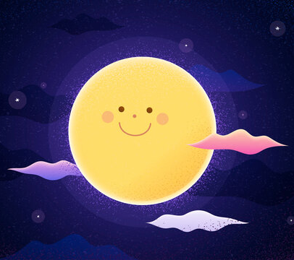
The Dark by Carol Ann Duffy
Second person
You think of the dark
as a black park
and the moon as a bounced ball,
You fear nothing,
you know
there’s nothing to be frightened of
at all.

Slide 11
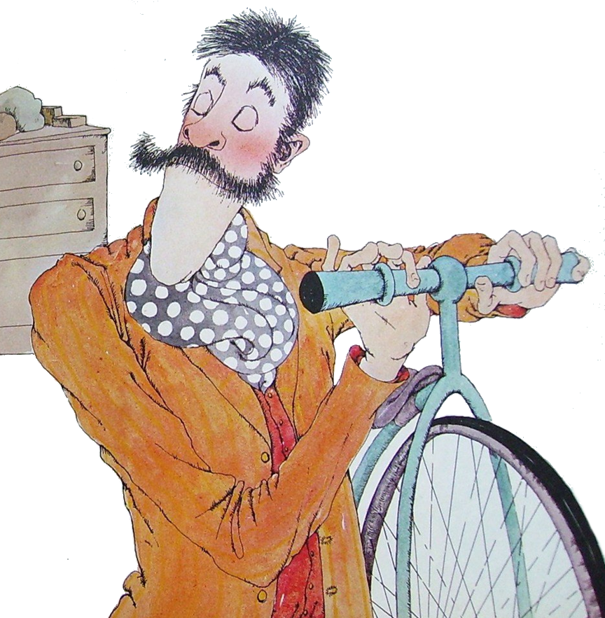
Mulga Bill by Banjo Patterson
Third person
'Twas Mulga Bill, from Eaglehawk, that caught the cycling craze;
He turned away the good old horse that served him many days;
He dressed himself in cycling clothes, resplendent to be seen;
He hurried off to town and bought a shining new machine;

Slide 12
Voice

Slide 13
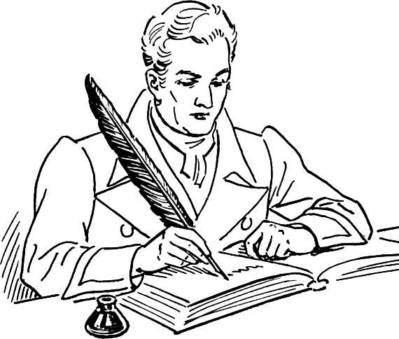
Persona vs Poet
Just like in a book, the persona (also called speaker or narrator) of a poem is not always the poet (the author/writer).
Sometimes the poet says things from their own point of view, explains their own thoughts & feelings, or describes an event that happened to them
Sometimes they speak from the point of view of another character.

Slide 14
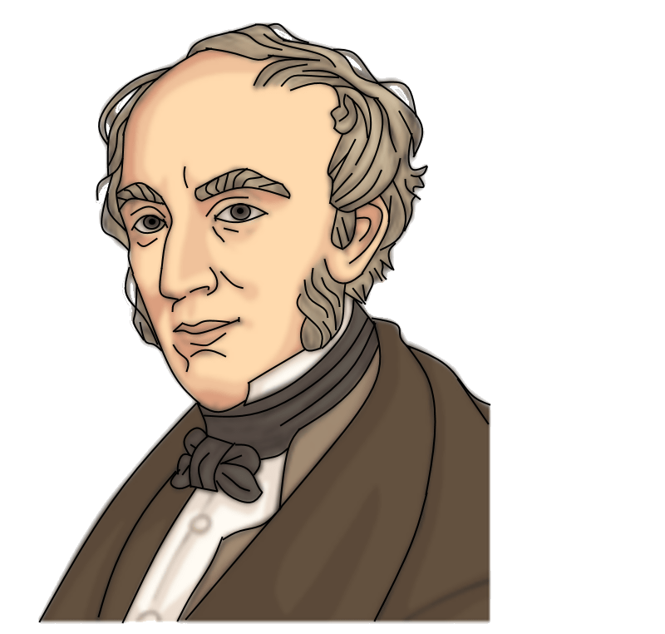
I wandered lonely as a cloud
That floats on high o'er vales and hills,
When all at once I saw a crowd,
A host, of golden daffodils;
Beside the lake, beneath the trees,
Fluttering and dancing in the breeze.
First Person POV
Persona: the poet
(William Wordsworth)

Slide 15
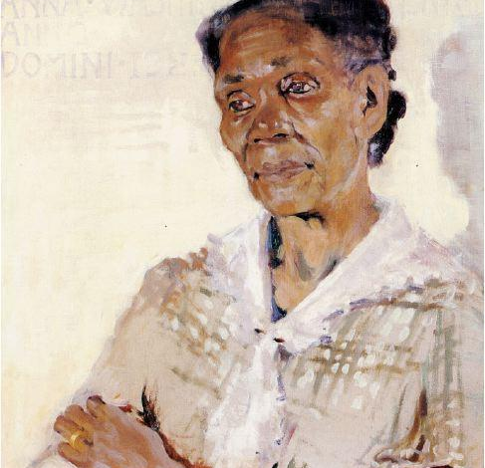
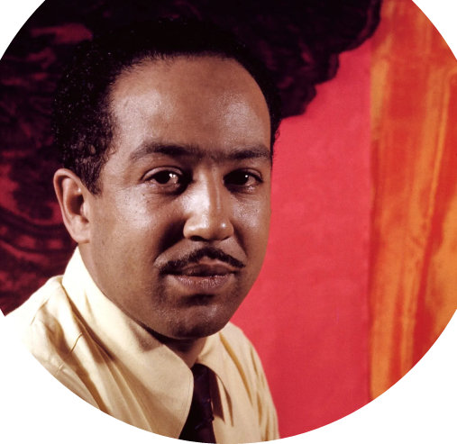
“Well, son, I’ll tell you:
Life for me ain’t been no crystal stair.
It’s had tacks in it,
And splinters,
And boards torn up…”
First Person POV
Persona:
A mother
Poet:
Langston Hughes

Slide 16
Persona:
A mirror
I am silver and exact.
I have no preconceptions.
Whatever I see, I swallow immediately
Just as it is, unmisted by love or dislike.
I am not cruel, only truthful
Most of the time I meditate on the opposite wall.
It is pink, with speckles. I have looked at it so long
I think it is part of my heart.
Poet:
Sylvia Plath

Slide 17
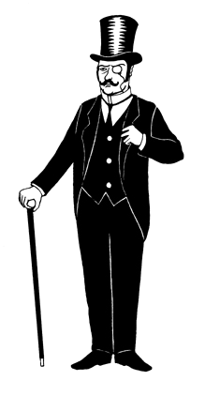
Voice
What type of words does the speaker use? How formal or casual do they sound? Do they use old fashioned words? Slang? Bad grammar?
The reader can guess or figure out things about the speaker based on their voice, or the way they talk (also called diction).
It is beneficial in an academic context to understand the etymology of literary terms.
Them folks told me to clear out. I ain't got nothin’ and I dunno where I’m goin’.
Text me when you’re ready to head home so I can pick you up.
Let us go then, you and I… when the evening is spread out against the sky

Slide 18
Tone & Mood

Slide 19
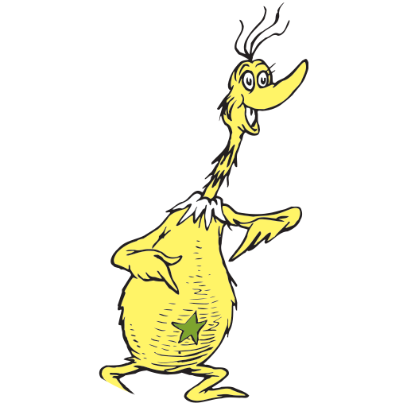
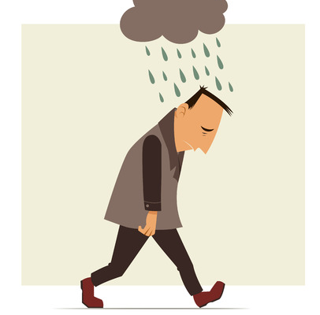
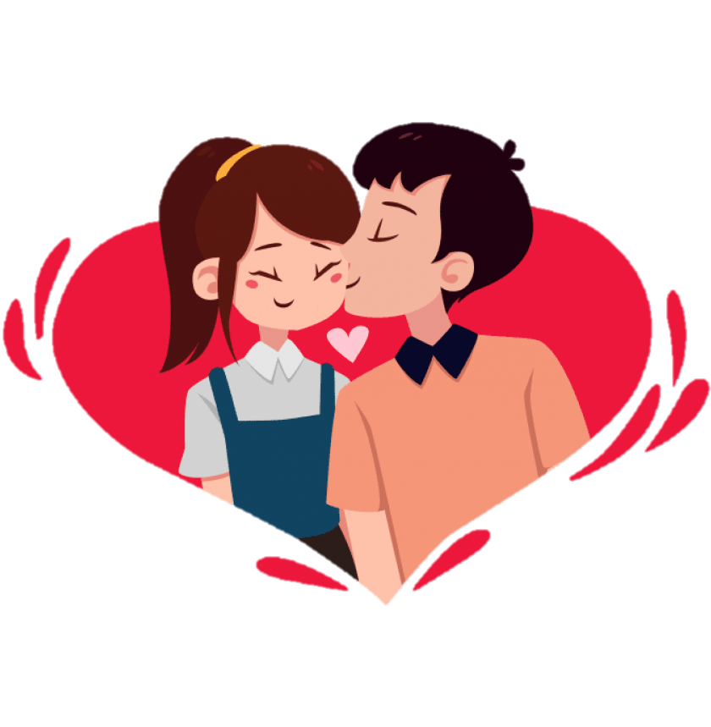
Tone or mood
How does the poet AND/OR the speaker seem to feel about the topic?
What feelings or emotions does this poem show?
Is it serious, cheerful, gloomy, excited, lovesick, funny, angry?

Slide 20
Style influences tone/mood
All of the elements we have looked at so far help shape the mood and tone:
Structure/form – free flowing lines vs strict rules
Rhyme & rhythm – patterns of words, repetition of sounds
Word choice – sounds of words: are they harsh, smooth, funny?
Figurative language – painting a picture: positive or negative?
Meaning – is the topic serious or fun?

