Slide 1
Poetry 1
Purpose, Form & Structure

Slide 2
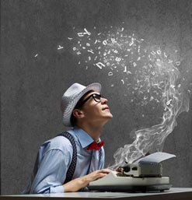
Purpose
In poems, authors use lots of different techniques to convey (show, deliver) their message.
The two most important questions you need to ask about every text (film, novel, poem, play):
What is the writer’s message?
How is it conveyed?

Slide 3
Form

Slide 4
FORM
We use the word ‘form’ to talk about the type of poem, the rules it has, the way it’s laid out.
Form can have an effect on the author’s message and how it’s conveyed.

Slide 5
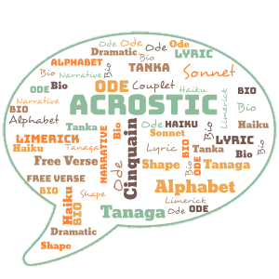
FORM
Last year we looked at…
Haiku
Limerick
Narrative poem
Lyric poem
Ode
This year we will look at…
Sonnet
Ballad
Psalm
Villanelle
Free verse

Slide 6
Form & Meaning
Poets can choose a form based on what they want to express.
If they want to:
Tell a dramatic story – might choose a ballad or narrative poem
Show appreciation for a single moment in nature – might choose a haiku
Say how much they love & admire something – might choose a lyric poem, a sonnet or an ode

Slide 7
Looking at Form in Poetry
When you first read a poem, ask:
What is the form of this poem?
Why has the author used this form?
Does the form help show the message?

Slide 8
Structure

Slide 9
Structure
Some key elements of structure in poetry:
Stanzas
Rhyme
Meter
Line breaks

Slide 10
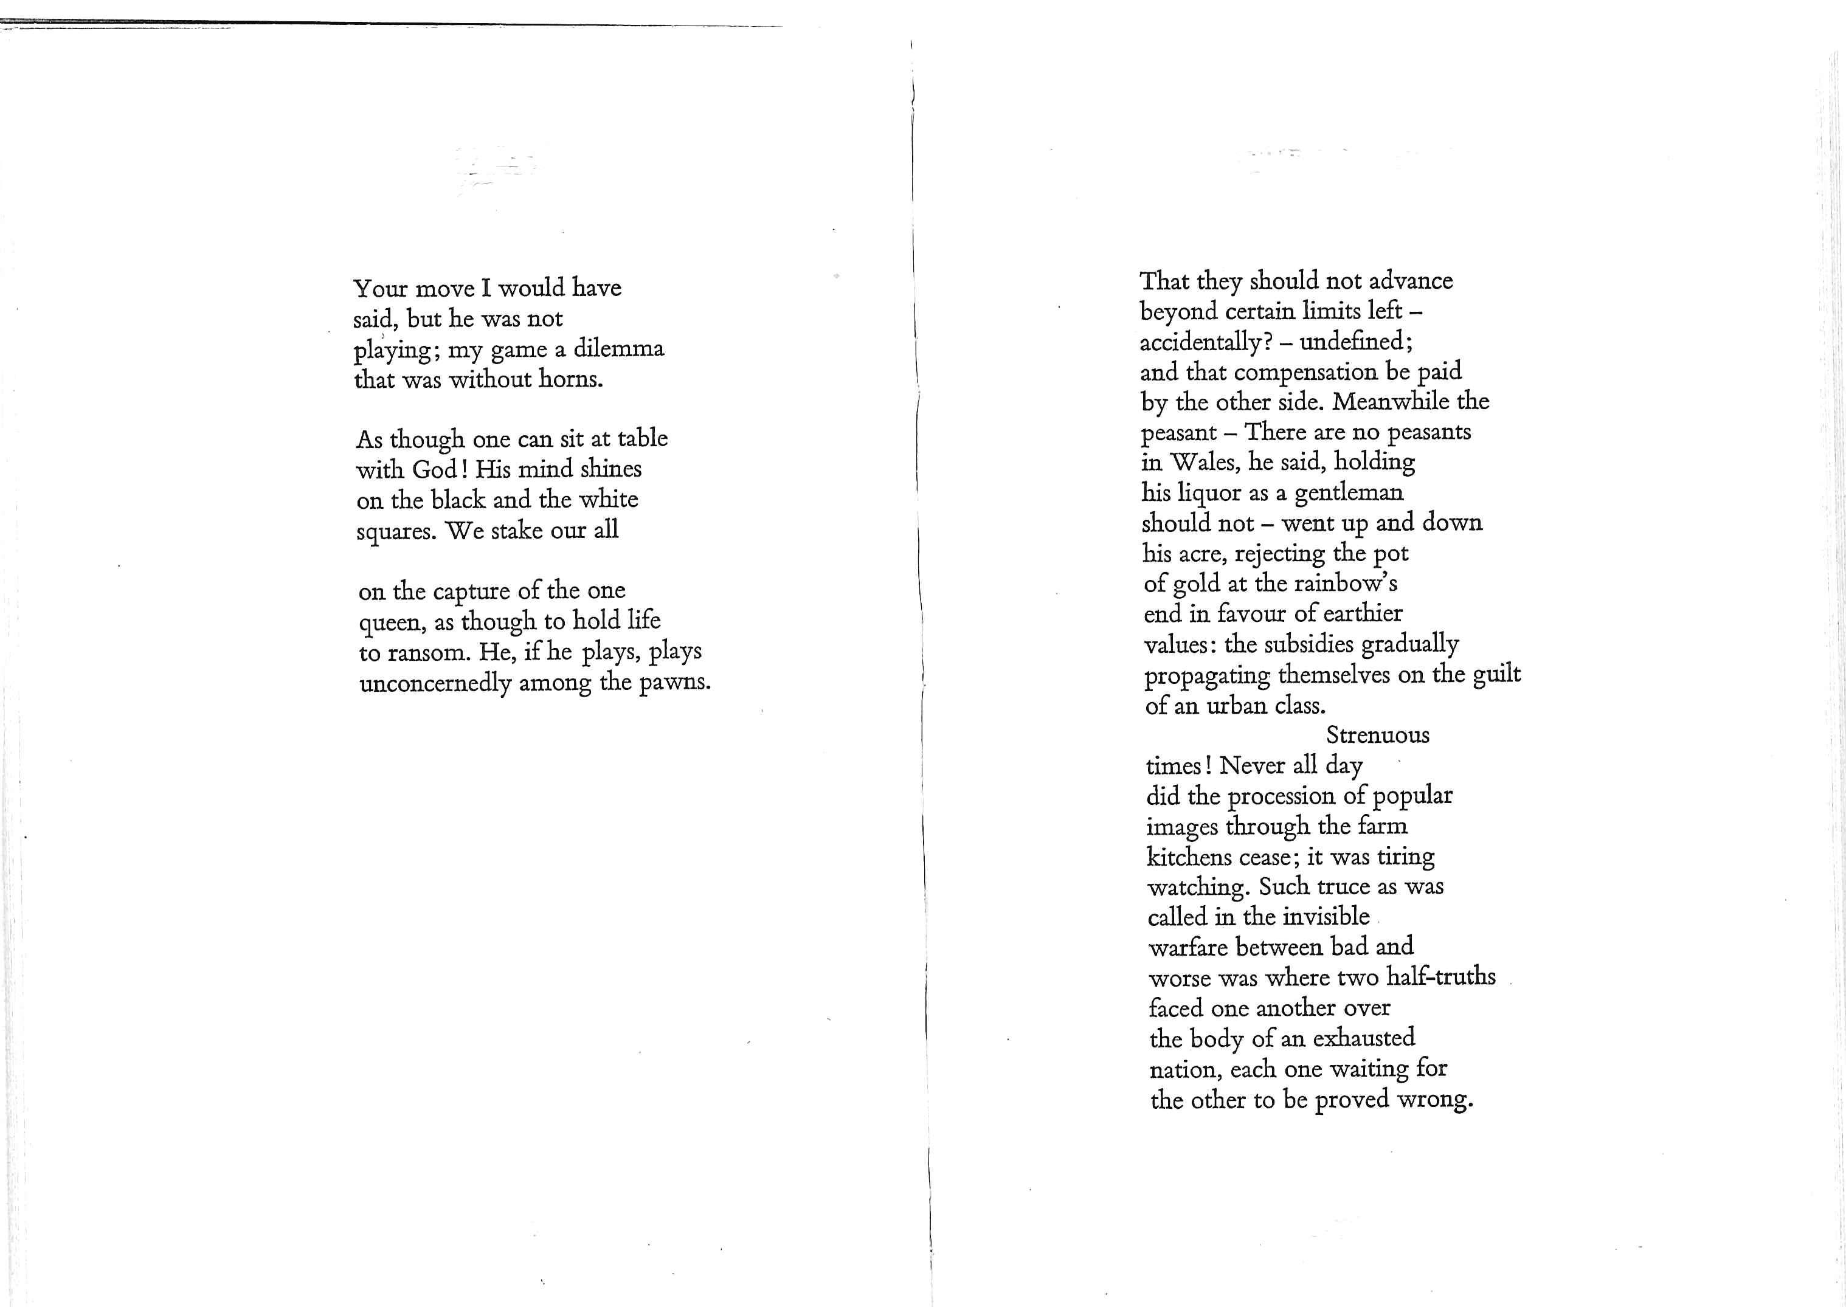
Stanzas
Stanzas in poetry = paragraphs or verses.
Usually, each stanza focuses on a single idea.
Stanzas can be long and free or short or tight.
Sometimes vary within a poem.

Slide 11
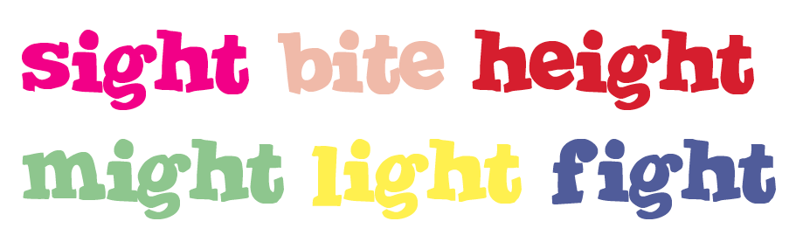
Rhyme
Give poems a pattern, a musical quality to hear when read aloud, like a song.
Often follows a specific pattern – e.g. ABAB CDCD EE
BUT doesn’t have to just be at the end of lines – poems can use internal rhyme (rhymes in the middle of lines)
Can change the speed of the poem, giving a frantic pace or calm slow appreciation.
Often used to emphasise certain words or link them to other words

Slide 12
Meter
A regular pattern of stressed beats.
Often same number of beats per line.
Can be used to creates a sense of order, like a drumbeat. Or a sense of movement e.g. marching, pacing.
Choosing to write without meter can make a verse seem free, chaotic, spontaneous.
You have brains in your head.
You have feet in your shoes.
You can steer your-self a-ny di-rec-tion you choose.

Slide 13
Line breaks
When/where the poet chooses to end one line and start the next
Breaking up thoughts over lines can change the meaning or the way you read it.
Controls how you connects the ideas.
Winter kept us warm, covering
Earth in forgetful snow

Slide 14
Structure & Meaning
The structure of a poem often reflects or mirrors what the poem is about
Short choppy lines, all with the same pattern/number of syllables suggests order, mechanical movement, or restriction
Might work well for a poem about soldiers marching, an animal in a cage, a train rattling along, horses galloping, swinging back and forth…
Long flowing lines, no rhyme or pattern suggests freedom, creativity, flight, speed, movement
Might work well for a poem about a bike ride, the wind rippling through a field, wandering thoughts or imagination, a roller coaster

