Slide 1
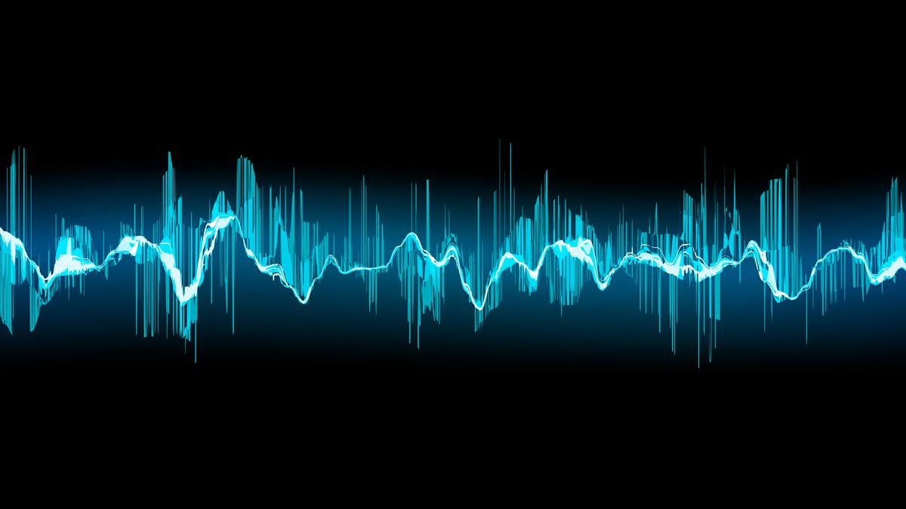
Poetry 2
Soundscapes

Slide 2
How do poems make a noise?
Traditionally, poems are supposed to be read aloud
Choosing words or groups of words with different sounds affects the overall ‘soundscape’ of the poem
Two main types of sounds can be created:
Euphony – Pleasant, harmonious sound
Cacophony – Harsh, unpleasant sounds
Poets choose which to use depending on what they’re trying to show.
Describing a field of flowers → euphony
Describing a battlefield → cacophony

Slide 3
Euphony
Pleasant soothing sounds help to create the impression of a calm or beautiful scene. Euphony can be created with:
Long vowel sounds
Consonants that make quiet, muffled, humming or shushing sounds: L, M, N, R
Examples
Five miles meandering in a mazy motion the sacred river ran
So long lives this, and this gives life to thee
When Zeus stills the winds asleep in the solid drift..

Slide 4
To Autumn, by John Keats
Season of mists and mellow fruitfulness,
Close bosom-friend of the maturing sun;
Conspiring with him how to load and bless
With fruit the vines that round the thatch-eves run;
To bend with apples the moss'd cottage-trees,
And fill all fruit with ripeness to the core;
To swell the gourd, and plump the hazel shells
With a sweet kernel; to set budding more,
And still more, later flowers for the bees

Slide 5
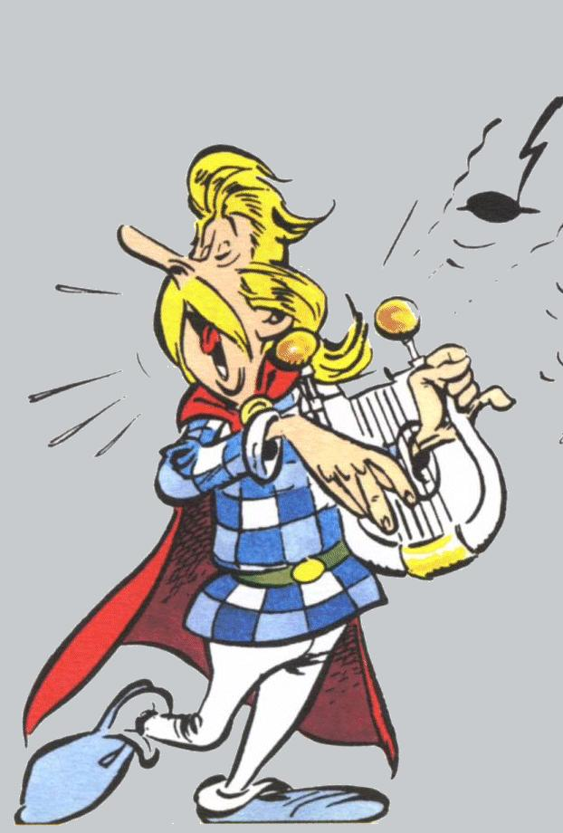
Cacophony
Unpleasant, jarring, harsh sounds are used to create the feeling of noise, chaos or violence. Cacophony can be created with:
Short vowel sounds
Consonants that make harsh or guttural sounds, like K, G, T, P, F
Examples
Chaffy grain beneath the thresher’s flail
Twas brillig, and the slithy toves did gyre and gimble in the wabe
This grim, ungainly, ghastly, gaunt, and ominous bird of yore

Slide 6
The Bridge, by Hart Crane
The nasal whine of power whips a new universe…
Where spouting pillars spoor the evening sky,
Under the looming stacks of the gigantic power house
Stars prick the eyes with sharp ammoniac Proverbs,
Power’s script, – wound, bobbin-bound, refined –
Is stopped to the slap of belts on booming spools, spurred
Into the bulging bouillon, harnessed jelly of the stars.

Slide 7
Ways to create soundscape in poetry
Rhyme
Alliteration
Consonance
Assonance
Onomatopoeia
Rhythm

Slide 8
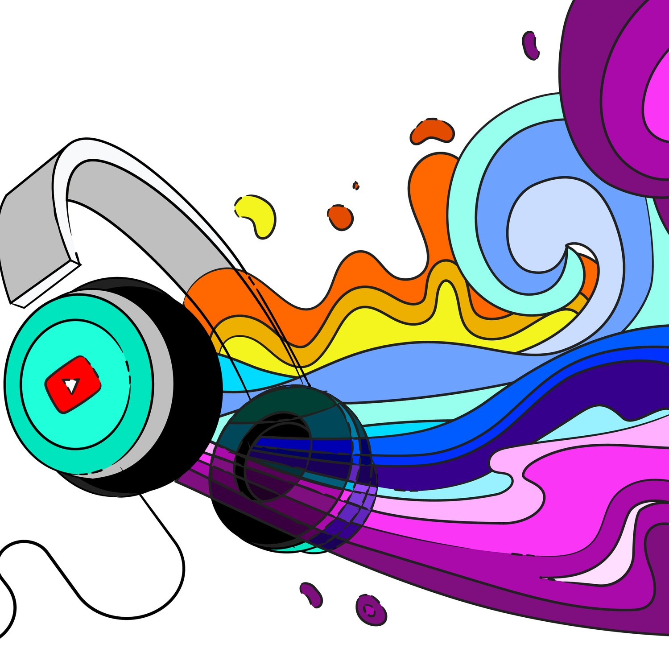
Rhyme
When words have the same or similar sound at the ends of words. Rhymes are part of the structure of the poem as well as the soundscape.
Perfect rhyme – exactly the same sound. Love, dove. Plunder, thunder
Imperfect rhyme (also called ‘slant rhyme’ or ‘half rhyme’) – sounds similar but not exactly the same. Lake, fate. Sparring, caring.
Rhyme can create a pleasant song-like effect, a pattern of harmonious repetition, like music
Can be used to create a link in meaning between the two rhyming words
Creates expectation – when there is a pattern in the rhyme you can predict what the next word will sound like

Slide 9
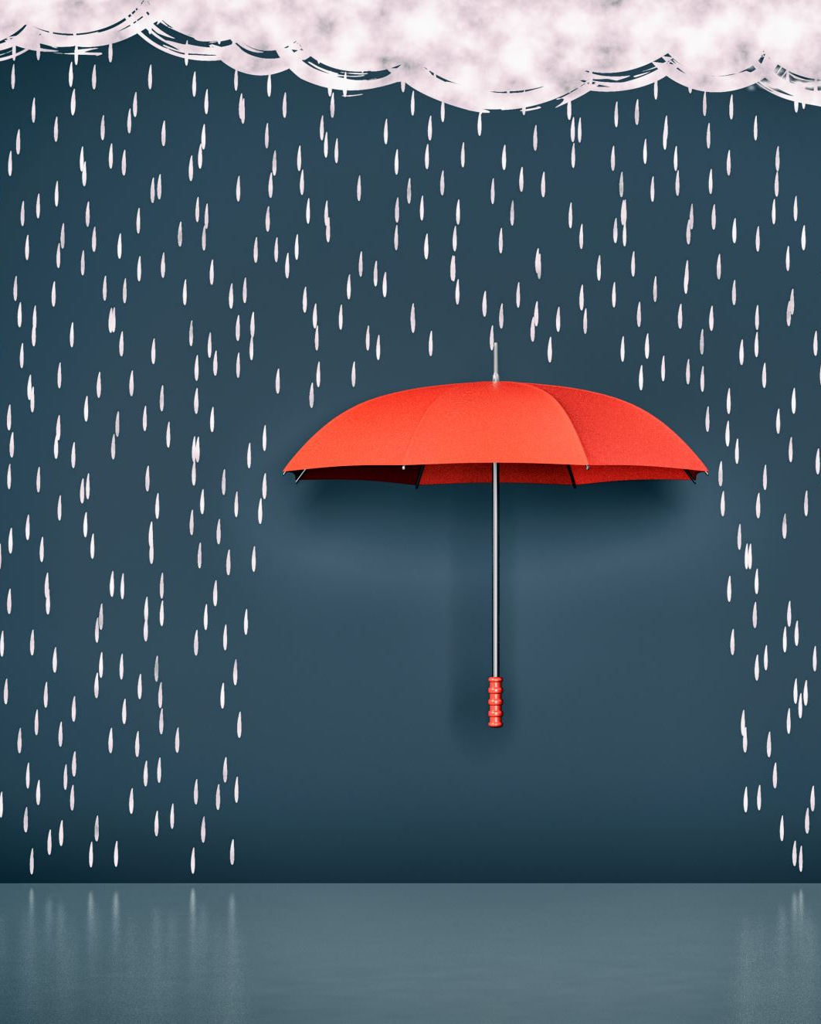
Alliteration
Repeated sound at the START of words – can be consonant or vowel
Wordlessly watching, he waits by the window
Upside-down under the umbrella with us
Whether alliteration makes a euphonic or cacophonic sound depends on the context
Liquid alliteration – repetition of l sounds
Almost always euphonic – soft & gentle. Love, lollipops, lemonade
Sibilance – repetition of s sounds
Can be soft & gentle like waves, or harsh/hissing like snakes

Slide 10
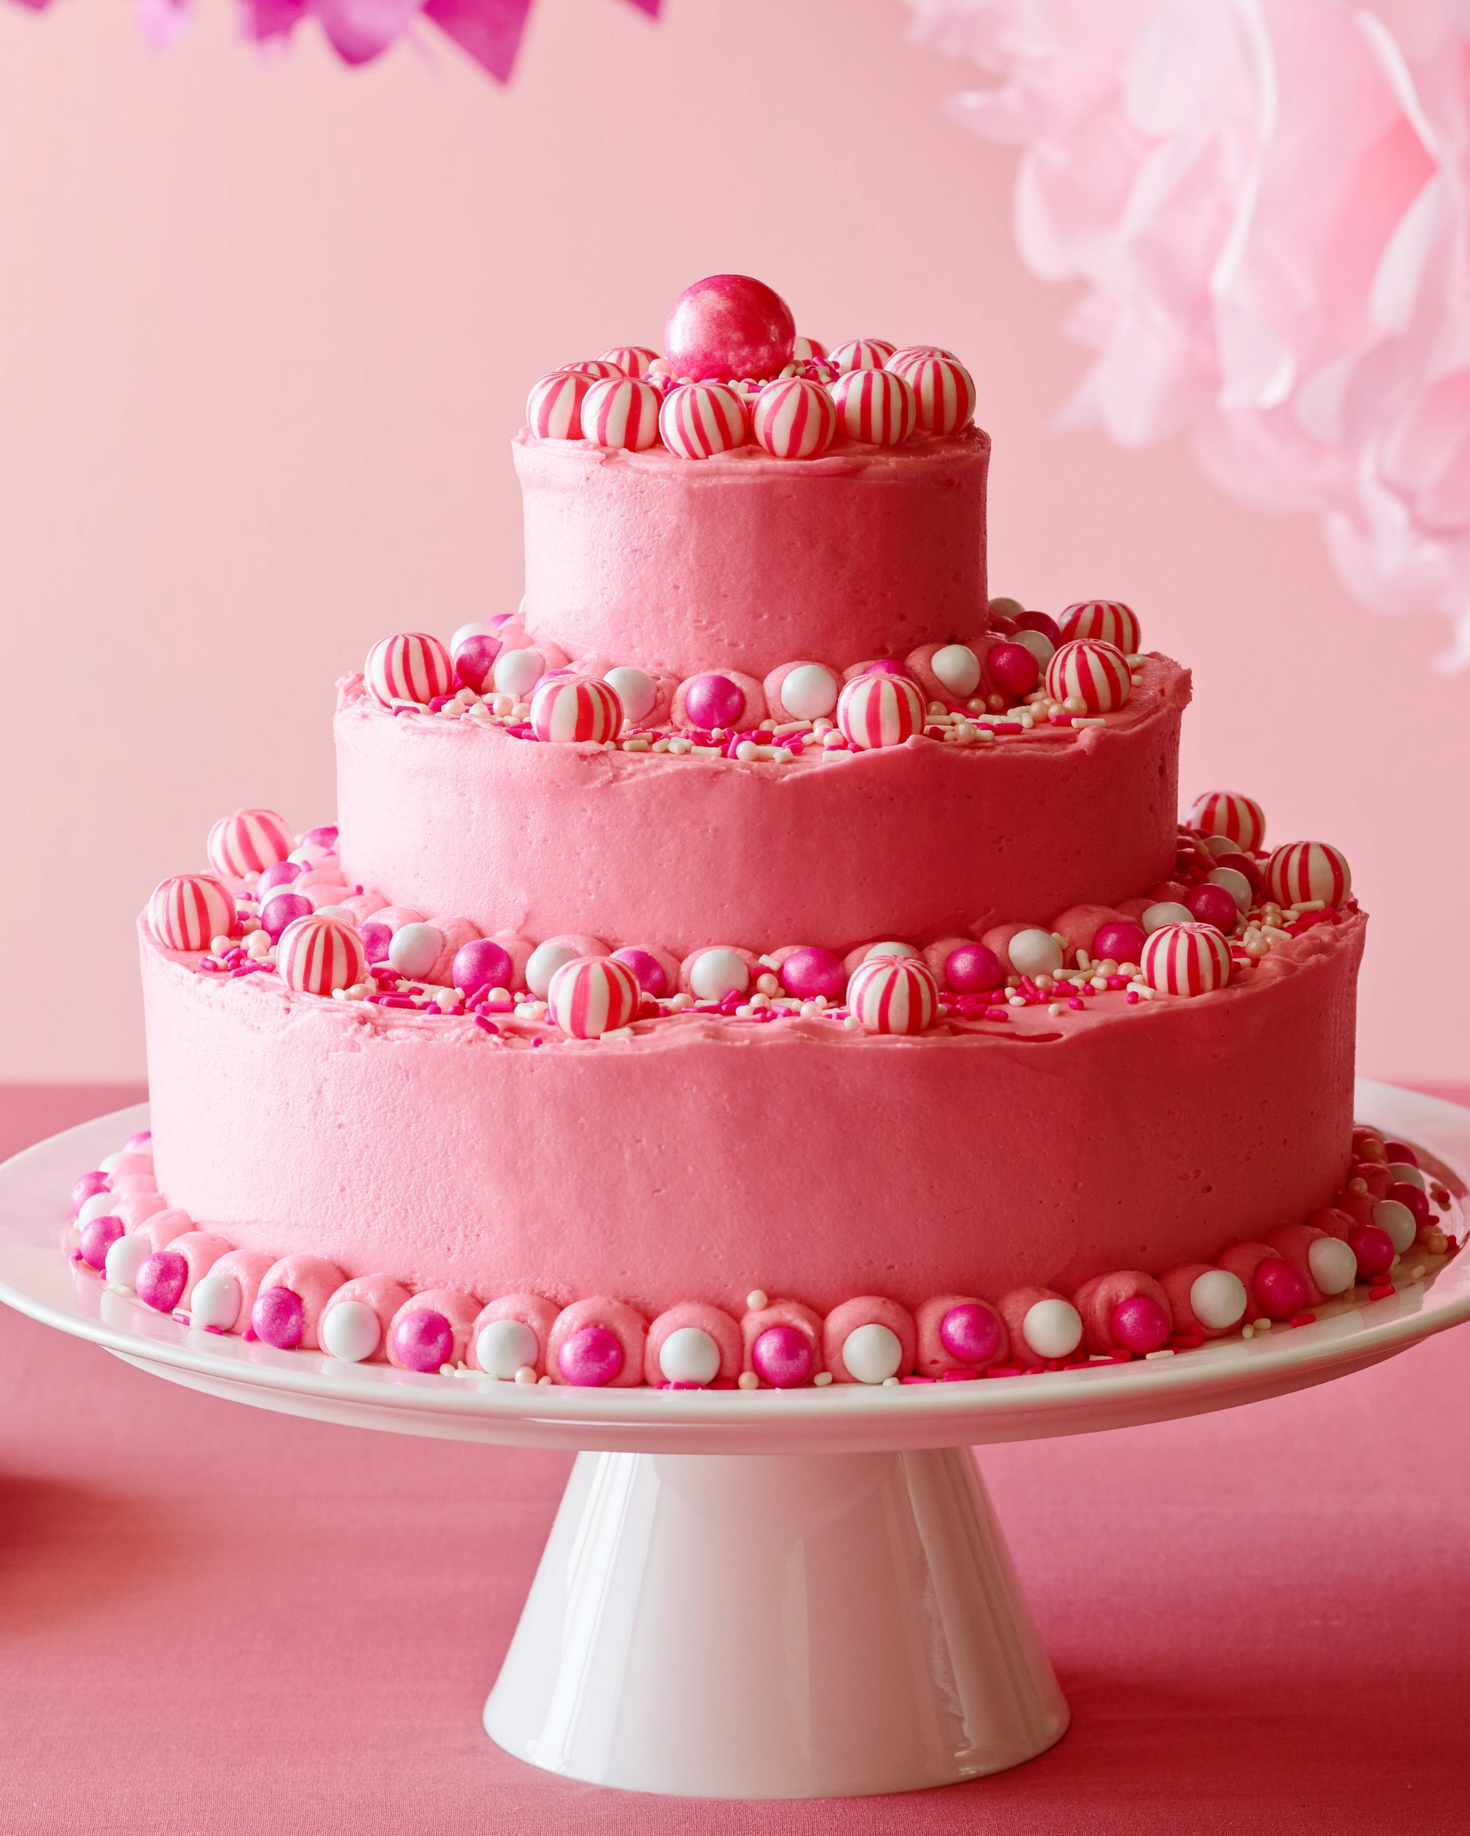
Consonance
A series of repeated consonant sounds in a line of poetry – in the middle or ends of words
Getting wetter from the rain’s pitter patter
I think I like the pink cake

Slide 11
Assonance
A series of repeated vowel sounds in a line of poetry – occurring in the middle or ends of words
He’s asleep beneath the tree
The rain in Spain stays mainly on the plain

Slide 12
Alliteration, Consonance & Assonance
Start of word | Middle or end of word
Alliteration – can be vowel or consonant Suddenly the silence stopped Actually, the apple is acidic | Consonance – same consonant sound Getting wetter from the rain’s patter Traffic figures, on July Fourth, to be tough
 | Assonance – same vowel sound He’s asleep beneath the tree The rain in Spain stays mainly on the plain

Slide 13
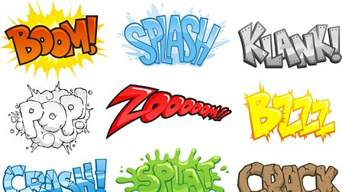
Onomatopoeia
Words that sound like what they are
Pop, hum, buzz, crash, squelch!
Make the soundscape of the poem feel familiar and realistic. Make you remember an experience you’ve already had.
Mimics the real sounds – helps you ‘hear’ what the poet is describing, make you feel like you’re there

Slide 14
Rhythm or Meter
Like in music – refers to the speed & flow of the poem
Sometimes slow & restrained, to depict something soft, gentle or boring
Other times fast, galloping – creating excitement, tension, movement
As with rhyme, can be used to emphasise certain words or link ideas together
The human brain likes repetition and patterns – a steady beat is pleasing to hear, like a consistent drum beat in a song
Makes it easier to remember – poetry is often intended to be memorised and performed

Slide 15
Meter - Revision
When words are arranged so that ‘stressed’ (emphasised) and ‘unstressed’ (non-emphasised) syllables form a pattern
Gives it a beat
Will there really be a morning
Is there such a thing as day?
Could I see it from the mountains
If I were as tall as they?
Will | there | real- | -ly | be | a | morn- | -ing
Is | there | such | a | thing | as | day?
Could | I | see | it | from | the | moun- | -tains
If | I | were | as | tall | as | they?

Slide 16
Syllables vs meter
Even if two lines have the same number of syllables, they won’t have the same ‘beat’ if the emphasis is different
Compare:
I am a pirate with a wooden leg (10 syllables)
I never want to eat a scrambled egg (10 syllables)
I am a pirate with a wooden leg (10 syllables)
I’d prefer eating a lightly poached egg (10 syllables)

Slide 17
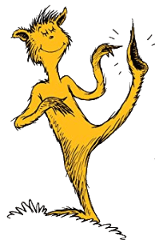
FEET
A ‘foot’ in poetry refers to a short combo of stressed & unstressed syllables. There are names for each combo, and they are all very weird!
Trochee (DAH-da) e.g. TROphy
Iamb (da-DAH) e.g. inDEED
Spondee (DAH-DAH) e.g. TV
Dactyl (DAH-da-da) e.g. CERtainly
Anapest (da-da-DAH) e.g. interRUPT

Slide 18
Meter = how many feet per line
So when it says a sonnet is in ‘iambic pentameter’
It means there are five ‘iamb’ feet in each line.
one foot = monometer
two feet = dimeter
three feet = trimeter
four feet = tetrameter
five feet = pentameter
six feet = hexameter
seven feet = heptameter
eight feet = octameter

Slide 19
Meter = how many ‘feet’ per line
Anapestic tetrameter = four anapests per line
(da da DAH da da DAH da da DAH da da DAH)
Dr Seuss often uses anapestic tetrameter
On the fifteenth of May, in the Jungle of Nool,
In the heat of the day, in the cool of the pool,
He was splashing, enjoying the jungle’s great joys…
When Horton the elephant heard a small noise.

Slide 21
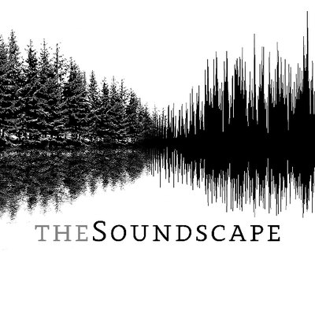
Soundscapes & Meaning
Poets carefully choose sound techniques to make their poems sound a certain way when read aloud
When analysing poetry, important to consider two things:
What techniques did the writer use to create the ‘soundscape’ of the poem
WHY did they choose these techniques, what effect does it have on the meaning?

