Slide 1
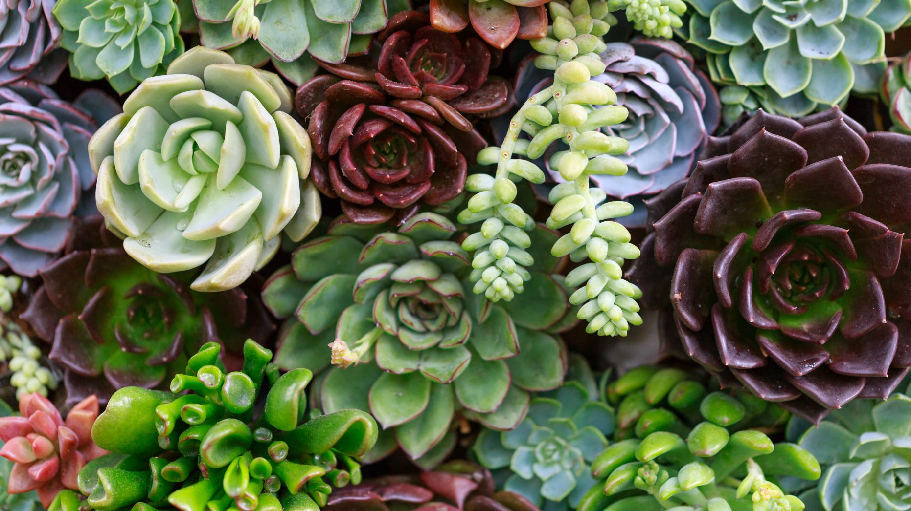
5 New Poetry Forms
Ballad | Sonnet | Psalm | Villanelle | Free Verse

Slide 2
One of the oldest forms of English poetry
Lots of different forms & types, but usually have rhyme & rhythm, often a repeated refrain or chorus
Traditional ballads:
Set to music, intended to be sung
Passed on verbally, not written down
Author is often unknown
Written in ‘common meter’ - alternating lines of iambic tetrameter (8 syllables) and iambic trimeter (6 syllables).

Slide 3
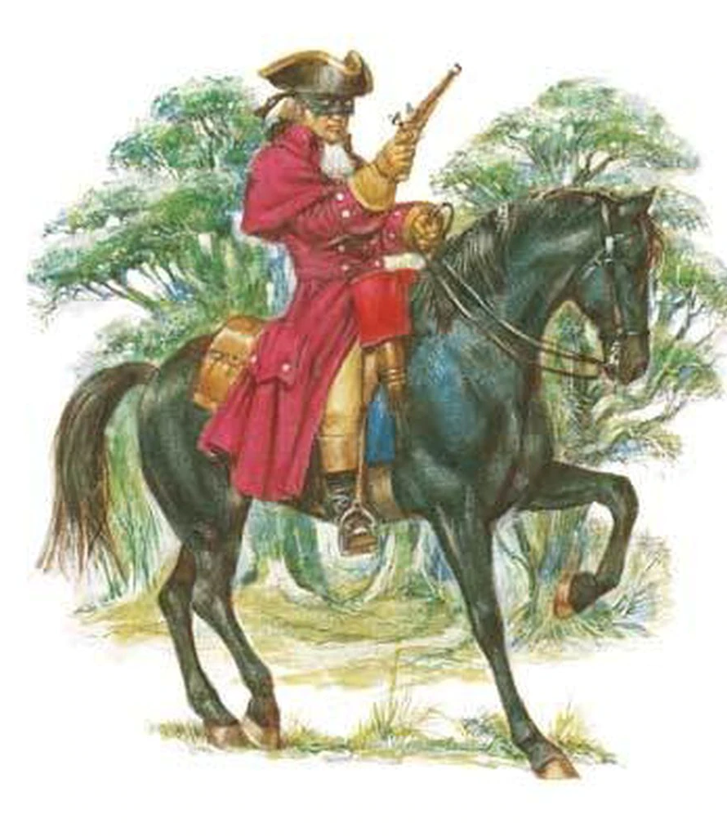
Ballads = Stories
Ballads are ‘narrative poems’ - they tell a story
Often the tale of an important event or legendary hero
Typical topics:
raids and battles
murders
hauntings
shipwrecks
tragic love affairs
funny incidents

Slide 4
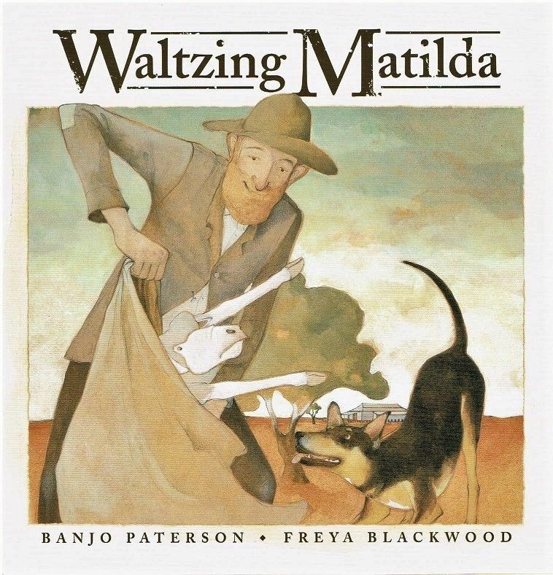
Ballad: Examples
The Lady of Shallot by Alfred Tennyson
Waltzing Matilda by Banjo Patterson
The Highwayman by Alfred Noyes
The Wreck of the Hesperus by Henry Wadsworth Longfellow
Paul Revere’s Ride by Henry Wadsworth Longfellow

Slide 5
The Ballad of Davy Crockett

Slide 6
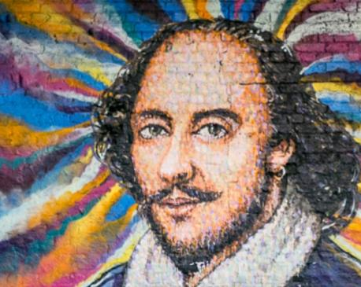
Sonnet
A sonnet is a 14-line poem in iambic pentameter. There are two main types:
1. English (Shakespearian)
Rhyme scheme ABAB CDCD EFEF GG
Usually has a ‘turn/shift’ at around line 9
2. Italian (Petrarchan)
First 8 lines rhyme ABBA ABBA, then last 6 can be CDECDE or CDCDCD
Also has shift at around line 9

Slide 7
Sonnet: Examples
Shakespearean
Sonnet 18 - shall I compare thee to a summer’s day? By Shakespeare
When I have fears that I may cease to be by John Keats
Petrarchan
How do I love thee? By Elizabeth Barret Browning
Composed upon Westminster Bridge by William Wordsworth
Remember by Christina Rosetti

Slide 8
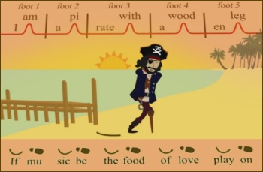
Iambic Pentameter
Roughly 10 syllables per line
Syllable count is less important than the beat or pattern of emphasis
Five iambs (or five ‘da-DAH’s) per line
da-DAH, da-DAH, da-DAH, da-DAH, da-DAH
Right: “I think that I should pause and contemplate.”
Wrong: “I think I should pause and quickly reflect.”

Slide 10
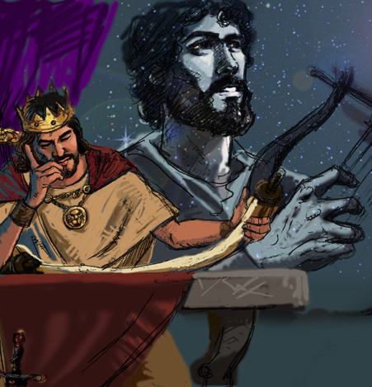
Psalms
Structure & Sound
In Hebrew poetry the structure of ideas is very important
Often use stanzas (verses) arranged in a particular order
Ideas must be balanced – key point is often in the middle
Sometimes had a refrain (e.g. “for his mercy endureth forever”)
Sometimes acrostic – each line begins with a letter of alphabet (in Hebrew)
Sometimes use rhyme, alliteration, consonance or assonance (in Hebrew)

Slide 11
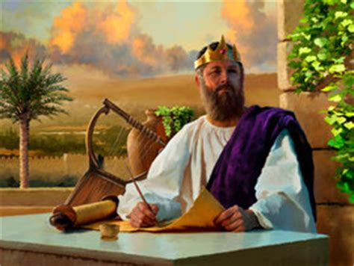
Psalms - Parallelism
One of the key features of Hebrew poetry is parallelism, a form of repetition or balancing of ideas. There are three main types:
Synonymous: saying something in multiple ways, expanding on it a little more each time, giving us different ways to grasp the meaning
You…
who dwell in the shelter of the Most High
who abide in the shadow of the Almighty
Blessed is the man…
who walks not in the counsel of the ungodly
nor stands in the way of sinners
nor sits in the seat of scoffers

Slide 12
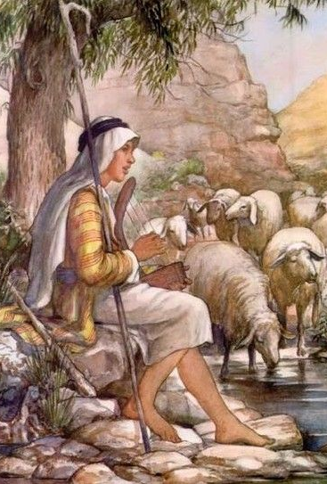
Psalms - Parallelism
2. Antithesis – saying something and then saying the opposite, to give a balance or contrast
A wise child makes a father rejoice, but a foolish child is a grief to his mother.
Some trust in chariots and horses, but we trust in the name of the Lord
3. Chiasm – repeating in reverse order
Have mercy on me, God, in your goodness.
In your abundant compassion, blot out my offense.
Wash me thoroughly from my guilt;
from my sin, cleanse me

Slide 13
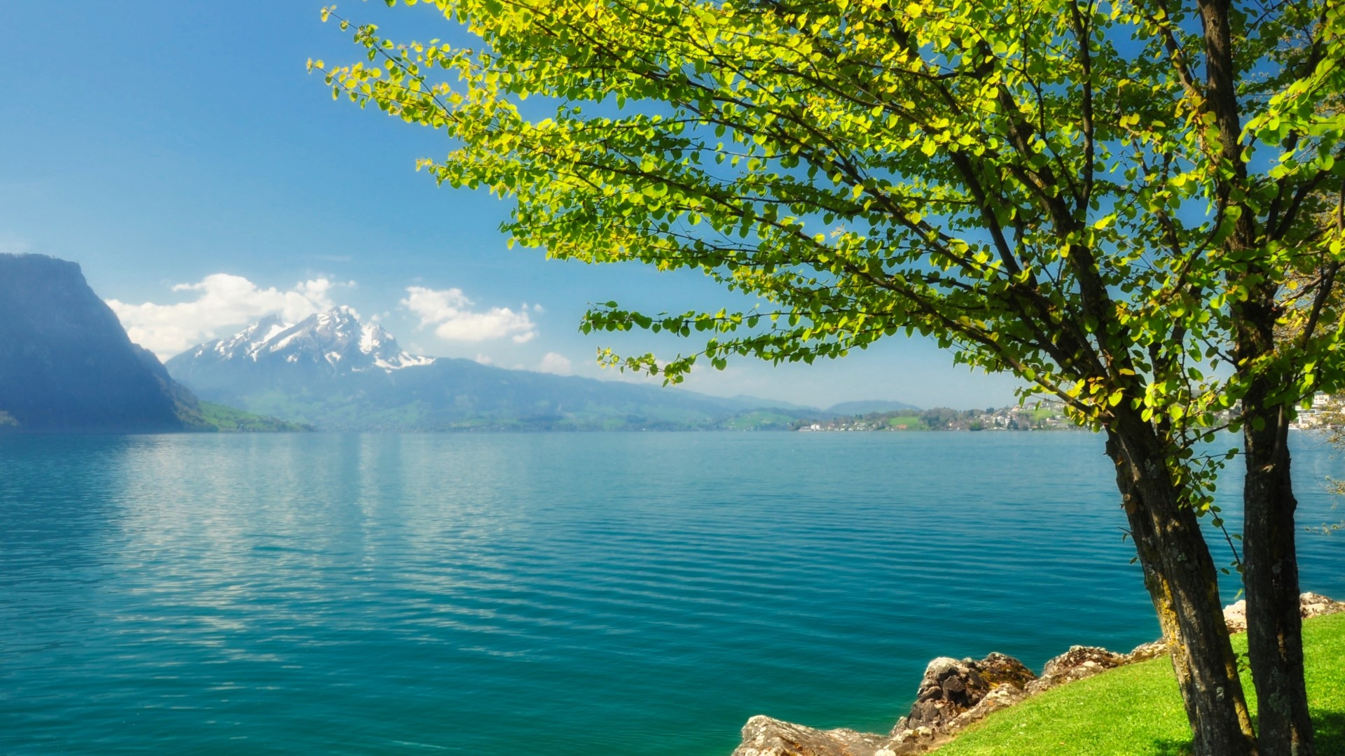
Psalms – Figurative language
LOTS of imagery, personification, hyperbole, metaphors and similes
The faithful are like a tree planted by streams of water
Enemies are bulls, lions, dogs
The hills clap their hands and the mountains sing for joy
Human beings weigh less than a breath
God is a rock, a tower of strength, a fortress
Wings like a dove, wings as eagles (symbol of freedom from sin or oppression)
Longing for God is like a deer longing for water or a dry arid land longing for rain
The waters were afraid and the deep trembled

Slide 15
Example of a modern day psalm
Praise to God, our loving Father
Praise to the God who gives us all good things
I praise You, Lord, for Your hand of blessing and protection on my children
Thank you, Father, for loving them, guiding them and prospering them
May they give You praise and glory all the days of their lives
Lord, fill their mouths with truth and praise
Lord, use their hands to change the lives of others
Please protect them from a world that is like a crumbling cliff, or a boat adrift on the open sea
Praise to almighty God, for He is faithful from one day to the next
Praise Yahweh, for he is merciful from age to age

Slide 16
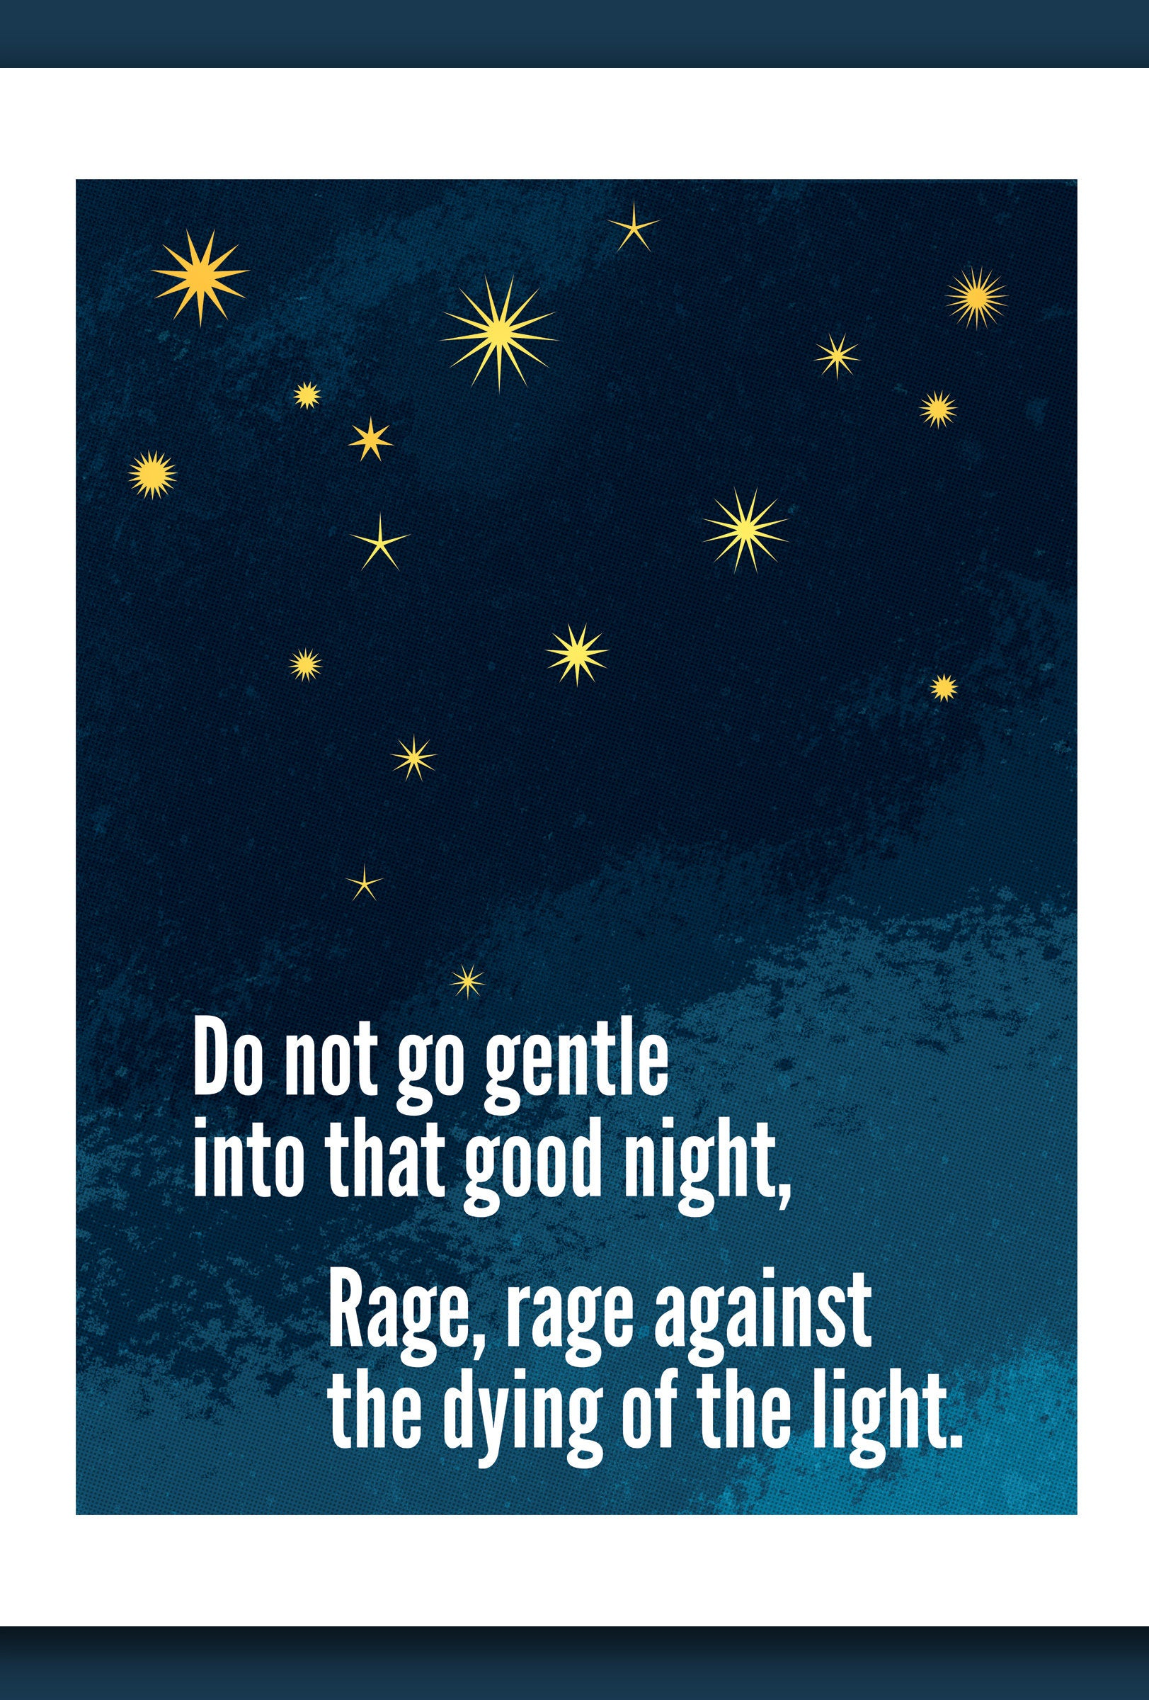
Villanelle
A villanelle is a poem with a very specific structure, originating in France.
It has 19 lines, divided into six stanzas (verses):
5 tercets (3-line stanzas) with rhyme ABA
1 quatrain (4-line stanza) with rhyme ABAA
It should have a consistent metre/rhythm
It has two repeating refrain lines that alternate all the way through it

Slide 17
Do Not Go Gentle by Dylan Thomas
Do not go gentle into that good night,
Old age should burn and rave at close of day;
Rage, rage against the dying of the light.
Though wise men at their end know dark is right,
Because their words had forked no lightning they
Do not go gentle into that good night.
Good men, the last wave by, crying how bright
Their frail deeds might have danced in a green bay,
Rage, rage against the dying of the light.
Wild men who caught and sang the sun in flight,
And learn, too late, they grieved it on its way,
Do not go gentle into that good night.
Grave men, near death, who see with blinding sight
Blind eyes could blaze like meteors and be gay,
Rage, rage against the dying of the light.
And you, my father, there on the sad height,
Curse, bless, me now with your fierce tears, I pray.
Do not go gentle into that good night.
Rage, rage against the dying of the light.

Slide 18
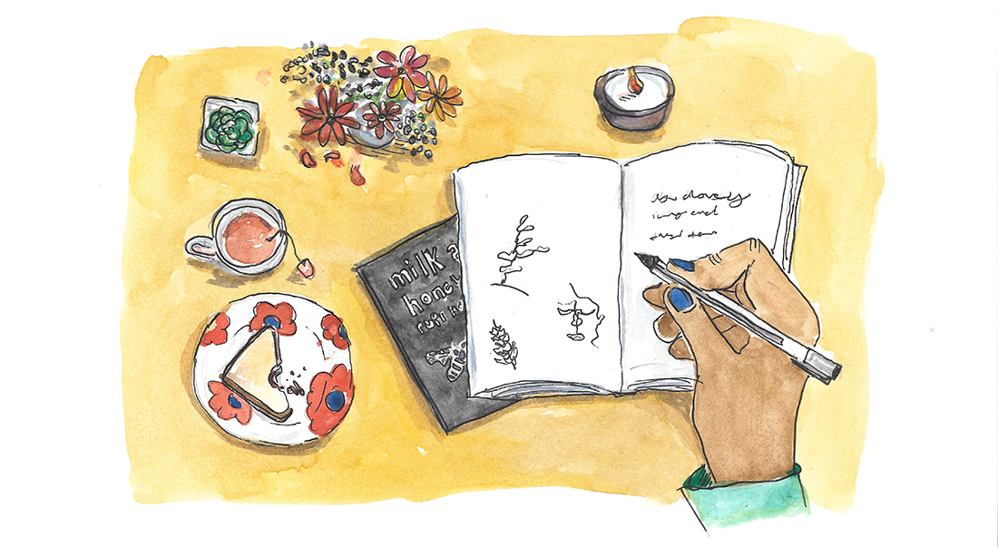
Villanelle - Style
A Villanelle should introduce an idea or theme and then develop on it a little more in each stanza – building intensity
Make each stanza give a different example
In Thomas’ poem he discusses different men (good men, wild men, grave men) and how each approaches the “dying of the light” (death)
Make each stanza contain bigger & bigger examples
In Elizabeth Bishop’s villanelle about loss she starts by talking about losing things like keys or glasses and then goes on to talk about losing cities & continents.

Slide 20
Villanelle - examples
Some examples to read to get an idea of this style:
The Home on the Hill by Edward Arlington
If I Could Tell You by W H Auden
The Waking by Theodore Roethke
One Art by Elizabeth Bishop (non-traditional format)

Slide 21
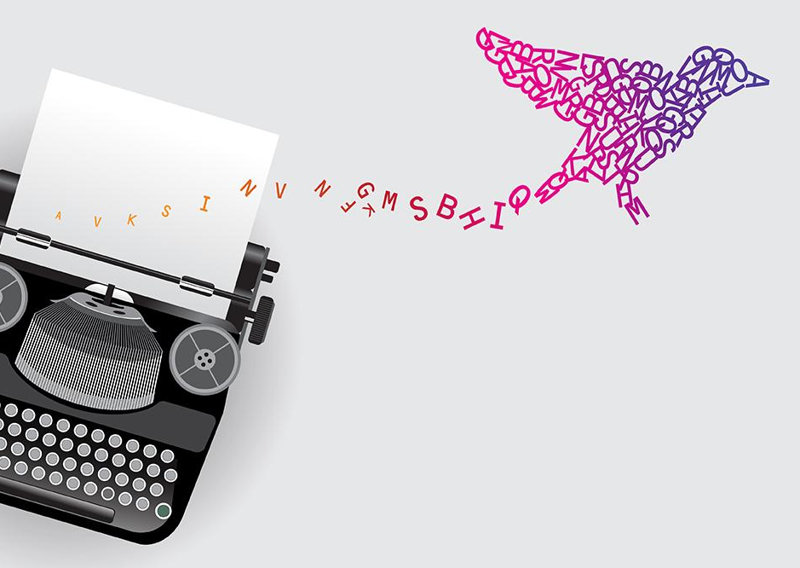
Free Verse
Free verse is poetry that doesn’t have a set form
No set rhyme scheme – BUT should use other sound devices like alliteration, consonance, assonance, internal rhyme
No set metre – BUT should still try and choose words that flow well and have a natural cadence
Often uses enjambment (putting a line break in the middle of a thought or sentence) to hurry the reader on to an important point.

Slide 22
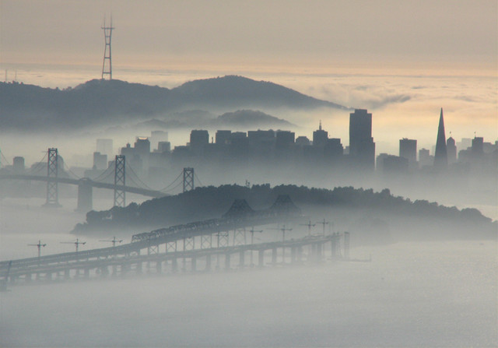
Fog by Carl Sandburg
The fog comes
on little cat feet.
It sits looking
over harbour and city
on silent haunches
and then moves on.

Slide 24
More Examples of Free Verse
After the Sea-Ship by Walt Whitman
Autumn by T.E. Hulme
Siren Song by Margaret Atwood
Taking Leave of a Friend by Ezra Pound
i carry your heart with me (i carry it in my heart) by e.e. cummings
Vacation by Rita Dove

