Slide 1
Year 8 Vocab
Term 1 Week 3

Slide 2
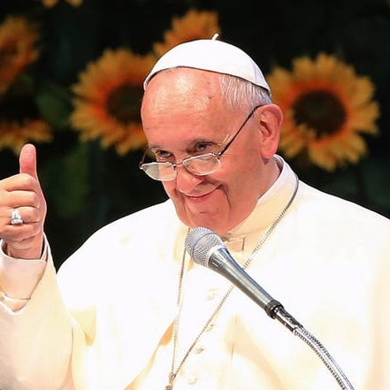
infallible
Part of speech: adjective
Meaning: unable to make mistakes or be wrong
Catholics believe the Pope is infallible.
Doctors are not infallible.

Slide 3
reiterate
Part of speech: verb
Meaning: to repeat
She didn’t understand the question, so she asked him to reiterate.
I must reiterate the importance of protecting our homes.

Slide 4
precarious
Part of speech: adjective
Meaning: dangerous, not secure
The only way to get to the city was a precarious path along a cliff.
You’ve left me in a precarious position here.

Slide 5
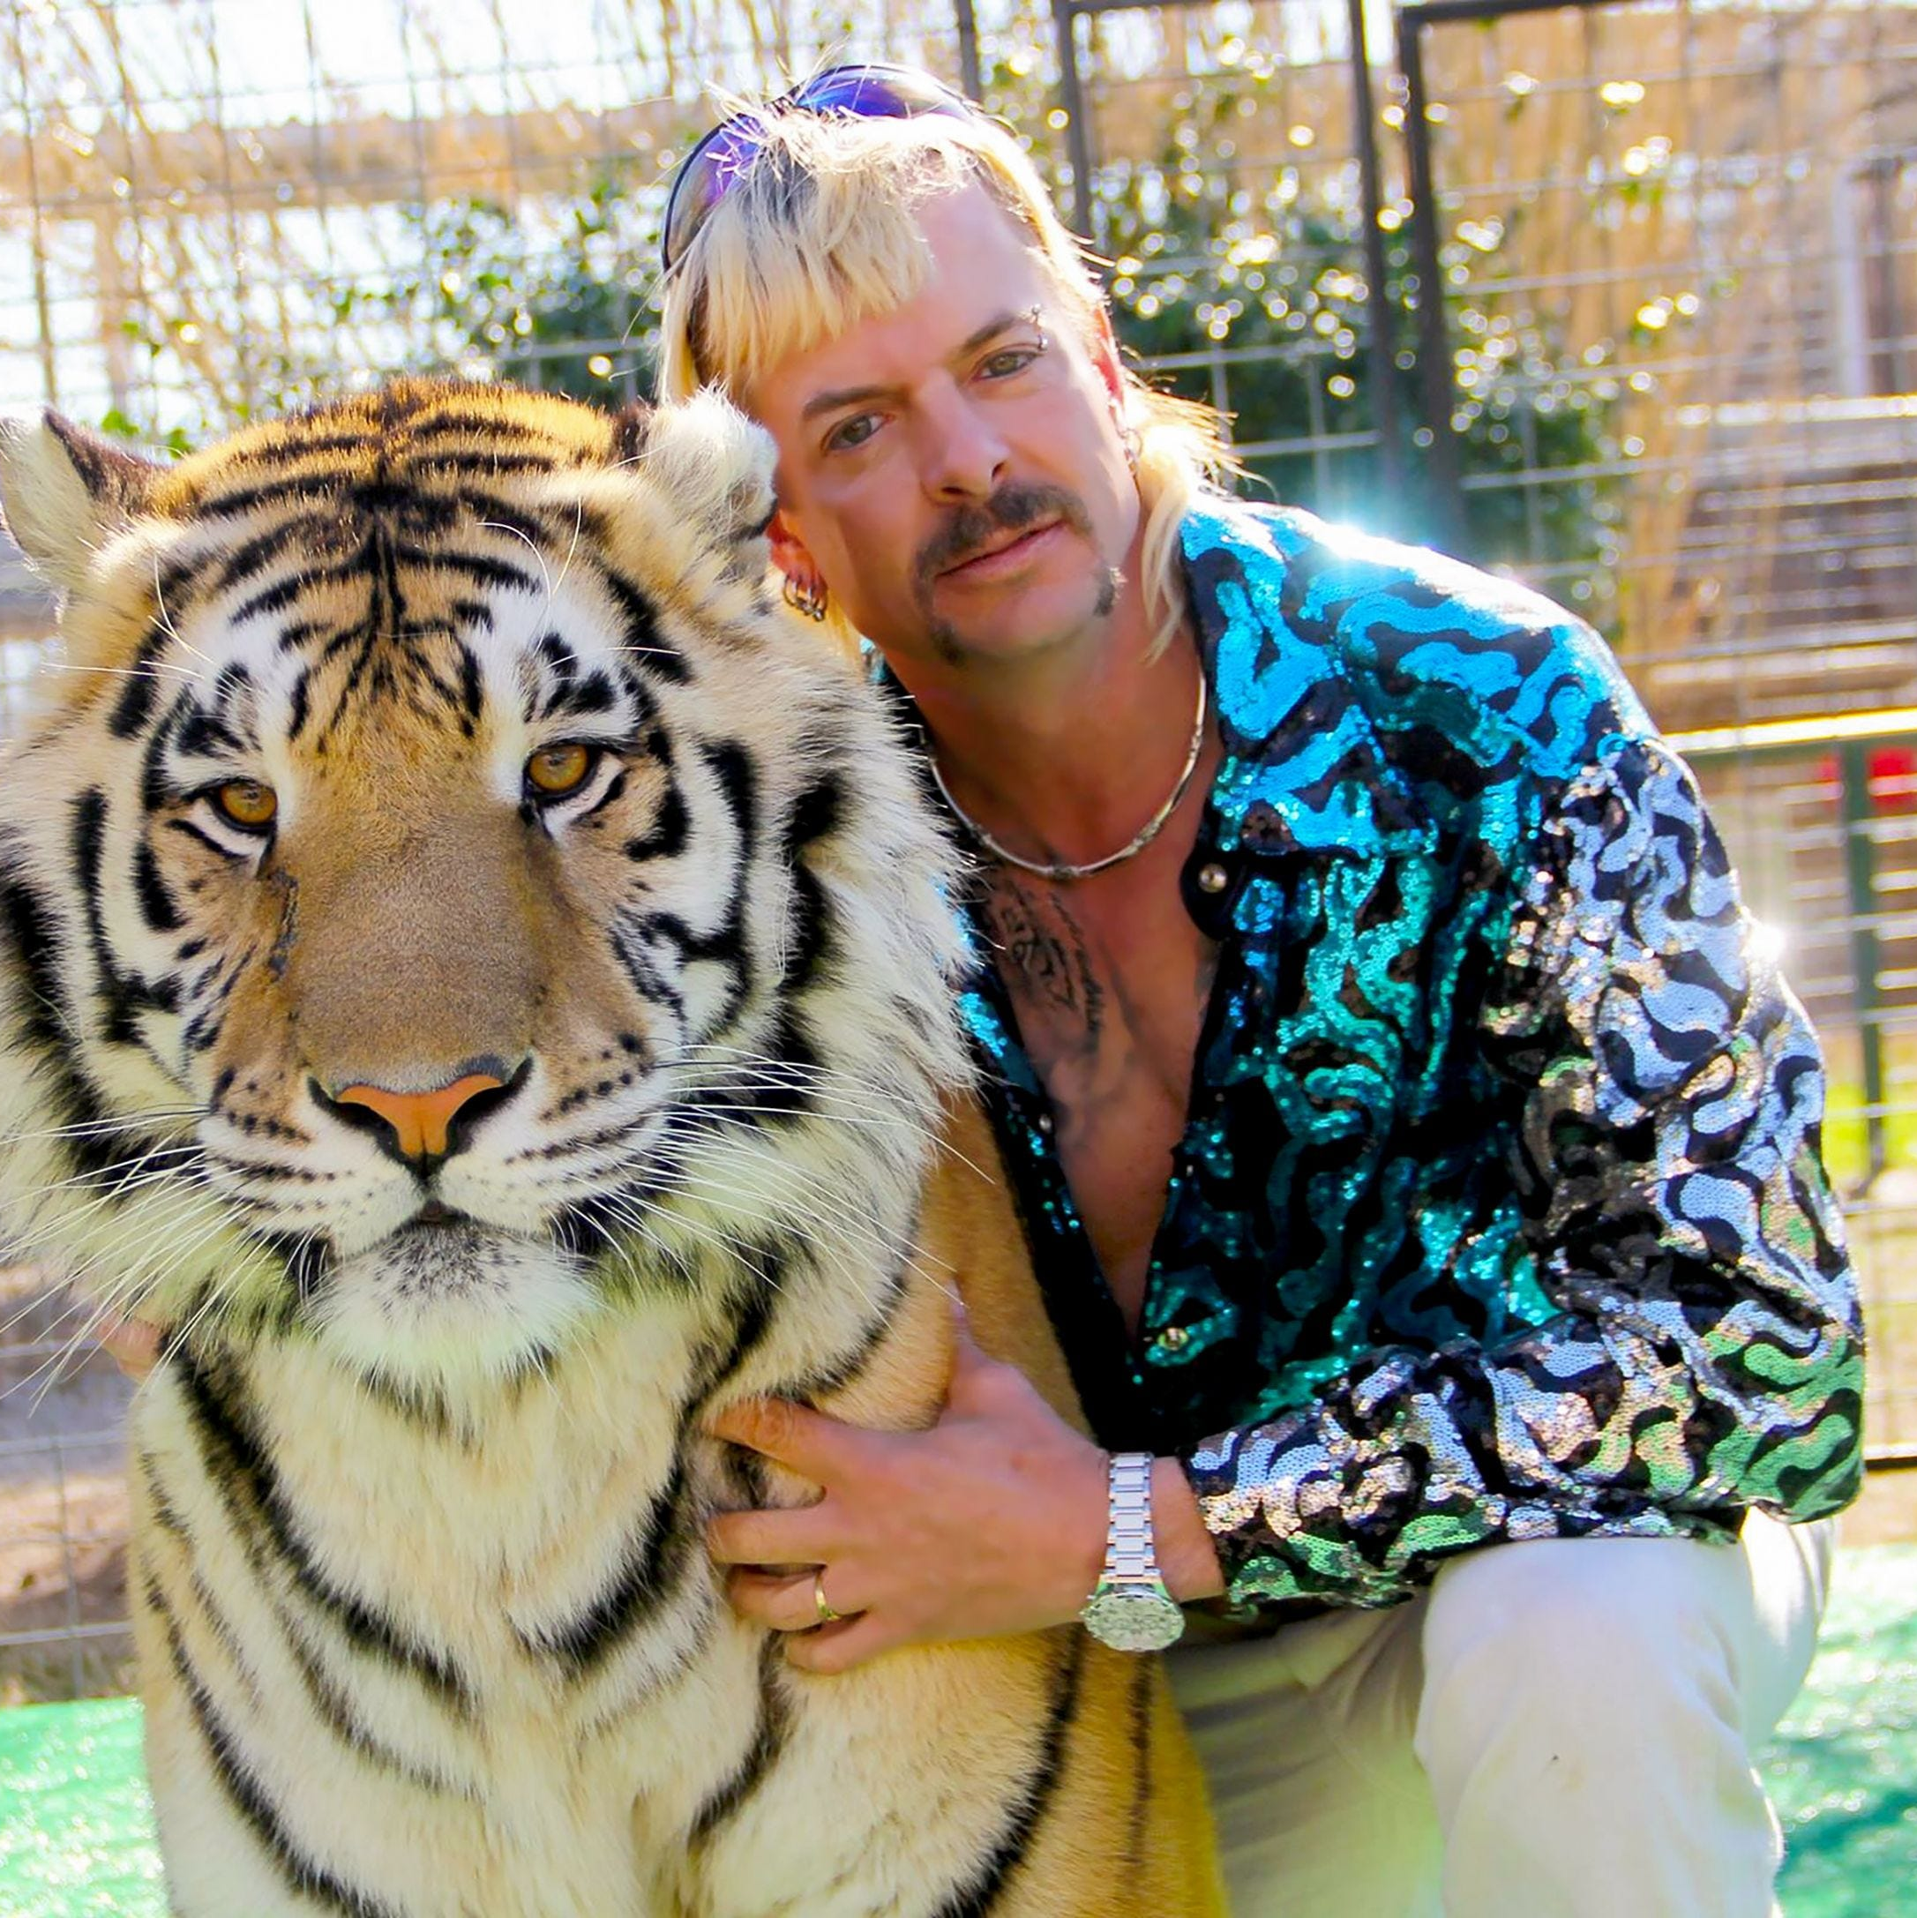
Exotic
Part of speech: adjective
Meaning: unusual or foreign; from a faraway country
She dreamed of flying to exotic places.
In some parts of America, it’s not illegal to keep exotic animals as pets.

Slide 6
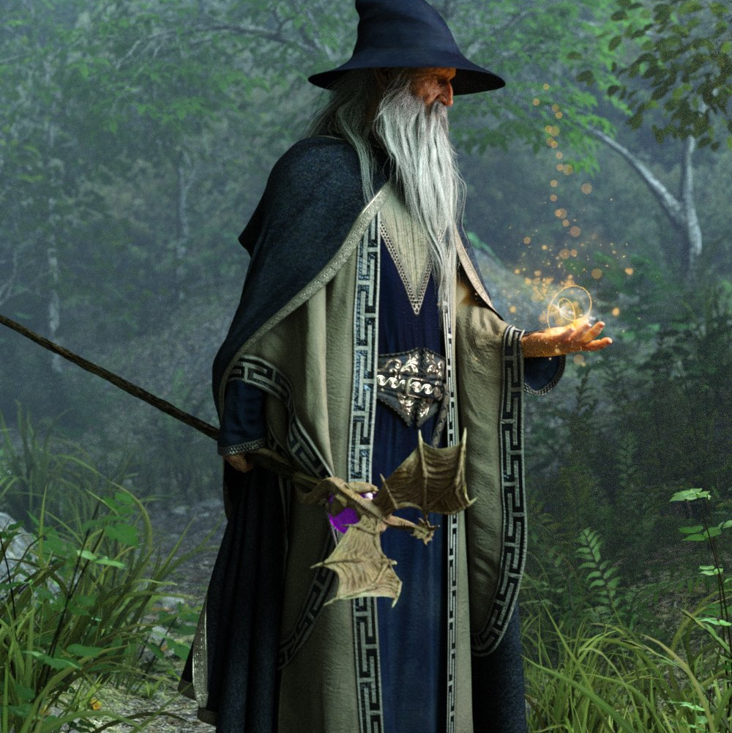
banish
Part of speech: verb
Meaning: to send away or get rid of
The wizard cast a spell to banish evil spirits.
The dictator banished anyone who disagreed with him.

Slide 7
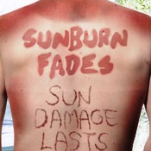
consequence
Part of speech: noun
Meaning: a result (usually bad)
People who spend a lot of time tanning often get skin cancer as a consequence.
There will be consequences if you are late home, young lady!

Slide 8
degrade
Part of speech: verb
Meaning: to put down or treat with disrespect; to spoil the beauty; to make worse
Bullies degrade their victims by making fun of them.
The quality of the plastic will degrade over time.
Some people think cleaning toilets for a living is degrading.

Slide 9
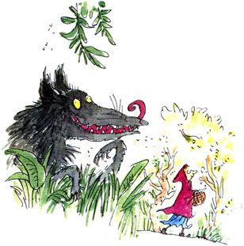
indulge
Part of speech: verb
Meaning: to allow a special treat or luxury; to give in to something you want that is not good for you.
Parents who indulge their children too often can spoil them.
“I know full well my tummy’s bulging but oh, how I adore indulging!”

Slide 10
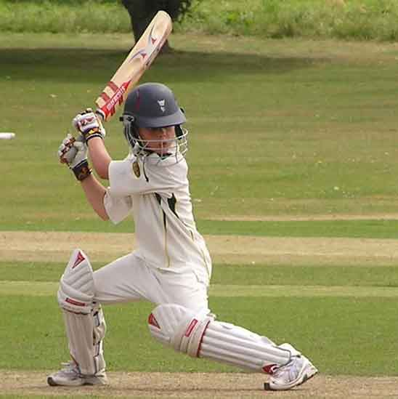
potential
Part of speech: noun
Meaning: a possibility or chance; a clue or suggestion that something will be big in the future.
He has the potential to be a great cricket player.
This spot has potential as a picnic location.

Slide 11
rapt
Part of speech: adjective
Meaning: completely fascinated or thrilled
The audience listened with rapt attention.
Mum and Dad gave me a new surfboard for my birthday – I’m rapt!

