Slide 1
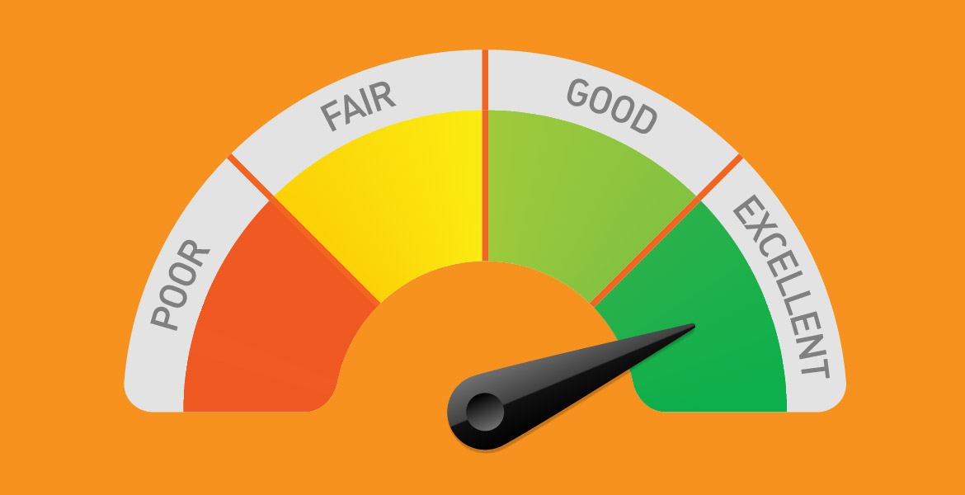
Evaluative Language

Slide 2
Evaluative Language = opinions
Evaluative language expresses an opinion or a point of view about something.
It is NOT facts that everyone could agree on.
Fact: the entree was minestrone soup
Evaluation: the entree was revolting
Evaluation judges the worth and assesses the quality of things.
Measures them up against the author’s criteria. Compares them to other things and decides if they’re better or worse.

Slide 3
Different types of evaluation
Explicit = (clearly stated) “His outfit looks dreadful.”
Implicit = (suggested) “He’s brave to wear THAT outfit.”
Intense/extreme – I absolutely hated and despised it with every fibre of my being!
Mild/moderate – it was not too bad.
Biased – my darling grandson is the cleverest and most handsome boy at the school!
Supported by evidence – 90% of the restaurant reviewers agreed with me that the food was bland.
Persuasive – disgusting pollution in our waterways is a threat to innocent wildlife! Anyone who cares about animal welfare must agree that corporations need to stop dumping garbage into the ocean.

Slide 4
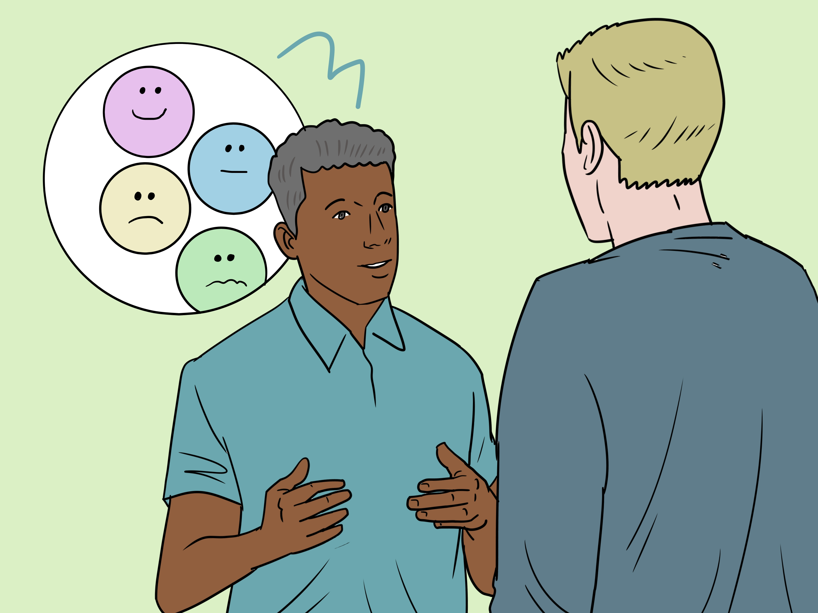
Evaluative texts = persuasive texts
Evaluative writing can be a form of persuasive writing
The author is often trying to convince the reader to agree with his assessment of the thing he is evaluating
To sound even more convincing, they can use persuasive writing techniques like connotations, figurative language, and modality

Slide 5
Evaluative langauge is used in:
Any type of review – book, film, restaurant, product, game, fashion show
Sports journalism – commentary on a game, recap of a game
Opinion pieces in newspapers/magazines
Blogs, journals, online articles
Business evaluations
School reports
End of term effort self-assessment

Slide 6
Evaluative Language Tools
Judgement
Use evaluative adjectives to show judgment (e.g. bad, great, awful)
Comparison
Use comparative & superlative adjectives to juxtapose (put next to/compare) two things (e.g. good, worse, better than)
Persuasion
Use modal verbs (should, must)
Use figurative language (similes, metaphors)
Use emotive words with positive or negative connotations (disgusting, pure)

Slide 7
Evaluative Adjectives
Words that express a judgment on what they are describing.
Positive | Positive | Negative | Negative
Amazing | Astonishing | Appalling | Atrocious
Awesome | Beautiful | Awful | Disastrous
Excellent | Fantastic | Disgusting | Dreadful
Fascinating | Incredible | Ghastly | Horrendous
Lovely | Magnificent | Horrific | Revolting
Marvellous | Sensational | Ridiculous | Shocking
Wonderful | Unbelievable | Terrible | Unbelievable

Slide 8
Comparative & Superlative Adjectives
Words that compare and rank things in order.
Adjective | Comparative | Superlative
Good | Better/Better than | Best
Bad | Worse/Worse than | Worst
Annoying | More annoying | Most annoying
Beautiful | More beautiful than | Most beautiful
Cheap | Cheaper | Cheapest
Friendly | Friendlier | Friendliest

Slide 9
Persuasive Language
Evaluative texts are persuasive – you want the reader to agree with your assessment
Use high modality/modal verbs
Absolutely, never, certainly, always, should, must!
Use figurative language
Non-literal language e.g. similes, metaphors, hyperbole, personification
Use emotive language – words that make people feel
E.g. toxic, innocent, cowardly, damaging, vulnerable, tragic. Word connotations: ‘luxurious’ or ‘decadent’ makes it sound good, ‘wasteful’ or ‘extravagant’ makes it sound bad

