Slide 1
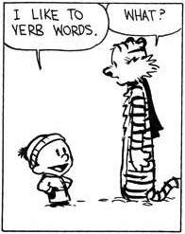
Nominalisation
Notes:
Nominalisation is an important skill that you’ll use a lot as you go into Yr 10-12. Not just for English, also used in written reports, job applications, business presentations, etc, to create more formal, detached, precise sentences. It’s an important part of academic language, which is what you need to be using in your Mulan essays.
If you have finished drafting your essay, this is something you could do to improve your sentences and make your language more formal and academic.

Slide 2
Intro

Slide 3
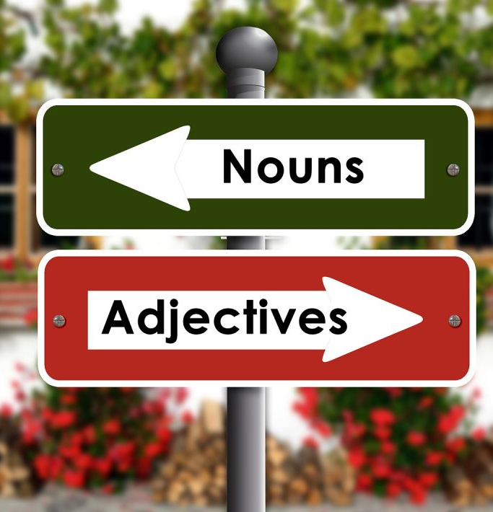
What is nominalisation?
Nominalisation means changing other types of words into nouns.
Usually means changing verbs into nouns, but can also be done on adverbs or adjectives.
To do this, you usually need to add a suffix like –ness, –tion, or –ment.
React (verb) → reaction (noun)
Create (verb) → creation (noun)
Eager (adjective) → eagerness (noun)
Happily (adverb) → happiness (noun)
Many words in English can be morphed into ALL the different parts of speech:
Obey (verb), obedience (noun), obediently (adverb), obedient (adjective)

Slide 4
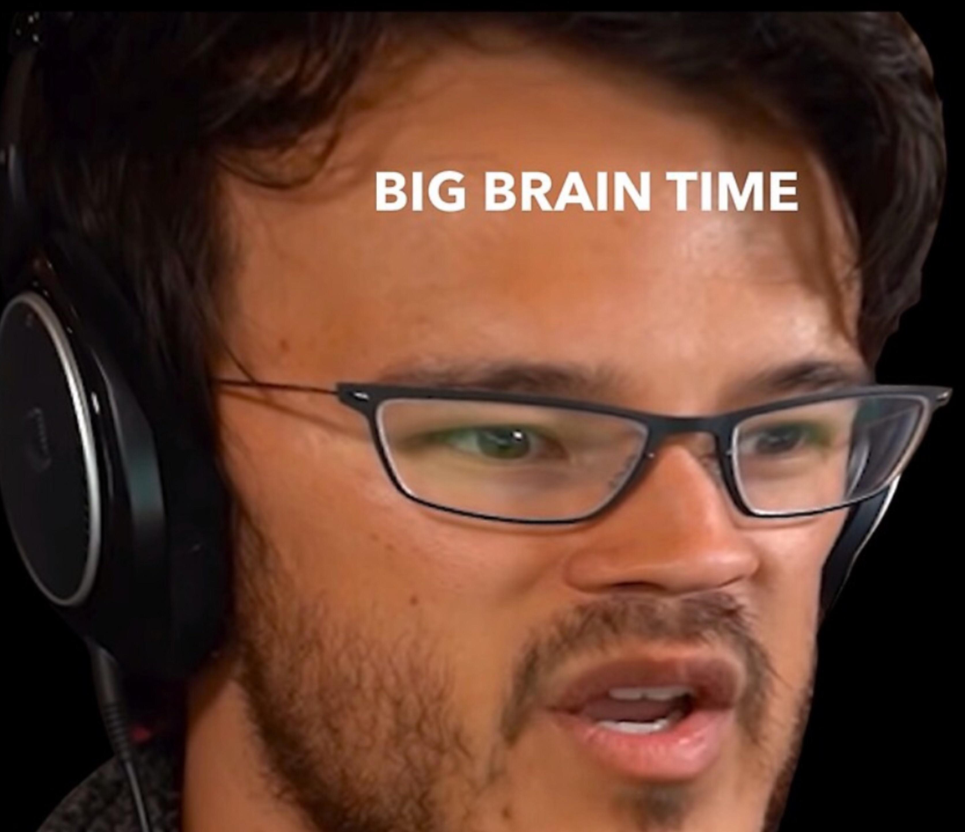
Why nominalise?
Nominalising the verbs makes writing sound…
More formal and professional
Detached – less personal, less dramatic
Focus is on the action, not who did the action
Clearer and more precise
Shows the relationship between pieces of information
Forces you to explain more, dig deeper, and explain the cause and effect

Slide 5
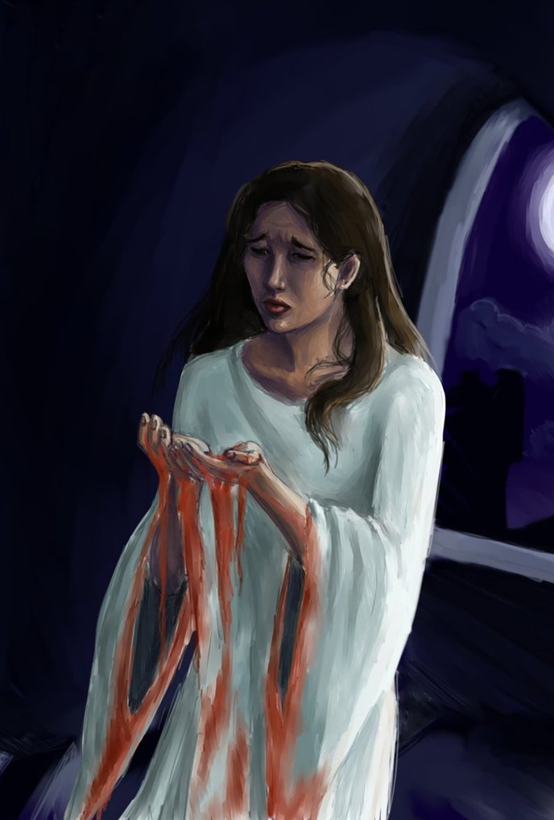
Example
Normal: Lady Macbeth was ambitious.
Nominalised: Lady Macbeth’s ambition….
The un-nominalised sentence is complete, but doesn’t give you as much information.
The nominalised sentence is unfinished. To finish it, you need to add more information about Lady Macbeth’s ambition:
What it was like
What it caused or led to
Lady Macbeth’s ambition was all-consuming.
Lady Macbeth’s ambition led to her decision to plot the king’s murder.

Slide 6
More Examples
We analysed the data. → The analysis of the data showed…
The children reacted. → The children’s reaction was…
The team departed. → The team’s departure caused…
We have contaminated the earth. → Our contamination of the earth has led to…

Slide 7
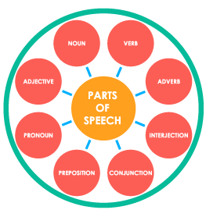
Parts of Speech
In order to nominalise, you have to know your parts of speech well
If you can’t tell where the nouns, verbs, adjectives and adverbs are in a sentence:
won’t know which words to change
can’t check to see whether you’ve changed it into the right thing
If you’re having trouble with nominalisation, try taking a step back and making sure you’re clear on the parts of speech.

Slide 8
How to nominalise
Find the key verbs in your sentence.
If there are no verbs that will work, try adjectives or adverbs.
Remember, doesn’t always have to be one word – can use whole verb phrase.
Change these words into nouns by changing their form. Try these suffixes:
-ness
-tion or -sion
-ment
-ty, -ity, -lty
-ance or -ence
-ism
-ury
Rearrange the sentence so that it still makes sense.

Slide 9
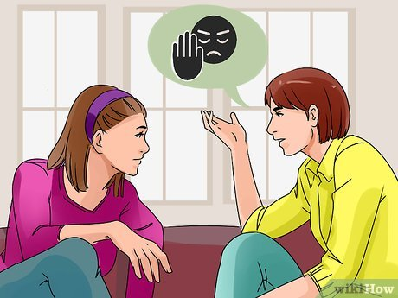
Practice
“My friend rejected my idea but I didn’t let it divide us.”
Step 1: Find the verb/s
Rejected, divide
Step 2: turn into nouns
Add suffix –ness? –tion? –ment? –ity?
Rejection, division
Step 3: Rephrase sentence
My friend’s rejection didn’t cause a division.
Notes:
Pause before you click next. Get the class to look at the sentence, ask what are the verbs? Get them to have a go at turning them into nouns. Get them to have a go at rephrasing the sentence verbally.

Slide 10
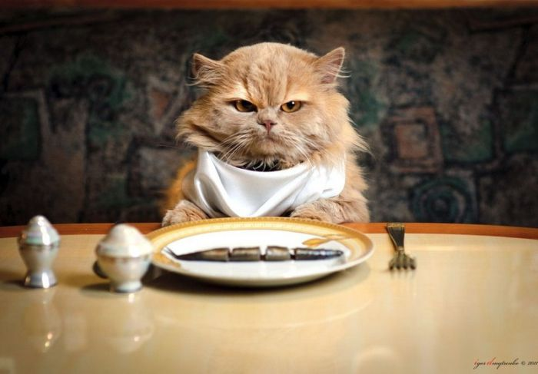
Practice
“I might treat you differently if I’m hungry.”
Step 1: Find the verb, or other suitable candidates
Treat, hungry
Step 2: turn into nouns
Add suffix –ness? –tion? –ment? –ity?
Treatment, hunger
Step 3: Rephrase sentence
My treatment of you may change due to my hunger.
Notes:
Pause before you click next. Get the class to look at the sentence, ask what are the verbs? Get them to have a go at turning them into nouns. Get them to have a go at rephrasing the sentence verbally.

Slide 11
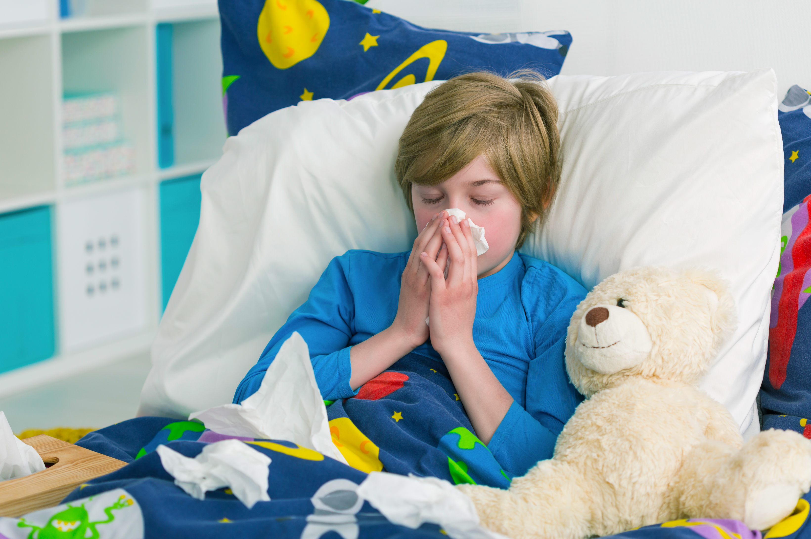
Practice
“I handed in my essay late because my kids were sick.”
Step 1: Find the verb, or other suitable candidates
Handed, were sick
Step 2: turn into nouns
Add suffix –ness? –tion? –ment? –ity?
Sickness, handing in - submission
Step 3: Rephrase sentence
The late submission of my essay was due to the sickness of my children
Notes:
Pause before you click next. Get the class to look at the sentence, ask what are the verbs? Get them to have a go at turning them into nouns. Get them to have a go at rephrasing the sentence verbally.

