Slide 1
CAP
Context Audience Purpose

Slide 2
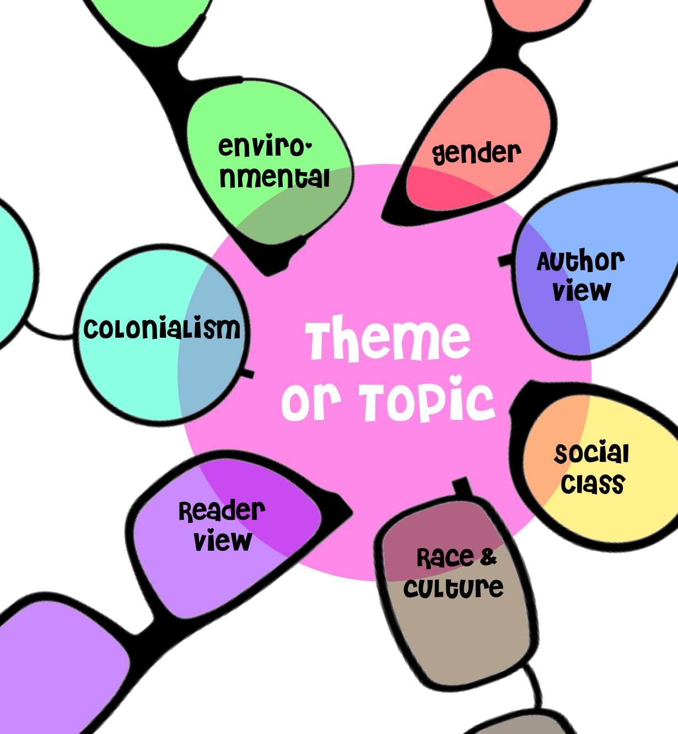
To understand any text…
Look at the C.A.P.
Context
Audience
Purpose

Slide 3
Context
The circumstances or environment in which a text was created
When in history? Where in the world?
What events were happening at that time?
What beliefs, values, experiences, knowledge, and cultural practices did most people have in that time/place?
Did the creator of the text share these beliefs & practices?

Slide 4
Audience
Who was this text created for?
What age, gender, education, wealth/class?
What beliefs, values, experiences, knowledge, cultural practices?
Did this influence the author?
Were they hoping to reach or appeal to a particular group?
Did this affect/change the way they wrote it?

Slide 5
Purpose
The reason the text was created
Why does it exist?
What motivated the creator to make it?
What did they want to achieve by creating this text?

Slide 6
Purpose
The purpose of a text usually falls into one of 3 broad categories:
To inform (e.g. encyclopedia, news article)
To entertain (e.g. novel, film, play)
To persuade (e.g. advertisement, opinion piece)
These can overlap – might do all 3 at once

