Slide 1
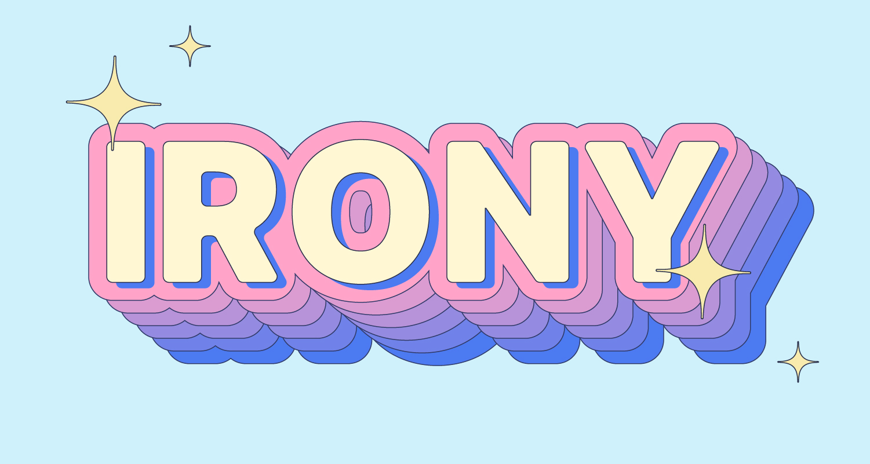

Slide 2
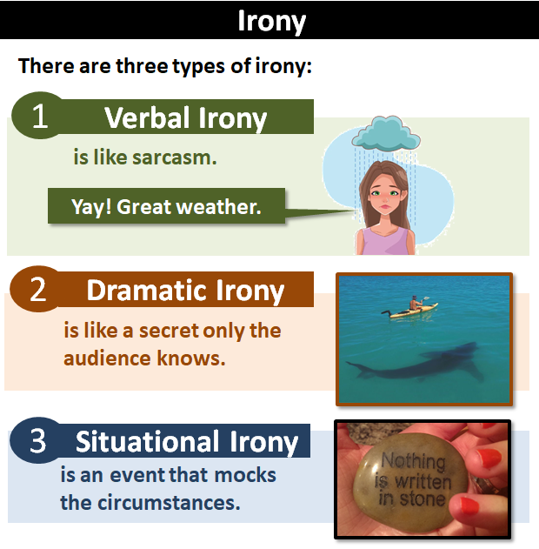
What is Irony?
Irony is about EXPECTATIONS!
It’s ironic if it’s the opposite of what is expected.
3 kinds of irony:
Verbal
Dramatic
Situational

Slide 3
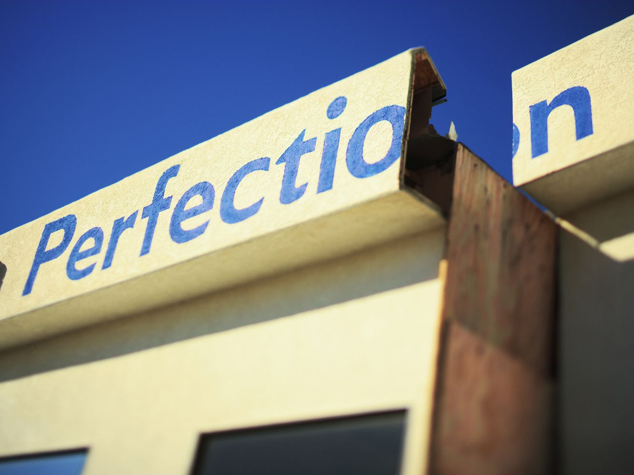
Irony: Purpose (why it is used)
Like other figurative (non-literal) language, the use of irony can add interest, depth, suspense, and humour, to texts.
In order to work out and understand the irony, the reader has to engage their brain and use their imagination. This makes it more engaging.
Irony is about contrast – the difference between reality and what’s being said. This means it can be used to point out the hypocrisy in society or two-faced people.
Real life is full of irony and ironic situations, so using it reflects reality.

Slide 5
Verbal Irony
Saying the opposite of what you mean
One form of verbal irony is sarcasm
Sarcasm is usually negative – intended to mock or insult someone, often said in a sneering way:
“Thanks for that, genius.”
“Nice monobrow.”
Verbal irony is usually not personal and not intended to be insulting.
“Oh, fantastic, I just spilled coffee on my shirt!”
“Yay, just what I always wanted!”

Slide 8
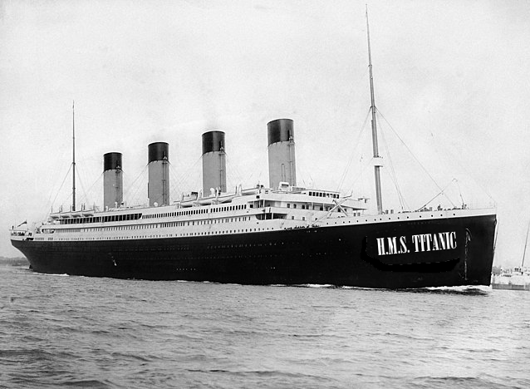
Dramatic Irony
An unsinkable ship! What could go wrong?
This is going to be a wonderful trip!
When the audience knows more than the characters (in a film, play, novel etc)
Can create tension/suspense or comedy
Can also happen in real life
E.g. you’re laughing at someone for sitting on wet paint, unaware that you are also sitting on it

Slide 9
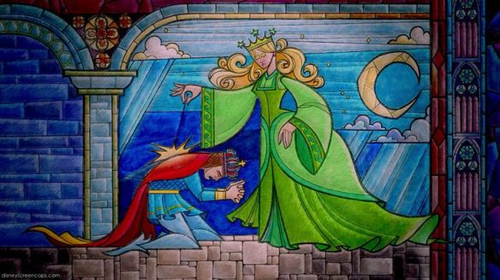
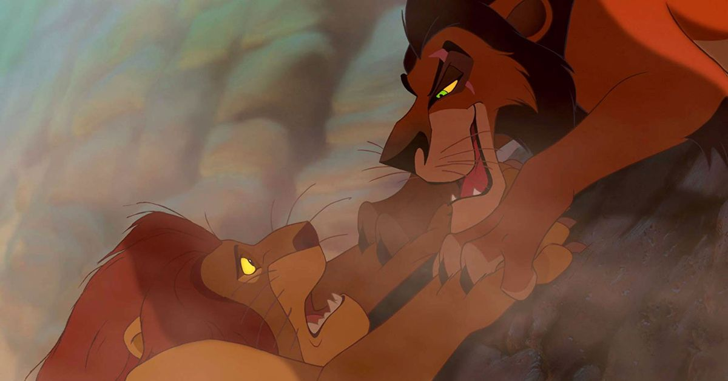
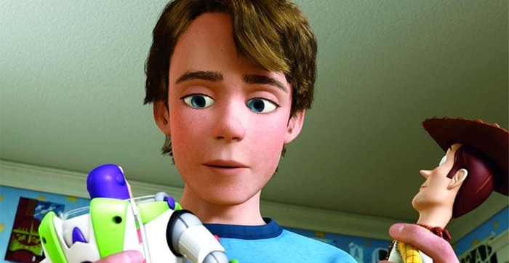
Examples
In Beauty and the Beast, Belle doesn’t know that the Beast is really a prince, but the audience does.
In The Lion King, the audience knows that Scar killed Mufasa but Simba doesn’t.
In Toy Story, Andy doesn’t know that his toys come to life when he’s not around, but the audience does.
Dramatic irony creates suspense (WILL the character find out what I know?) It creates depth and layers of meaning. This engages the audience and captivates their interest.

Slide 10
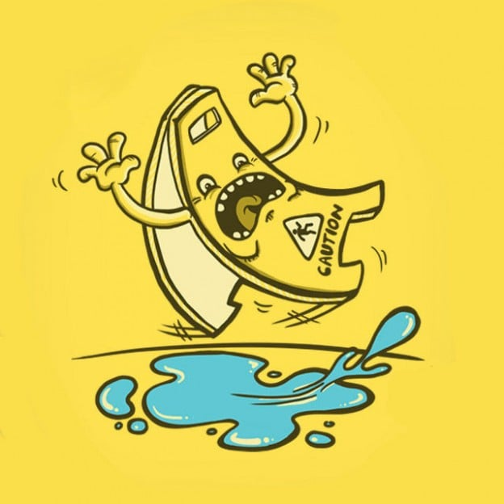
Situational Irony

Slide 11
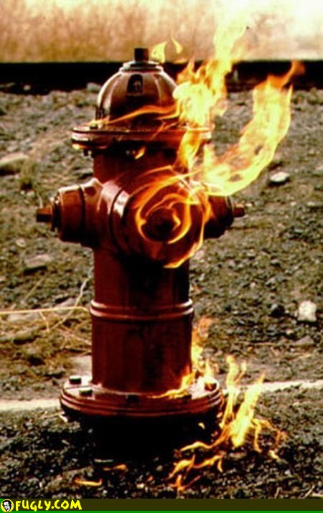
Situational Irony
When a situation or event is ironic because it’s the opposite of what you would expect.
Examples:
A fire station burns down
A marriage counsellor gets a divorce
A lifeguard drowns while trying to rescue someone from drowning
A navigational expert gets lost
Someone cuts themselves while doing a demonstration about knife safety

Slide 12
Summary
Irony = opposite to expectations
Words are the opposite of what you’d expect – verbal irony
Character expects the opposite of what the audience expects – dramatic irony
Event is the opposite of what you’d expect – situational irony

