Slide 1
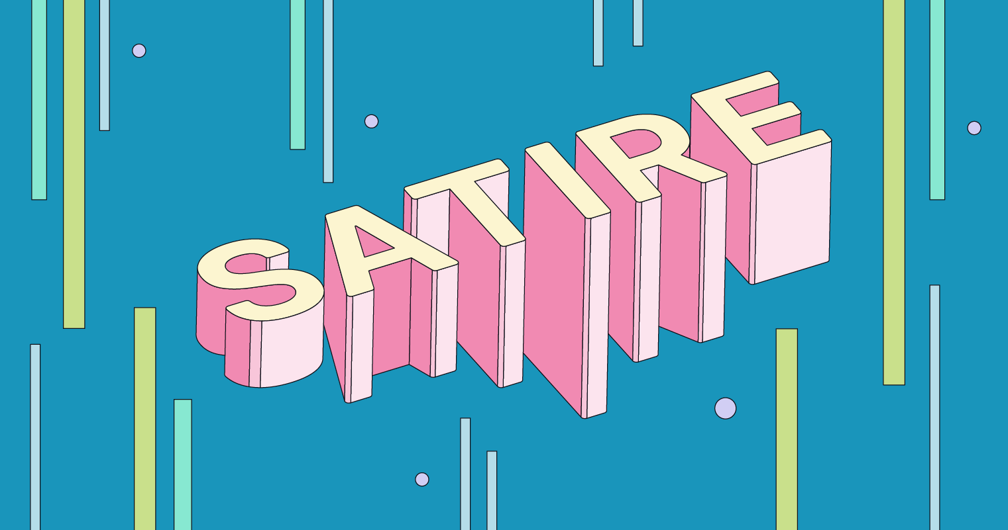

Slide 2
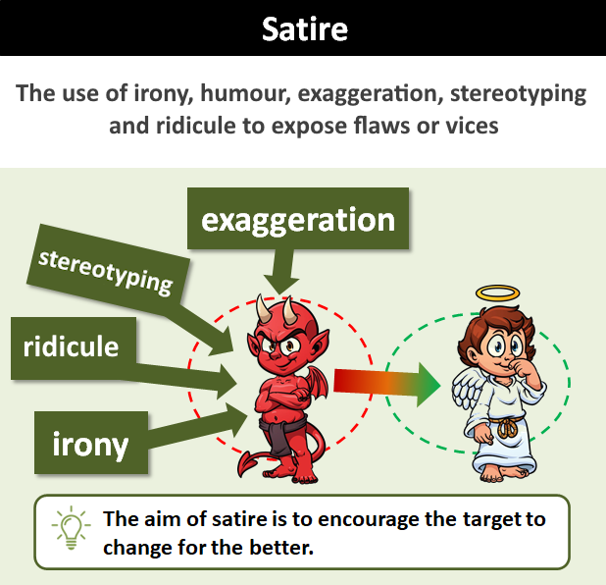
What is Satire?
The use of irony, humour, exaggeration, stereotyping and ridicule to expose and criticise people’s stupidity or vices, particularly in the context of politics and other current issues.
The aim of satire is to encourage the target to change for the better

Slide 3
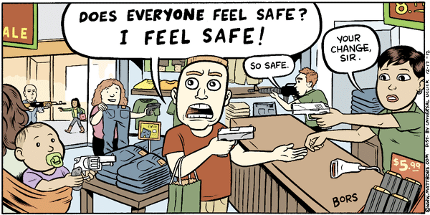
Purpose of Satire
Satire has two main purposes:
To entertain and make people laugh
To make people think
Why is this being mocked?
It’s true, this IS ridiculous!
Satire is a form of social commentary. It is often used to highlight or draw attention to flaws or problems in institutions, people, or ideas. It points out behaviour or attitudes that are wrong or bad and need to change.

Slide 4
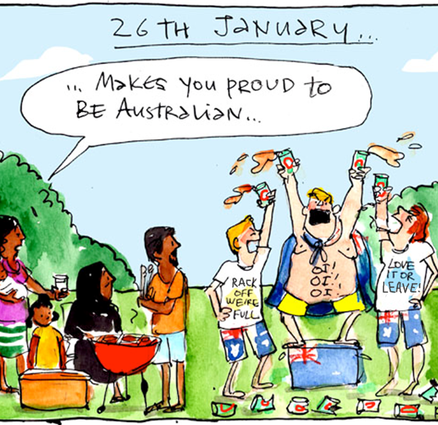
Example 1
What is the issue?
Negative attitude towards migrants by white Australians – seen on the slogans of their T-shirts. “Rack off, we’re full” (we don’t want migrants here, there’s no room) and “Love it or leave” (if you don’t like the way things are in Australia, go to another country).
Why is this attitude being mocked?
The T-shirt wearers are proud of being Australian and think it is an exclusive privilege or right that they don’t want anyone else to have. However, ironically, their own behaviour suggests that Australians aren’t very nice people.
Where is the humour?
The comic uses ridicule to point out the toxic behaviour of the T-shirt wearers (drunken shouting in public, littering, rudeness) as contrasted to the behaviour of the migrant family, suggesting that perhaps they are not the ones who should be unwelcome.

Slide 5
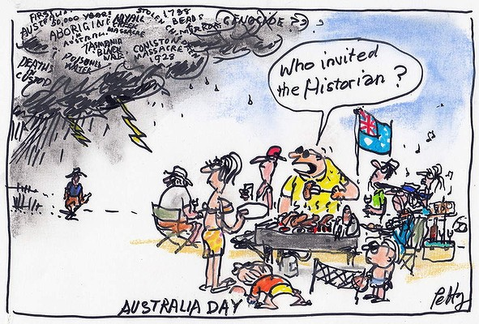
Example 2
What is the issue?
While most white Australians celebrate Australia Day with BBQs and parties, many Indigenous Australians consider it hurtful and disrespectful to celebrate a historical event which involved slaughtering their people & taking over their homeland.
Why is this attitude being mocked?
The people celebrating do not want to be reminded of the past. They would rather ignore it and enjoy themselves, even if it hurts others. This shows wilful ignorance and lack of respect.
Where is the humour?
The comic uses exaggeration and ridicule to expose white Australia’s tendency to stick their heads in the sand when faced with Indigenous people and their problems.

Slide 6
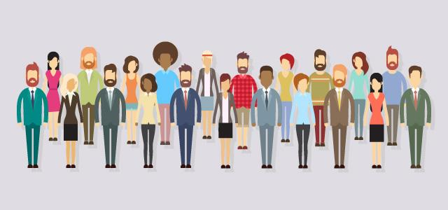
Stereotypes

Slide 7
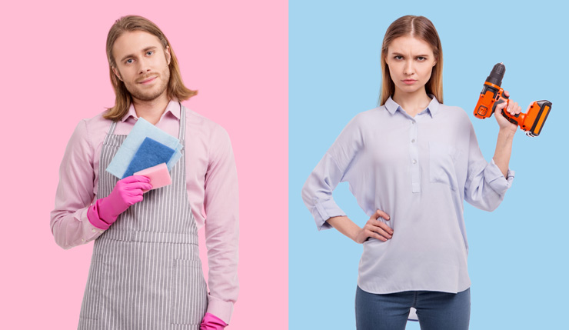
Stereotypes
Stereotypes are beliefs or assumptions about a particular group of people. They can involve various aspects such as race, ethnicity, gender, religion, nationality, age, occupation, or social class. Stereotypes can be both positive and negative.
Examples:
Elderly people are wise and experienced
Blondes are dumb
Women are nurturing and caring
Muslims are terrorists
Asians are good at maths

Slide 8
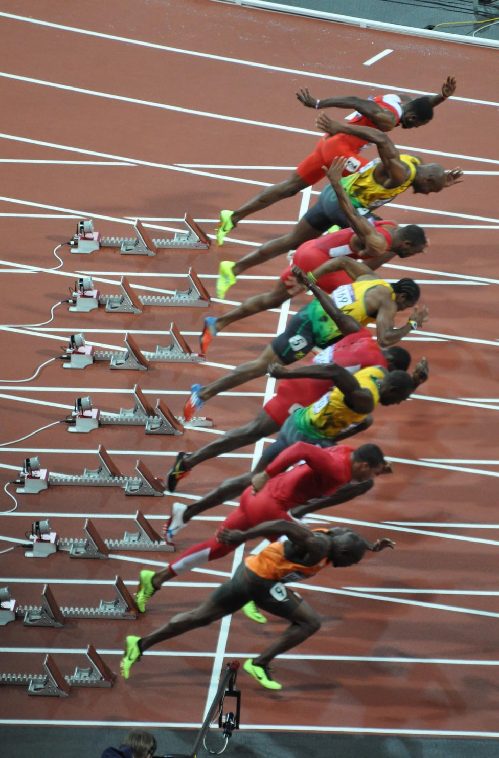
Why do stereotypes exist?
Some generalisations exist because data shows a majority occurs within a group. Humans like to generalise and lump things into simplified categories for easy reference.
Statistically speaking…
Most terrorists are male
Most social media users are teenagers
Most Italians are Catholic
Most Olympic sprinters are black
Despite this, it’s important to remember that generalising everyone based on the majority isn’t always useful or true.
EVEN THOUGH most terrorists are male…
Doesn’t mean ALL men are terrorists
Doesn’t mean women CAN’T be terrorists
Can’t assume any man you meet is probably a terrorist

Slide 9
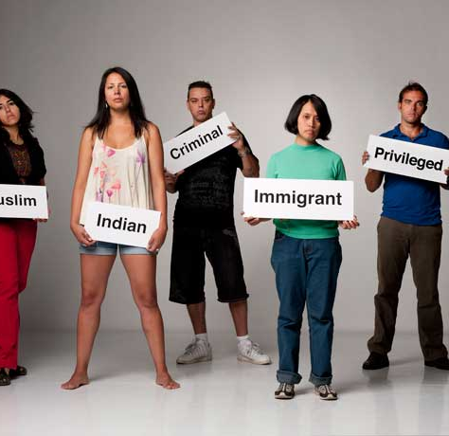
Harmful Stereotypes
Stereotypes don’t accurately represent the diversity and individuality that exists inside a group
People often base stereotypes on limited data. A single personal experience with one or two individuals can shape their idea of an entire country
Stereotyping can lead prejudice, discrimination, and unfair treatment of individuals based on their perceived group characteristics rather than their individual merits or qualities.
Even positive stereotypes can cause incorrect assumptions.

Slide 10
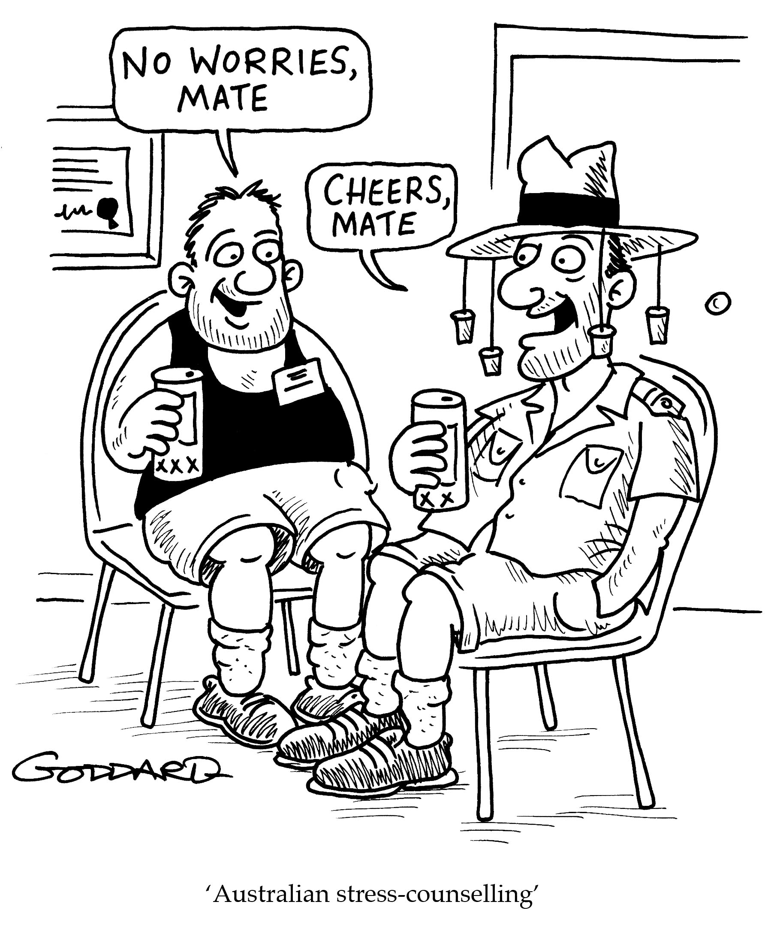
Stereotypes in Satire
Stereotypes can be used in satire as a tool to criticize or mock societal attitudes, prejudices, and assumptions.
Satire often uses exaggeration or subversion of stereotypes to expose the absurdity or flaws in them
Exaggeration – taking the stereotype to extremes to show why it’s ridiculous
E.g. a teen character stares obliviously at their phone as the house burns down around them, to challenge the stereotype that ‘teenagers are always on their phones’
Subversion – reverse the stereotype to challenge people’s expectations.
E.g. a female character saying stereotypically ‘manly’ things, to point out how silly they sound out of context

Slide 11
Activity
Do the worksheet – questions on stereotypes & satire
Can discuss answers in groups, but must submit answers individually in your own words.
Put your answers on a word doc & email it to me when finished

