Slide 1
Context, Audience & Purpose
Informative Texts

Slide 2
CAP
To understand any text, look at the C.A.P.
Context
Audience
Purpose
These 3 things have a huge
impact on texts and impact
each other
C.A.P.

Slide 3
Context
Context is the circumstances or environment in which a text was created
When in history and where in the world was it written?
What events were happening at that time?
What beliefs and practices did people have at the time?
Did the person who made it agree with these beliefs & practices?

Slide 4
Audience
Audience is who this text was created FOR. Who’s likely to read this?
When and where are they from? How old are they? Boys or girls? Rich or poor? Educated or not?
What do they already know or believe? What do people from their country/culture/time normally do?
Did the audience influence the author? Was the author hoping to reach or appeal to a particular group? Did this affect/change the way they wrote it?

Slide 5
Purpose
The reason the text was created – WHY does it exist?
What motivated the creator to make it? What did they want to achieve by creating this text?
There are 3 main categories, although they can overlap:
To inform (e.g. encyclopedia, news article)
To entertain (e.g. novel, film, play)
To persuade (e.g. advertisement, opinion piece)

Slide 6
Informative Texts
Factual texts intended to inform people about a topic

Slide 7
Context: Informative Texts
The context of an informative text will influence the information it contains and how it’s presented
Think of the differences there would be in the following:
A science textbook from England published in 1965
A science textbook from China published in 2023
A pamphlet about ‘Bible Truths’ written by a Christadelphian
A pamphlet about ‘Bible Truths’ written by a Mormon
A news broadcast about global health from before COVID-19
A news broadcast about global health from after COVID-19

Slide 8
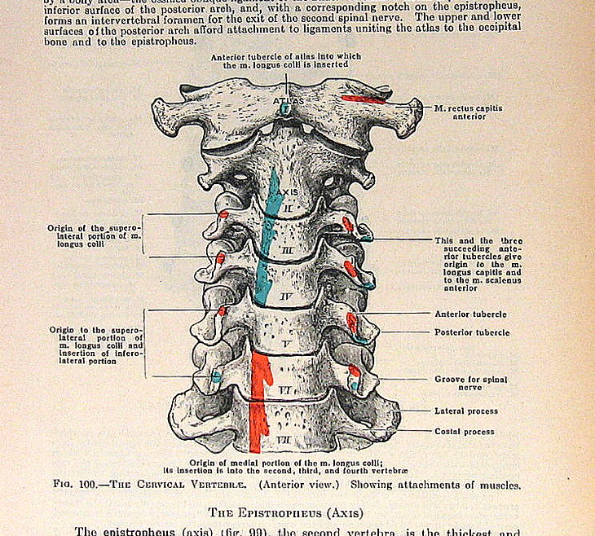
Audience: Informative Texts
The intended audience of an informative text will change the features it has or the way it’s written
An informative text for children might use less formal language, large bright pictures, and shorter, simpler sentences
An informative text for doctors might use highly specific vocabulary and detailed medical diagrams
An informative text for consumers (people who want to buy a product) might use persuasive language to convince the audience to buy it

Slide 9
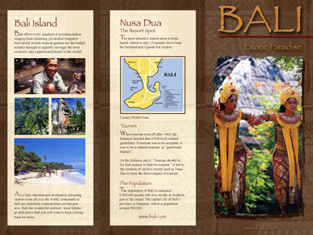
Purpose: Informative Texts
The purpose of informative texts is mainly to inform people – give them researched, factual information to help them understand a topic.
But informative texts can ALSO be entertaining or persuasive, depending on the context and audience.
The main purpose of a travel brochure about Bali is to give people information about the country and things to do and see there.
However, a secondary purpose might be to persuade them that Bali is a fun and interesting place to visit.

Slide 10
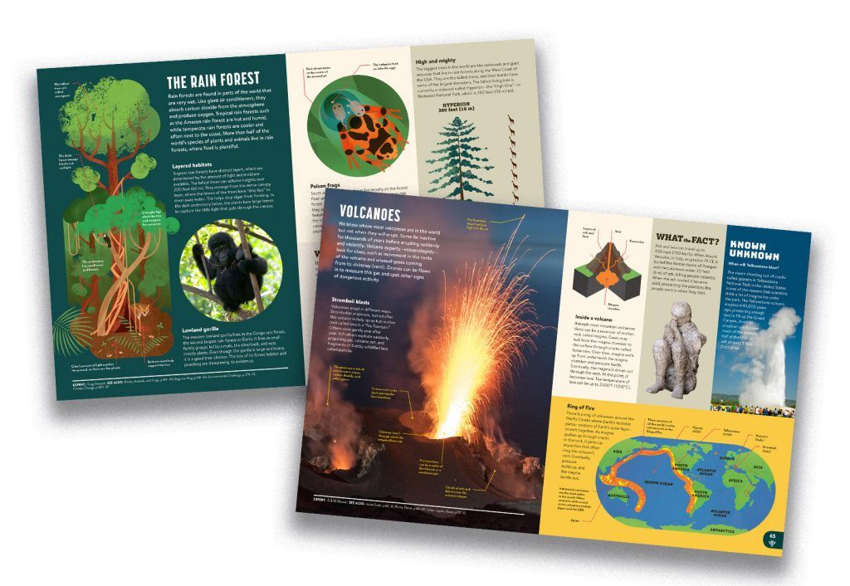
Features of an Informative Text

Slide 11
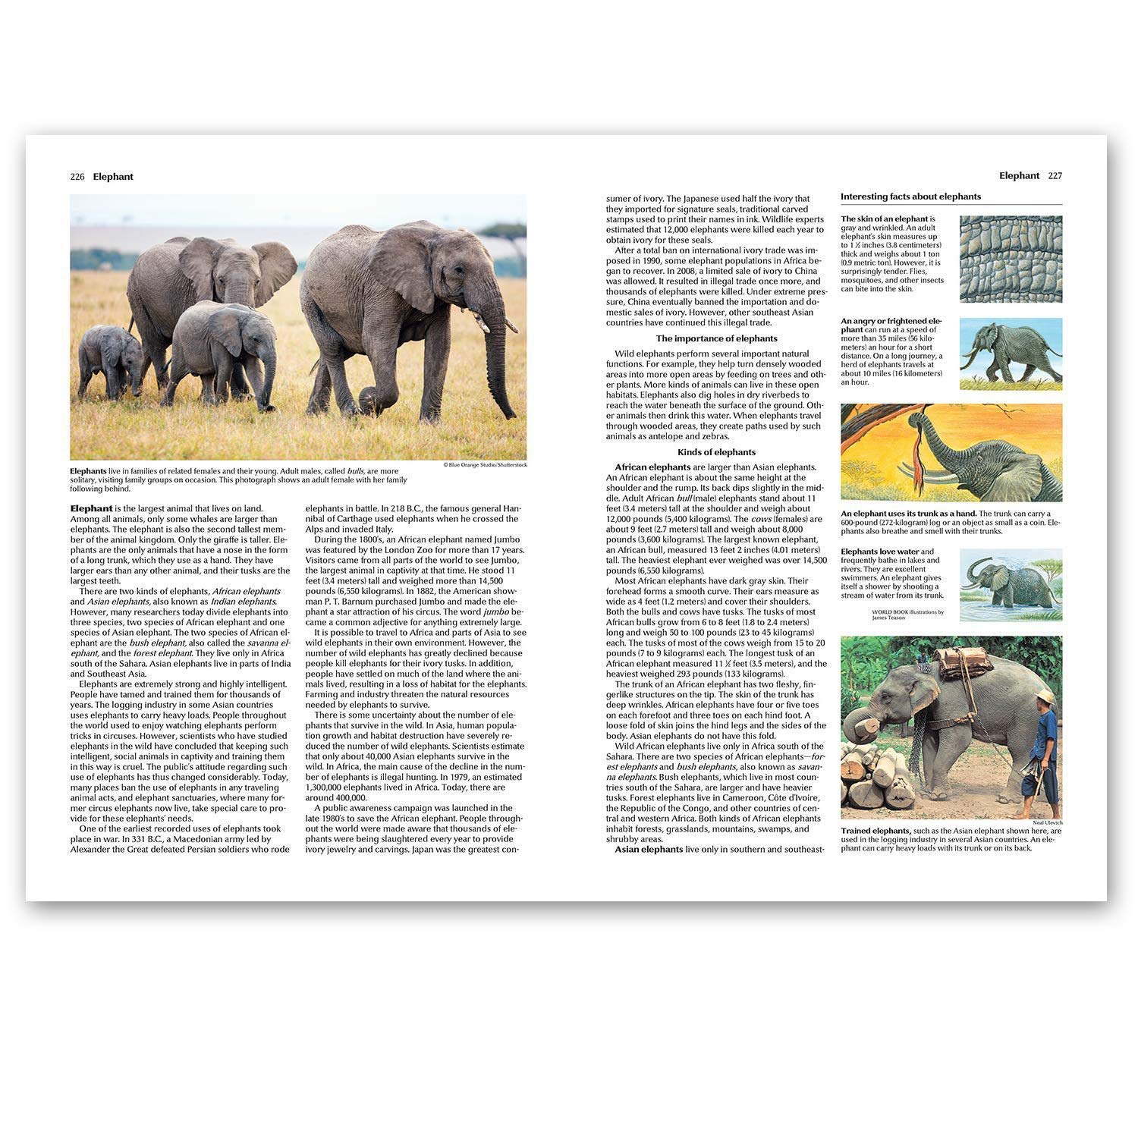
Informative texts often have the following features:
Facts (not opinions – able to be proved)
Short, structured paragraphs
Headings & sub-headings
Formal, academic language
List of citations or references
Pictures/diagrams with captions
Index or contents page
Glossary

Slide 12
Research
Other People’s Knowledge, Your Words
To find the facts for your informative text you will need to do some research
Research involves finding, understanding, and describing the ideas of experts
Quoting, paraphrasing, and summarising, are ways to include other people’s ideas in your own work without plagiarising
These techniques allow you to demonstrate your own understanding of the key points of your topic

