Slide 1
Research Skills
Finding Reliable Sources of Information

Slide 2
Source
Source = place where you go to get information or facts
Books & magazines
Websites
Newspaper articles
First-hand accounts
Photographs & videos
News broadcasts or documentaries
Social media

Slide 3
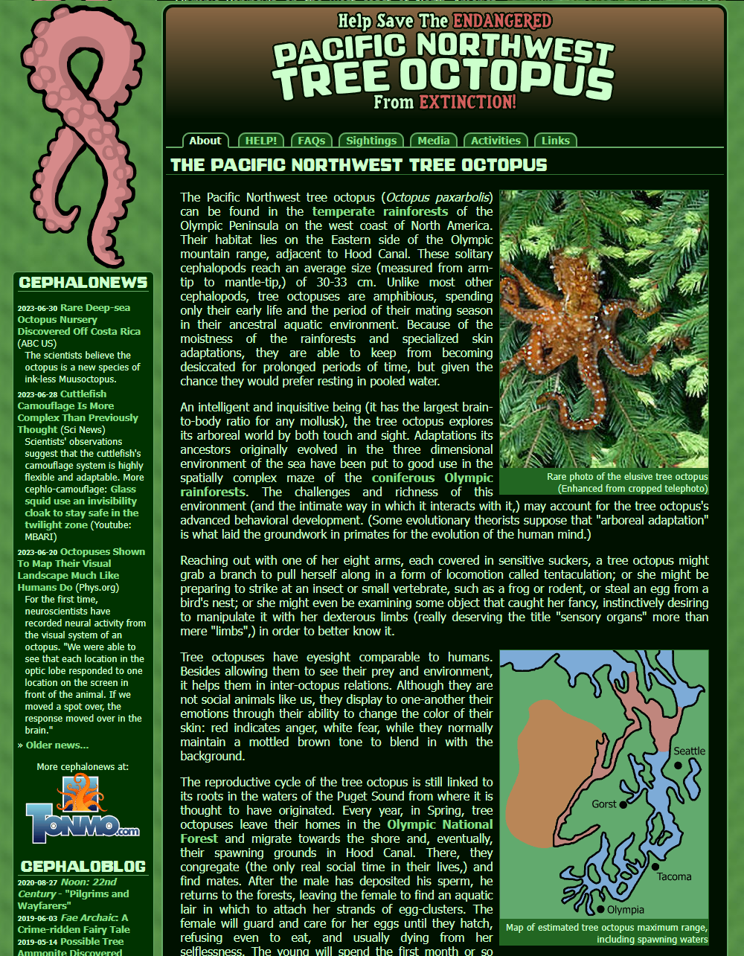
Good & Bad Sources
Some sources are more reliable or trustworthy than others
Which source is more likely to contain true or correct information? Why?
A facebook post
A medical textbook
It’s very easy for people to put wrong or incorrect information on the internet. They can make it SEEM very convincing
Need to be critical of sources – evaluate them carefully, ask questions, and make sure the information is true
A credible source is one that is reliable. You can trust that the information is true and has been checked by experts.

Slide 4
ABCDE Checklist
Author
Who wrote this? Are they qualified or an expert?
Best before
How recent and up-to-date is this info?
Connections
Are there links or references to statistics, scientific studies, or research? When you compare this information to other sources, does it say the same thing?
Design & layout
Does it look professional? Are there lots of typos, broken links, ads?
Expected outcome
Why has this information been shared – are they trying to sell something? Could they be biased?

Slide 5
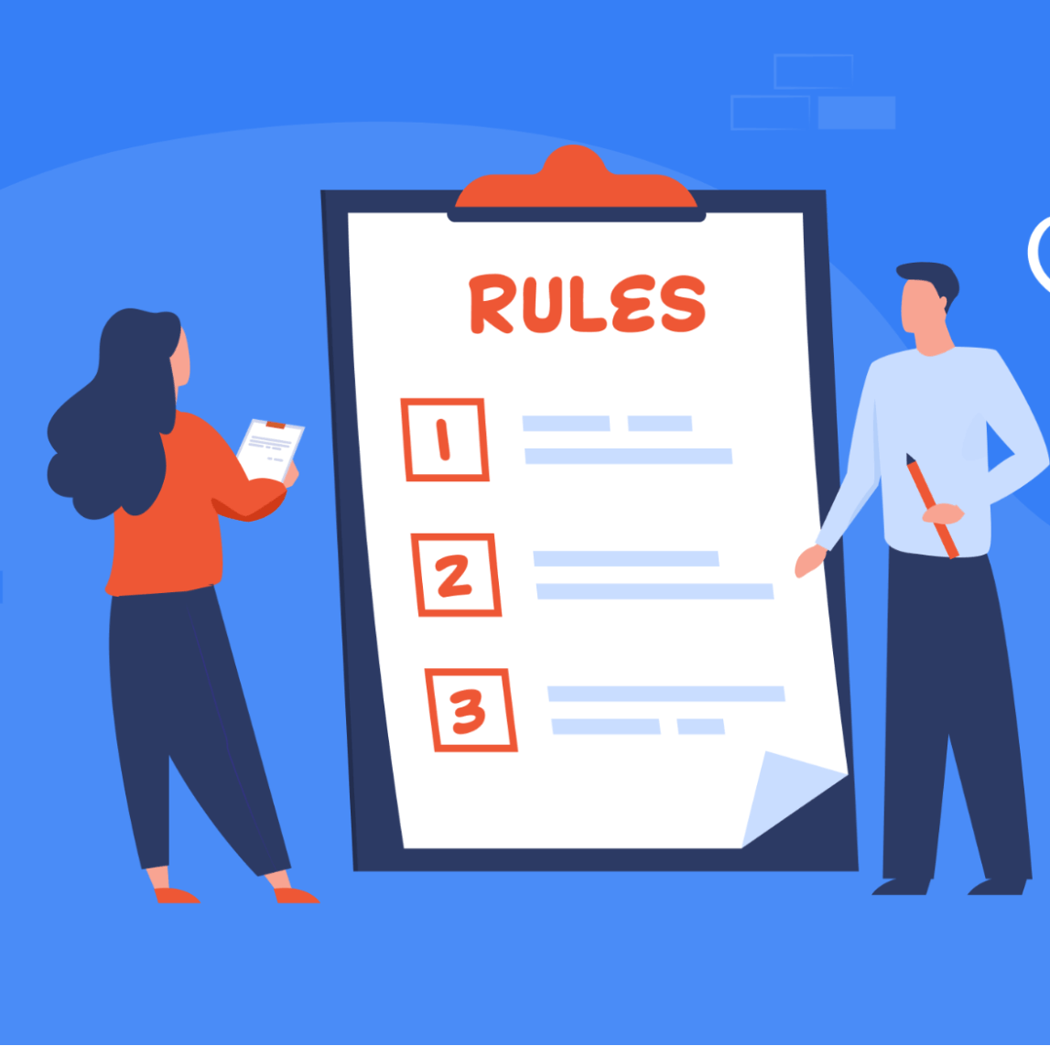
Responsible Internet Research
3 important rules to remember
Check sources – make sure info is true and reliable
Put it into your own words – no copy/pasting!
Reference – show where you got the information from

Slide 6
Your Own Words
When you are handing in work with your name on it, you should always take care to make sure it is your own work
If someone else wrote it, drew it, or created it, that’s dishonest.
‘Someone else’ could mean:
Random person on the internet (copy/pasted it from google)
A sibling
A classmate
Your mum/dad
AI – ChatGPT

Slide 7
Plagiarism
Passing off someone else’s work as your own is called plagiarism.
Dishonest, lazy, cheating
Trying to trick the teacher
You won’t learn anything & won’t get smarter
Passing on your work to others for them to copy is also considered plagiarism
Can have serious consequences in the real world
fired from jobs
expelled from universities
sued for copyright infringement

Slide 8
Easy to Detect
Plagiarised sections immediately stand out
Sounds odd, not like something you would say or write
Especially if you suddenly use perfect spelling, grammar & punctuation, and lots of big words!
AI programs like ChatGPT have a particular ‘style’ of writing that is easy to recognise
Plagiarism checkers are free & very easy to use
They compare your work to the internet & find combinations of words that are exactly the same or in the same order
They also work for AI
You can use them yourself to check that your work isn’t too similar

Slide 9
Using Quotes
The only time you CAN use other people’s exact words is when you quote them. This is fine as long as it’s done correctly.
Put quotation marks around the words that are from someone else
List the author or reference – say who said this or where it comes from
“I have no special talent. I am only passionately curious.” (Albert Einstein)
“The truth will set you free” (John 8:32)

