Slide 1
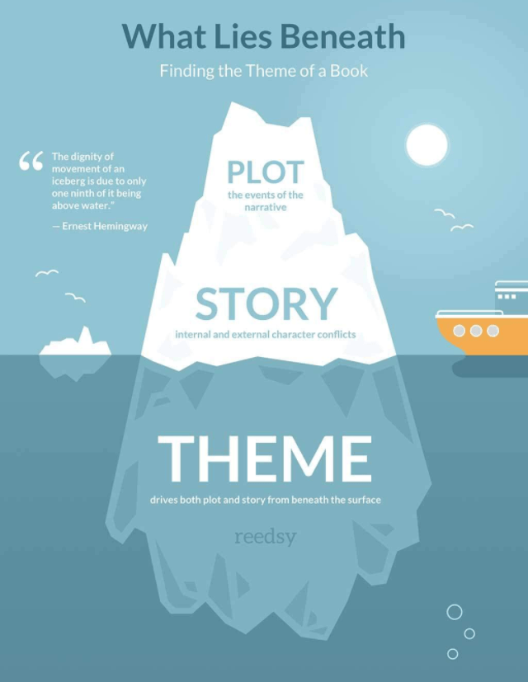
Themes

Slide 2
What is a theme?
An idea, lesson, or message that is explored in a text
Different to the topic/subject
All texts (books, movies, comics, stories) have themes
Themes are usually underlying (not directly stated)
Usually re-occur several times in the novel
Multiple events or conversations in the book demonstrate how the characters feel or what they believe about this theme

Slide 3
Common themes in literature
Good vs evil (Harry Potter)
Love or Relationships
Family (Little Women)
Forbidden or unrequited (Romeo & Juliet, Phantom of the Opera)
Friendship (Lord of the Rings)
Redemption (A Christmas Carol, The Grinch)
Coming of age (To Kill a Mockingbird)
Revenge (The Count of Monte Cristo)
Survival (The Hatchet)
Courage or Triumph of Human Spirit (A Wrinkle in Time)

Slide 4
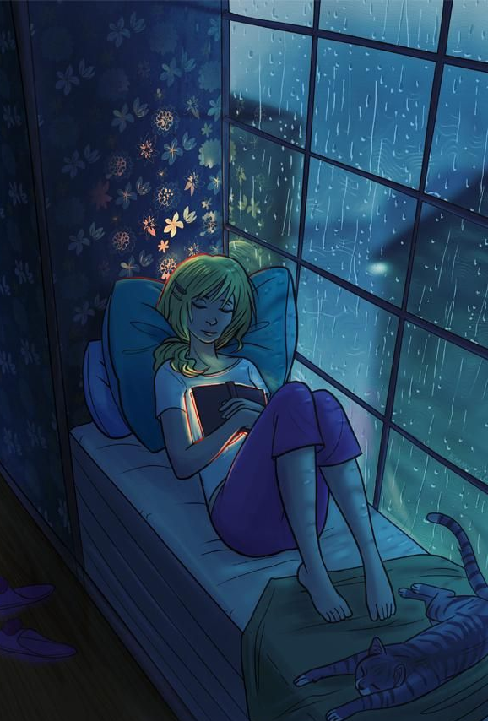
Why are themes important?
Helps the reader connect with the story
Relate to the characters
Recognise yourself or people you know
Makes you care about what happens in the story
Gives the reader something to take away
A message or lesson
An idea to consider
Think about life - why people act the way they do, what makes us who we are, what’s important to you etc

Slide 5
How to recognise themes
Think about the story as a whole. Look at the ‘big picture’ rather than just single events
Think about the author’s message – why they shared this story, what they may have been hoping to teach us
Look for incidents, situations, or conversations that happen more than once in the story
Look for reoccurring symbols or motifs (physical objects that might represent an idea)
Dust = depression
Rain = hope
Apples = rebirth
Fire = destruction

Slide 6
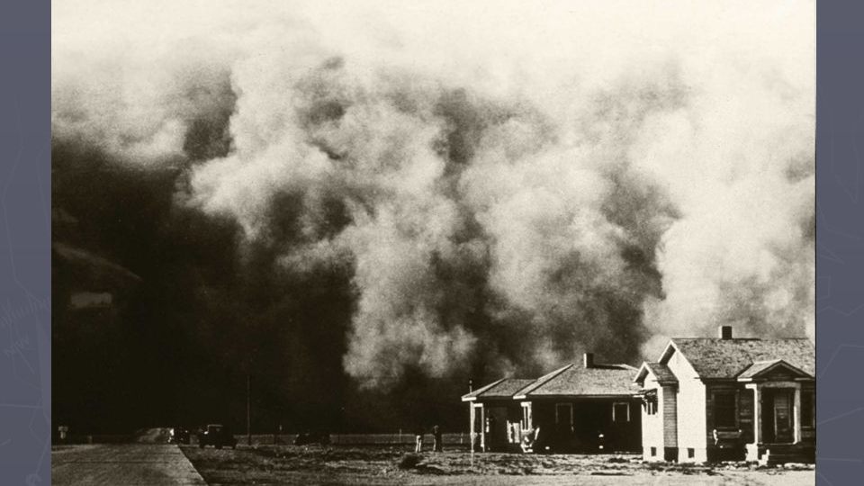
Themes in Out of the Dust
NOTE: this is not a complete list, you might be able to see some others

Slide 7
Loss and Grief
Billie Jo experiences multiple losses in the novel
Her best friend Livvie
Her Ma & newborn baby brother
Her ability to play the piano
Her self-respect
Anger and bitterness – natural response to grief
Blames herself
Blames her father
Slowly begins to accept what happened
Understands that her father is also grieving
Eventually can forgive him & heal their relationship
Begins to feel hope for the future again
Her father also experiences many losses
Wife & child, crops, livelihood, his daughter (when she runs away)
This event results in new insights for both & redefining of their family

Slide 8
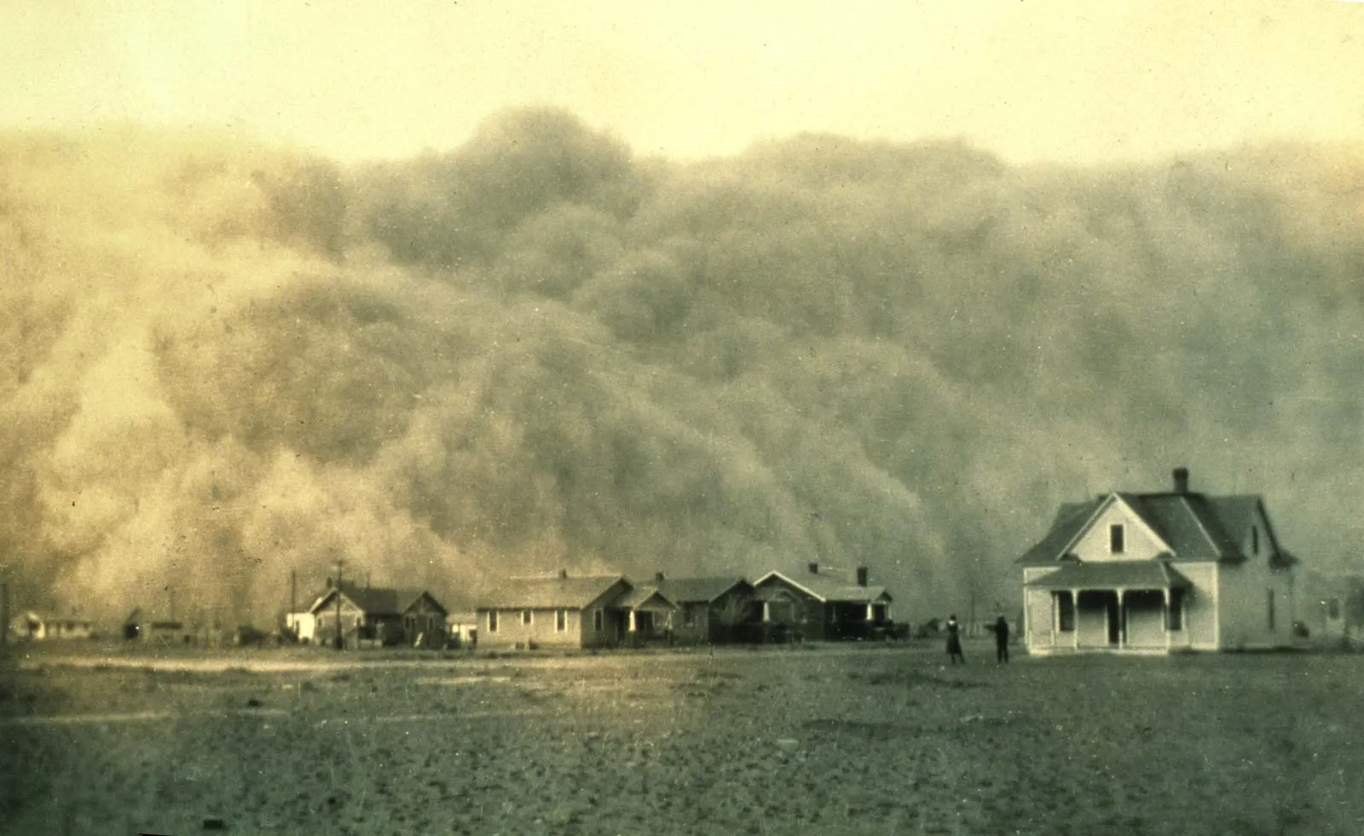
Environment
The novel is set during a period of extreme drought, economic downturn & ecological disaster (Dust Bowl)
This environment has a huge effect on the characters in the novel
Crops & animals die
Dust storms cause accidents, injuries & damage to property
Worsens existing financial hardship
Makes everyday life a struggle
Characters respond in different ways
Decrease in morale, despair, and lack of hope
Some try & see the funny side, e.g. Billie Jo's father at first (pretending to think the dust in their food is pepper)
Fear: Billie Jo asks “where would we be without somewhere to live? Without some work to do? Without something to eat?”
Although some leave, many choose to stay and try and farm the land despite the extremely difficult living conditions
The setting helps readers appreciate their own environment & demonstrates how pain and struggles in life are balanced by joy and relief when suffering is over

Slide 9
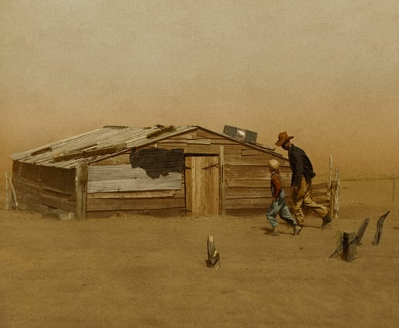
Family
The family situation changes dramatically over the course of the novel.
At the beginning of the story, they are a normal family despite their struggles
Longed-for baby is on the way
Dad farms, Ma cooks, Billie Jo does schoolwork & piano
Terrible accident destroys their family unit
Unspoken blame and resentment
Each struggling with their own grief
Feel like strangers living in the same house
When Billie Jo returns home after running away:
She & her father finally feel able to communicate
Redefine their relationship and their family
Are able to include Louise in their family

Slide 10
Setting

Slide 11
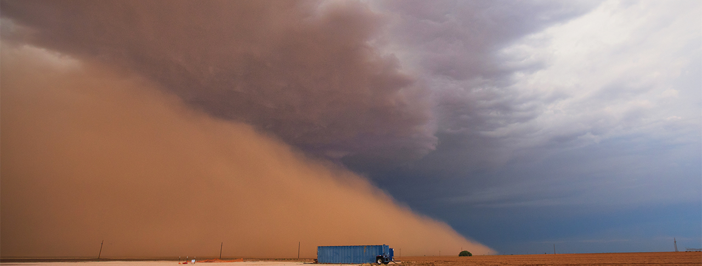
Setting
Creates a backdrop for the events of the story
Creates a context for the action, character development, and conflict
Has a big effect on the feel or ‘mood’ of the novel
Makes the story feel real and believable
Insight into a historical time period/culture – what life was like for people from this era, how it’s different to us

Slide 12
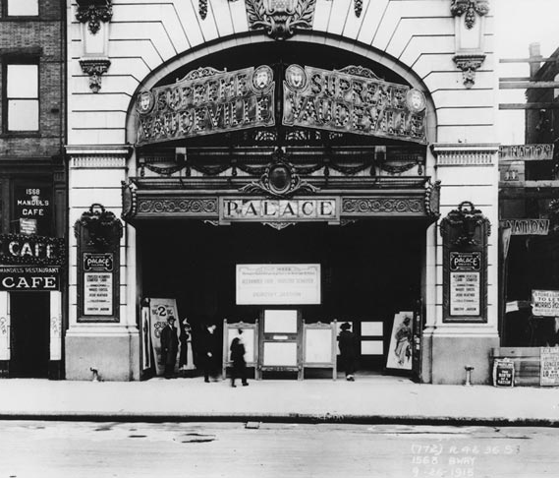
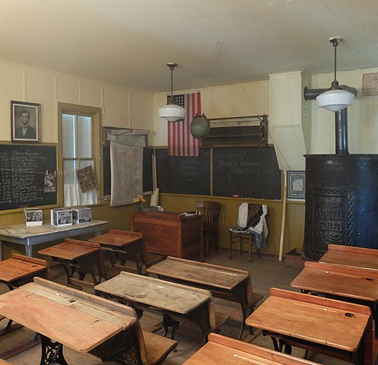
Effect of setting
Affects the mood
Affects the characters’ motivations, choices, expectations
Can be symbolic – highlight themes or mirror events in the novel
Dust – physical metaphor for the Depression
Like the Dust Bowl, the accident that killed Ma & injured Billie Jo was a series of mistakes that turned fatal
Storms = hard times in life
Gives insight into characters
How they describe the setting demonstrates their feelings about it
E.g. Mad Dog tells Billie he loves the land, but she notes he hasn’t been burned by it, hands are ‘scarless’

Slide 13
Style

Slide 14
Writing style
Style = the way the author tells the story
Choice of words/language
Use of techniques e.g. figurative language, description, emotive language
Intended to have an effect on the reader. Can shape and direct their understanding and interpretation of the novel.

Slide 15
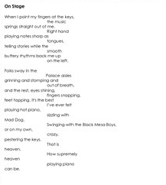
Free Verse Poetry
Sparse – economy of words (few words) matches harsh, empty landscape
Expressing strong emotion – easier in poetry
Quick to read, unusual format intended to appeal to young adult audience (dislike long books)
Sad topic – moving through it quicker might make it seem less overwhelming/depressing
Visually interesting, use of white space e.g. (pg. 13) “On Stage” looks like piano keys

Slide 16
Enjambment
When a line break occurs in the middle of a sentence
Can have various effects:
Hurry the reader on to the next point
Change emphasis – highlight a word that would otherwise be unnoticed in middle of sentence
Suggest pauses between thoughts
Many short lines – gives impression of loneliness or hopelessness

Slide 17
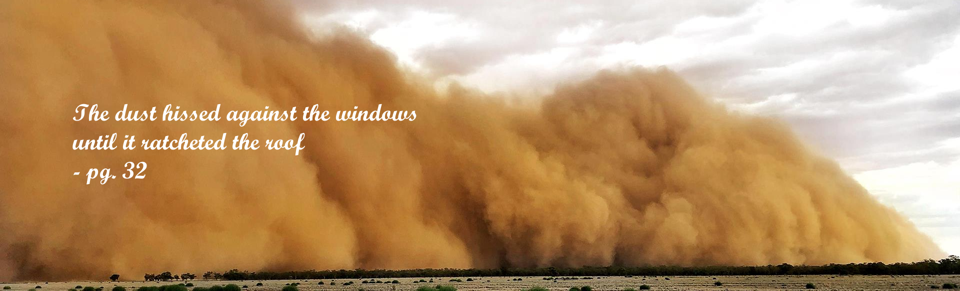
Sound Devices: Alliteration, Consonance, Assonance, Onomatopoeia
Draws attention to certain key words or links them to other words
Can mimic the sound of what it’s describing.
Can create euphony or cacophony – repeated soft sounds create calm gentle feel, repeated harsh sounds create jarring uncomfortable feel.
Makes the reader feel like they are really there and can ‘hear’ the scene
Memorable & interesting
“…rain notes spilling from the gutters, gushing through gullies...” (pg. 105)
“…a black cloud, big and silent as Montana, boiling on the horizon and barrelling toward us.” (pg. 163)
“Bare as a pear… ripe and striped like a melon.” (pg. 55)

Slide 18
Figurative Language
Examples
Effect
Similes
“Voices rose like ghosts on the howling wind” (pg. 143)
“As foul as maggoty stew” (pg. 29)
Metaphors
“Caves of dust” (pg. 162)
“She’s an old mule on the subject of my schooling” (pg. 10)
Personification
“Piano, my silent mother… uncomplaining, you accept the cover to your keys” (pg. 193)
“My fingers leave sighs in the dust” (pg. 139)
Comparisons help the reader create a specific and accurate mental image of what the poet is describing
Links to past memories or previous experiences the reader has
Concise way to communicate multiple or complex ideas
Interesting – sticks in the reader’s memory
Adds layers of meaning, creating depth and complexity

Slide 19
First Person POV
Story is told from Billie Jo’s perspective (looking through her lenses)
Helps the reader feel involved, as if Billie Jo is telling the story to us, or we are experiencing it along with her
Only tells her side of the story
Sometimes leaves out part of events or isn’t quite honest with herself
Portrays people based on how she feels about them
We don’t know how other characters are thinking/feeling
have to guess based on clues & hints
e.g. we know very little about Ma’s background

