Slide 1
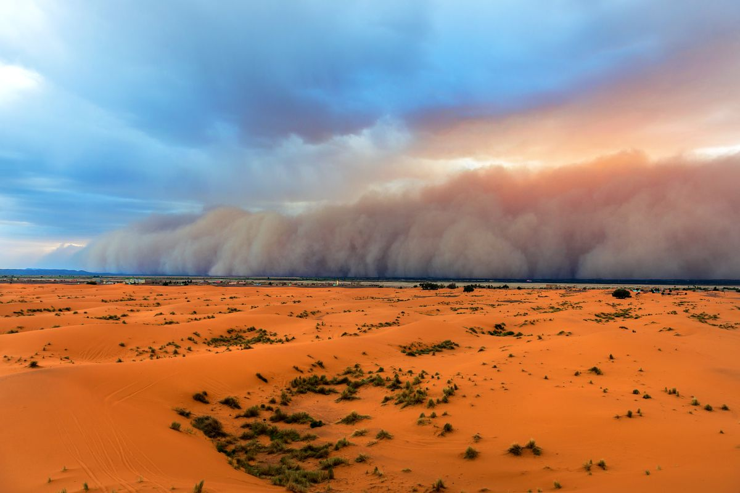
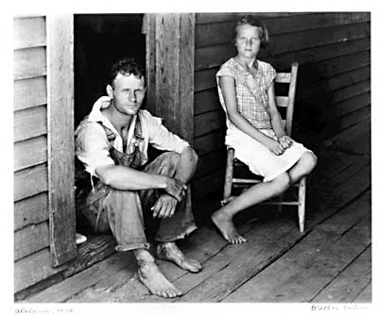
Character & Relationships
Out of the Dust

Slide 2
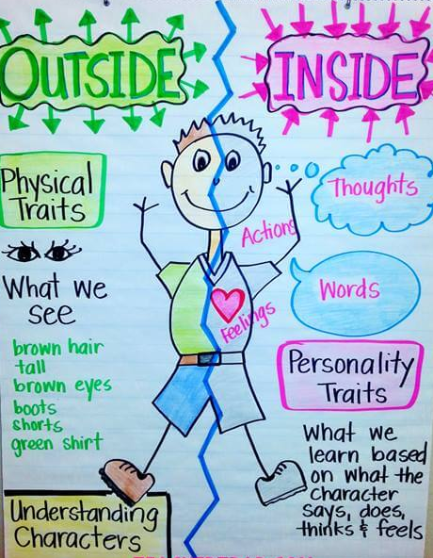
Characters in novels
Drive the plot (make things happen)
Develop the themes (explore the underlying ideas)
Show the reader how other people think and behave
How they relate to each other and solve personal conflicts
How they deal with trauma or circumstances in life
This can provide examples for your own life
Even if you don’t like the characters or don’t approve of their actions, they can be an example of how NOT to behave!

Slide 3
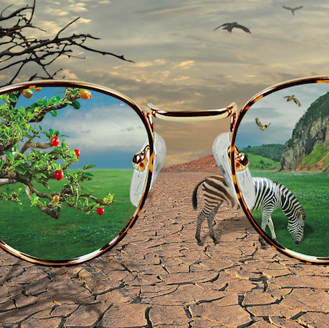
We see characters through the narrator’s eyes
The way a character is described or portrayed in a novel reveals what the narrator thinks about them.
Louise: “she’s a good cook, without showing off”… “has a way of making my father do things”… “knows how to come into a home and not step on the toes of a ghost” (respects her)
Mr Hardley: “was in the habit of charging too much for his stale food and he made bad change when he thought he could get away with it”… “argued over every nail and every little minute” (dislikes him)

Slide 4
Billie Jo Kelby
Smart, determined, ambitious
Highest score in state test (pg. 30)
“Someday, I plan to play for President Franklin Delano Roosevelt himself. Maybe I'll go all the way to the White House in Washington, D.C.” (pg. 16)
Insecure
Describes her appearance critically (pg. 3)
Feels worthless after accident, a “poor motherless thing” with “deformed hands” (pg. 92)
Says Mad Dog “could have any girl, why would he want me?” (pg. 152)

Slide 5
Billie Jo Kelby
Creative/artistic, yearns for culture
Frustrated when she’s only person who hasn't heard of Madame Butterfly (pg. 42)
Angry about lack of opportunity to see art exhibit (pg. 95)
Dissatisfied, wants more in life than living on a farm in a small town
From the earliest I can remember I’ve been restless in this little shack we call home” (pg. 4)
Jealous when Livvie moves away – “wanting my feet on that road to another place instead of Livvie’s” (pg. 9)
Longs to be travelling with Black Mesa Boys (pg. 183)
Her piano skill was her ticket out of there – another reason she is so devastated by the accident

Slide 6
Ma (Polly)
Tension/resentment over piano
Ma doesn’t approve, wants Billie to focus on schoolwork instead
Billie Jo suspects she is “jealous” & hints there are unfulfilled dreams in Ma’s past (pg. 113) “afraid of me going somewhere with the music she can’t follow” (pg. 28)
Not forthcoming with praise
“I knew you could” – makes her feel taken for granted. “I wish she’d give me a little more to hold on to” (pg. 30)
After her death Billie comes to realise she did love her & showed it in many small ways, longs for even those small words of praise “It would be enough” (pg. 95)

Slide 7
Ma (Polly)
Open to new ideas – told Daddy to diversify on the farm & build a pond
Different physically & mentally to Billie Jo –
Billie Jo only sees similarities between her & her dad
But has forgotten piano & apples
Billie could confide in her about crushes (pg. 153)
Says Ma could soothe conflict between her & daddy
Or is this rose coloured glasses?

Slide 8
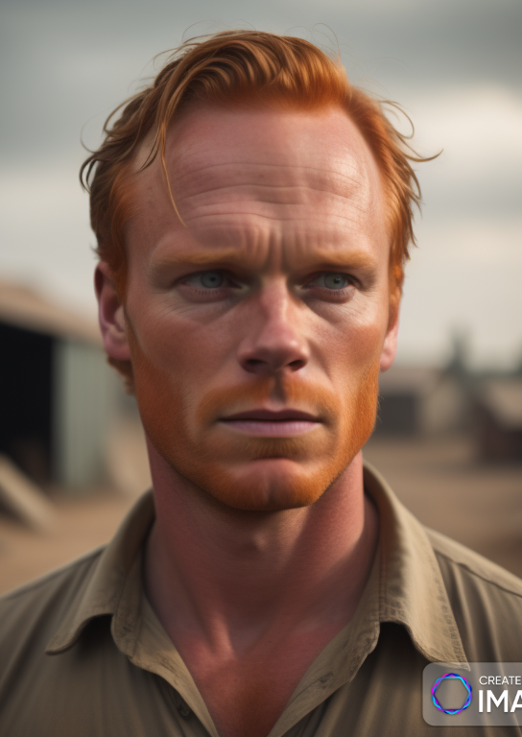
Daddy (Bayard)
He wanted a boy, named her & raised Billie like one. Makes her feel unwanted (pg. 3)
Very similar to Billie Jo in looks & personality – even their walk, gestures etc are similar (pg. 108)
Farmer’s optimism & persistence
Keeps hoping for rain even when it’s impossible.
Will never leave the land “no matter how bad it gets” – “He and the land have a hold on each other” (pg. 74)
Stubborn – doesn’t want to change what he knows (growing wheat) won’t listen to Ma’s advice
Served in France WWI – most vivid memory is the poppies. Shows he appreciates beauty (similar to Billie Jo)
Grief causes him to act self-destructively
Wasting saved money to get drunk
Becomes distant & self-absorbed, digging the pond
Pays no attention to Billie Jo who needs him, won’t talk to her,
They are like strangers living in the same house, “I don’t know him anymore (pg. 75)

Slide 9
Daddy (Bayard)
Won’t get treated for skin cancer (pg. 153)
Shows he is in a bad place mentally – doesn’t care if he lives or dies.
This is what finally drives Billie Jo to run away. Seems like he doesn’t care enough about her to stay for her sake
After Billie Jo runs away and comes back, their relationship changes.
He realises how much he needs her & that his behaviour has been driving her away.
They talk to each other more
He goes to the Dr about his skin cancer – not giving up hope – she also asks Dr about her hands for the same reason
Takes night classes so they will have something to fall back on if farming doesn’t eventually pay and meets Louise.
Willing to try new farming techniques.
“You can stay in one place and still grow” (pg. 230)

Slide 10
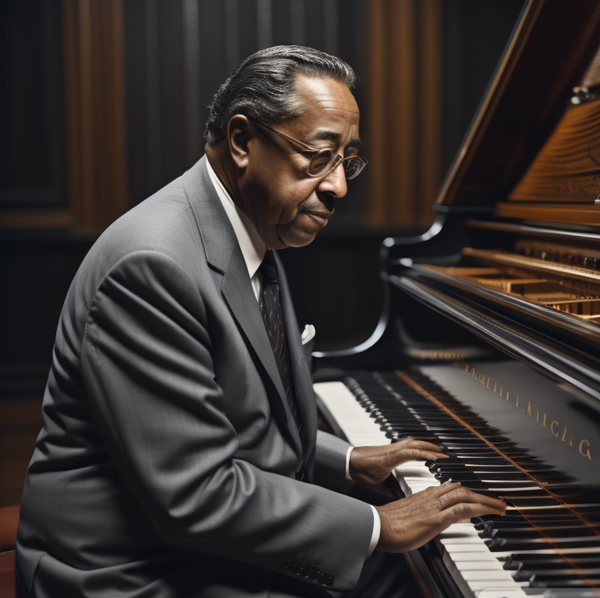
Arley Wanderdale
Teaches music once a week at Billie Jo’s school
Ma says he’s “no teacher, just a local song plugger” (pg. 10)
Invites Billie Jo & Mad Dog, school aged kids, to perform with his band
Professional gigs and on tour, pays them wages.
Shows he believes in their talent.
Pairs them up – putting talented people together can help them both develop
Billie Jo finds comfort listening to him play when her hands are too badly injured (pg. 73)

Slide 11
Arley Wanderdale
When people shy away from her injury after the accident, Arley is the first person to believe she could play piano again and encourage her to try (pg. 88)
Invites her to play at shows even after accident – must have been a professional risk for him but Billie saw he was asking genuinely and it “looked like it meant a lot to him” (pg. 90)
Billie wishes she could be good again without him “making excuses” for her (pg. 126)
Asks her to play again straight after competition when her hands are still sore & swollen – won’t accept her excuses & insists she try, leads to her playing badly which is embarrassing for her (pg. 136)
Even when she refuses to play, he’s friendly, keeps in contact, asks after her dad and her hands.
Feels bad for her when she can’t play at the graduation (pg. 174)

Slide 12
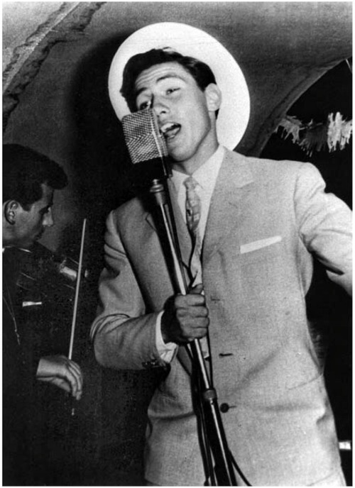
Mad Dog Craddock
Handsome, blue eyes, “smooth voice”. Works as a plowboy and sings with Arley Wanderdale and his band, the Black Mesa Boys.
Good looking, good singer, female fans. Could let it go to his head and be an arrogant jerk, but he doesn’t
Happy to explain the funny/embarrassing story about his nickname (he bit people as a child) rather than letting them think it’s because he’s so “wild and untamed” (pg. 92)
One of the few people who treats Billie Jo the same after the accident
Doesn't pity her or stare at her scarred hands (pg 91).
Respects her and sees her as someone he knows, Billie Jo Kelby the person and musician, not the “poor motherless thing" that others see first.

Slide 13
Mad Dog Craddock
Escapes the Dust Bowl by getting a job in Amarillo as a radio performer.
If Billie Jo's hands hadn’t been burned, she may have been able to join him.
Heightens her own sense of being stuck.
Finds it hard to cheer when they feature on the radio “my throat felt like a trap had snapped down on it” – “That Mad Dog, he didn’t have a thing to worry about… he’ll go as far as he wants” (pg. 185)
Says he "loves this land, no matter what" (pg. 170), but it hasn’t hurt him – hands are “scarless”
She likes him - “If I had any boy court me it’d be Mad Dog” but feels like she’s not worthy – he “can have any girl” (pg. 151)
Not clear whether he sees her as more than a friend. Possibly. Comes to see them after the storm, stays chatting for longer than he meant to, but she specifically notes he didn’t come to court her (pg. 169)

Slide 14
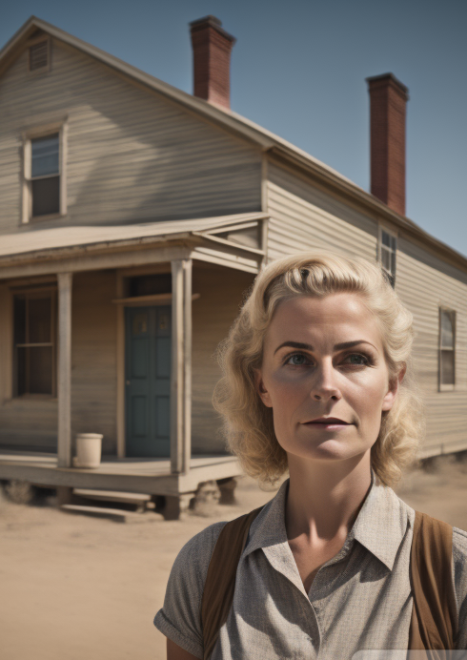
Louise
She helped Billie’s father during a tough time
“She stayed by Daddy the days I was away” (pg. 212)
May have talked with him & made him see that his behaviour has driven Billie Jo away
Would be very easy for Billie Jo to hate & resent her.
Memories of her mother are still very painful and raw.
She has only just started to mend her relationship with her dad. Worries that Louise will “crowd me out of Daddy’s life… when I am just finding my way back into it.” (pg. 215)
Calls her “the other woman” at first and says she “didn’t intend to like her” (pg. 213)

Slide 15
Louise
Wins Billie Jo over – can’t help liking her
She’s “so plain and so honest” (pg. 213)
Doesn’t push in, knows how to respect their past (pg. 226)
Makes Daddy laugh (pg. 214)
Listens to Billie without telling her what to do (pg. 219)
Expects dad to help around the house and takes his efforts seriously
“Has a way of making my father do things” (pg. 213)
Billie Jo “took a lesson” from this – previously felt she was expected to do it all

