Slide 1
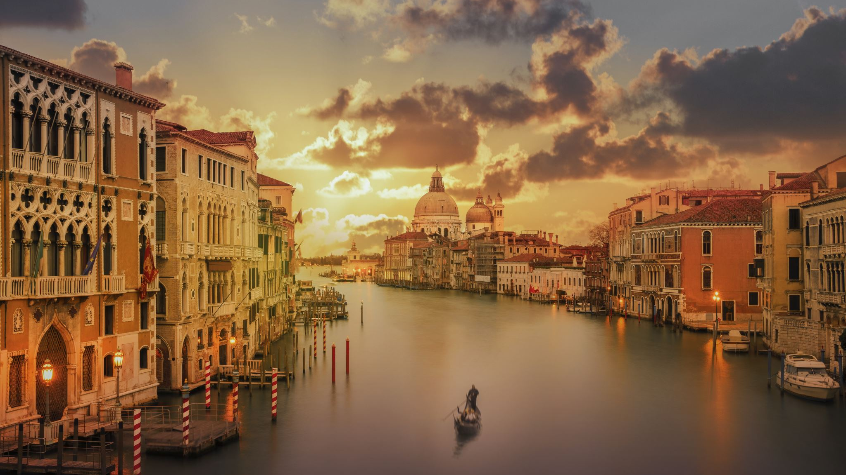
The Merchant of Venice
Context, Themes & Characters

Slide 2
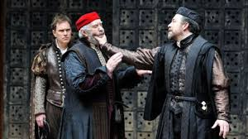
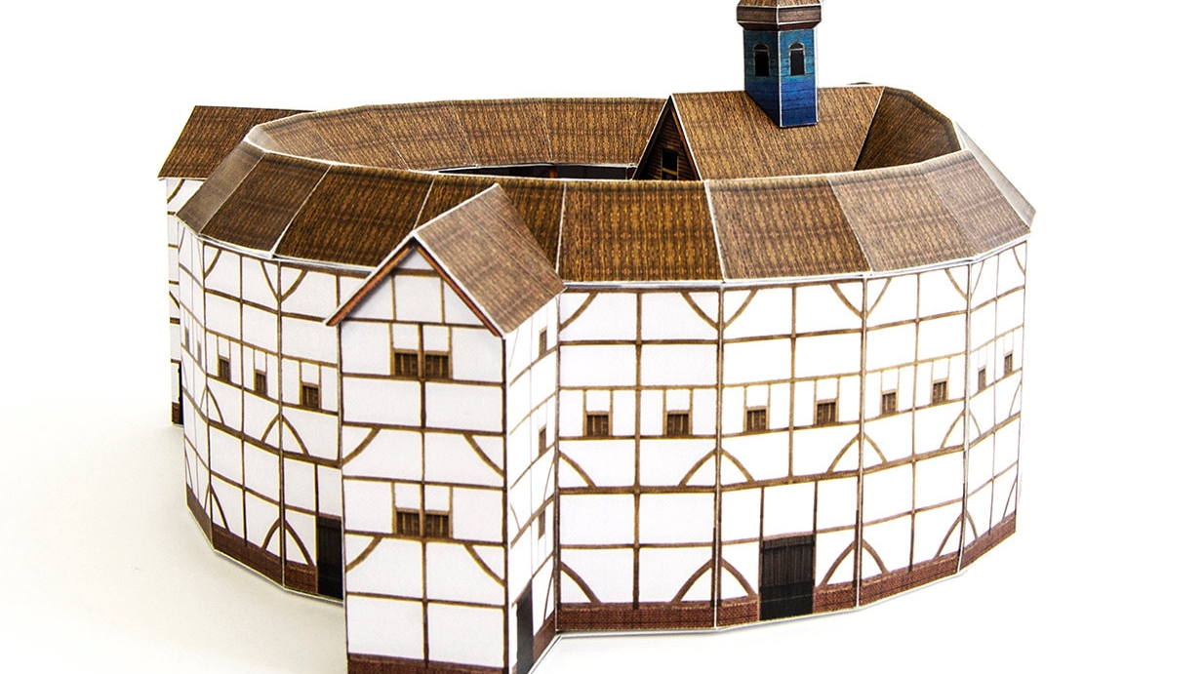
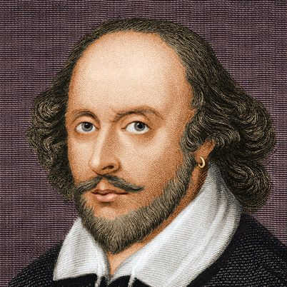
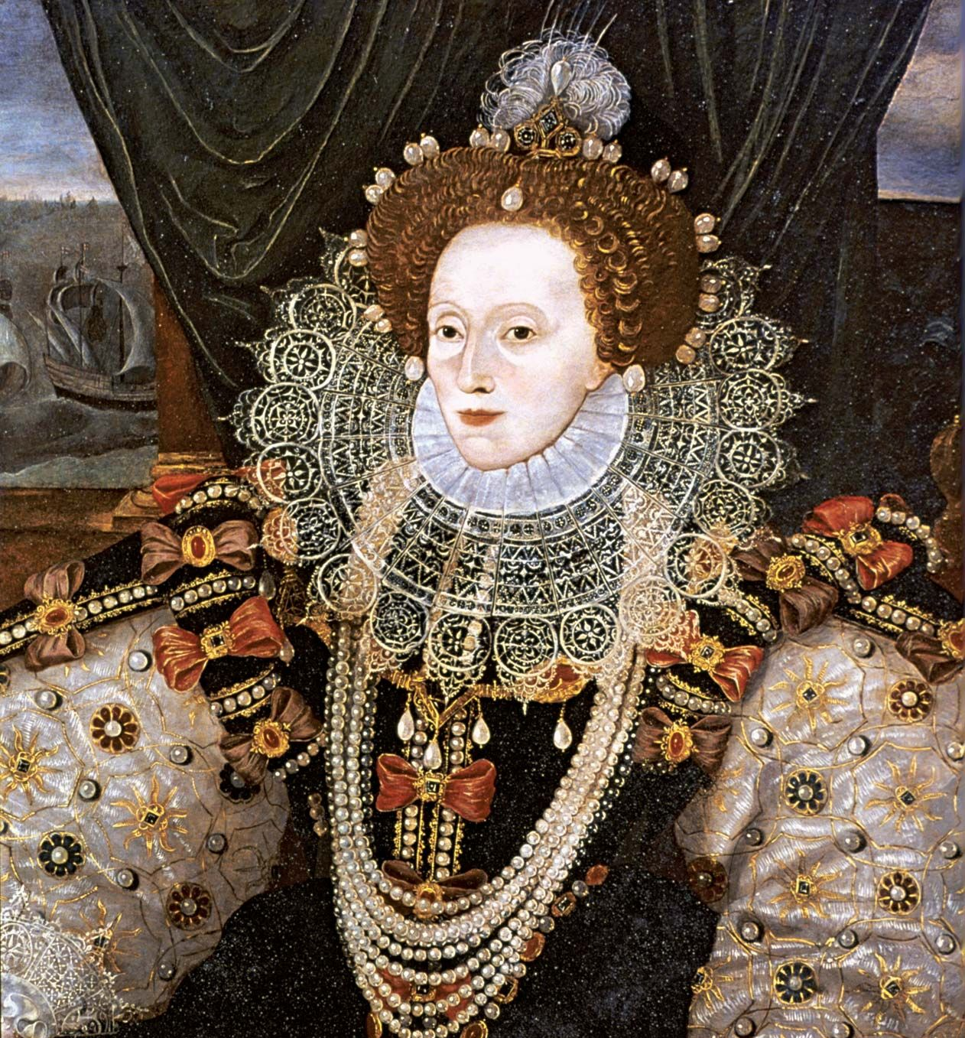
Context: Who, What, When, Where, Why?
Who? William Shakespeare
What? A play about a Venetian merchant and a Jewish moneylender
When? Elizabethan era (1558-1603)
Where? Set in Italy but written in England
Why? Plays were a popular form of entertainment, loved by Queen Elizabeth. The Globe Theatre in London could accommodate people of all classes

Slide 3
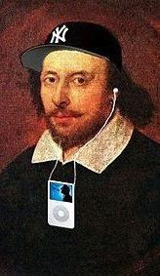
Why Study Shakespeare?
Understanding Shakespeare = understanding culture
Significant influence on Western & global culture over hundreds of years.
Many references & allusions in other texts & media
Modern adaptions, reworkings & versions of his plays are still being made
Uses language in an amazing way – worth appreciating
He invented lots of the words and phrases we use today
Master of vivid figurative language & clever wordplay
Themes are still relevant
Shows us that human nature hasn’t changed – people still struggle with the exact same issues
Challenge your brain
Studies show reading Shakespeare builds brain flexibility – working it out is like solving a puzzle
Like learning another language but easier!

Slide 4
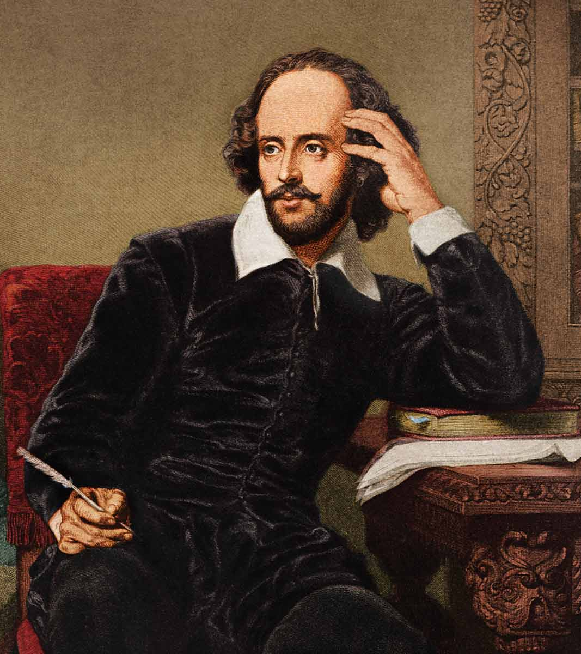
About the Author
William Shakespeare (1564-1616) was an English playwright, author and actor. He is generally considered England’s greatest author.
He wrote 38 plays, 154 sonnets, 2 long narrative poems, and a few other verses.
Very little is known about Shakespeare’s early writing career (when he started writing, who taught him to write).
He traveled to London to work as an actor and playwright in 1590. Two years later, he had established his reputation and grew quite wealthy.
Was favored by royalty in his time – Queen Elizabeth I and King James I
His works have had a massive influence on western culture and have continued to be read and performed since they were first published in the seventeenth century

Slide 5
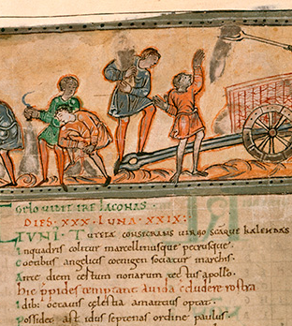
Language
Shakespeare’s plays are written in blank verse – some of it rhymes, but not all of it.
This is NOT how the Elizabethans talked!
Elizabethan English was renowned for puns.
At the start of the 1500s, the English were not proud of their language
Middle English came from Anglo Saxon – it was seen as the language of the poor people/peasants
New books being written in English, and translations of other works into English (particularly the Bible) extended the English language, adding lots of new words, phrases and idioms
By the end of the 1500s, English was one of the most complex and varied languages, with the largest number of synonyms.

Slide 6
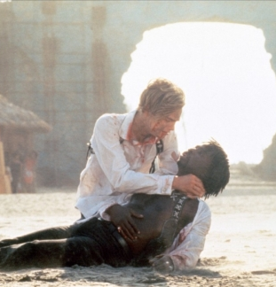
Examples of Shakespeare’s Wordplay
A new king from York has brought happier times after a long period of hardship:
“Now is the winter of our discontent made glorious summer by this son (sun) of York.”
Romeo explains he is too depressed to dance:
“You have dancing shoes with nimble soles, but I have a soul of lead.”
Mercutio is asked if he is joking about being badly wounded:
“Ask for me tomorrow and you shall find me a grave man.”

Slide 7
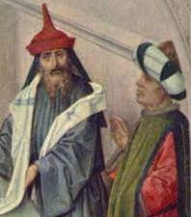
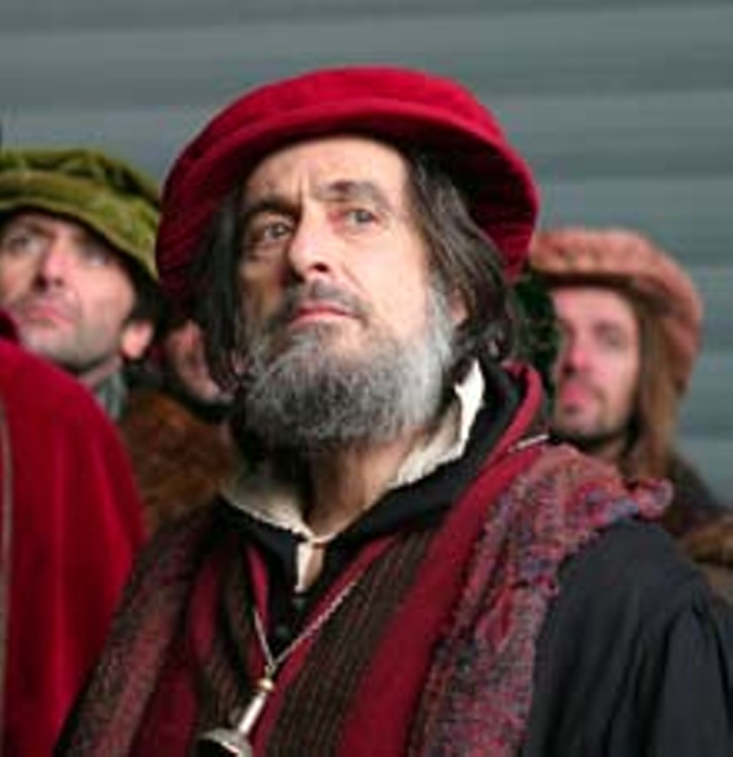
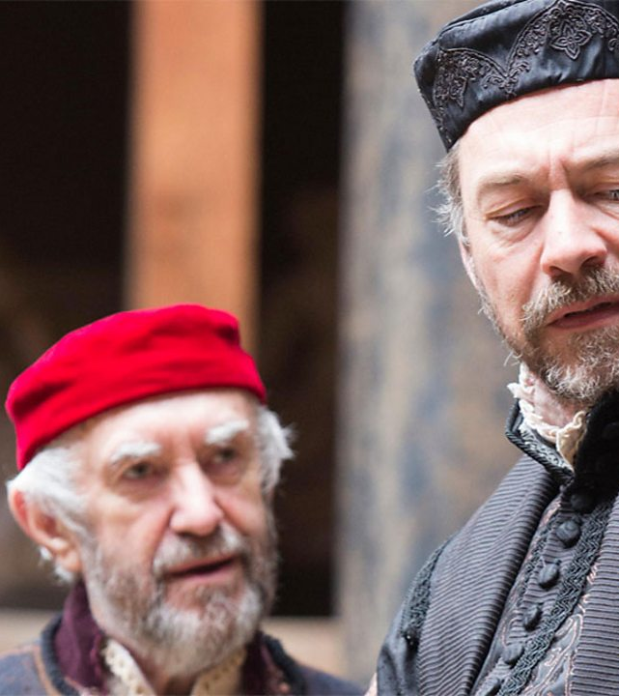
Jews
Europe was predominantly Catholic/Christian – they blamed the Jews for the crucifixion of Christ
The Crusades exacerbated Christian hatred of Jews. In 1290 the king expelled all Jews from England
Jews across Europe were discriminated against and marginalized, frequently victims of Christian violence
Often worked as moneylenders
Not allowed to own land – kept most of their wealth in coins.
Christians couldn’t lend money or accept interest on loans.
Had to live in segregated areas and wear identifying clothes (usually a red cap)
Often portrayed as villains and became the subject of mockery in literature

Slide 8
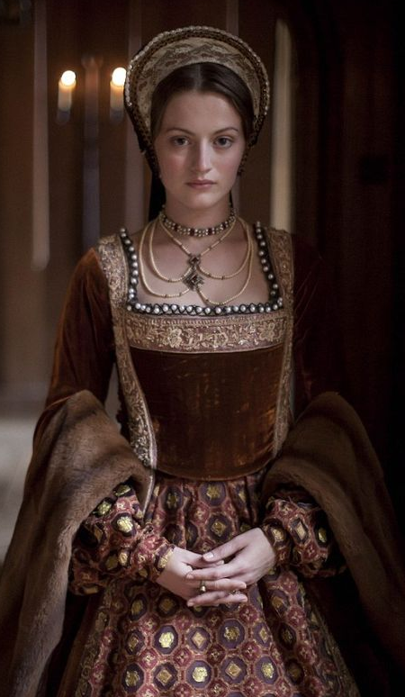
Women
England/Europe was a patriarchal society during this time
Women were considered physically and mentally inferior to men.
Basically homebound – often couldn’t leave the house without a chaperone. Expected to be quiet and subservient.
They had few legal or social rights:
Not allowed to vote, usually not educated.
Couldn’t work most types of jobs, could inherit property but not buy it.
Marriages were arranged
Parents chose a husband based on social/financial gain.
Unmarried girls had to obey their fathers.
Married women were the ‘property’ of their husbands
All their possessions belonged to their husband, had to obey him.
Husbands were allowed to punish wives for any perceived wrongdoing.
Very real danger if their husband was paranoid about other men – could kill them for ‘unfaithfulness’ with no proof.

Slide 9
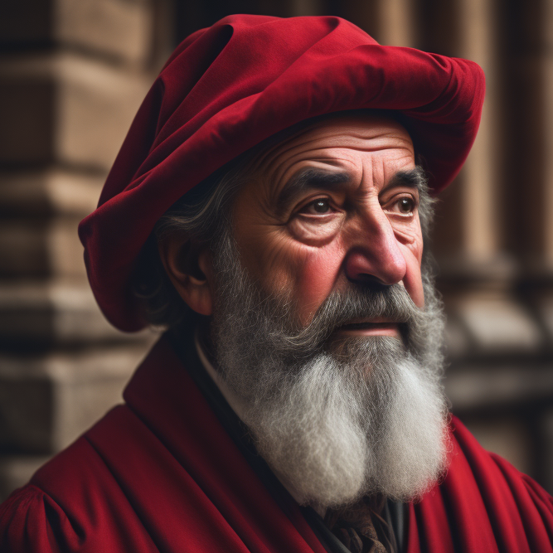
Shylock
A greedy, mean, and ruthless Jewish money lender
Values money more than his own daughter
Bloodthirsty – wants his enemy’s heart as payment.
He is mistreated by Christians in Venice, particularly Antonio. Most of the play’s characters see him as an inhuman monster.
Shakespeare may have been inspired by another character – Barabbas from Christopher Marlowe's play The Jew of Malta.
Shylock is a much more complex and sympathetic character than Barabbas.
Only hates Christians because he’s been treated horribly by them his whole life.
Makes eloquent speeches pointing out that Jews are human too and don’t deserve to be persecuted just because of their race/religion

Slide 10
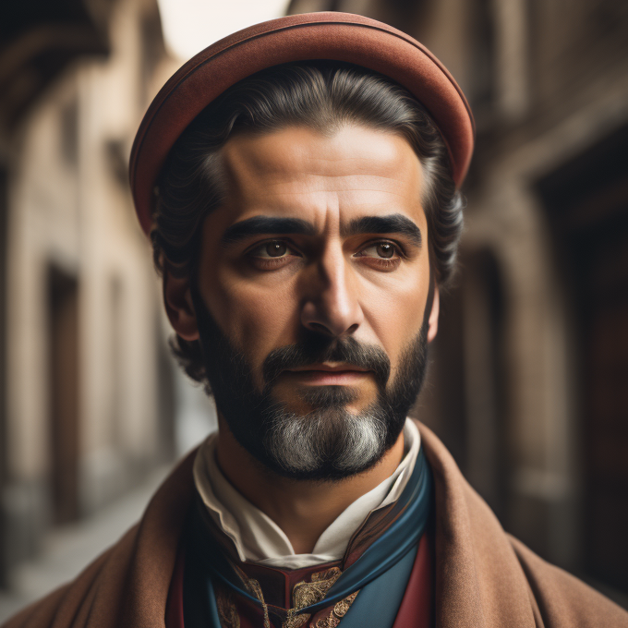
Antonio
Wealthy merchant with good credit rating
Bassanio can’t get a loan, but he can
Gives loans to people with no interest (undercuts Shylock’s rates)
Relative & good friend of Bassanio
Very loyal to him, willing to put his life on the line to help him
Moody personality
Often depressed for no reason
Antisemitic
Hates Jews & has mistreated Shylock
Does show some mercy to him at the end

Slide 11
Bassanio
Good-natured but irresponsible – in debt due to poor money management
Relative & dear friend of Antonio
Wants to borrow money from him to try and win Portia’s hand
Antonio’s money is tied up in investments, so they end up getting a loan from Shylock
Wants to marry Portia for her money at first but they fall in love
Correctly guesses the right casket (not completely stupid)
Loyal – drops everything on his honeymoon & rushes to help Antonio (although it WAS his fault that he got into that situation in the first place)

Slide 12
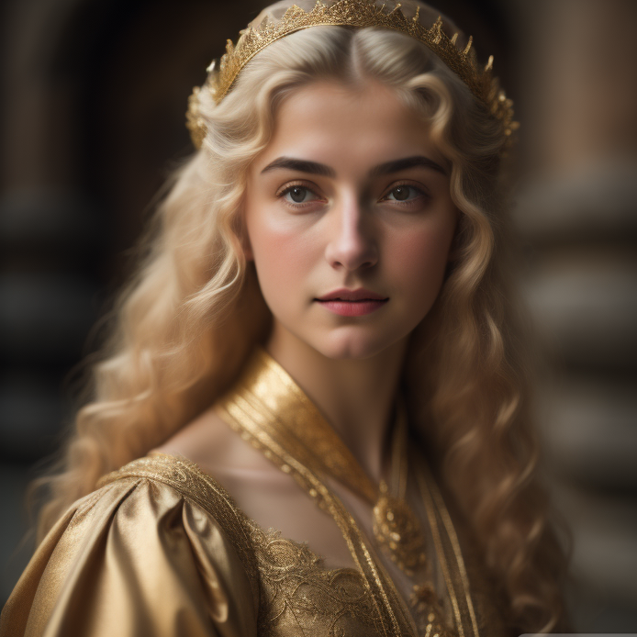
Portia
Beautiful, intelligent, and wealthy
Not allowed to decide who she will marry
Her father set up a rule in his will that she must marry the man who chooses the correct casket.
He did this for a good reason, in theory. Doesn’t want her to marry someone who’s just after her money.
Portia is not impressed about him controlling her even from beyond the grave “a living daughter curbed by the will of a dead father!”
Educated (unusual for a woman in this time) – has studied law
Figures out a way to help the guy she loves (Bassanio) win the casket game
Disguises herself as a male lawyer and gives an amazing defence which saves Antonio’s life
Tests Bassanio’s loyalty while in disguise
He fails, she forgives him anyway

Slide 13
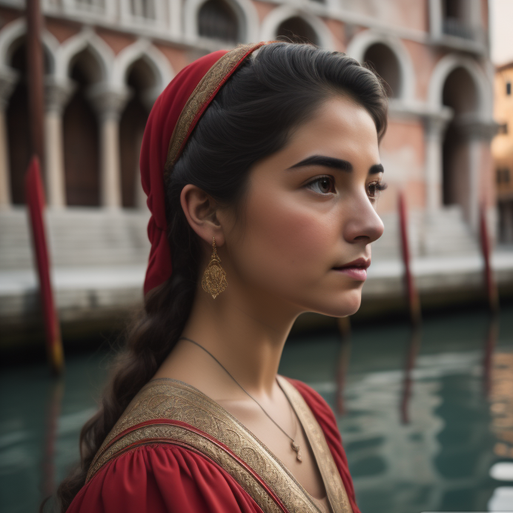
Jessica
Shylock’s daughter – he loves her but controls her.
Jessica hates life in her father’s house, calling it “tedious” and “hell”
She doesn’t want to be like Shylock – can see he is cruel and greedy, is ashamed of him
Breaks her father’s heart by betraying him completely:
Runs away to marry Lorenzo (a Christian)
Converts to Christianity
Steals a chest of her father’s money
Trades his beloved ring (a present from her dead mother) for a pet monkey
Unsure whether she’s supposed to be a good character or not – she is smart and funny but also a bit selfish

Slide 14
Minor Characters
Gratiano – Friend of Bassanio. While Bassanio courts Portia, Gratiano falls in love with and eventually marries her servant, Nerissa.
Lorenzo – A Venetian and friend of Bassanio and Antonio, who is in love with Shylock's daughter Jessica. Lorenzo elopes with Jessica, taking money and precious items that she has stolen from her father.
Nerissa – Portia's servant and best friend
Launcelot Gobbo – A clownish servant, who leaves Shylock to work for Bassanio (Old Gobbo is his blind father)
Salerio & Solanio – Venetian nobleman, friendly with Antonio, Bassanio, Gratiano, and Lorenzo.
Princes of Morocco & Aragon – suitors of Portia who choose the wrong caskets.
Duke of Venice – Presides over the trial of Antonio. Although the Duke attempts to persuade Shylock to show Antonio mercy, he knows that Venice's commercial interests depend on a consistent application of its laws, so he can't make an exception to help Antonio.
Tubal – A wealthy Jew in Venice, Shylock's friend
Balthazar – The servant Portia sends to obtain her letters of introduction and costume from Bellario. Balthazar is also the name Portia takes when she impersonates a lawyer at court.

