Slide 1
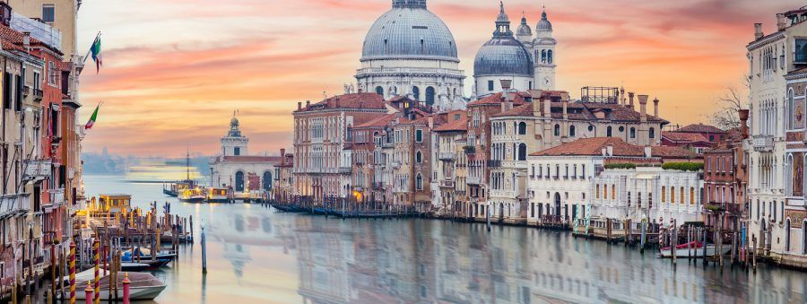
Merchant of Venice
Symbols, Themes, Language & Power

Slide 2
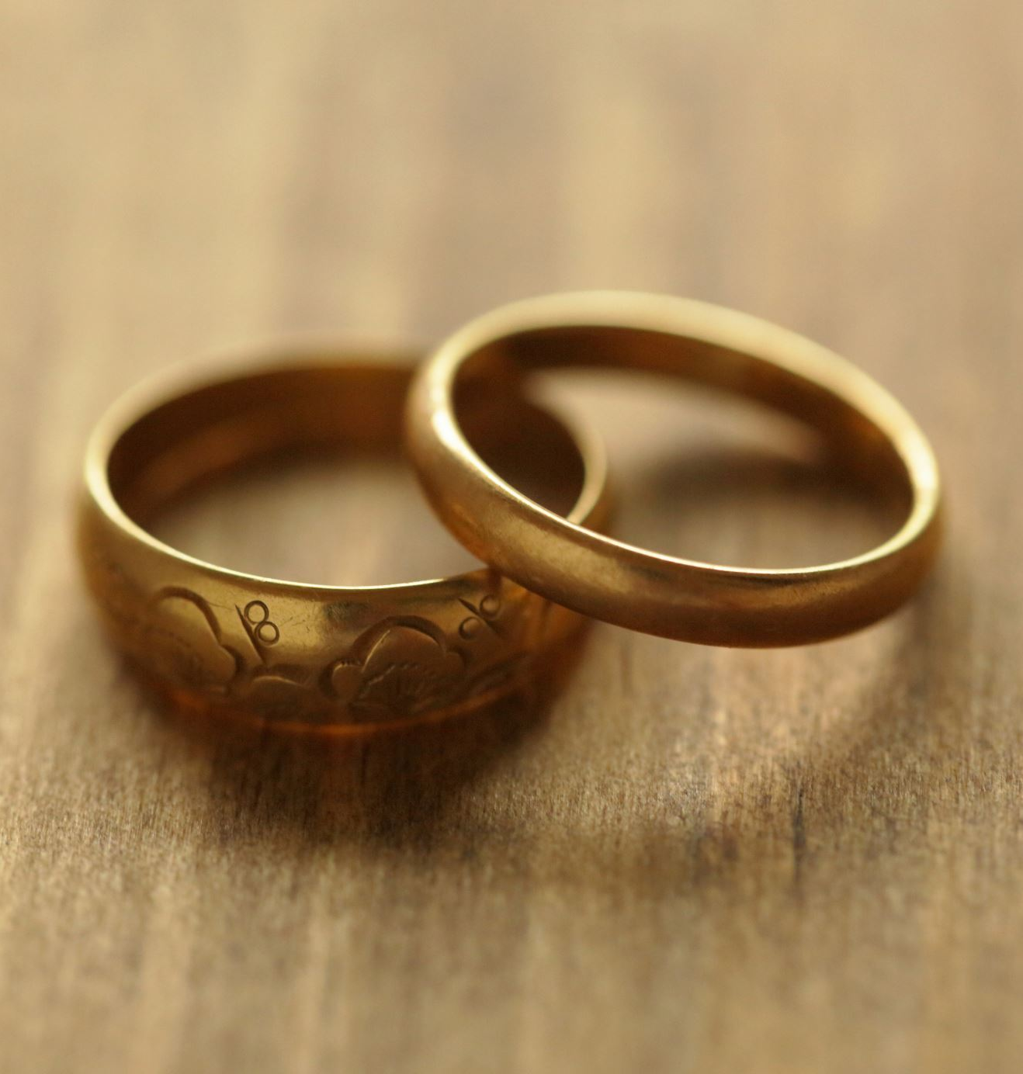
Symbols
The caskets – gold, silver and lead
The pound of flesh
Leah’s ring
Portia’s ring
Money/ducats
TASK:
With a partner, work out what these symbols mean in the play. Use online sources to help if you need to.

Slide 3
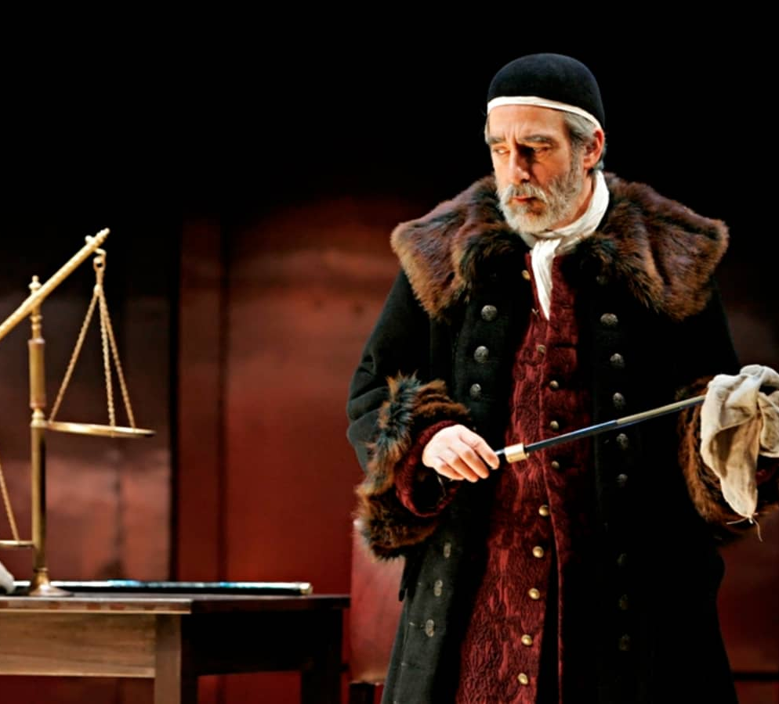
Themes
Race & Prejudice
Gender
Mercy, Revenge & Justice
Money
Love & Friendship (family loyalty, self-interest vs love)

Slide 4
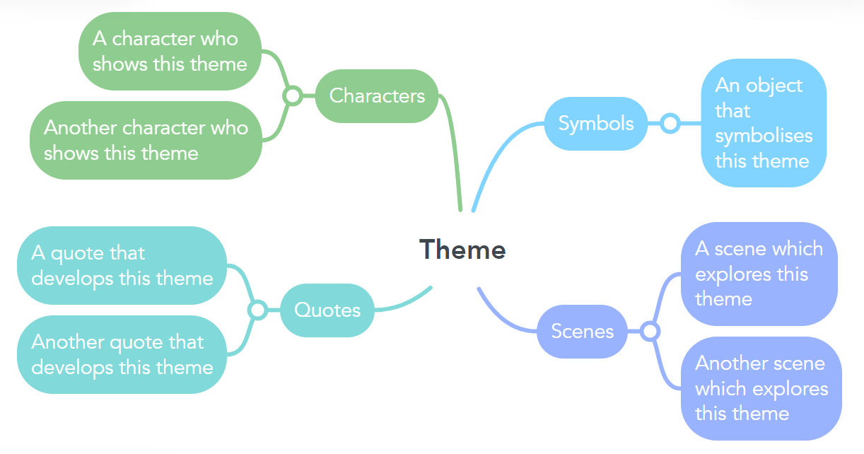
Themes Tasks
Watch the 5 clickview videos on theme (on haiku)
Choose one theme & create a mind map showing how Shakespeare develops this theme in the play.
Put the theme in the middle and create 4 subheadings: scenes, characters, quotes, symbols
Give at least one example for each
With a partner, for each of the themes listed on the previous slide, write down two modern-day situations where this theme would be relevant.

Slide 5
Language & Power
Language creates power, and there is power in language. Powerful people use language to…
Show that they are powerful
Convince others of their power
Keep their power
Who has the power in this conversation? How can you tell?
“Sit down. Where are you going?”
“Just out for a walk.”
“To the village?”
“Yes… no. I mean, nowhere in particular.”

Slide 6
Language & Power
Who has the power in this conversation? How can you tell?
Doctor: Your pancreas metabolism is impaired in its ability to manufacture insulin, and therefore, your digestive processes cannot utilize your intake of glucose.
Patient (to nurse): what did he say?
Nurse: A pancreas is a little organ in your body that creates insulin, to help you digest sugar. Yours isn’t working properly, so your body can’t process the sugar in your diet.
Patient: Oh… so why didn’t he say that in the first place?

Slide 7
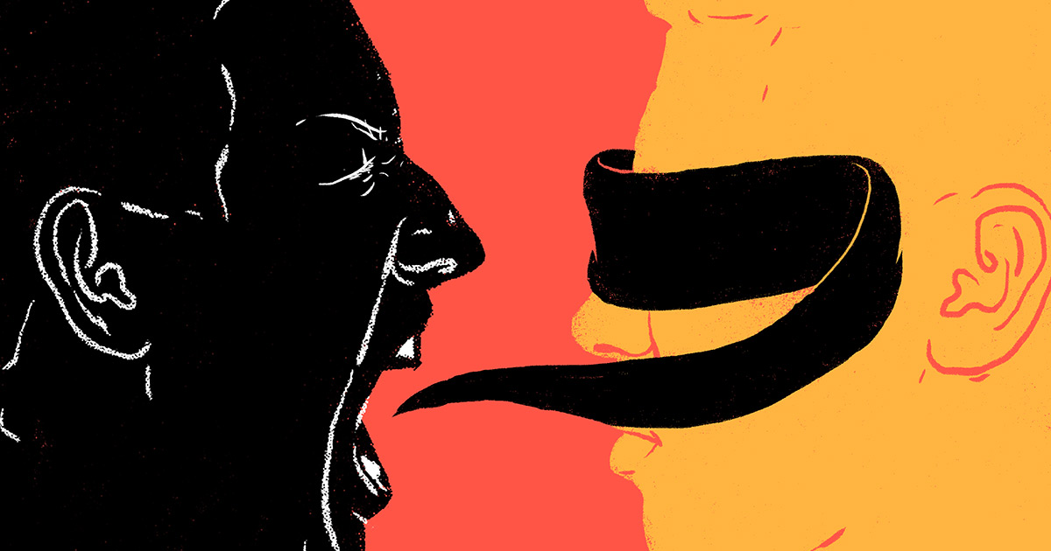
Specific Language Features
Language that shows power:
High modality (must, shall, should, will, would)
Formal register (complex sentence structure & vocabulary), technical jargon
Imperatives (giving instructions, demands, warnings or advice)
Conditional statements (“if you don’t… then….”)
Language that shows lack of power:
Low modality & qualifiers (can, could, might, may, kind of)
Filler words, hesitancy (um, like, er…)
Tag questions – seeking validation (“that’s right, isn’t it?”)
Disclaimers (“I’m not an expert but…” “I might be wrong, but…”)
Informal register (simple sentence structure & vocabulary)
Praising, suggesting, thanking, promising, pleading

Slide 8
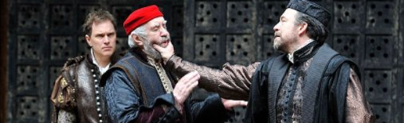
Tasks
Examine how Antonio speaks to Shylock in Act 1 Scene 3. What words and phrases reflect their relationship?
Look at how Shylock speaks to Antonio. Is there an imbalance of power in this relationship? How can you tell – give examples.
What frames Antonio as a hero despite his racism? What frames Shylock as a villain?
You can use Sparknotes to help you

