Slide 1
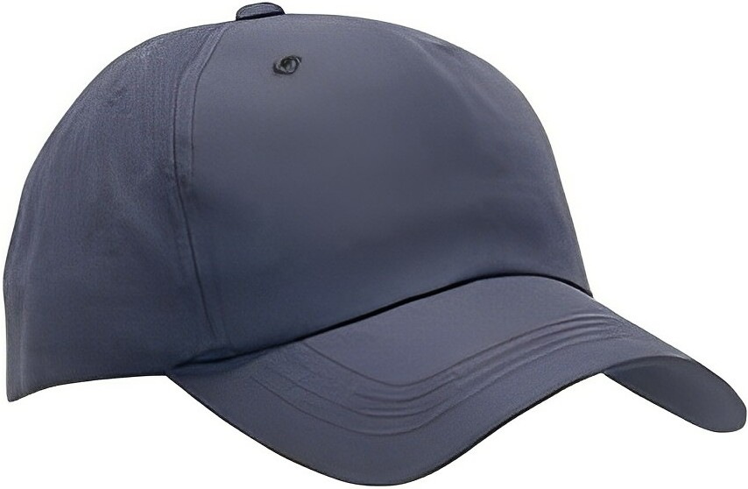
Context, Audience & Purpose
Informative Texts

Slide 2
CAP
To understand any text, look at the C.A.P.
Context
Audience
Purpose
These 3 things have a huge
impact on texts and impact
each other
C.A.P.

Slide 3
Context
Context is the circumstances or environment in which a text was created
When in history and where in the world was it written?
What events were happening at that time?
What beliefs and practices did people have at the time?
Did the author agree with these beliefs & practices?

Slide 4
Audience
Audience is who this text was created FOR. Who’s likely to read this?
When and where are they from? Are they old or young, male or female, rich or poor…?
What do people from their time/country/culture usually think or believe?
Was the author hoping to influence the audience or change their minds?

Slide 5
Purpose
The reason the text was created – WHY does it exist?
What motivated the creator to make it? What did they want to achieve by creating this text?
There are 3 main categories, although they can overlap:
To inform (e.g. encyclopedia, news article)
To entertain (e.g. novel, film, play)
To persuade (e.g. advertisement, opinion piece)

Slide 6
Informative Texts
Factual texts intended to inform people about a topic

Slide 7
Context: Informative Texts
The context of an informative text will influence the information it contains and how it’s presented
Think of the differences there would be in the following:
A science textbook from England published in 1965
A science textbook from China published in 2023
A pamphlet about ‘Bible Truths’ written by a Christadelphian
A pamphlet about ‘Bible Truths’ written by a Mormon
A news broadcast about global health from before COVID-19
A news broadcast about global health from after COVID-19

Slide 8
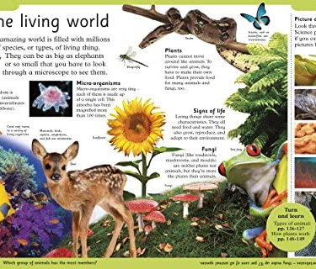
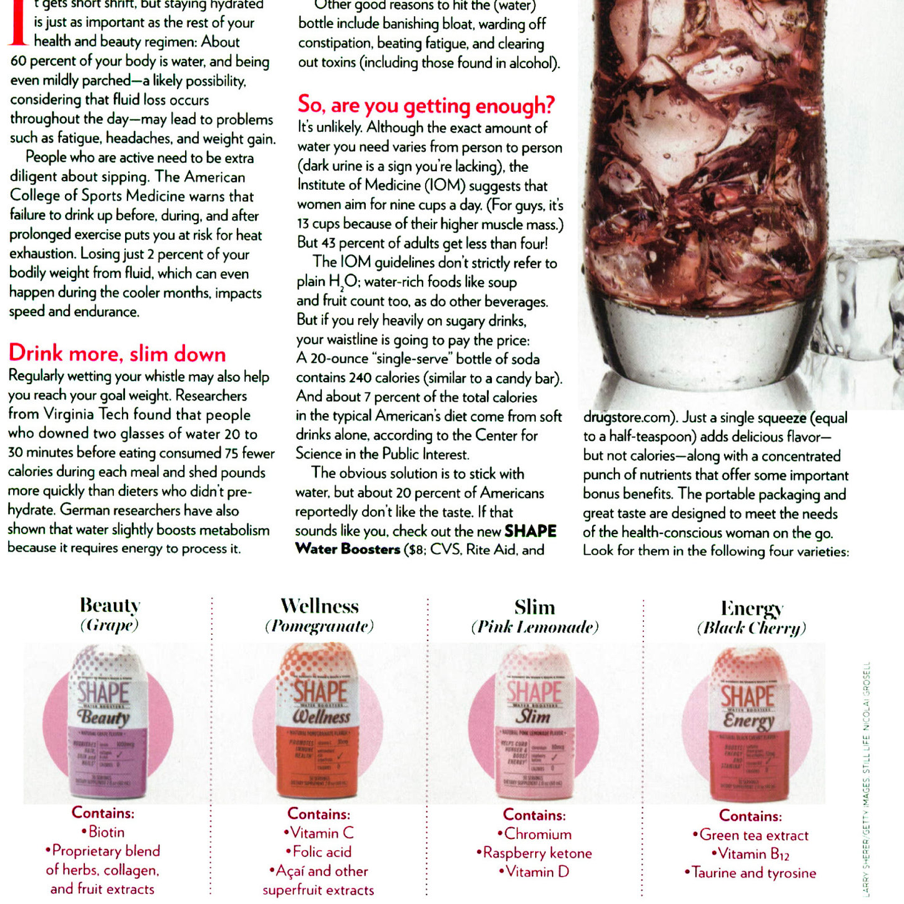
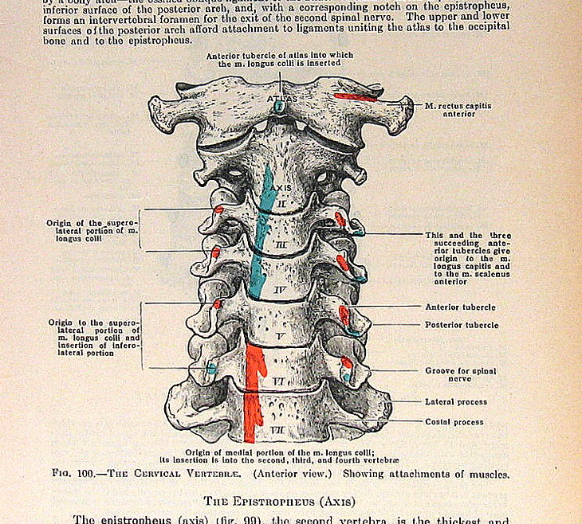
Audience: Informative Texts
The intended audience of an informative text will change the features it has or the way it’s written
An informative text for children might use less formal language, large bright pictures, and shorter, simpler sentences
An informative text for doctors might use highly specific vocabulary and detailed medical diagrams
An informative text for consumers (people who want to buy a product) might use persuasive language to convince the audience to buy it

Slide 9
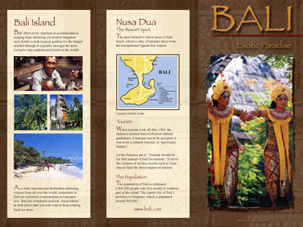
Purpose: Informative Texts
The purpose of informative texts is mainly to inform people – give them researched, factual information to help them understand a topic.
But informative texts can ALSO be entertaining or persuasive, depending on the context and audience.
The main purpose of a travel brochure about Bali is to give people information about the country and things to do and see there.
However, a secondary purpose might be to persuade them that Bali is a fun and interesting place to visit.

Slide 10
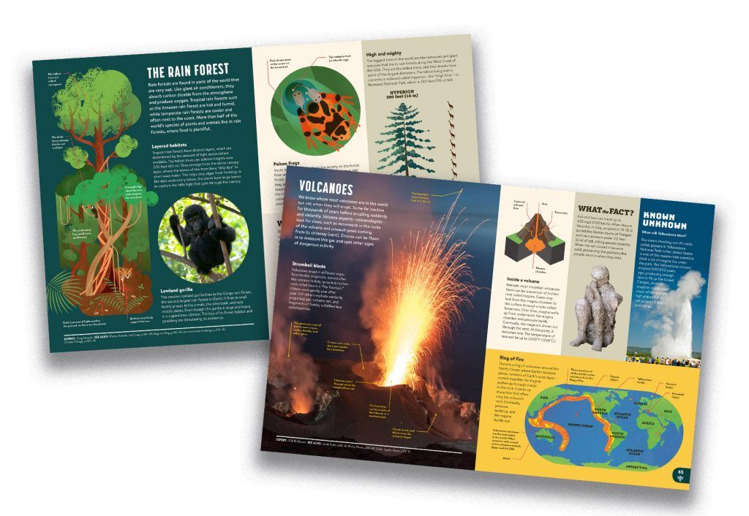
Features of an Informative Text

Slide 11
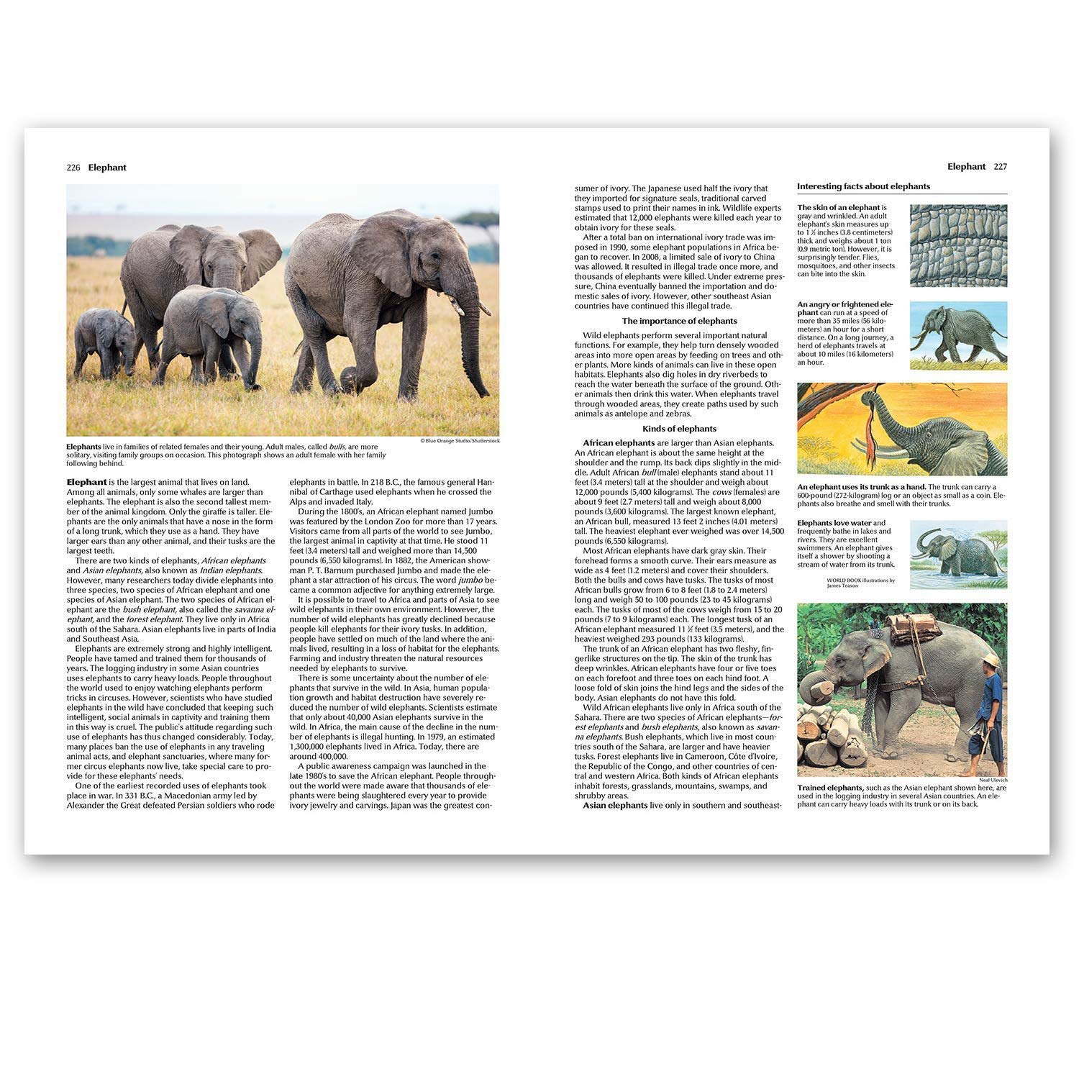
Informative texts often have the following features:
Facts (not opinions – able to be proved)
Short, structured paragraphs
Headings & sub-headings
Formal, academic language
List of citations or references
Pictures/diagrams with captions
Index or contents page
Glossary

Slide 12
Research
Other People’s Knowledge, Your Words
To find the facts for your informative text you will need to do some research
Research involves finding, understanding, and describing the ideas of experts
Quoting, paraphrasing, and summarising, are ways to include other people’s ideas in your own work without plagiarising
These techniques allow you to demonstrate your own understanding of the key points of your topic

Slide 13
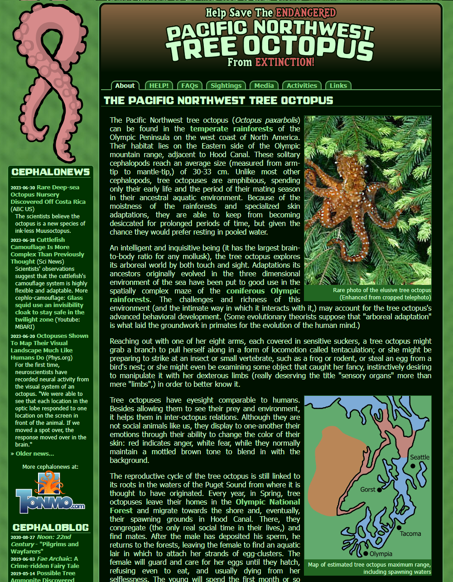
Good & Bad Sources
Some sources are more reliable or trustworthy than others
Which source is more likely to contain true or correct information? Why?
A facebook post
A medical textbook
It’s very easy for people to put wrong or incorrect information on the internet. They can make it SEEM very convincing
Need to be critical of sources – evaluate them carefully, ask questions, and make sure the information is true
A credible source is one that is reliable. You can trust that the information is true and has been checked by experts.

Slide 14
ABCDE Checklist
Author
Who wrote this? Are they qualified or an expert?
Best before
How recent and up-to-date is this info?
Connections
Are there links or references to statistics, scientific studies, or research? When you compare this information to other sources, does it say the same thing?
Design & layout
Does it look professional? Are there lots of typos, broken links, ads?
Expected outcome
Why has this information been shared – are they trying to sell something? Could they be biased?

Slide 15
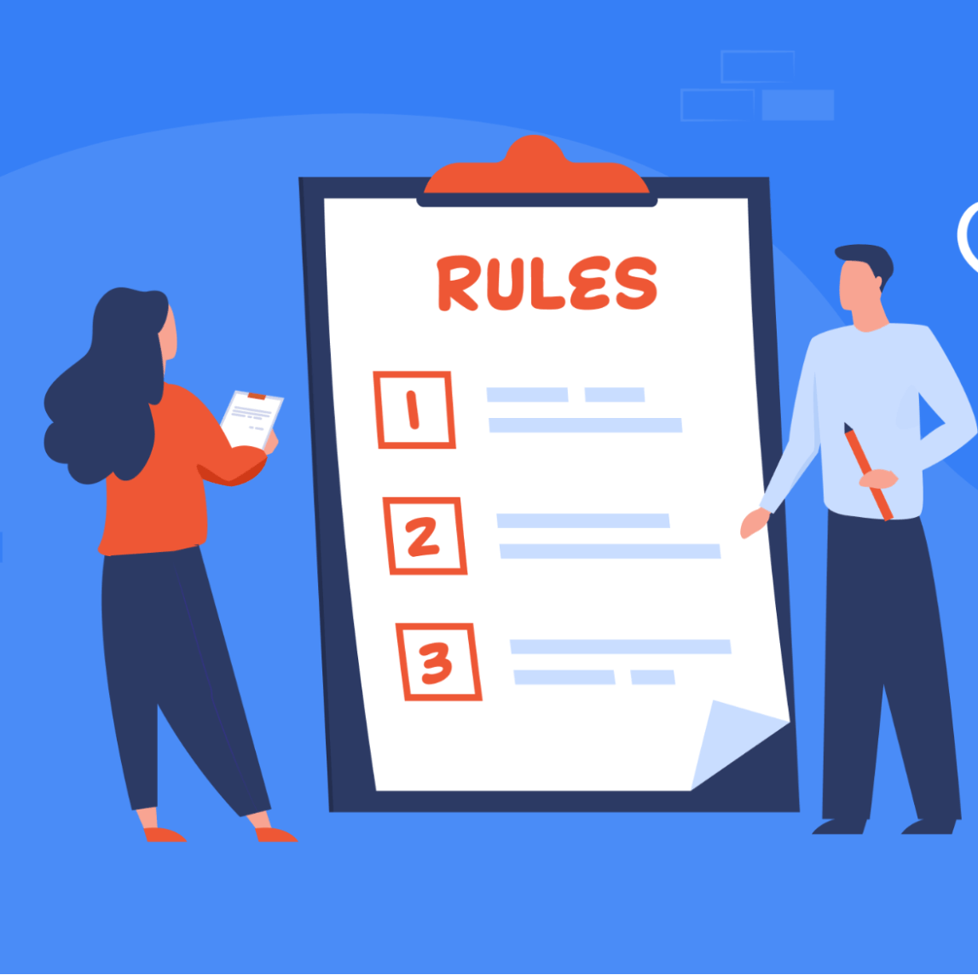
Responsible Internet Research
3 important rules to remember
Check sources – make sure info is true and reliable
Put it into your own words – no copy/pasting!
Reference – show where you got the information from

Slide 16
Plagiarism
Passing off someone else’s work as your own is called plagiarism.
Dishonest, lazy, cheating
Trying to trick the teacher
You won’t learn anything & won’t get smarter
Passing on your work to others for them to copy is also considered plagiarism
Can have serious consequences in the real world
fired from jobs
expelled from universities
sued for copyright infringement

Slide 17
Using Quotes
The only time you CAN use other people’s exact words is when you quote them. This is fine as long as it’s done correctly.
Put quotation marks around the words that are from someone else
List the author or reference – say who said this or where it comes from
“I have no special talent. I am only passionately curious.” (Albert Einstein)
“The truth will set you free” (John 8:32)

