Slide 1
Referencing
In-Text & Bibliography

Slide 2
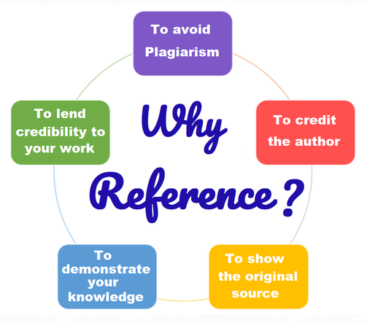
You CAN use other people’s words or ideas in your writing, if you:
Quote directly and reference correctly
Put it into your own words (still a good idea to cite a reference if it’s not your own ideas)

Slide 3
How much of an assignment can be quoted?
You can use as many quotes as you like to help make your point or explain your ideas
BUT you can’t just make up your whole essay out of quotes!
Usually quotes don’t count towards the word count. Only your own words do.

Slide 4
Two types of references
In-text referencing
Bibliography or Reference List

Slide 5
In-Text referencing
If you quote, paraphrase or summarise a source, you should acknowledge this with an in-text reference. Briefly mention the source of the information within your informative text.
Put the author’s last name, year and page number (if there is one) directly after the quote or sentence.
If there’s no specific author name, use the name of the organisation, website, or publisher.

Slide 6
Bibliography or Reference List
At the end of an informative text, you should include a reference list or bibliography
Here you should list the full details of any sources of information that you used:
Author’s name
Date published
Title
URL of website
Date viewed

Slide 7
There are VERY SPECIFIC rules about the order and formatting for a bibliography, and they are different for each type of source. For a website, the correct order & formatting is:
Author(s) of the website:
If there’s an author, use their last name & initial - e.g. Watson, J
If there’s 2-3 authors, list all of them separated by commas – e.g. Watson, J, Smith, Q & Jones, P
If there’s 4+ authors, just list the first and then use ‘et. al’ – e.g. Watson, J et. al
If there’s no specific author – use the publisher or company name – e.g. BBC Wildlife
Year of publication
Title of the website: Give the title as presented in the source. Only the first letter of the first word and proper nouns are capitalized.
URL: Give the full URL of the web page including the http://
Date of access: give the day, month and year

Slide 8
Website: Bibliography
Author’s last name (comma) first initial (NO comma) Year (comma) Title of webpage in italics (comma) URL (comma) date accessed
Examples:
Crenshaw, M 2019, Shoe Science, http://famoushoesoftheworld.com accessed 4 September 2019
World Health Organization 2021, WHO recommendations for routine immunization, http://www.who.int/immunization/policy/immunization_tables/en accessed 1 May 2021

