Slide 1
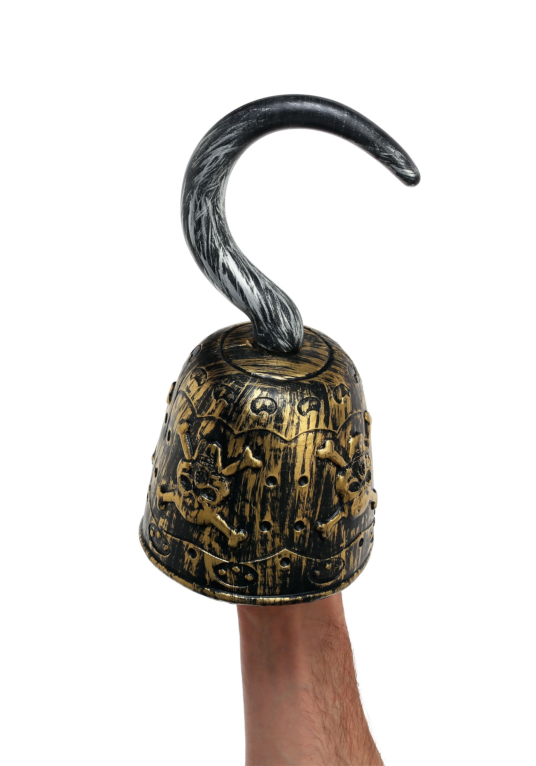
Hooks

Slide 2
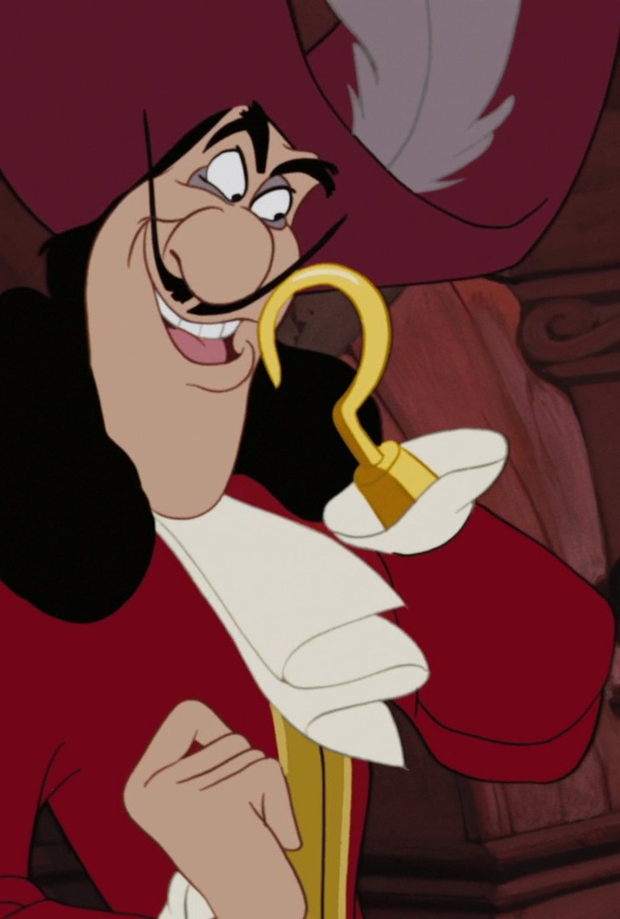
What is a hook?
A hook is a technique to grab the reader or listener’s interest at the very start of a speech or a piece of writing
It’s a way of making sure they will keep reading because they want to know more.
You should try and use a ‘hook’ in the first paragraph of your recount.
The slides following have some examples of ways to ‘hook’ the reader’s attention straight away.

Slide 3
Types of Hooks
Rhetorical Question
Quote or dialogue
Humour
Bold statement or controversial claim
Interesting statistic
Description – painting a picture with words
Analogy
Onomatopoiea
Suspense

Slide 4
A Rhetorical Question
A question that doesn’t need an answer – makes people think
Examples:
Have you ever wanted something so much you were willing to give up everything?
Why do we have brothers? I mean, what are they actually good for?

Slide 5
A quotation or dialogue
Dialogue – people talking – is easier to read than a block of text, and can make writing more dramatic, like a play. Quoting a famous person or expert adds credibility.
Examples:
I’ll never forget the morning my Dad rushed in yelling “Quick, hit the floor, and whatever you do, don’t look up!”
John Lennon once said, “Life is what happens when you’re busy making other plans”.

Slide 6
Humour
People love to laugh! A funny comment or joke early on will make people want to keep reading because humour is entertaining.
Examples:
I never make mistakes. I thought I did once, but I was wrong.
Everyone laughed at me when I said I wanted to be a comedian. Well, they’re not laughing now!

Slide 7
A Bold Statement or Controversial Claim
A good way to get people’s attention is to say something they disagree with!
Examples:
It has long been said that knowledge is power. This is not in fact the case.
Hear me out here – what if the earth IS flat?

Slide 8
Interesting statistic
Engage their curiosity with something they didn’t know – but make sure it’s something very surprising or unexpected!
Examples:
It is estimated that 99% of all the species that have ever lived on Earth are now extinct.
Did you know that 54% of pilots have admitted to falling asleep while flying? And almost a third said they woke up to find their co-pilot asleep!

Slide 9
Description or action – painting a scene
Descriptive writing with lots of powerful visual words trigger the audience’s emotions.
Example:
Imagine you’re sailing on the ocean on a beautiful calm day. The sun sparkling on the water, the cool breeze in your hair…. But all of a sudden you notice the ocean is full of stinking garbage, floating plastic choking the wildlife, toxic oily residue fouling up the water.

Slide 10
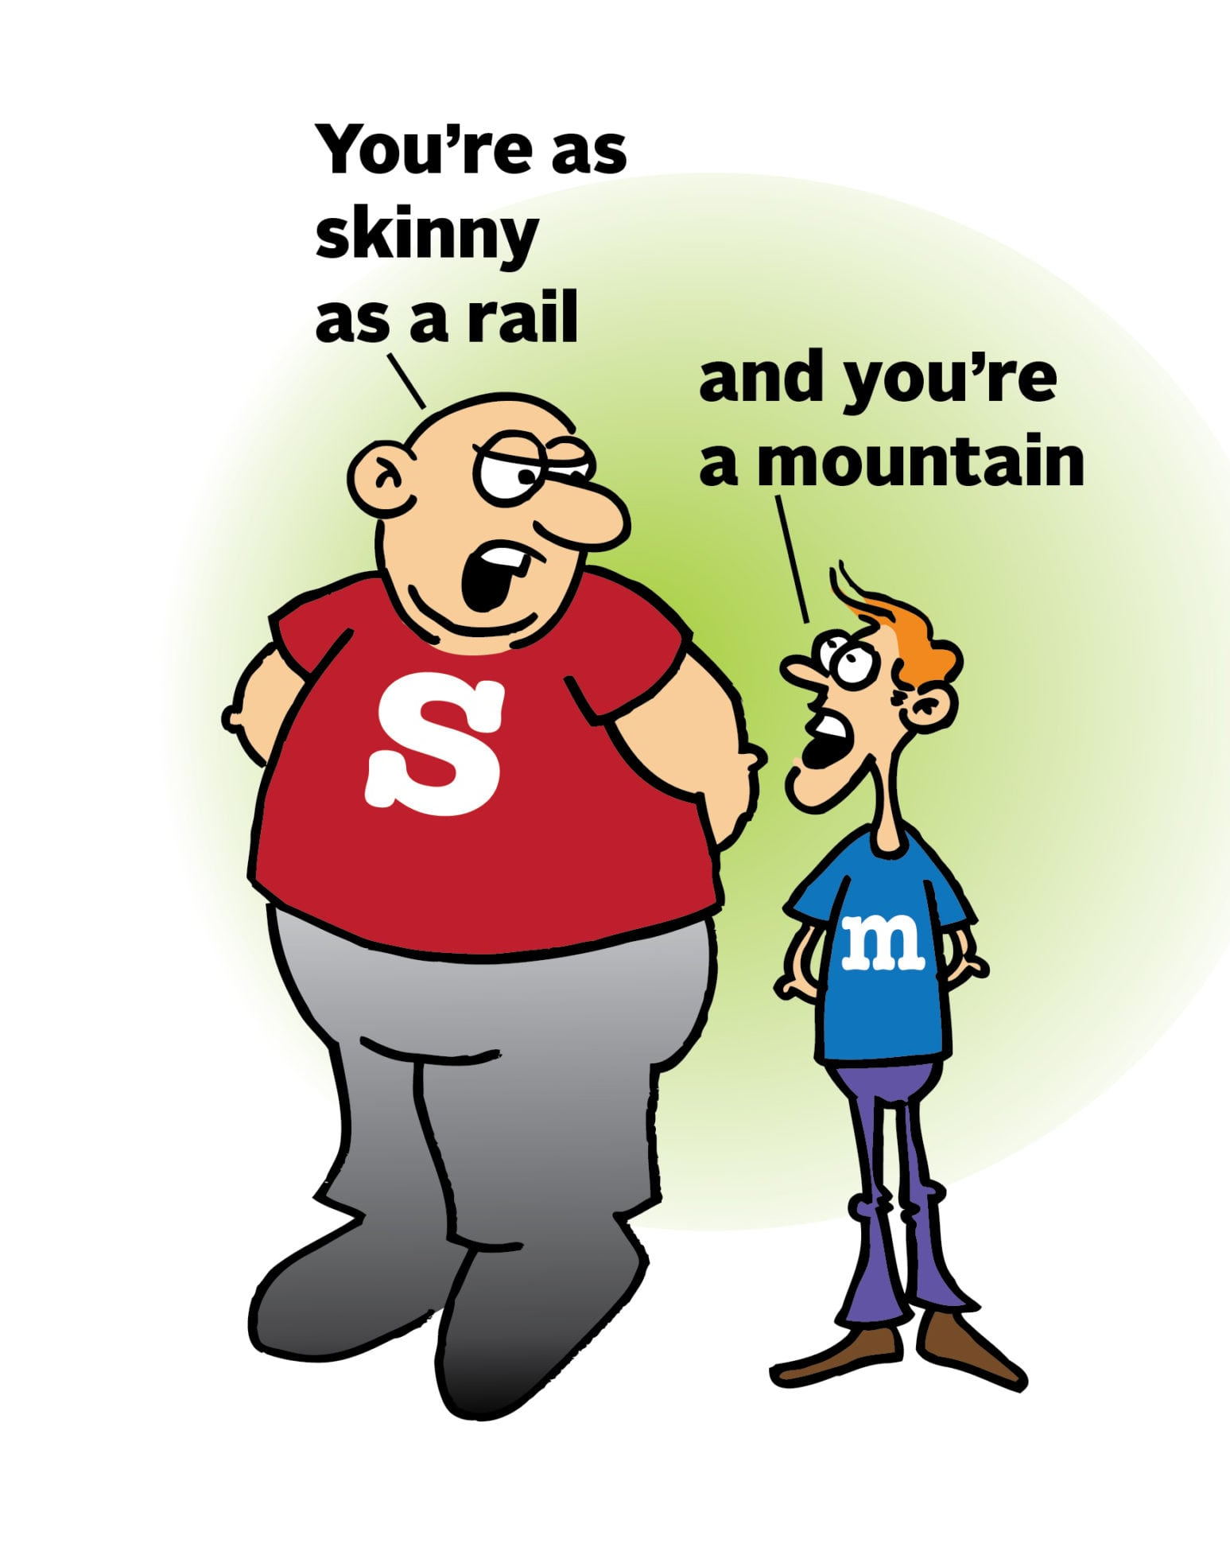
An analogy (comparison) e.g. similes, metaphors
Connecting two ideas is a good way to explain them. Makes people look at things in a new way
Examples:
Running a business is in many ways like riding a roller coaster that never stops.
Our bodies are engines that need fuel to run. And the best kind of fuel produces the best results!

Slide 11
Onomatopoeia
Unexpected (gets attention), often makes people laugh. Helps them picture a scene.
Example:
Close your eyes and imagine sending a basketball from across the court, straight through the hoop. SWISH!
CRASH! Uh-oh. You’ve just broken your mum’s favourite vase.

Slide 12
Suspense
This is kind of like ‘click bait’. People are curious and want to know what happens next, which will make them keep reading.
Examples:
The day I found a letter hidden in the attic, I discovered a shocking truth that changed everything I thought I knew about my own life.
You’ll never guess what happened…
I bet you don’t know…

