Slide 1
FLAN
How to nominalise and condense noun groups
Worked Examples

Slide 2
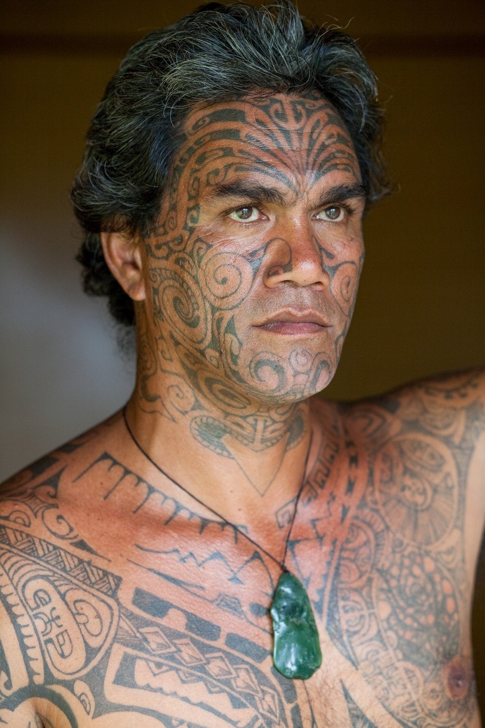
Paragraph 1
Humans acquire culture through interacting socially. Some ethnic groups portray their culture visibly through items such as clothing and jewellery that is ceremonious and also traditional. They may also modify their appearance with tattoos and piercings. They do this to identify themselves as part of a particular culture.

Slide 3
STEP 1 – Find the Verbs
Find the Verbs. They are the doing/action words.
What are the verbs in this paragraph?
Humans acquire culture through interacting socially. Some ethnic groups portray their culture visibly through items such as clothing and jewellery that is ceremonious and also traditional. They may also modify their appearance with tattoos and piercings. They do this to identify themselves as part of a particular culture.

Slide 4
STEP 1 – Find the Verbs
Find the Verbs. They are the doing/action words.
What are the verbs in this paragraph?
Humans acquire culture through interacting socially. Some ethnic groups portray their culture visibly through items such as clothing and jewellery that is ceremonious and also traditional. They may also modify their appearance with tattoos and piercings. They do this to identify themselves as part of a particular culture.

Slide 5
NOTE: Verb Meanings
Acquire – means to get or collect
Interacting – means communicating with or dealing with
Portray – means to show
Modify – means to change or edit
Identify – means to feel like part of a group, see yourself a certain way

Slide 6
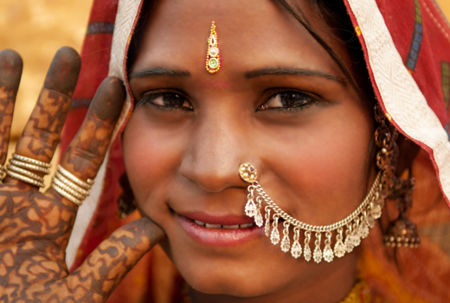
STEP 2 – Convert the Verbs to Nouns
Try changing the endings: -tion, -ence, -ness, -ment, -al, -ity.
Not all of them will easily convert. Look for the easiest or most obvious candidates.
Do these in your head:
Acquire
Interacting
Portray
Modify
Identify

Slide 7
STEP 2 – Convert the Verbs to Nouns
Acquire – acquisition
Interacting – interaction
Portray – portrayal
Modify – modification
Identify – identification

Slide 8
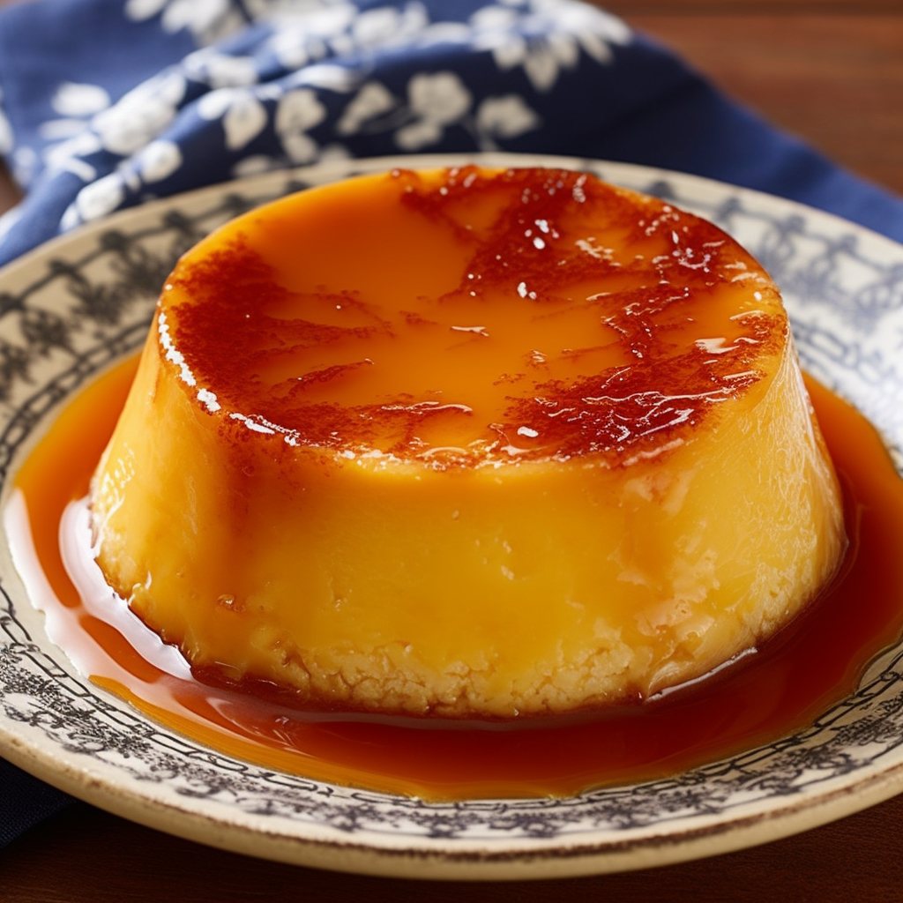
NOTE
Any adverbs connected to the verb should be converted into adjectives.
For example:
“Interacting socially” becomes:
social interaction
“Portray visibly” becomes:
visible portrayal

Slide 9
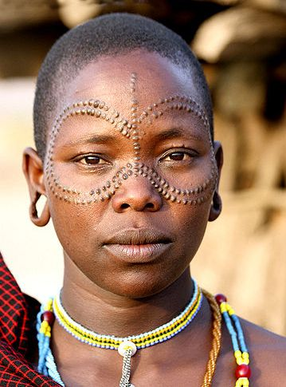
STEP 3 – Find & Condense Noun Groups
There will not always be any. But there is one in this paragraph. See if you can spot it.
Look for groups of adjectives (describing words)
Humans acquire culture through interacting socially. Some ethnic groups portray their culture visibly through items such as clothing and jewellery that is ceremonious and also traditional. They may also modify their appearance with tattoos and piercings. They do this to identify themselves as part of a particular culture.

Slide 10
STEP 3 – Find & Condense Noun Groups
There will not always be any. But there is one in this paragraph. See if you can spot it.
Look for groups of adjectives (describing words)
Humans acquire culture through interacting socially. Some ethnic groups portray their culture visibly through items such as clothing and jewellery that is ceremonious and also traditional. They may also modify their appearance with tattoos and piercings. They do this to identify themselves as part of a particular culture.

Slide 11
STEP 3 – Find & Condense Noun Groups
Condense Noun Groups:
Clothing and jewellery that is ceremonious and also traditional.
Find the nouns & adjectives
Nouns: clothing, jewellery
Adjectives: ceremonious, traditional
Put the noun last & list all adjectives first
Ceremonious, traditional clothing & jewellery

Slide 12
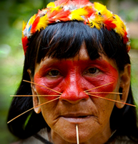
STEP 4 – Other Mistakes
Look for any other formal writing mistakes:
Contractions – can’t, don’t
Pronouns – you, me, I
Casual words/slang – really, totally, awesome
Opinions – I believe, better/best, should, must
Are there any in this paragraph?
Humans acquire culture through interacting socially. Some ethnic groups portray their culture visibly through items such as clothing and jewellery that is ceremonious and also traditional. They may also modify their appearance with tattoos and piercings. They do this to identify themselves as part of a particular culture.

Slide 13
STEP 4 – Other Mistakes
Are there any in this paragraph?
Humans acquire culture through interacting socially. Some ethnic groups portray their culture visibly through items such as clothing and jewellery that is ceremonious and also traditional. They may also modify their appearance with tattoos and piercings. They do this to identify themselves as part of a particular culture.
No.
But don’t forget to check.

Slide 14
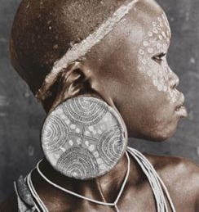
STEP 5 - Rewrite
Rewrite the paragraph. Use all your NICE NEW nouns and noun groups.
Don’t forget to fix up any other formal writing mistakes.
Humans acquire culture through interacting socially. Some ethnic groups portray their culture visibly through items such as clothing and jewellery that is ceremonious and also traditional. They may also modify their appearance with tattoos and piercings. They do this to identify themselves as part of a particular culture.
acquisition
social interaction
visible portrayal
ceremonious, traditional clothing & jewellery
modification
identification

Slide 15
STEP 5 – Replace words
Humans acquisition culture through social interaction. Some ethnic groups visible portrayal their culture through items such as ceremonious, traditional clothing & jewellery. They may also modification their appearance with tattoos and piercings. They do this to identification themselves as part of a particular culture.

Slide 16
STEP 5 – Edit until it makes sense
Human acquisition of culture is gained through social interaction. Some ethnic groups Visible portrayal their of culture is practiced by through items such as ceremonious, traditional clothing & jewellery. They may also can also be achieved through modification appearance with such as tattoos and piercings. They do this to Identification themselves as part of with a particular culture.

Slide 17
Result:
AMAZING!!!!!!!!
WOW!!!!!!!!
Acquisition of culture is gained through social interaction. Visible portrayal of culture is practiced by some ethnic groups through ceremonious traditional clothing & jewellery. Identification with a particular culture can also be achieved through appearance modifications such as tattoos and piercings.
SUPERB!!!!!!!!

Slide 18
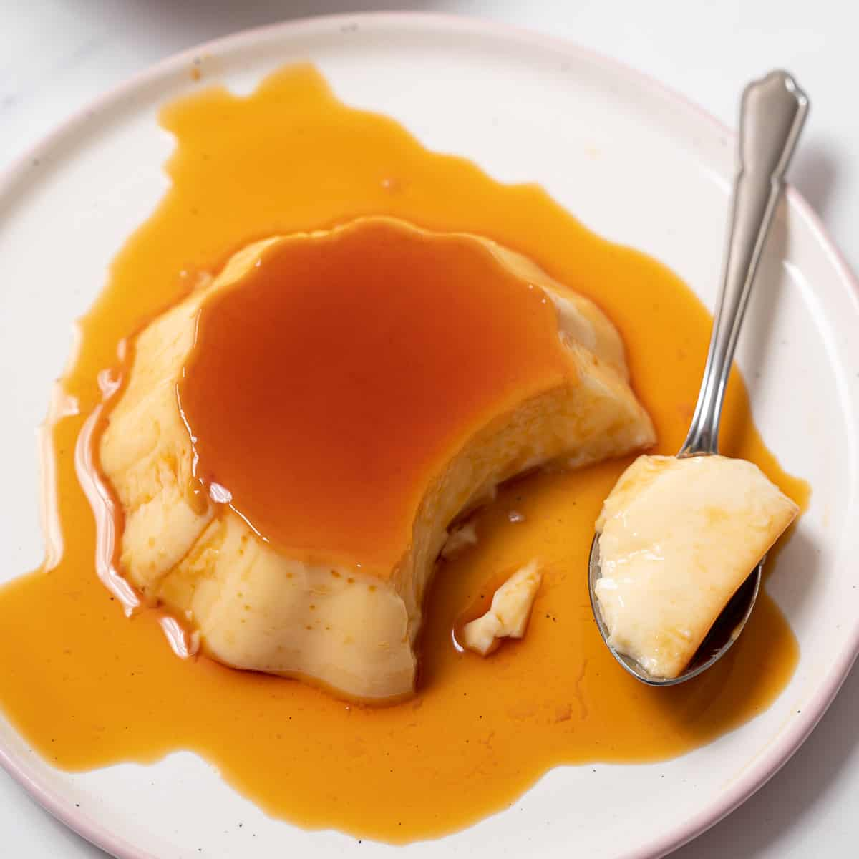
Worked Example 2
A harder example

Slide 19
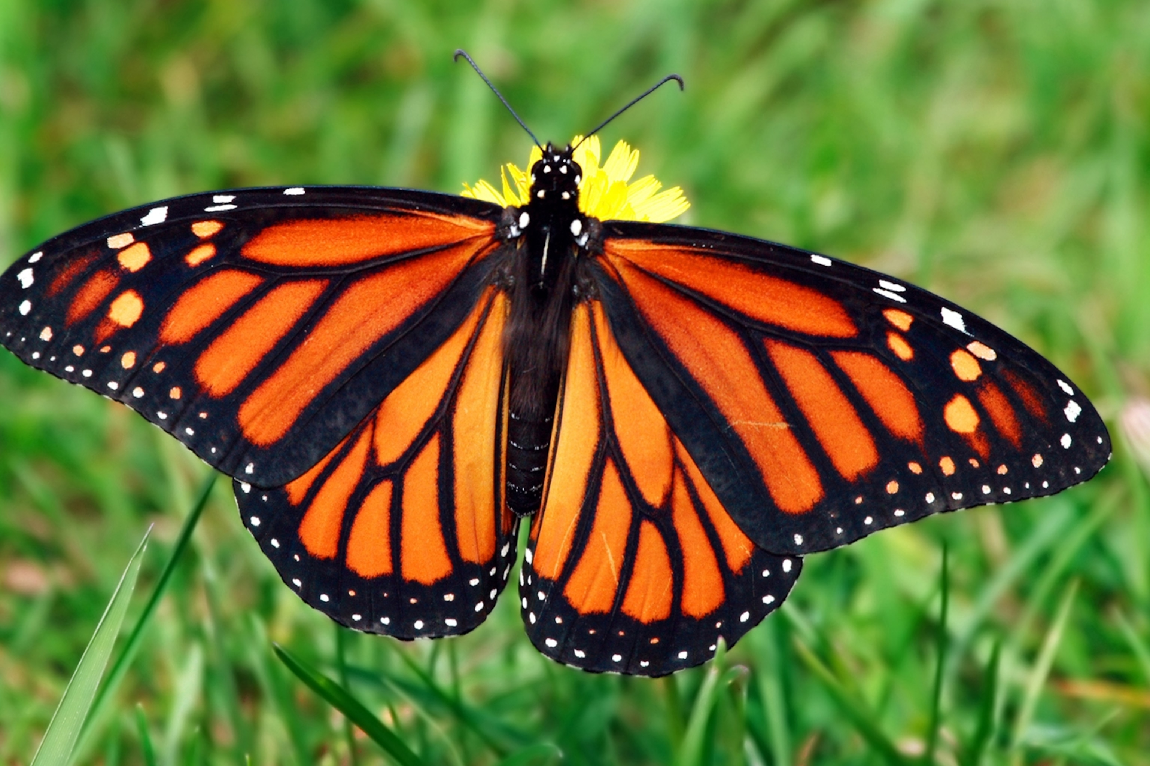
Paragraph 2:
Butterflies are totally fascinating insects, and you can find out a lot about them by examining them. They’re known for their wings which are super colourful and delicate. During their life cycle, they transform in a process known as metamorphosis. They start their lives as tiny eggs before they hatch into caterpillars.
What’s the first step?

Slide 20
Step 1: Find the Verbs
What are the verbs in this paragraph?
Butterflies are totally fascinating insects, and you can find out a lot about them by examining them. They’re known for their wings which are super colourful and delicate. During their life cycle, they transform in a process known as metamorphosis. They start their lives as tiny eggs before they hatch into caterpillars.

Slide 21
Step 1: Find the Verbs
What are the verbs in this paragraph?
Butterflies are totally fascinating insects, and you can find out a lot about them by examining them. They’re known for their wings which are super colourful and delicate. During their life cycle, they transform in a process known as metamorphosis. They start their lives as tiny eggs before they hatch into caterpillars.
These verbs are not as easy to convert!

Slide 22
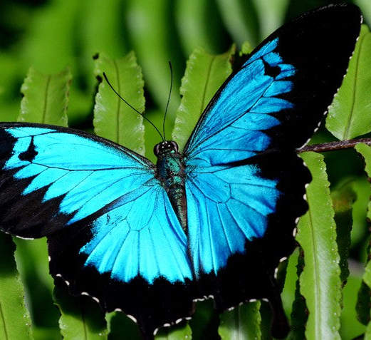
Step 2: Convert Verbs into Nouns
Try changing the endings: -tion, -ence, -ness, -ment, -al, -ity.
Not all of them will easily convert. Look for the easiest or most obvious candidates.
Do these in your head:
Examining
Transform

Slide 23
Step 2: Convert Verbs into Nouns
Do the easiest ones first
Examining – Examination
Transform – Transformation

Slide 24
Special Case 1: what if…?
…the verb form is the same as the noun form?
Start as a verb (to start a journey, we need to start the car)
Start as a noun (the start of the trip, let’s make a start)
Answer: Use the noun form of the word. Make sure you can put ‘a’ or ‘the’ in front of it.
OR: Use a synonym (e.g. the beginning, the commencement)

Slide 25
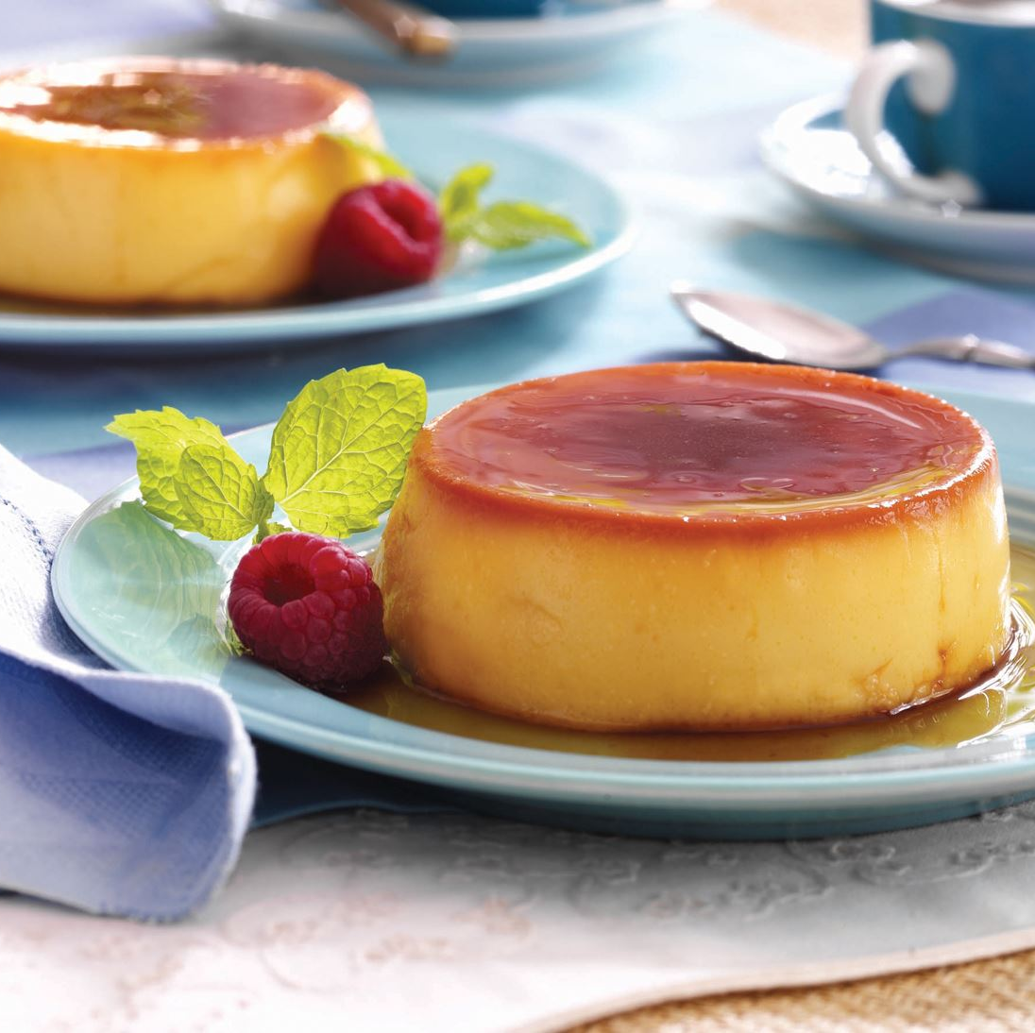
Special Case 2: what if…?
…the verb is a phrase instead of a single word?
Are known for
Can find out
Answer: Find a single word synonym. Must be a noun.
Are known for = renown, reputation, fame
Can find out = discovery, understanding

Slide 26
Special Case 3: what if…?
…the verb just doesn’t have a clear noun form?
Hatch (hatchment? Hatchness? Hatchion? Hatchity?)
Answer: find a synonym.
Hatch – emergence, inception
OR: leave it and find a different word to convert. Try an adjective.
Fascinating – fascination.

Slide 27
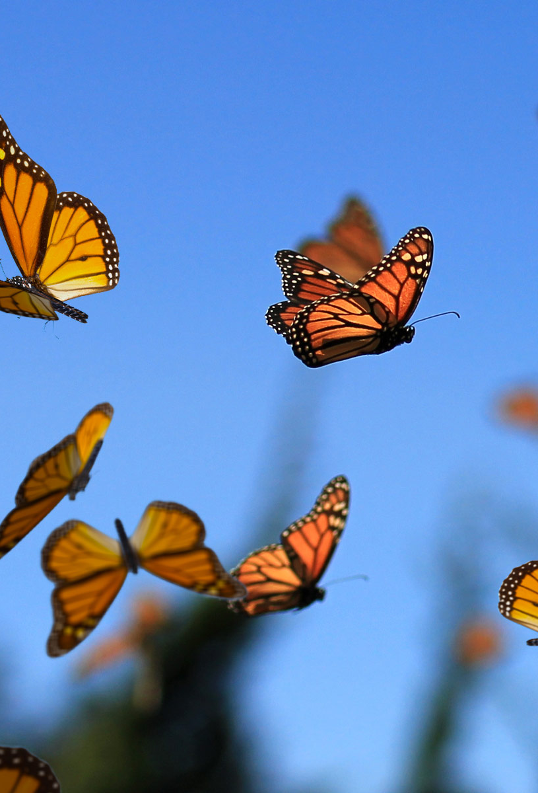
Step 3: Find and Condense Noun Groups
There will not always be any. But there is one in this paragraph. See if you can spot it.
Look for groups of adjectives (describing words)
Butterflies are totally fascinating insects, and you can find out a lot about them by examining them. They’re known for their wings which are super colourful and delicate. During their life cycle, they transform in a process known as metamorphosis. They start their lives as tiny eggs before they hatch into caterpillars.

Slide 28
Step 3: Find and Condense Noun Groups
There will not always be any. But there is one in this paragraph. See if you can spot it.
Look for groups of adjectives (describing words)
Butterflies are totally fascinating insects, and you can find out a lot about them by examining them. They’re known for their wings which are super colourful and delicate. During their life cycle, they transform in a process known as metamorphosis. They start their lives as tiny eggs before they hatch into caterpillars.

Slide 29
Step 3: Find and Condense Noun Groups
Condense Noun Groups: Their wings, which are super colourful and delicate
Find the nouns & adjectives
Nouns: wings
Adjectives: colourful, delicate
Put the noun last & list all adjectives first
Colourful, delicate wings

Slide 30
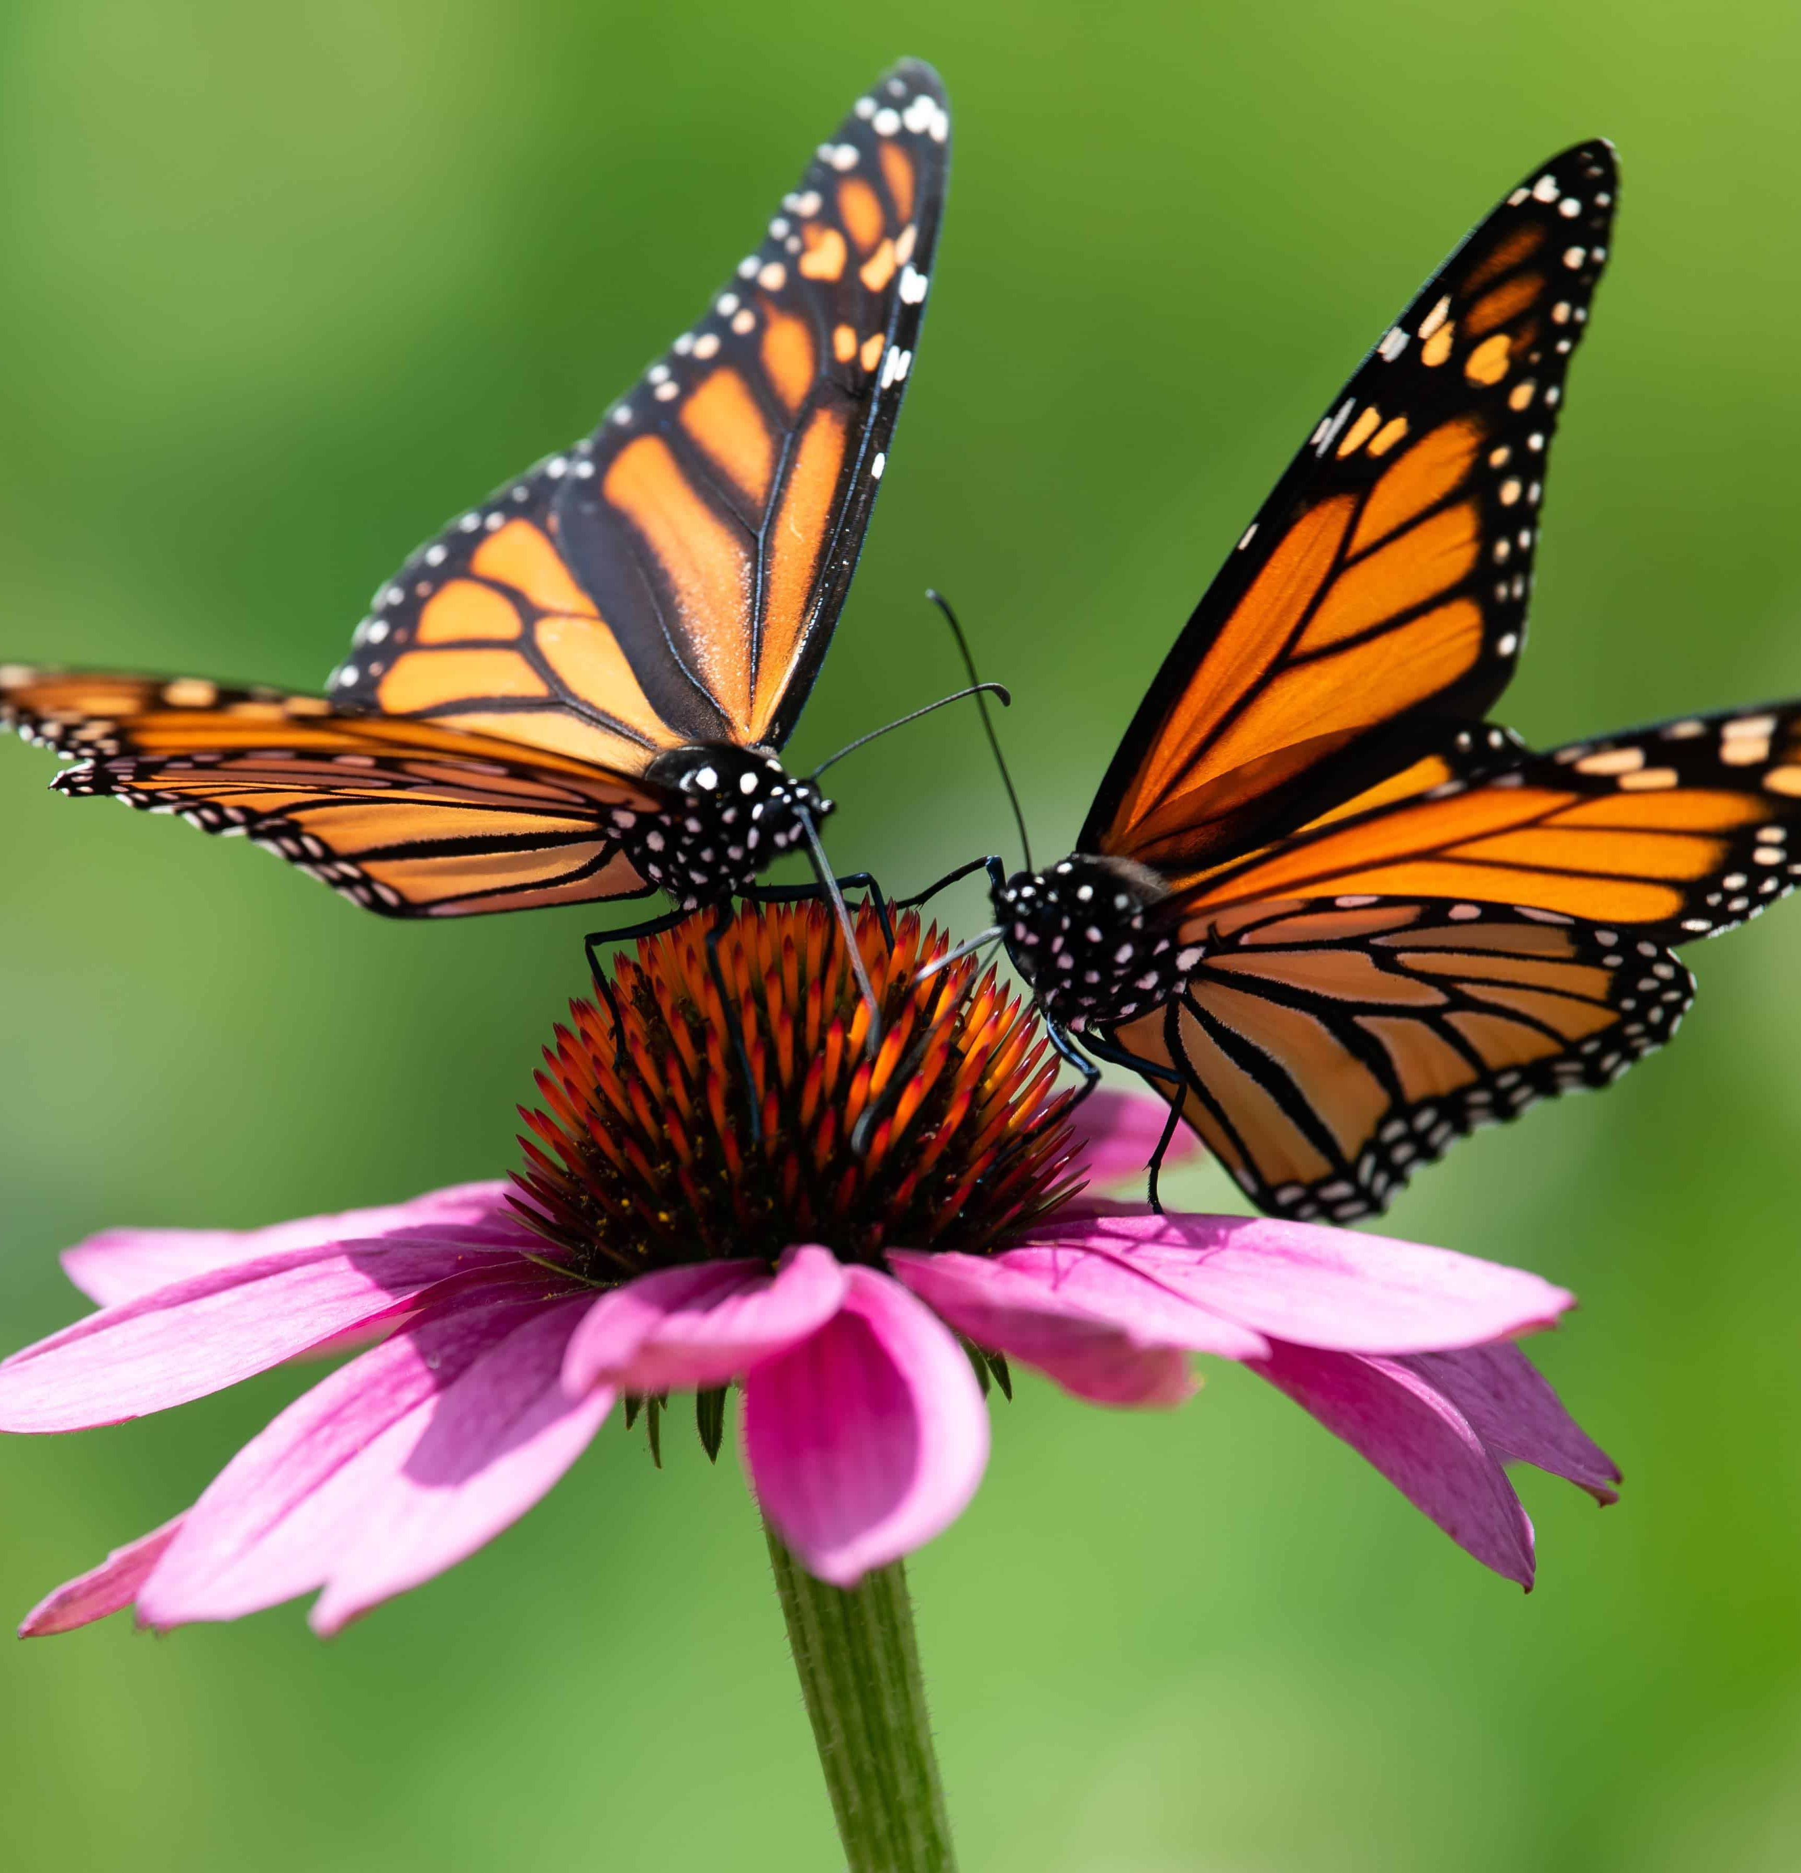
Step 4: Other Mistakes
Look for any other formal writing mistakes:
Contractions – can’t, don’t
Pronouns – you, me, I
Casual words/slang – really, totally, awesome
Opinions – I believe, better/best, should, must
Are there any in this paragraph?
Butterflies are totally fascinating insects, and you can find out a lot about them by examining them. They’re known for their wings which are super colourful and delicate. During their life cycle, they transform in a process known as metamorphosis. They start their lives as tiny eggs before they hatch into caterpillars.

Slide 31
Step 4: Other Mistakes
Look for any other formal writing mistakes:
Contractions – can’t, don’t
Pronouns – you, me, I
Casual words/slang – really, totally, awesome
Opinions – I believe, better/best, should, must
Are there any in this paragraph?
Butterflies are totally fascinating insects, and you can find out a lot about them by examining them. They’re known for their wings which are super colourful and delicate. During their life cycle, they transform in a process known as metamorphosis. They start their lives as tiny eggs before they hatch into caterpillars.

Slide 32
Step 5: Rewrite
Use all your NICE NEW nouns and noun groups.
Don’t forget to fix up any other formal writing mistakes.
Butterflies are totally fascinating insects, and you can find out a lot about them by examining them. They’re known for their wings which are super colourful and delicate. During their life cycle, they transform in a process known as metamorphosis. They start their lives as tiny eggs before they hatch into caterpillars.

Slide 33
Step 5: Rewrite
Use all your NICE NEW nouns and noun groups.
Don’t forget to fix up any other formal writing mistakes.
Butterflies are fascination insects, and you can understanding them by examination them. Fame for their colourful, delicate wings. During their life cycle, they transformation in a process known as metamorphosis. The beginning their lives as tiny eggs before they emergence into caterpillars.

Slide 34
Result
AMAZING!!!!!!!!
WOW!!!!!!!!
Butterflies hold great fascination as insects, and an understanding of them can be gained through examination. Their fame is often attributed to their colourful, delicate wings. During their life cycle, they undergo a transformation process known as metamorphosis. Before their emergence as caterpillars, their beginning is as tiny eggs.
SUPERB!!!!!!!!

