Slide 1
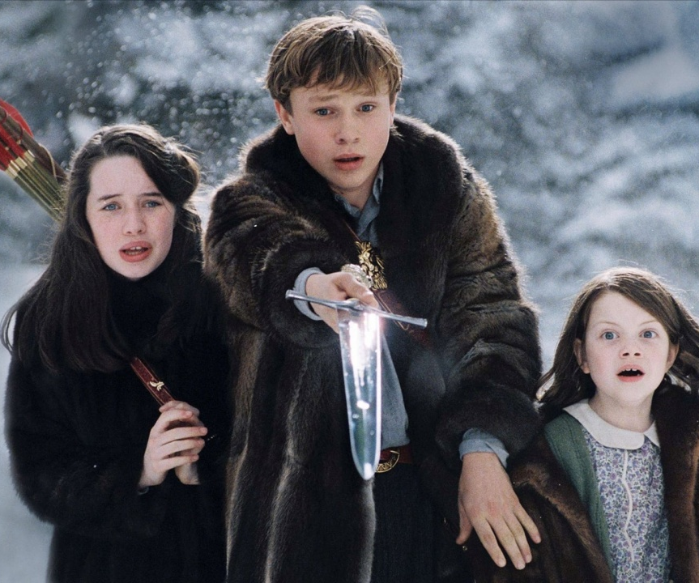
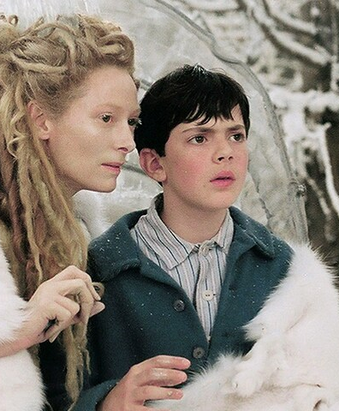
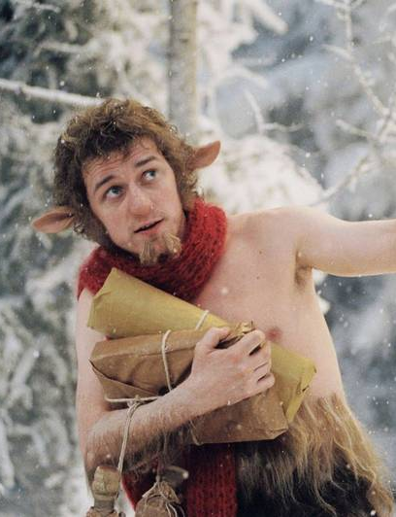
Characters & Relationships
How Mise-en-scene and Editing are used
to Create Relationships or Develop Characters

Slide 2
Ways to Remember Elements of Mise-En-Scene
Claps Maps
Costumes
Lighting
and
Props
Set
Movement
and
Proxemics
Sound
Slap Scamp
Set
Lighting
and
Props
Sound
Costumes
and
Movement/
Proxemics
Spam Claps
Set
Props
and
Movement
Costumes
Lighting
And
Proxemics
Sound
Aunty Danielle’s One: CaPS CaPSL
Costumes
and
Props
Set
Character movements
and
Proxemics
Sound (diegetic/non-diegetic)
Lighting

Slide 3
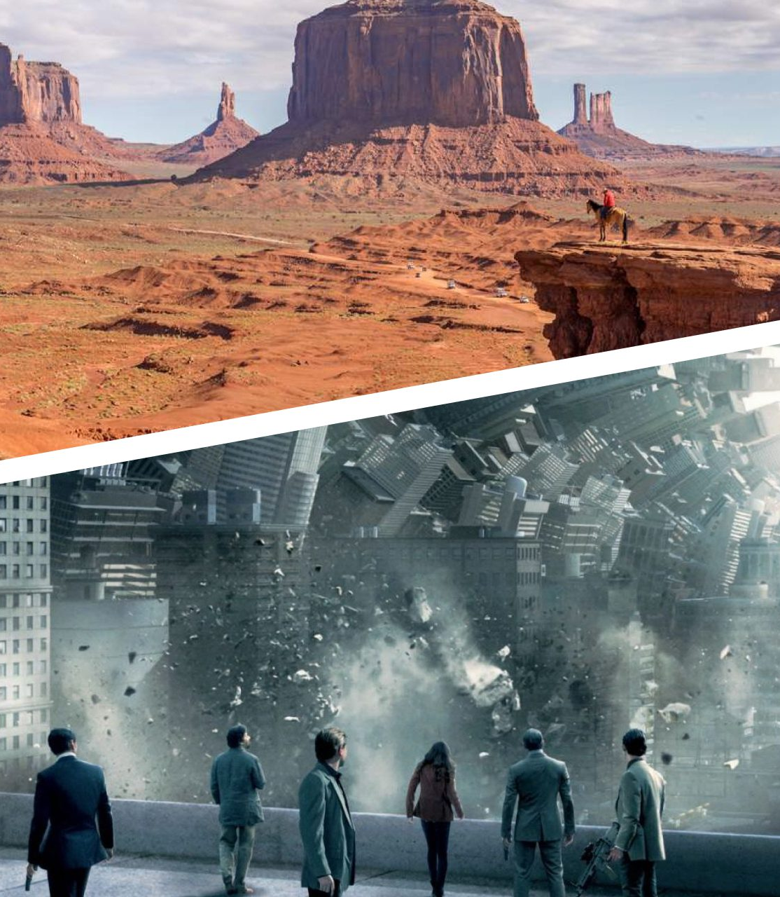
Set
The character’s surroundings instantly give the audience some implied information about their culture, background, lifestyle, status, etc
Luxurious penthouse in 1920s New York = wealthy, successful, ambitious
Rundown apartment in a crime-ridden city in modern-day Mexico = poor, struggling to survive
Rural farmhouse in the English countryside in 1850 = simple lifestyle, traditional values
Futuristic space station = scientific or technological knowledge, adventurous

Slide 4
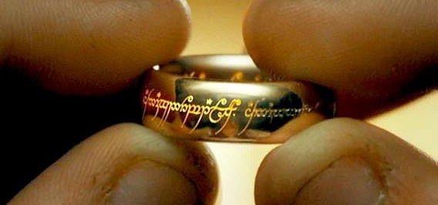
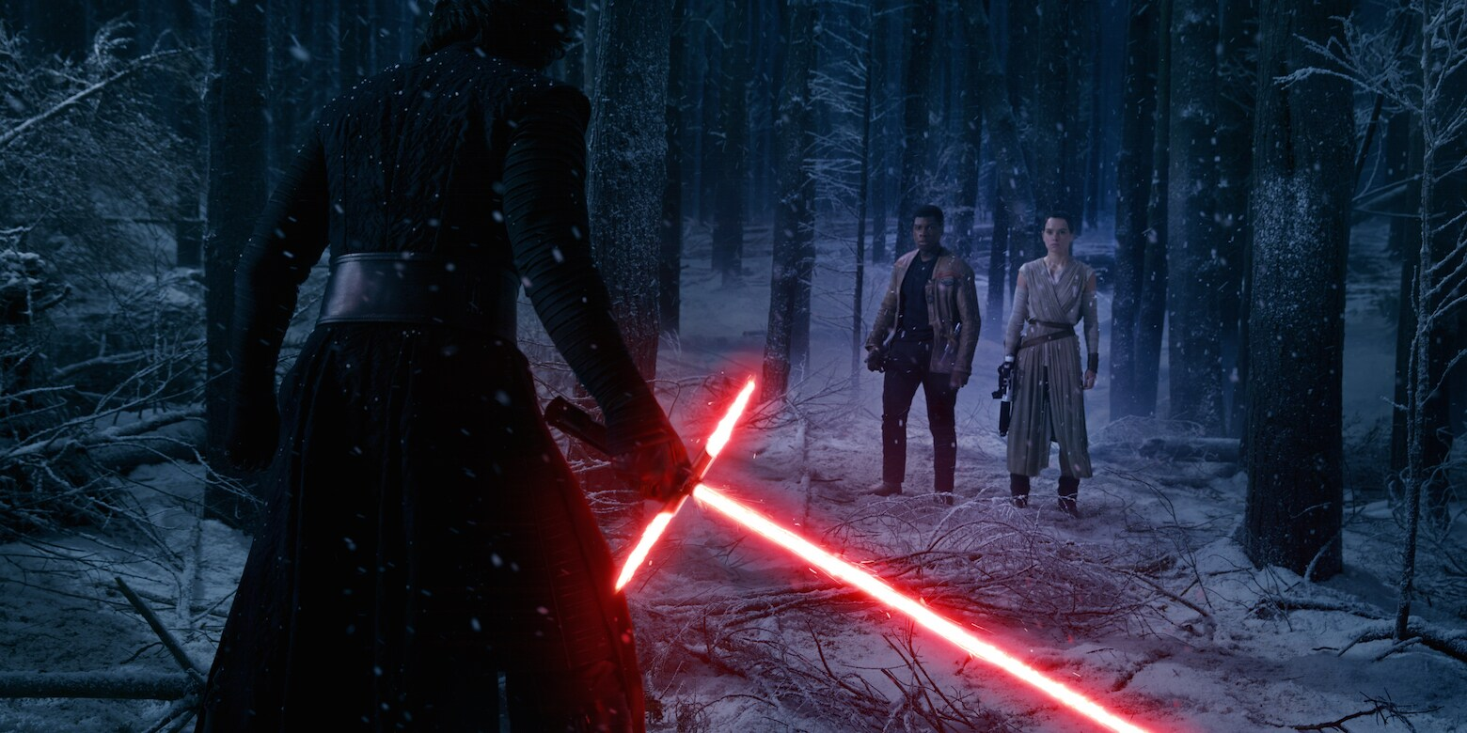
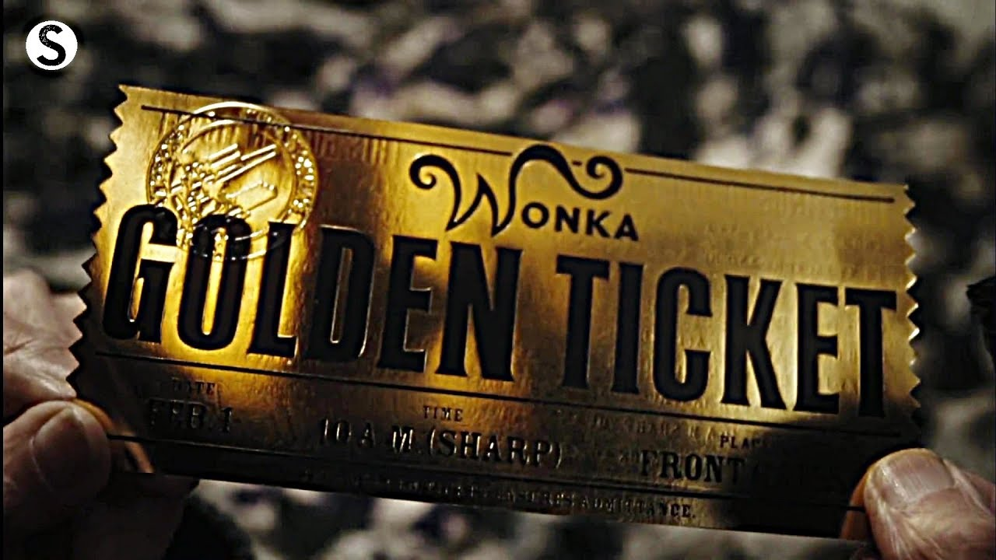
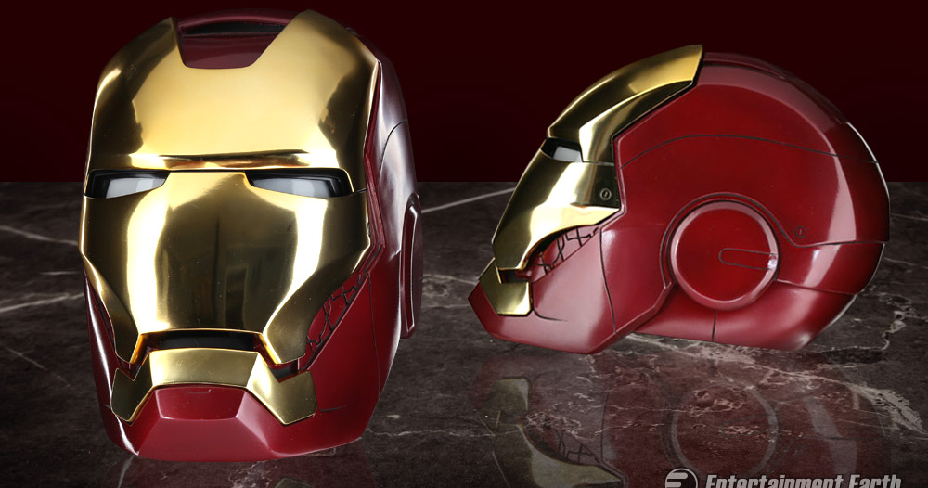
Props
The objects in the scene, and the way they are arranged, can give you clues about the characters:
Interests, personality, backstory
Books, artwork, or musical instruments = intellectual or creative pursuits
Family photos or heirlooms = personal connections and history
Symbolic of their desires, conflicts, or relationships
A wedding ring = commitment or loyalty
A weapon = power, danger, desire for control
Character interaction with props – reveals personality or relationships
A character meticulously arranging items on a desk = perfectionist, attention to detail
A character clutching a cherished possession during a difficult moment = emotional attachment or reliance
Shared objects = can show cooperation, connections, or conflicts between characters

Slide 5
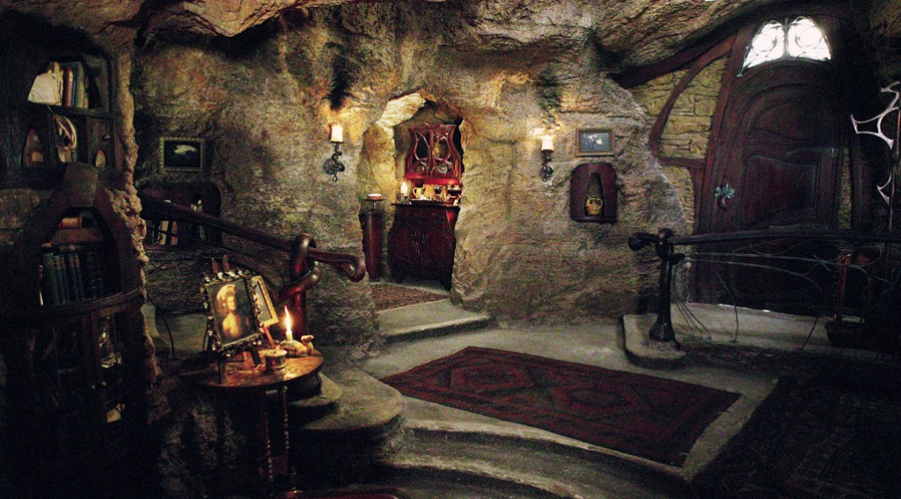
Mr Tumnus’s house
What could you guess or assume about Mr Tumnus by looking at the setting & props used in his house?
In a cave, but cosy & warm looking
Carved wooden furniture
Lots of bookshelves
Fireplace, rugs on floor
Tea tray
Portrait of his father displayed prominently

Slide 6
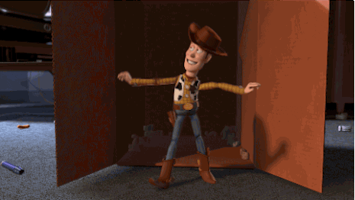
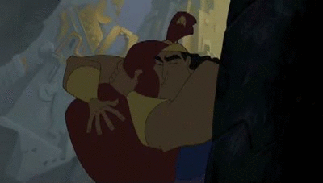
Movement
The movement of characters within a scene can reveal their relationships and power dynamics.
Movement
Quick, purposeful movements, swagger/strut = confidence, arrogance
Slow, deliberate movements = thoughtful or hesitant
Sudden jerky movements = agitation or anxiety
Body language
Nervous fidgeting or crossed arms, avoiding eye contact = insecurity or defensiveness
Invading others personal space = dominance, aggression
Facial movement/expressions
Trembling lower lip, tears in eyes = sad/emotional
Furrowed brow, clenched jaw = anger

Slide 7
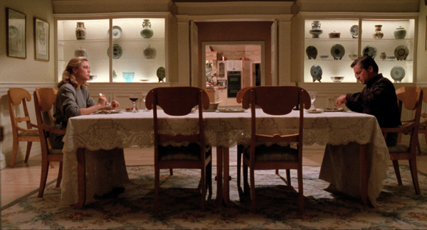
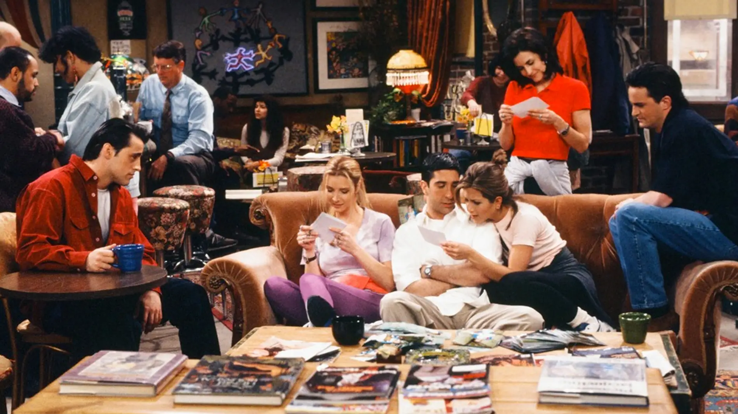
Proxemics
Distance between characters
Deep space – shows emotional distance. Character feels lost/alone in their environment OR used in moments of reflection or peace.
Shallow space – close, intimate, crowded together. Characters are friendly and comfortable OR invading personal space/claustrophobia
Relationship to setting
Sprawled across the furniture – comfortable/confident in surroundings
Hugging the ground – relief at being safe
Hesitating to touch anything – feels out of place
Changes in proxemics = changes in relationships
Gradually moving closer to each other – growing connection or reconciliation
Moving away from each other – conflict, distrust, emotional withdrawal.

Slide 8
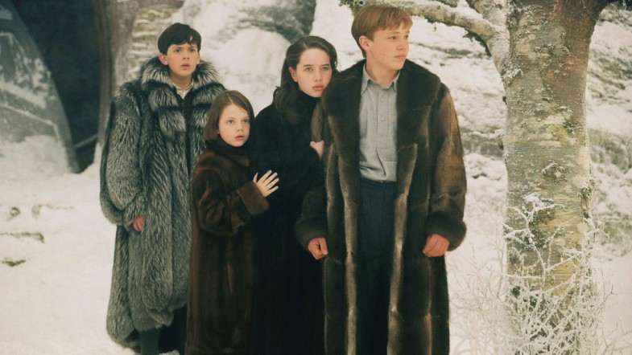
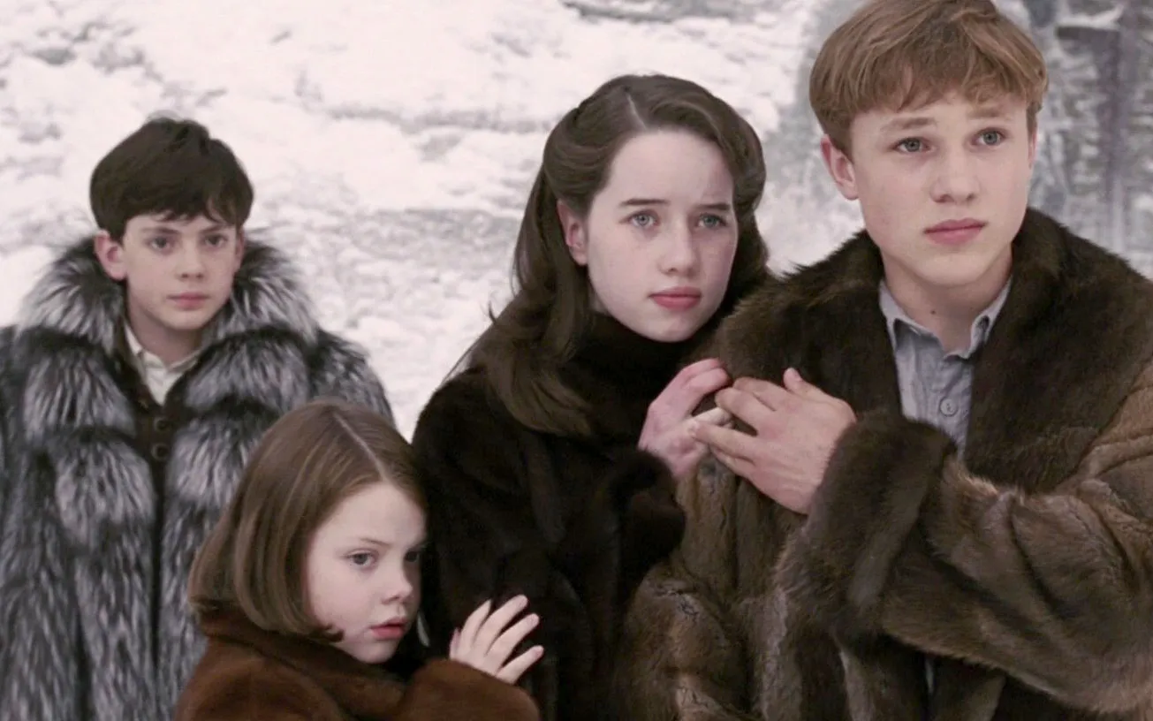
The Pevensie Children
What do their movements and proxemics in this scene tell you about them?
Peter, Lucy & Susan grouped together but Edmund standing apart
Susan & Lucy both standing slightly behind Peter, clutching his arm
Peter reaching behind to take Susan’s hand
Girls & Peter’s expressions are anxious/scared but Edmund looks a bit irritated

Slide 9
Costumes
Clothing, hairstyles, and makeup can reveal aspects of a character's identity, status, or emotional state.
Style and Fit:
Jewels, expensive designer brands, embroidery = royalty, wealth, status
Baggy, unkempt clothing = laid-back or careless personality, poor, chaotic
Tailored suit = sophisticated, professional, cares about their job
Colour Palette:
Bright, vibrant colours = extroversion, energy, or optimism
Dark, muted tones = seriousness, mystery, melancholy
Hidden details or symbolism:
Costume designers often incorporate subtle details into costumes that have a symbolic or hidden meaning
E.g. lots of buttons might suggest a character is ‘buttoned up’ or emotionally reserved
Outfits & Relationships:
Characters who share close relationships may wear complementary outfits to visually reinforce their connection
E.g. romantic partners may wear coordinating colours, family members might have similar styles or accessories
Differences in costumes between enemies or rivals can underscore their conflict

Slide 10
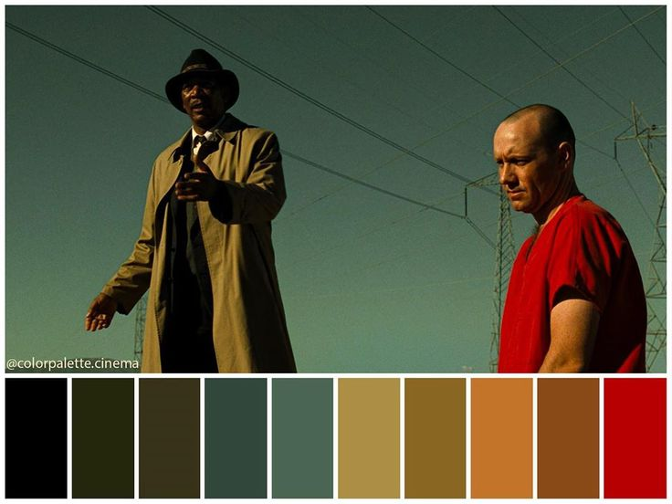
Lighting & Colour
Lighting
Can symbolically reflect characters' inner states or journeys. A character struggling with inner conflict may be shown in a dimly lit environment. A character experiencing enlightenment or clarity might be bathed in bright light.
Strong lighting can draw attention to or highlight a character, emphasizing their importance in the scene or story
Creates mood, which in turn affects how the character is perceived. Harsh upward lighting might make a character look scary or threatening, creating tension or drama. Soft flickering lighting might suggest warmth, safety, or intimacy.
Colour
Warm colours like reds and oranges are associated with passion, energy, or danger. Cool colours like blues and greens are associated with calmness, tranquillity, or sadness. Neutral whites and greys are associated with purity, neutrality, or emotional coldness
Desaturation or muted colours can create a sense of bleakness or melancholy. Lots of bright contrasting colours suggest happiness, safety, daylight.

Slide 11
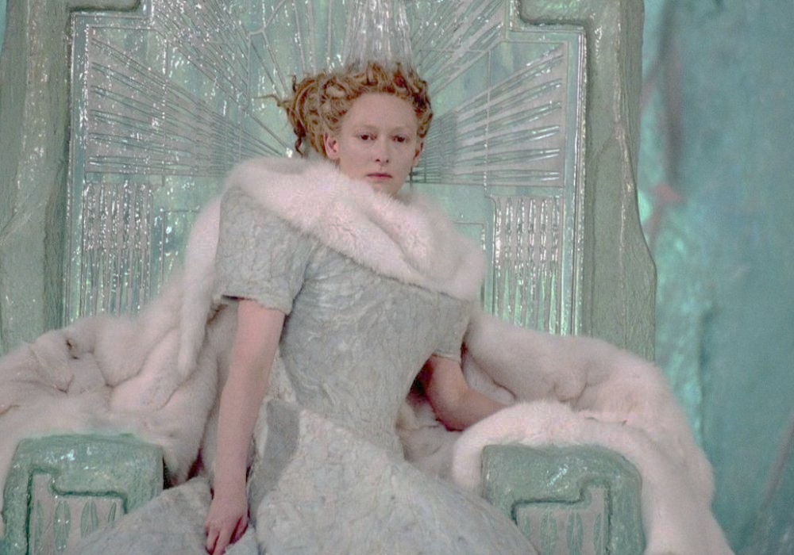
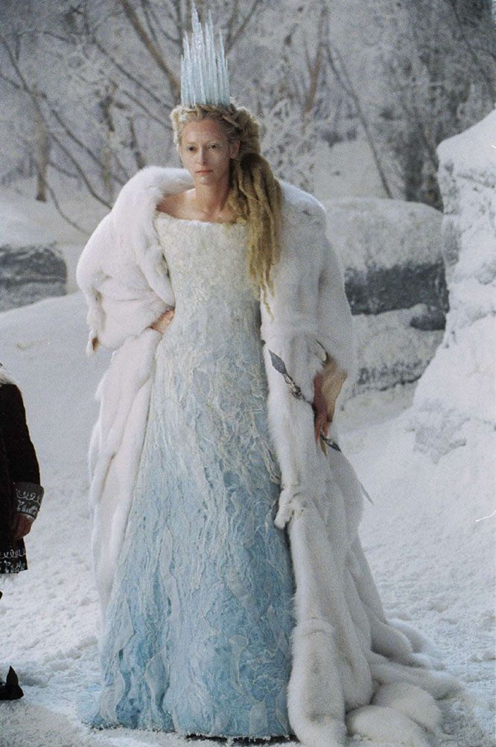
The White Witch
What can we tell about the White Witch by her costume, lighting and colour palette?
Pale blue & whites, glittery/shiny
Wearing lots of furs, some with animal faces still attached
Spiky/pointy crown & sceptre
Gown has big shoulders, very structured, rough textured fabric
Twisted dreadlocks like tree roots
Face is very pale with colourless lips and eyebrows but dark eyes
Palette changes as film goes on & summer comes to Narnia. She wears warmer browns & golds

Slide 12
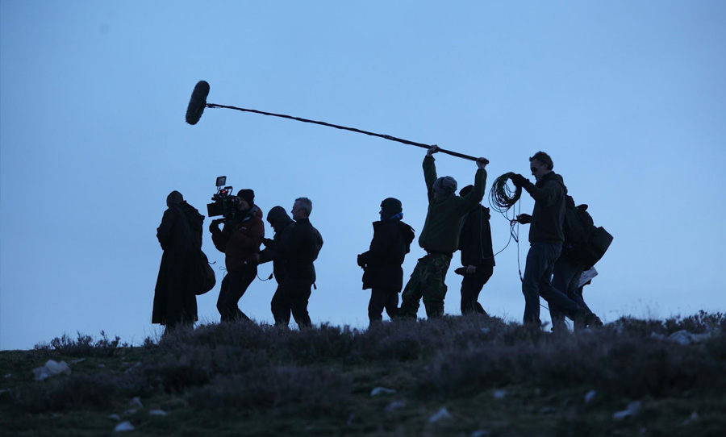
Sound
Dialogue between characters is part of the sound. These conversations provide direct insight into their relationships, personalities, and dynamics. The tone, content, and manner of speech can convey emotions, power dynamics, and underlying tensions between characters.
Diegetic sound can reflect characters' emotions and interactions. For example, the sound of footsteps approaching may signify anticipation or tension, while the chirping of birds might suggest tranquillity or innocence.
Non-diegetic sound Romantic music accompanying a montage of a budding relationship helps build a sense of connection between the characters. Tense, suspenseful music can underscore conflicts or confrontations, amplifying the drama and stakes of the situation.
Themes – repeated tunes associated with specific characters or relationships can provide continuity and deepen audience engagement. By associating certain melodies with particular characters, composers can evoke emotions and reinforce narrative themes.

Slide 13
The Wardrobe
What do the sound elements in this clip suggest about what Lucy will find inside the wardrobe?
Diegetic (Lucy can hear)
Certain sounds fade in and out – why do the filmmakers want to draw our attention to them?
Non-diegetic (Lucy can’t hear)
What kinds of instruments are used (e.g. strings, flute, voices)
Dynamics – when does it get loud or soft
Tempo – when does it speed up, slow down, pause
Mood (ominous, suspenseful, bright, magical)
Do the sounds reflect the surroundings e.g. shivering tremolo sound on strings mimics cold fluttering snow falling

Slide 14
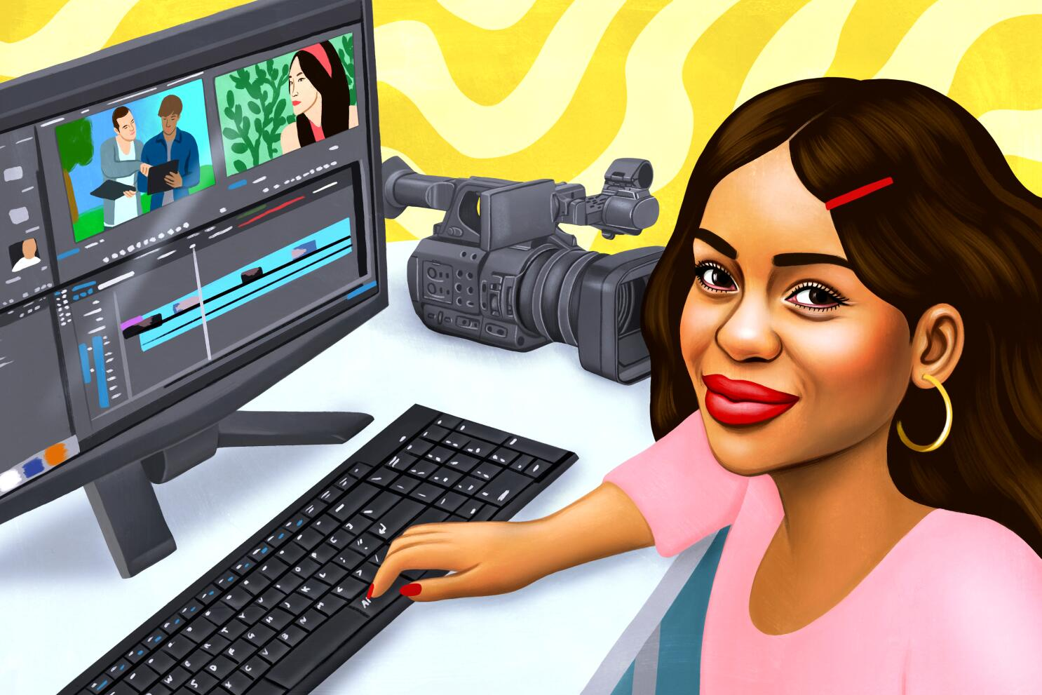
Editing
Montages
These condense time to show the development of relationships between characters. Through a series of cuts, audiences can see characters interacting, bonding, or experiencing significant moments together, thus forming connections and understanding their dynamics.
Transitions
Cross-cutting allows filmmakers to juxtapose (put next to each other) scenes of different characters or storylines. By cutting between them, the audience can see similarities or contrasts between characters' experiences, personalities, or actions, thus highlighting their relationships or conflicts.
Pacing and Rhythm
The pace of editing can reflect the energy and dynamics of character interactions. Rapid cuts can convey tension, excitement, or urgency, while slower pacing can show intimacy, contemplation, or emotional depth.
Flashbacks and Flash-forwards
These can provide insights into characters' pasts, motivations, and relationships. By intercutting between past and present moments, filmmakers can reveal significant events or experiences that have shaped characters' identities and behaviours.

Slide 15
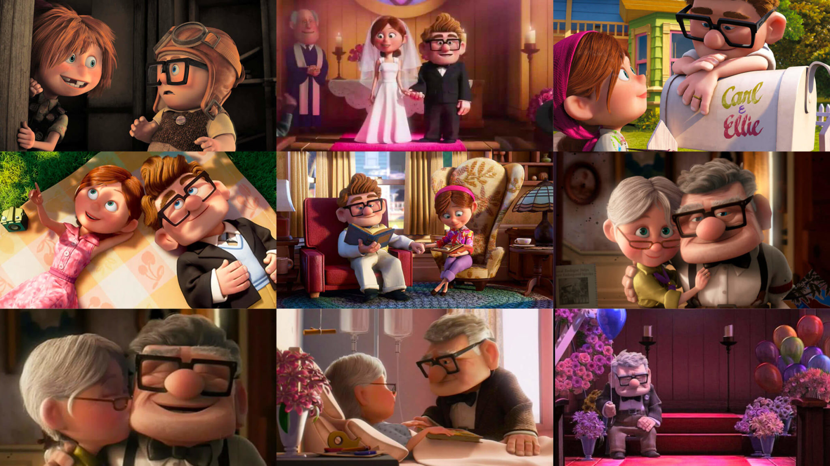
Examples
In "Up" (2009), the opening montage uses editing to depict the lifelong relationship between Carl and Ellie. Through a series of cuts, audiences see key moments in their lives together, from their childhood dreams to their shared adventures and eventual hardships. The montage establishes the depth of their connection and sets the emotional tone for the rest of the film.
In "The Social Network" (2010), director David Fincher employs rapid editing and parallel storytelling techniques to illustrate the complex relationships and power dynamics among the characters involved in the creation of Facebook. Through quick cuts between scenes of dialogue, legal depositions, and flashbacks, the film explores themes of friendship, betrayal, and ambition.

