Slide 1
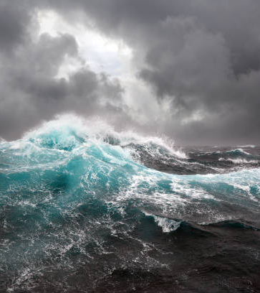
Tone & Mood
How Mise-En-Scene and Editing are used to Create Tone & Mood

Slide 2
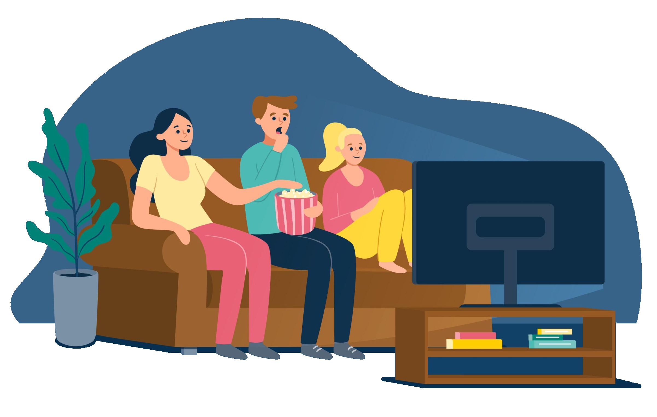
Tone vs Mood
What’s the difference?
Tone: the author/filmmaker’s feelings about the topic or characters
Mood: the atmosphere or feeling that the film gives the viewer
They are linked because the author’s tone affects the mood they create.

Slide 3
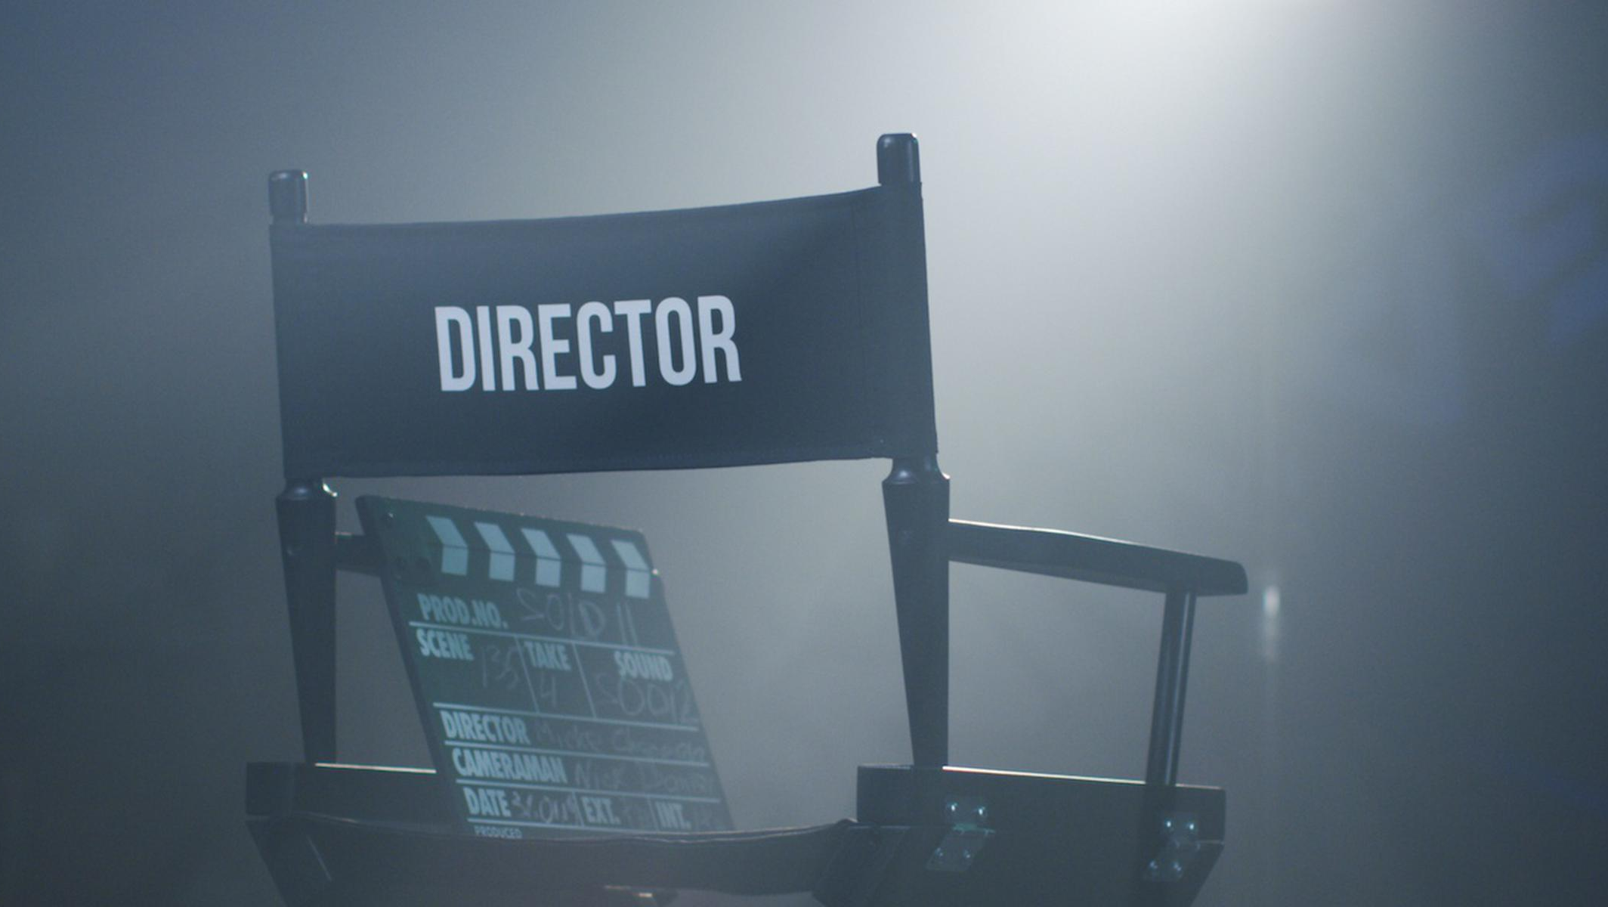
TONE

Slide 4
Tone in writing
When an author is writing about a character they don’t approve of, or a situation they think is bad, they might use negative descriptive words or phrases like ‘cowardly, ugly, disgusting, horrible’
If they like or admire the character, they might use positive or sympathetic words to describe them like ‘innocent, brave, friendly, cheerful’
You can tell from the words they pick how they feel about the topic.
Also shows what they want the reader to feel about it

Slide 5
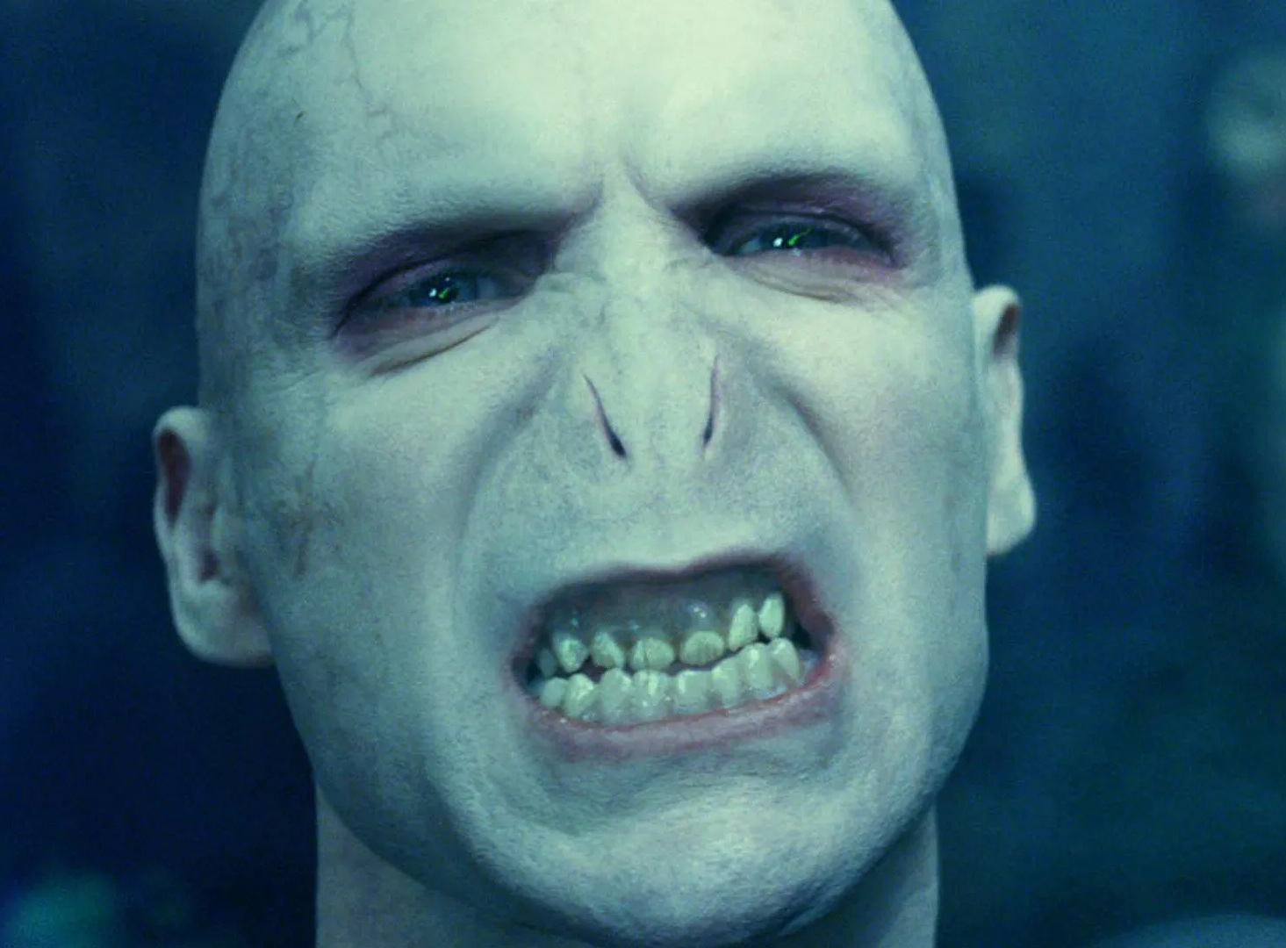
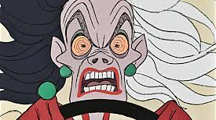
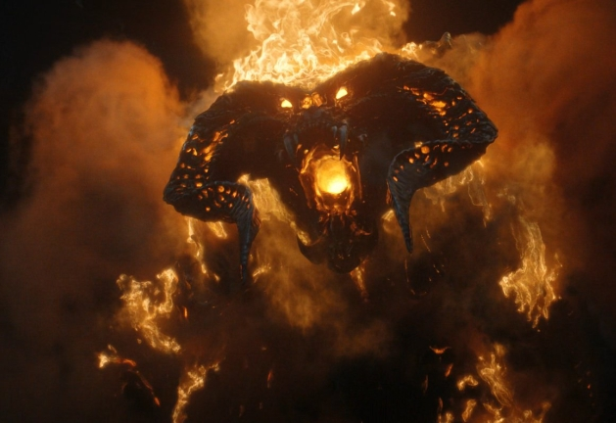
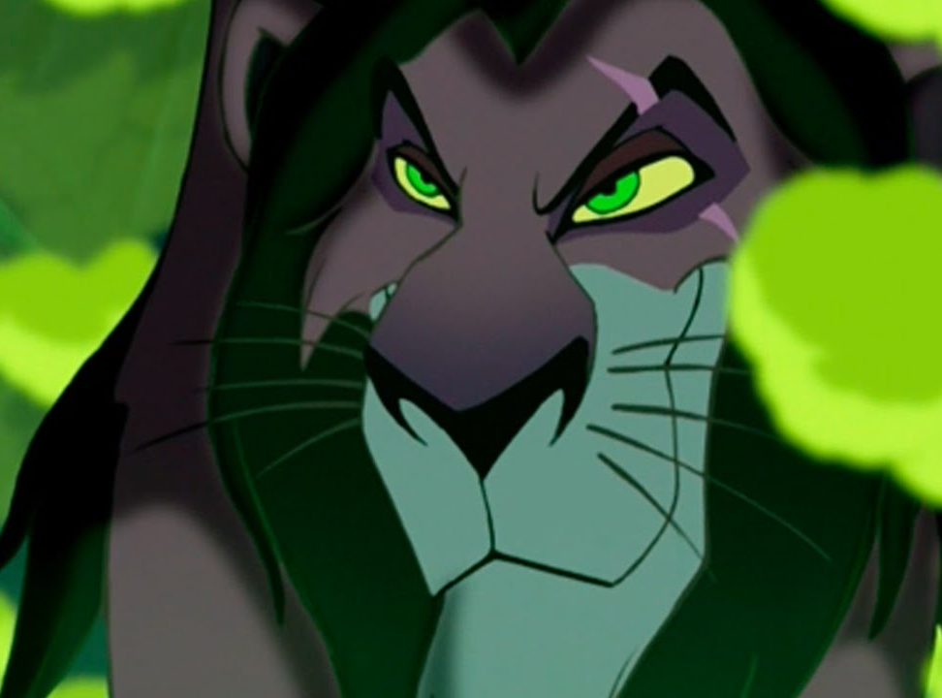
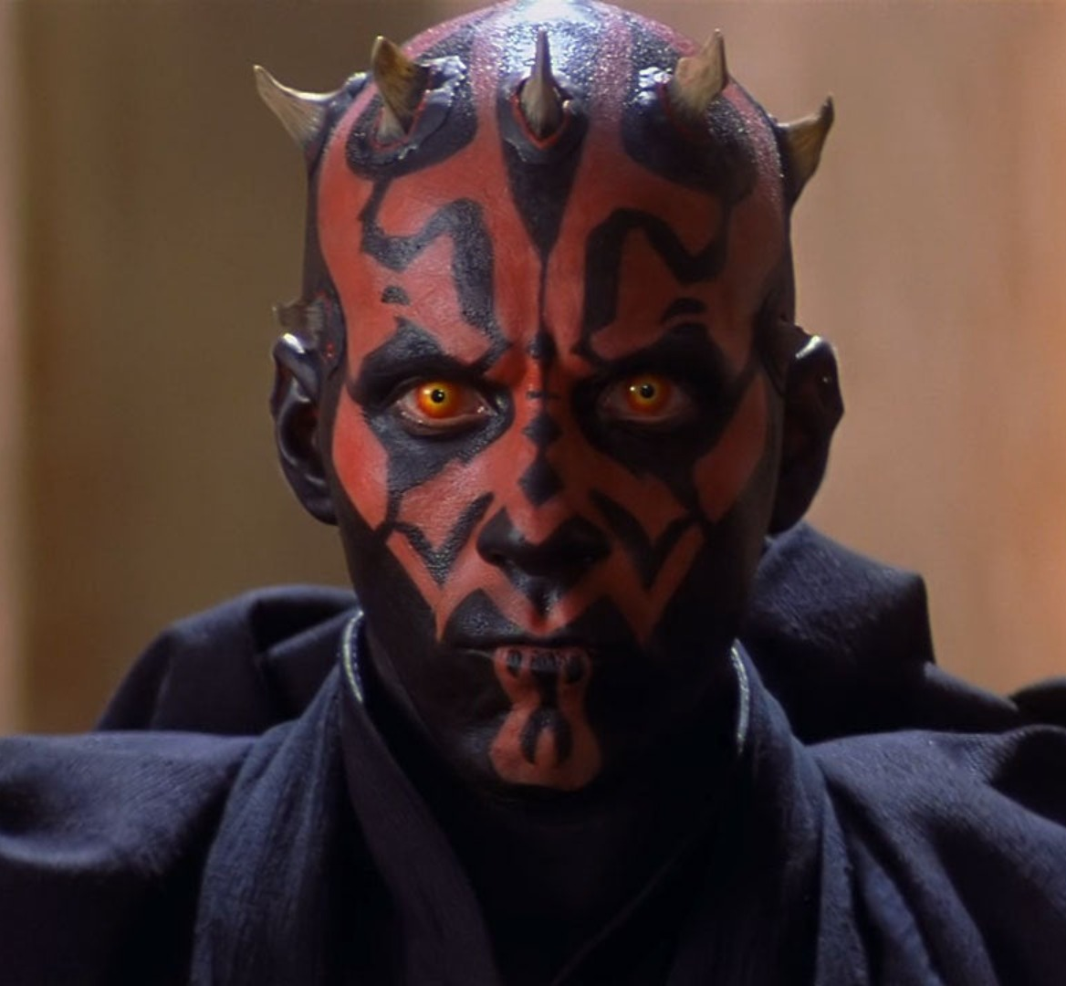
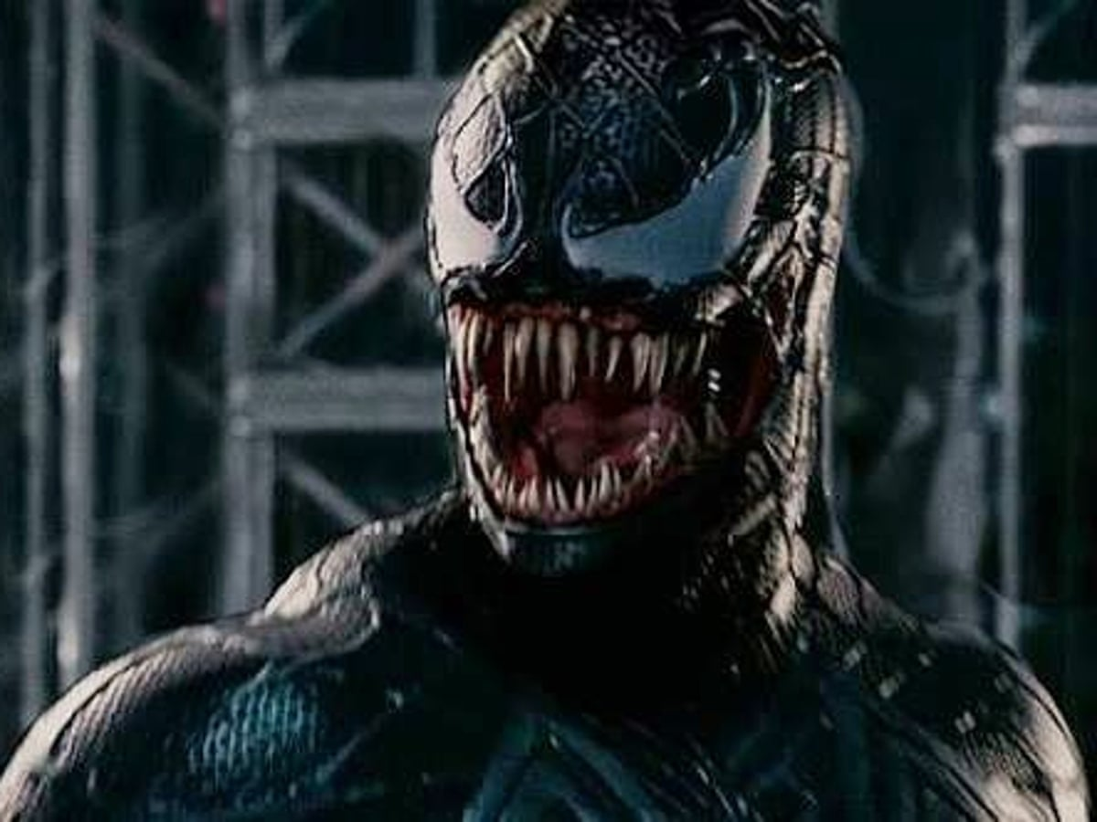
Tone in film
As well as words (in the script), filmmakers can use other techniques to make the viewers perceive characters as bad. For example:
Mise-en-scene
Scary/ominous music
High contrast lighting or silhouette lighting
Symbolism in props or costumes e.g. snake motif
Colours associated with danger/death e.g. red, black, lime green (evil magic or poison)
Makeup, costumes, prosthetics to make them look frightening
Setting – put them in surroundings that are dark, dirty or disgusting
Proxemics – have them get uncomfortably close, invading personal space
Cinematography
Low camera angle (they seem looming/threatening) or canted angle
Compound motion (dolly zoom)
Editing
Pacing – faster cuts with shorter durations between shots can create tension or urgency
Transitions - sudden cuts to close-ups or “jump scares”

Slide 6
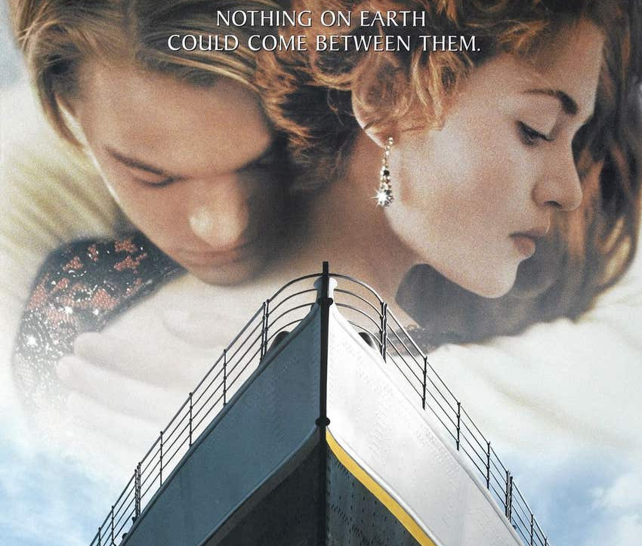
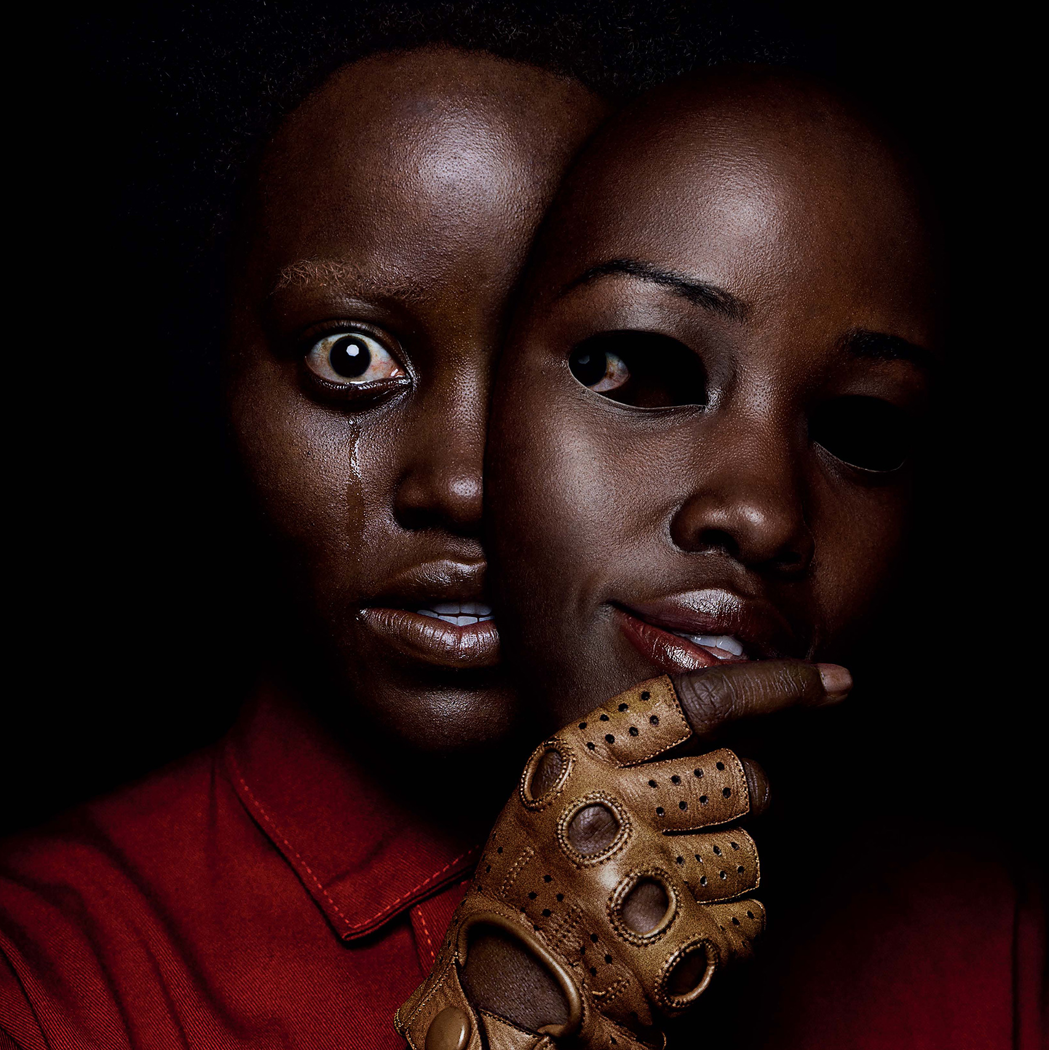
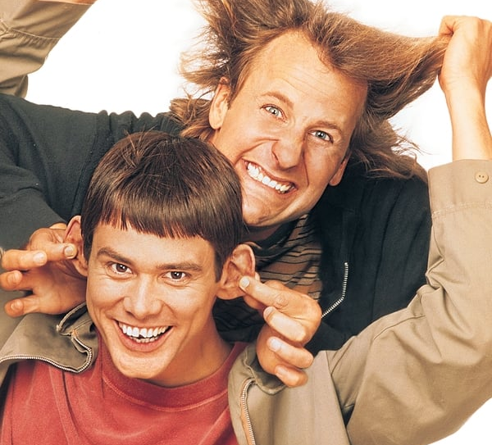
Types of Tone
In film, tone typically falls into one of three broad categories:
Comedic: The filmmaker is light-hearted toward the subject, and the overall intention is to make the audience laugh
Dramatic: The filmmaker is solemn or sincere about the subject, finds it inspirational or tragic
Suspenseful: The filmmaker is pessimistic, outraged or critical of the subject and wants the audience to be shocked or scared

Slide 7
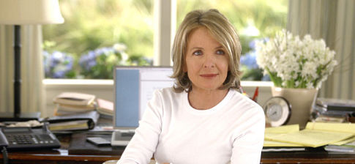
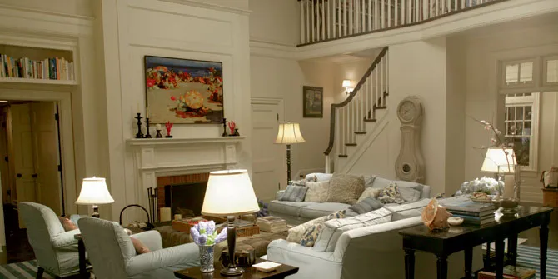
Examples of Tone
Nancy Meyers is known for her romantic comedies and frequently uses set design to create a pleasant, light-hearted comedic tone as a backdrop.
In her film Something’s Gotta Give, Meyers gives Erica Berry (played by Diane Keaton) a bright, large, comfortable home in a light cream-colored palette, helping flesh out the main character as someone who is self-sufficient and stable in her life before she falls in love.
The filmmaker is showing their attitude to the character using these techniques.

Slide 8
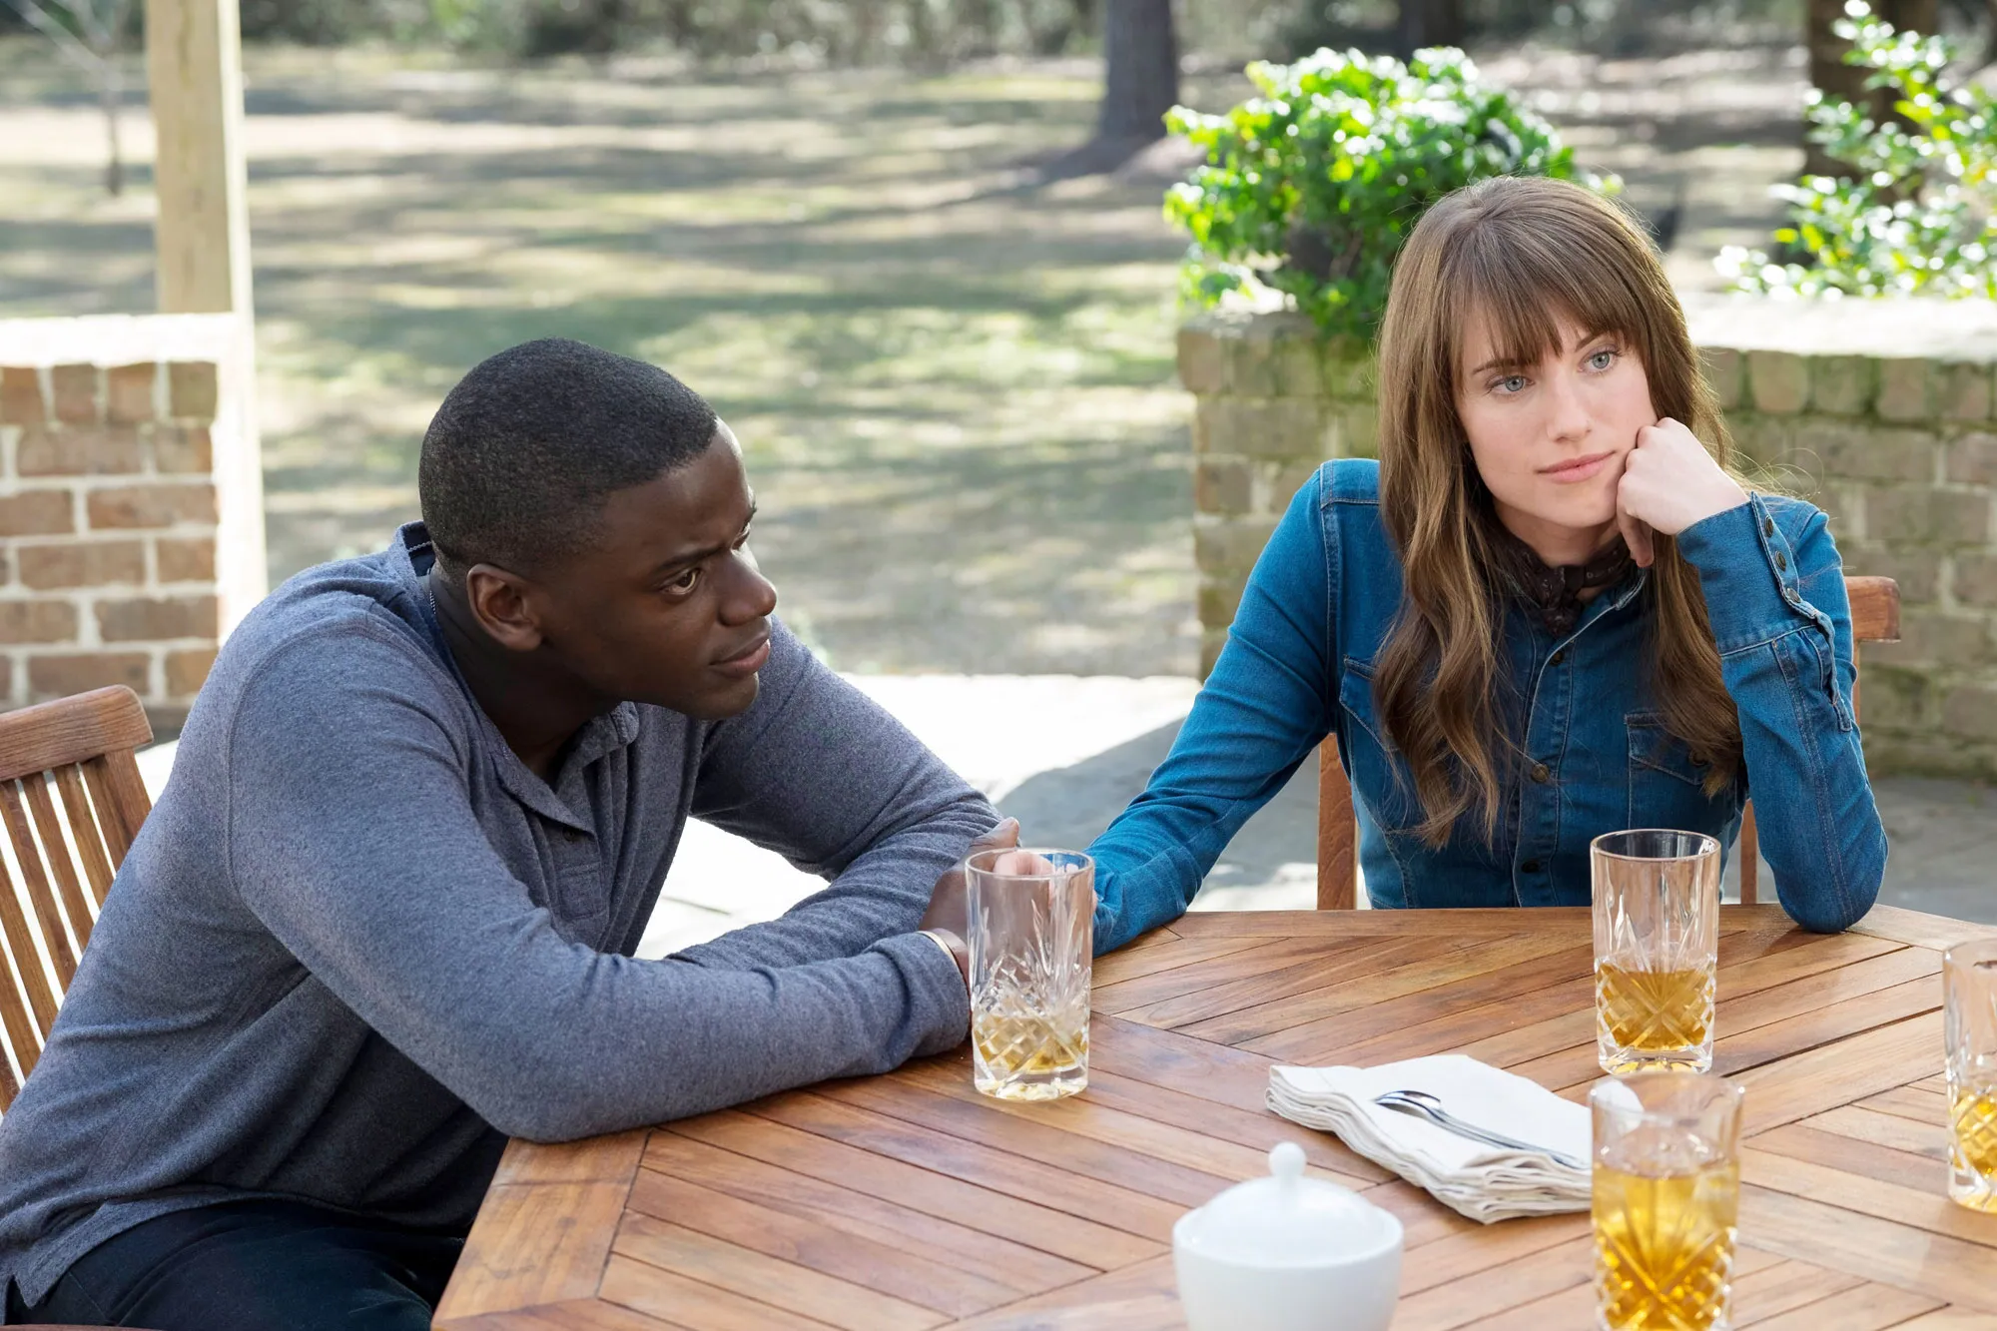
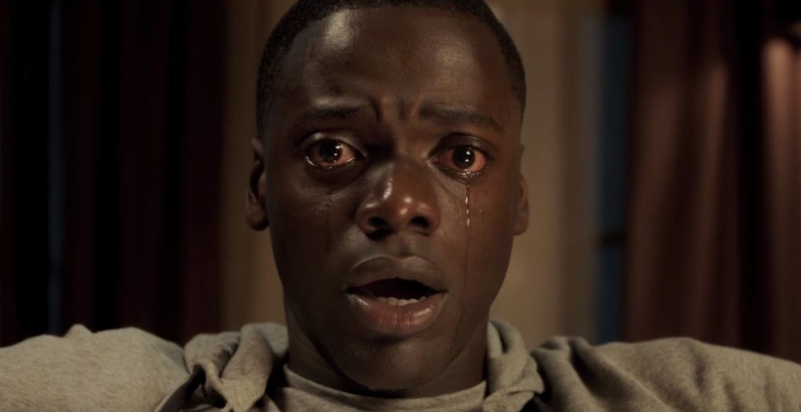
Examples of Tone
In the horror movie Get Out, director Jordan Peele uses lighting and contrasting colour palettes to create tension.
At the beginning of the film, when Chris Washington (played by Daniel Kaluuya) arrives at his girlfriend’s parents’ house, the lighting is warm, bright, and inviting, lulling the audience into a false sense of security.
As the film progresses and the threat of danger gets revealed, the lighting and colours become darker and more ominous. The filmmaker is showing their attitude to events by using these techniques.

Slide 9
Mood

Slide 10
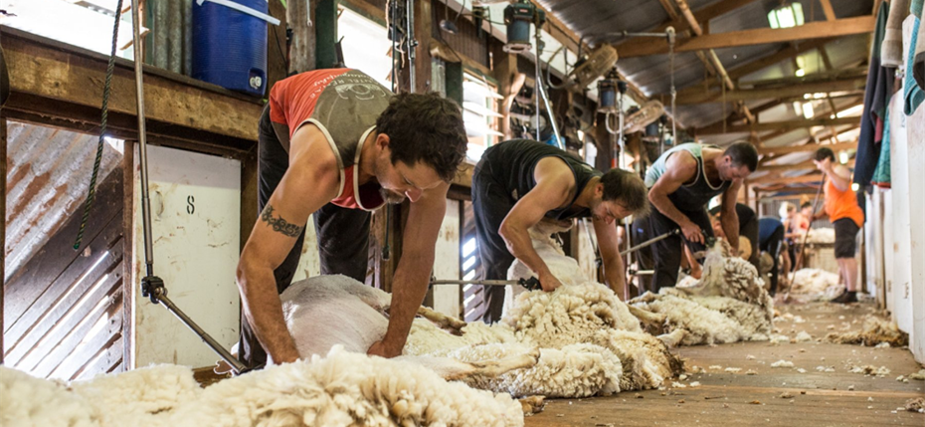
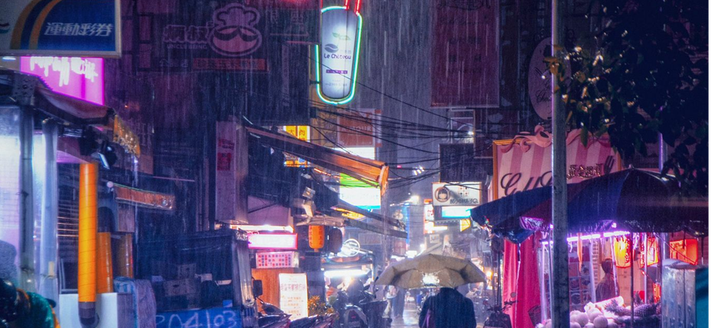
Mood
Mood is the feeling, atmosphere or ‘vibe’ that a film gives the audience
Mood is strongly linked to tone, but they are different:
Tone is how the filmmaker/author feels
Mood is how the audience feels
Filmmakers USE tone to CREATE mood
Although most films have an overall mood, generally the mood doesn’t stay the same for the whole film. It can shift suddenly

Slide 11
Examples of Mood
Finding Nemo is a children’s film and overall the mood is cheerful and positive. The colour palette is bright and vibrant.
However, the film often employs abrupt changes in mood, switching suddenly from a calm or light-hearted moment to scary chase scene
In these examples, notice how the mood switch is created by the change in music, lighting, and cinematography (camera movement/angles)

Slide 12
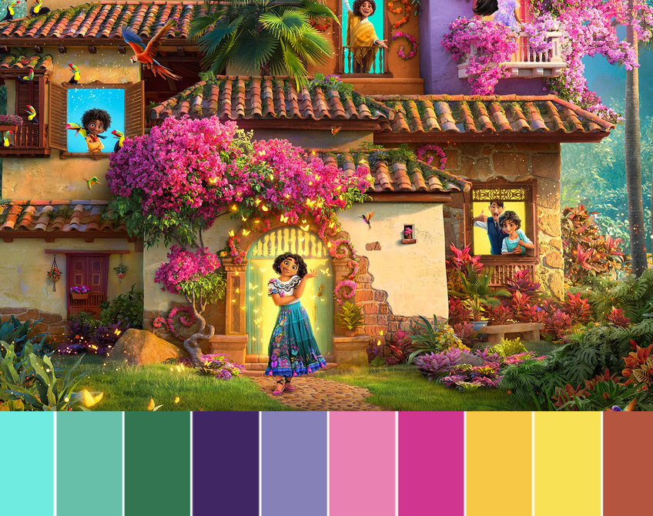
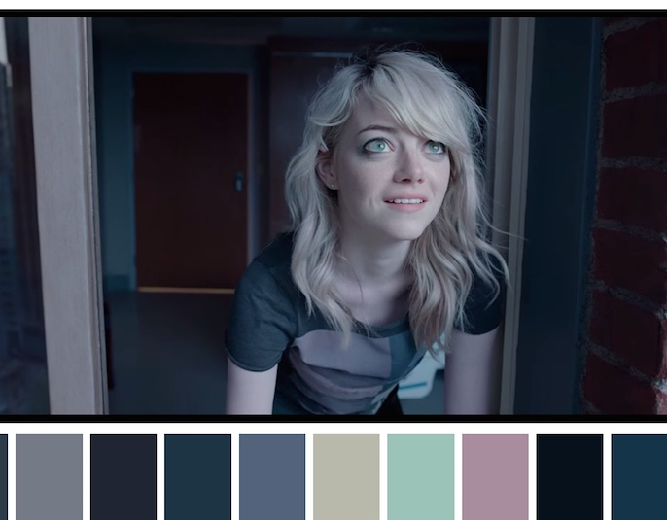
Key indicators of tone & mood
Although all film techniques can contribute to tone & mood, some of the biggest indicators are:
Lighting & colour palette: Dark shadows create mystery and suspense while bright ‘high key’ lighting contributes to a fun, relaxed mood. Lots of vivid colours creates a happy/funny tone, while duller shades usually indicate a more serious tone
Setting: when and where the film or scene takes place. A scene set at night in an abandoned mansion will have a very different mood to a scene set at daytime in a cotton candy kingdom.
Score: the same scene with different music can have a totally different, even opposite, mood
Genre: different genres of film often have pre-established moods that readers will expect. Thrillers, horror & crime films usually have a dark, ominous mood, while romance films often have a light-hearted, comedic mood.
However, sometimes filmmakers can subvert expectations by doing the unexpected, i.e. playing cheery music during a murder.

