Slide 1
How to Use a Semicolon
The most feared punctuation mark on earth

Slide 2
What is a semicolon?
Halfway between a comma and a full stop.
Stronger than a comma
Weaker than a full stop
Shows the link between two pieces of information that are separate but related to each other.
Can help make long complex lists of information less confusing

Slide 3
When To Use

Slide 4
Instead of a coordinating conjunction
Shows a link between two complete clauses
She went to the shops and she bought some milk and eggs.
She went to the shops; she bought some milk and eggs.
Murray has three dogs and a cat so clearly he loves animals.
Murray has three dogs and a cat; clearly, he loves animals.
Martha went to the library but her sister went to play soccer.
Martha went to the library; her sister went to play soccer.

Slide 5
Instead of an ‘em dash’ ( – )
Both are correct but they have a very slightly different effect. A dash usually indicates emphasis or a change in tone
She went to the shops – she bought some milk and eggs.
She went to the shops; she bought some milk and eggs.
Murray has three dogs and a cat – clearly, he loves animals.
Murray has three dogs and a cat; clearly, he loves animals.
Martha went to the library – her sister went to play soccer.
Martha went to the library; her sister went to play soccer.

Slide 6
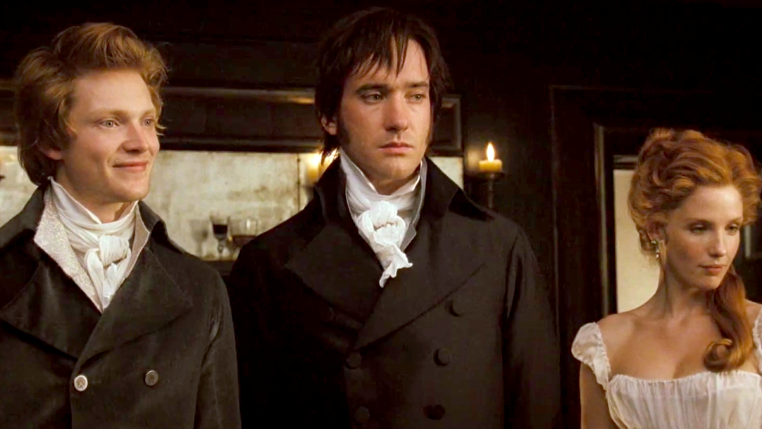
Semicolons in use – P&P
A single man of large fortune; four or five thousand a year. What a fine thing for our girls!

Slide 7
Complex lists – group information
In a list of complex items, semicolons can make it clearer which bits of information go together.
Compare:
My plan included taking him to a really fancy expensive restaurant for dinner going to the park to look at the stars which by the way are amazing this time of year and serenading him with my accordion.
My plan included taking him to a really fancy, expensive restaurant for dinner; going to the park to look at the stars, which, by the way, are amazing this time of year; and serenading him with my accordion.

Slide 8
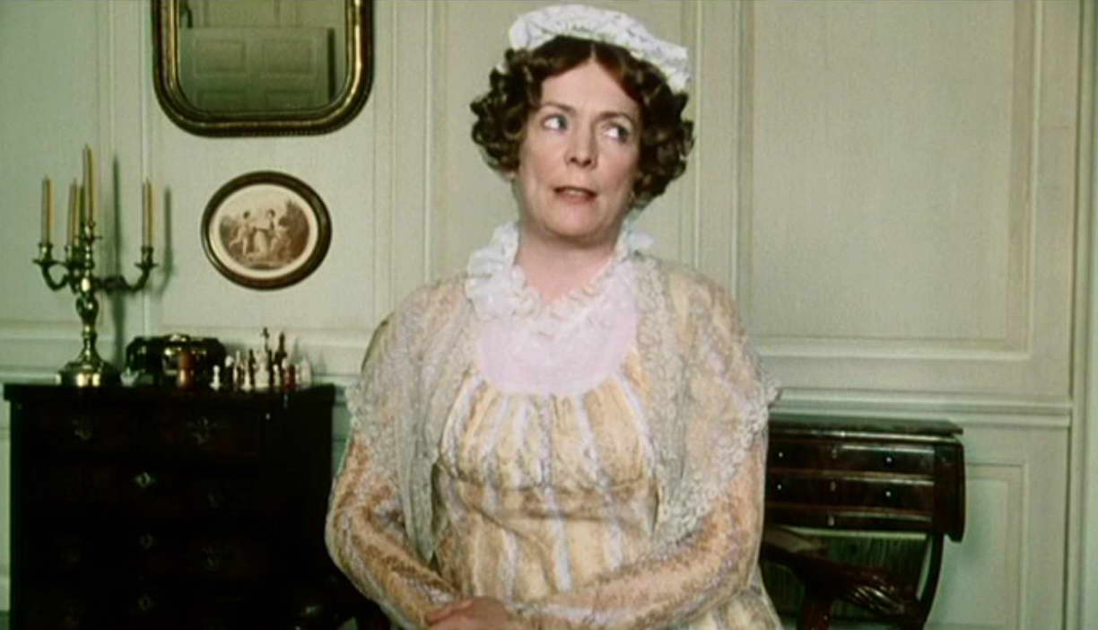
Semicolons in use - P&P
Why, my dear, you must know, Mrs. Long says that Netherfield is taken by a young man of large fortune from the north of England; that he came down on Monday in a chaise and four to see the place, and was so much delighted with it, that he agreed with Mr. Morris immediately; that he is to take possession before Michaelmas (Christmas), and some of his servants are to be in the house by the end of next week.
As we went along, Kitty and me drew up all the blinds, and pretended there was nobody in the coach; and I should have gone so all the way, if Kitty had not been sick; and when we got to the George, I do think we behaved very handsomely, for we treated the other three with the nicest cold luncheon in the world, and if you would have gone we would have treated you too.

Slide 9
With conjunctive adverbs
Conjunctive adverbs are adverbs that can be used in place of a conjunction e.g. moreover, nevertheless, however, otherwise, therefore, then, finally, likewise, consequently, also
I needed to go for a walk and get some fresh air; also, I needed to buy orange juice.
The students had been advised against walking alone at night; however, Cathy decided walking wasn’t dangerous if it was early in the evening.

Slide 10
Also: to separate in-text references
Effective leaders are adaptable (Nicoll 2019; Taylor 2018; Weir 2020).
This is good to know but not relevant to this task.

Slide 11
When NOT to use

Slide 12
Don’t use to connect unrelated sentences

Slide 13
DON’T use at the end of dot points
Things in the classroom include;
Desks;
Chairs;
Students;
Carpet;
Walls;
Pencil cases;
The first one should be a colon:
Dot points can finish with a full stop OR nothing.

Slide 14
DON’T overuse them to create massive paragraph-long Frankensentences
Too many semicolons in a row can make a paragraph crowded and difficult to read; if a sentence has a lot of punctuation marks, it might be a sign that the sentence is too long or complex; try to rewrite into shorter, clearer sentences; more than three semicolons per paragraph is probably too many; use full stops instead, especially if the information isn’t linked.

Slide 15
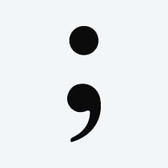
True or false?
You should use a capital letter after a semicolon.
FALSE! You don’t need a capital letter after a semicolon. It’s not a full stop.

