Slide 1
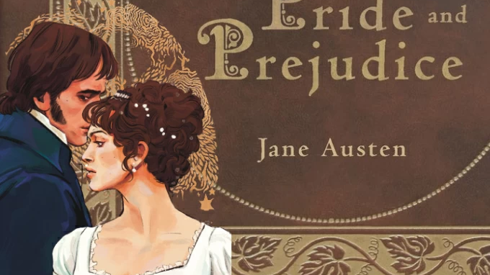
Pride & Prejudice
Context, Purpose & Audience

Slide 2
This novel was written in England, in 1797 (published in 1813)
Over 200 years ago
This has a big effect on the context, audience and purpose of the novel
What was life like for people back then?
How did they talk and behave?
What beliefs did they have?
These factors change the story – what it’s about and how it’s written

Slide 3
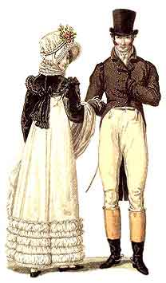
Vocabulary & Language
More formal – don’t use first names for partners
E.g. wife calls husband “My dear Mr Bennet” – however, sisters use first names to refer to each other
Use generally bigger words, more formal tone
“You must, indeed” and “I see no occasion for that.”
Word meanings have changed
“Party” = group of people
Some words aren’t used anymore at all
“A chaise and four” (carriage + four horses) “Michaelmas” (Christmas)
More complex sentence structure

Slide 4
Beliefs and Expectations
“It is a truth universally acknowledged” = this is something that everyone knows or believes
“Everyone knows that a single man with lots of money needs a wife!”
Everyone in Jane Austen’s time knew this.
In our time, this isn’t necessarily something everyone would agree with.
What are some ‘universally acknowledged’ truths from the 21st century?
Scientific – germs cause disease, the earth is a globe
Social – we shouldn’t discriminate based on race
Technology – computers are connected to a global network called the internet (even tiny kids know this)

Slide 5
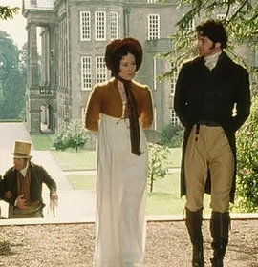
Behaviour & Social Rules
Regency England had very strict social rules about what was considered polite/acceptable behaviour
When to visit people, how long to stay, what to talk about, who to curtsey to when you see them on the street
Can’t go up and introduce yourself to someone - need a mutual acquaintance to introduce you (especially if they are higher in status)
Not illegal not to but rude, weird, socially unacceptable. Like picking your nose on the bus. People wouldn’t want to know you.
Social Hierarchy
Wealth & social class (‘rank’), gender, marital status etc affected what you were allowed to do
Men & wealthy/titled people had much more freedom than women or poorer/lower class people

Slide 6
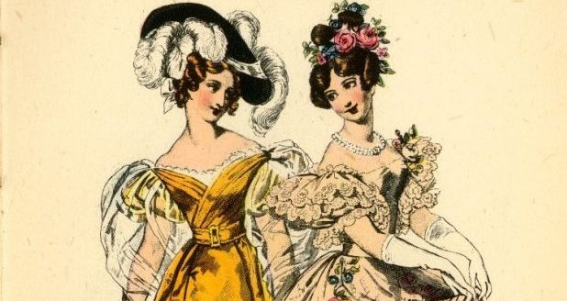
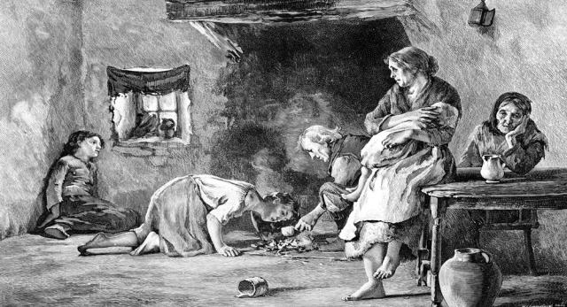
Money
Not socially acceptable to work for a living
“Gentleman” made money through owning land/property & renting it out OR investing inherited wealth
Even if you made enough money through a job to start owning land, people might still look down on you!
They were very snobby about wealth – didn’t associate with poor people (were charitable to them, but couldn’t be friends)
Very few ways for women to make money
Selling paintings or novels was ok
In some RARE cases they could inherit wealth from family or husband
Working as governess (private tutor) seamstress, shop owner – but would lose social status by doing a full-time job like that

Slide 7
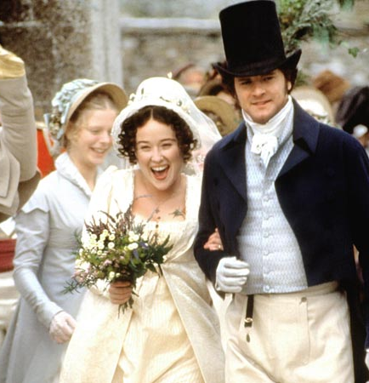
Marriage = Security
For men AND women, marriage meant two incomes which meant more financial stability
Gentlemen gained income through property or investments
MARRIED gentlewomen received a yearly income from their father’s estate/investments
You didn’t HAVE to get married, but many social and financial benefits were not available to unmarried people
Unmarried women had to live at home, didn’t get any money, had to do whatever their parents told them etc
Second sons got less than the firstborn, often had to work
If a woman married a very wealthy man (or vice versa – although rich single women were rare), he would be able to provide for her family too

Slide 8
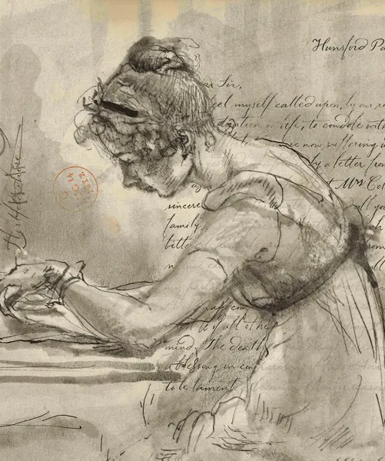
Audience
The author is writing for people from her own time and place
She is not a woman in 2024 writing about 1813
She is a woman from 1813, writing about what (for her) is present-day life
This means she doesn’t bother explaining things like carriages and social rules, because she assumes her audience will know
Fashions change in what’s considered ‘good writing’
a novel that we would consider well written today would have been considered badly written in her time

