Slide 1
Reading Poetry Aloud
For meaning & impact

Slide 2
Impact of Spoken Text
The WAY you read a poem can change the way the audience understands it
Changing your tone of voice, volume or speed/pacing can affect the message that the audience takes away
Using these techniques, you can:
Make sure listeners hear & understand all the words in the poem
Highlight points or words that you think are important, showing your attitude to the topic
Make the poem interesting and engaging to listen to, so that the audience is concentrating and receptive to the message

Slide 3
Tone of voice
Tone of voice = the emotion/attitude in your voice when you speak
Cheerful
Sarcastic
Compassionate
Bored
Tone impacts how the message is received and understood
A friendly tone might make the listener feel more engaged and open to the message
A harsh or condescending tone could lead to defensiveness or resistance

Slide 4
Changing Your Tone
Pitch
Higher pitch = excitement, enthusiasm, urgency
Lower pitch = seriousness, authority, sadness
Quality
Shaky, breathless or breaking voice = nervous, uncertain
Clear, smooth voice = confident, in control
Intonation (change in pitch)
Rising intonation at the end (getting higher) = questioning, uncertain, curious
Falling intonation (getting lower) = certainty, finality

Slide 5
Volume
Loud
Conveys excitement, anger, or urgency
Grabs attention or emphasizes important points
Note: too loud = can seem aggressive or overwhelming
Soft
Conveys peace, compassion, or seriousness
Draws listeners in, creating a sense of closeness or confidentiality
NOTE: too soft = message can be overlooked or misunderstood
Changes in volume
Suddenly making your voice louder or softer can emphasize certain words
Creates intensity – engaging to listen to

Slide 6
Speed or Pace
Fast
Conveys excitement, enthusiasm, nervousness, urgency
Speaking TOO quickly = confusing, difficult for listeners to process information
Slow
Conveys calmness, thoughtfulness, or emphasis
Ensures the listener fully understands complex ideas
Speaking TOO slowly = frustrating, can sound boring or patronizing
Changes in pace
Varying speed can add rhythm and emphasis to the message, enhancing its impact and capturing the listener's attention

Slide 7
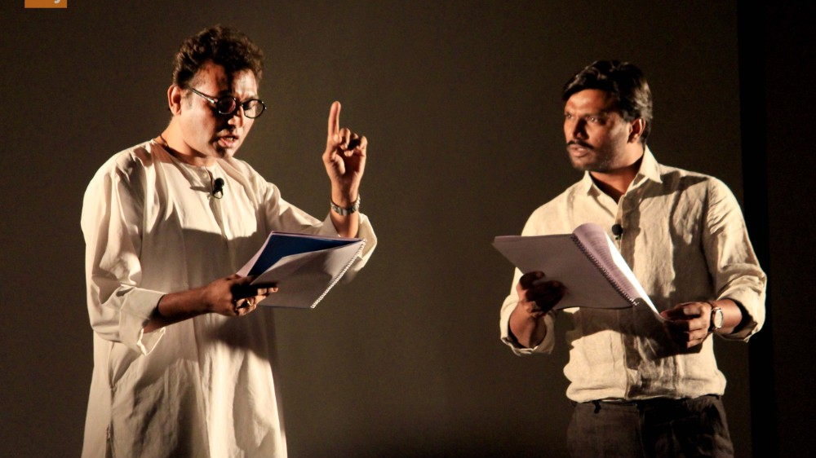
Preparing for your Dramatic Reading
Step by Step Process

Slide 8
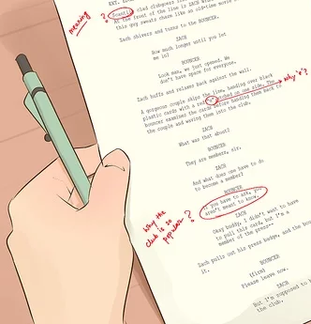
Step 1: Create a ‘Script’
Copy the poem into a word document & share with me
Google it or copy from haiku
If you are working with a group, share the poem with the other members of your group
This copy of the poem will be annotated with your notes and directions for your dramatic reading
Your script must be finished and checked by me before you perform your reading

Slide 9
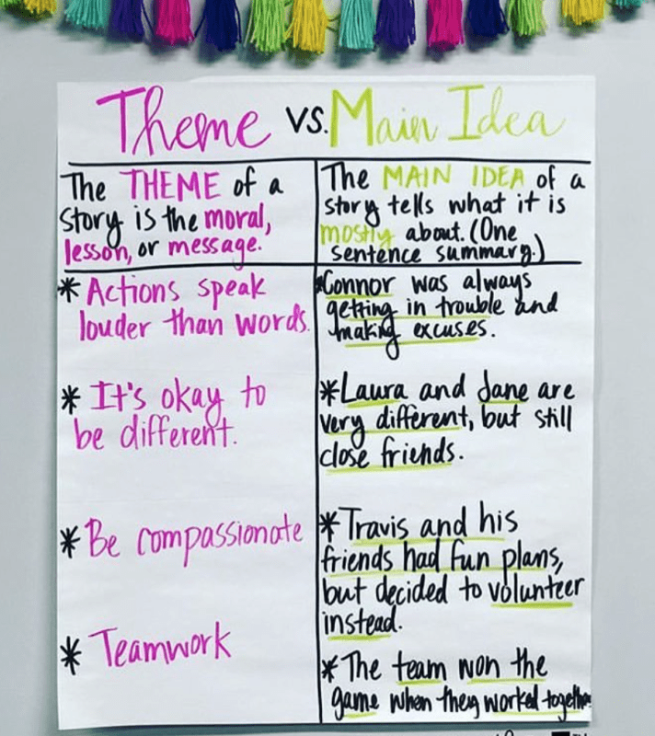
Step 2: Understand Meaning, Themes & Ideas
Read the poem through several times – in sentences, not lines
Make sure you know how to pronounce all the words
Write phonetic spelling next to any difficult words (e.g. dulce = “DULL-chay”)
Check meanings of any words you don’t know
Write meaning in brackets or in comments
Underneath the poem:
Write down the theme and main idea of the poem. What is the author’s point or message?
Each member of your group should write a few sentences about their personal experiences, values or feelings on the subject.
What do you think about the topic of the poem? Do you agree with the author’s point? How does it make you feel?

Slide 10
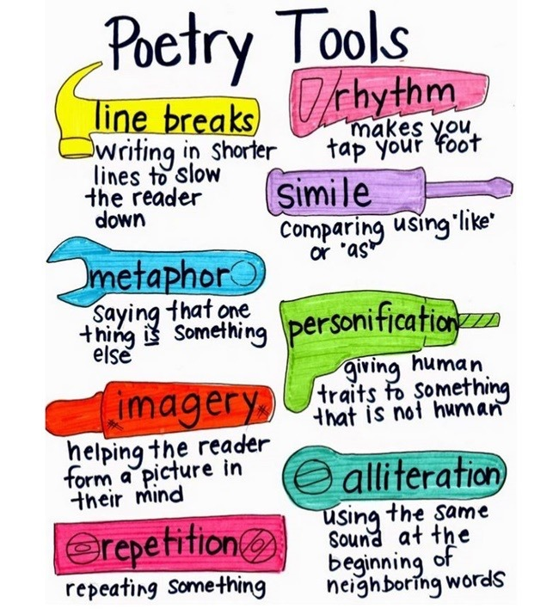
Step 3: Identify Techniques Used
Highlight or label the following:
Patterns in sound or repetition
Rhyme and rhythm
Consonance, assonance, or alliteration
Structure/layout
E.g. line breaks, stanzas, form (type of poem)
Figurative language
E.g. metaphor, symbol, personification, simile, hyperbole
Word choice
Connotations or emotive words
Use of contrast
Juxtaposition – putting two things next to each other as a contrast
Oxymoron – a phrase that contradicts itself e.g. humble brag, deafening silence

Slide 11
Step 4: Identify Tone and Mood
Underneath the poem, answer these questions about the tone and mood:
What is the overall tone of the poem – how does the author feel about this topic?
What is the overall mood of the poem – how does it make the reader/audience feel? Or what do you think the author wants them to feel?
Note places where the tone or mood seems to change. Are there any sections, phrases, or words that seem different to the rest?
Highlight sections in different colours

Slide 12
Step 5: Listen to recordings
Here are some examples – or find your own:
https://www.youtube.com/watch?v=nnTROuO-Y-o
https://www.youtube.com/watch?v=kx9RlCCRmDg
https://www.youtube.com/watch?v=Z5usuiEO5_E
https://www.youtube.com/watch?v=M5zT01lm3lw
https://www.youtube.com/watch?v=rx_nhtkXKFI
https://youtu.be/VMkTo9u0Mjs?si=t0rIPU7OascVRsi9&t=240
https://www.youtube.com/watch?v=t-dpxgDoVUw
Underneath your poem, write some notes about the different versions you watched and any differences you noticed in the speed, emphasis, tone, background music etc

Slide 13
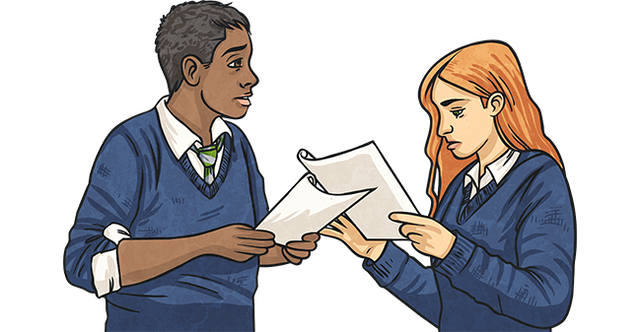
Step 6: Annotate & Practice
Label which sections will be read in a different voices.
Each person in your group needs to say some of the poem alone
Can say some sections together if you like (ONLY IF you think it makes sense based on the meaning)
Label the volume, speed and tone you will use for each line
Label any places you will change the volume, speed or tone
Underline or highlight which words you will emphasise
If you intend to use a backing track or set to music, write the details down underneath your poem
Practice reading aloud (in groups or alone)

