Slide 1
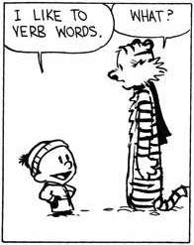
Nominalisation
Notes:
Nominalisation is an important skill that you’ll use a lot as you go into Yr 10-12. Not just for English, also used in written reports, job applications, business presentations, etc, to create more formal, detached, precise sentences. It’s an important part of academic language, which is what you need to be using in your Mulan essays.
If you have finished drafting your essay, this is something you could do to improve your sentences and make your language more formal and academic.

Slide 2
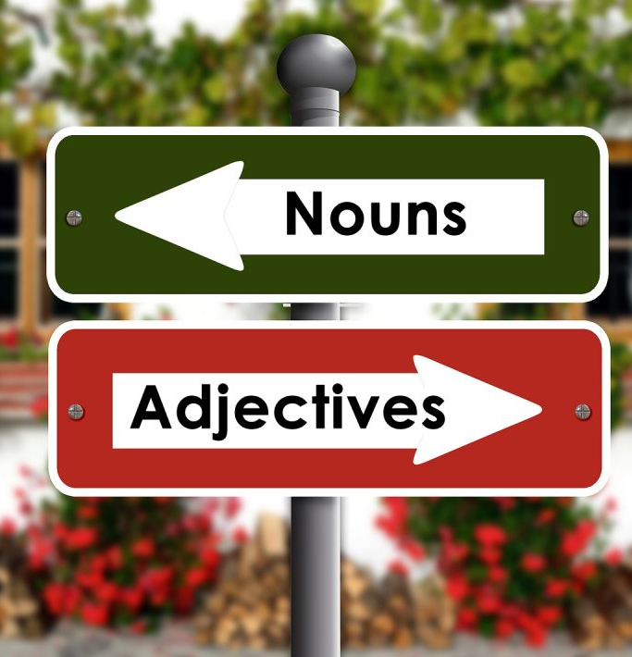
What is nominalisation?
Nominalisation means changing other types of words into nouns.
Usually means changing verbs into nouns, but can also be done on adverbs or adjectives.
To do this, you usually need to add a suffix like –ness, –tion, or –ment.
React (verb) → reaction (noun)
Create (verb) → creation (noun)
Eager (adjective) → eagerness (noun)
Happily (adverb) → happiness (noun)
Many words in English, when altered into a different versions of themselves, can be ALL the different parts of speech:
Obey (verb), obedience (noun), obediently (adverb), obedient (adjective)

Slide 3
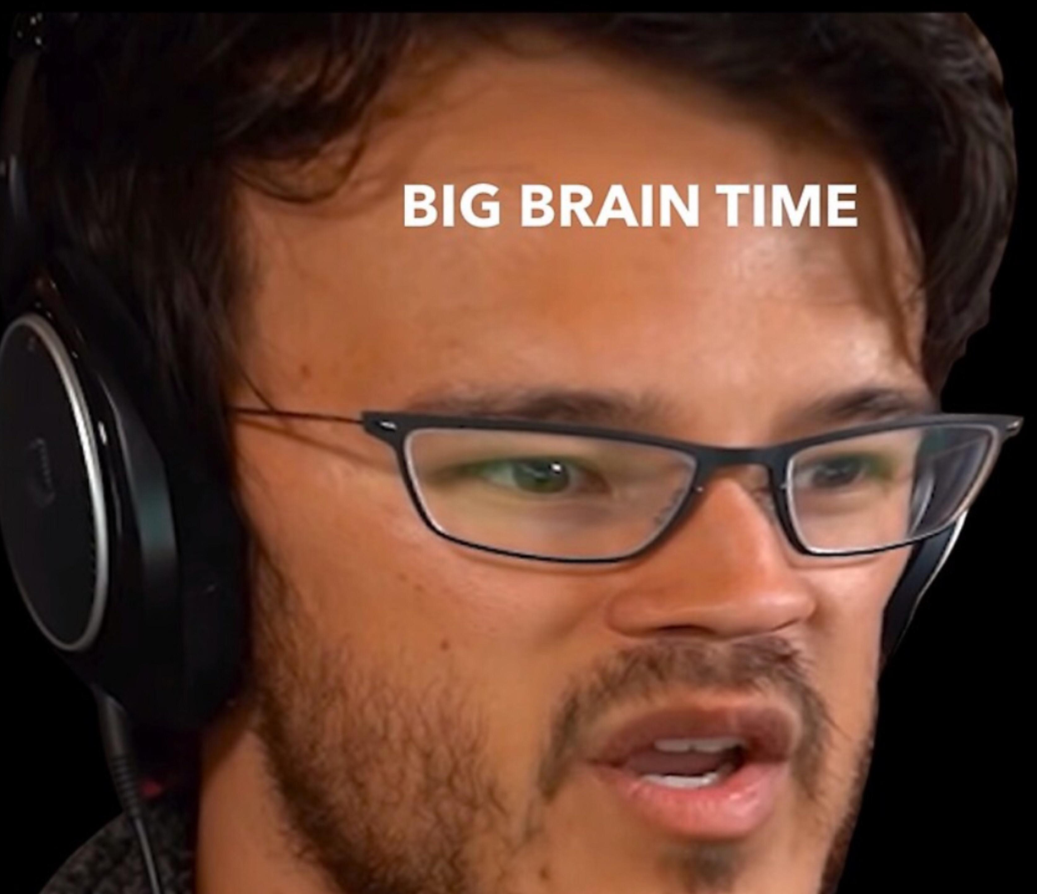
Why nominalise?
Nominalising the verbs makes writing sound…
More formal and professional
Detached – less personal, less dramatic
Focus is on the action, not who did the action
Clearer and more precise
Shows the relationship between pieces of information
Forces you to explain more, dig deeper, and explain the cause and effect

Slide 4
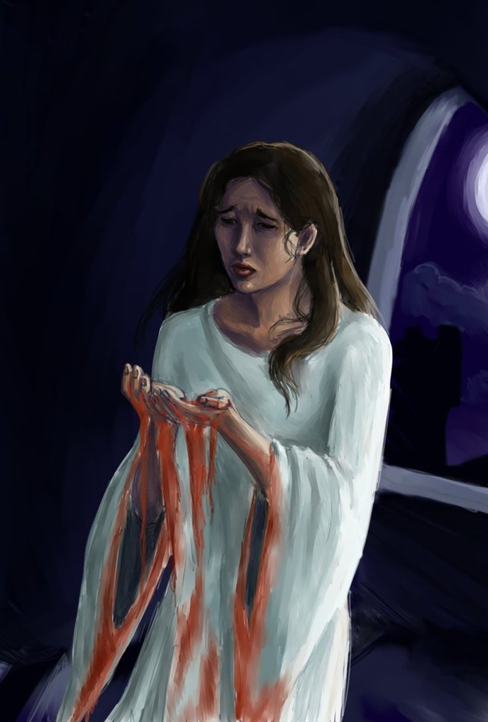
Example
Normal: Lady Macbeth was ambitious.
Nominalised: Lady Macbeth’s ambition….
The un-nominalised sentence is complete, but doesn’t give you as much information.
The nominalised sentence is unfinished. To finish it, you need to add more information about Lady Macbeth’s ambition:
What it was like
What it caused or led to
Lady Macbeth’s ambition was all-consuming.
Lady Macbeth’s ambition led to her decision to plot the king’s murder.

Slide 5
More Examples
We analysed the data. → The analysis of the data showed…
The children reacted. → The children’s reaction was…
The team departed. → The team’s departure caused…
We have contaminated the earth. → Our contamination of the earth has led to…

Slide 6
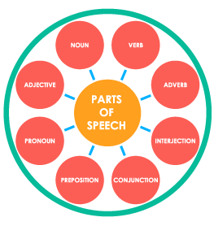
Parts of Speech
In order to nominalise, you have to know your parts of speech well
Need to be able to see where the nouns, verbs, adjectives and adverbs are in a sentence
If you can’t tell:
You won’t know which words to change
You can’t check to see whether you’ve changed it into the right thing
Helpful to know some rules or tests you can apply to figure out the part of speech

Slide 7
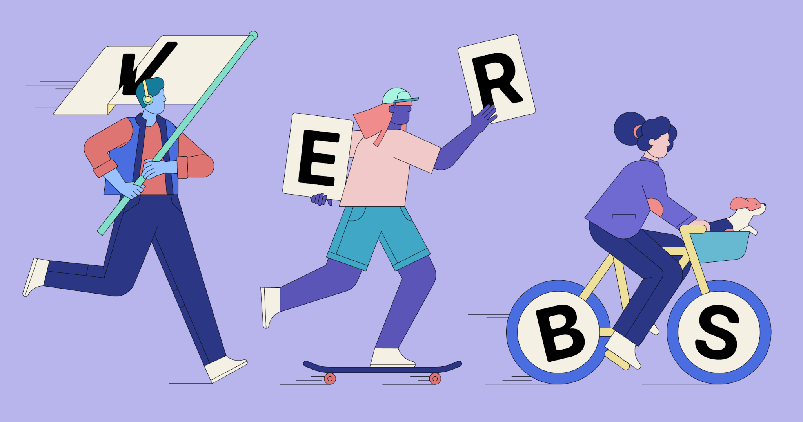
Test for a Verb
If it’s a verb, you should be able to put ‘We need to…’ or just ‘to…’ in front of it to make a complete phrase.
To run
To think
To feel
To be
To have
Won’t work for nouns, adverbs or adjectives!
To cat
To happiness
To yellow
To angrily

Slide 8
Test for a Noun
If it’s a noun, you should be able to put ‘a…’, ‘an…’ or ‘the…’ in front of it to make a complete phrase.
A house
The dog
A feeling
An emotion
The idea
Won’t work for verbs, adverbs or adjectives!
The give
An exist
A beautiful
An almost

Slide 9
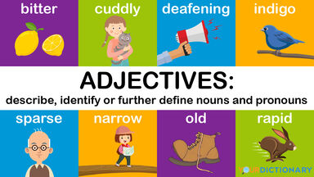
Test for an Adjective
If it’s an adjective, you should be able to put ‘he is…’, ‘she is…’ or ‘it is…’ in front of it to make a complete phrase.
Won’t work for adverbs, verbs or nouns!
It is book
He is computer
She is explain
It is attractively
He is fun
She is sporty
It is hot
He is loud
It is funny

Slide 10
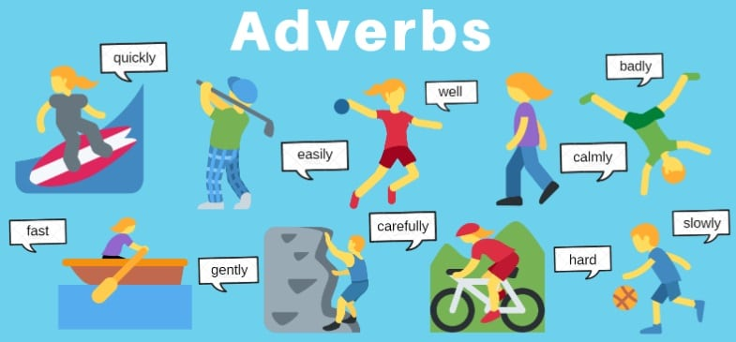
Test for an Adverb
If it’s an adverb, you should be able to put ‘he did it…’ or ‘she did it…’ in front of it to make a complete phrase.
Won’t work for nouns, verbs, or adjectives!
He did it computer
He did it attractive
She did it explain
He did it quickly
She did it angrily
He did it outside
She did it rarely
It did it slowly

Slide 11
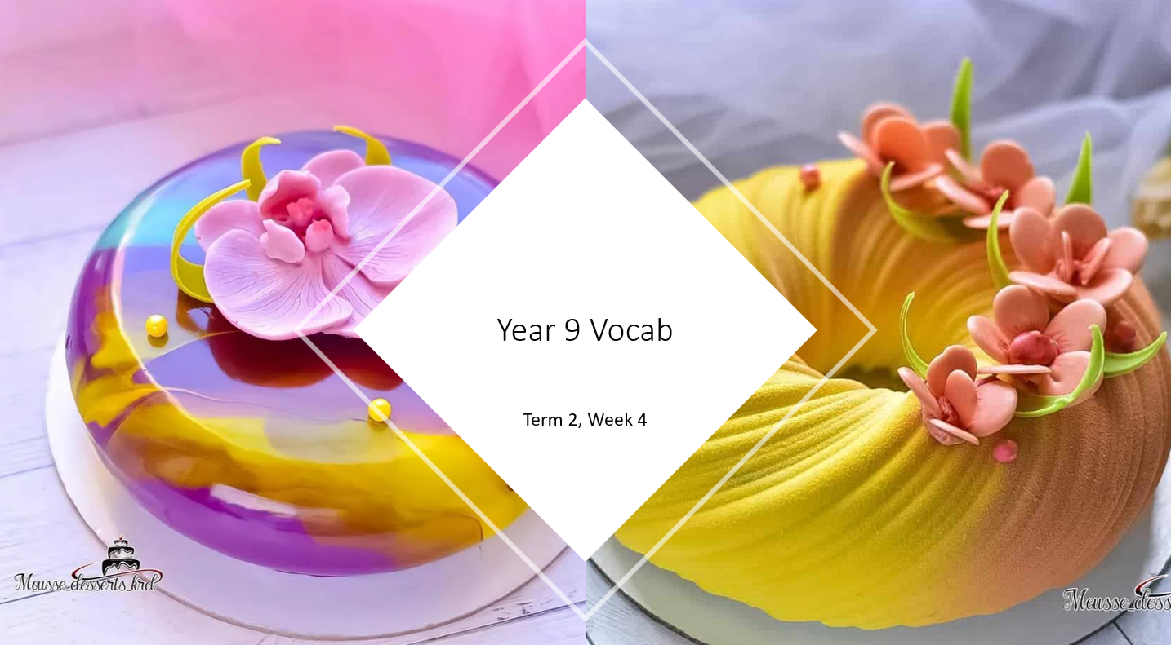
This can also help you with vocab quizzes
The beginning of a definition can be a CLUE about the part of speech
Repartee means “a quick and witty reply” → starts with ‘a’ → noun
Vitiate means “to destroy or damage” → starts with ‘to’ → verb
If it doesn’t start with either of those → probably adjective or adverb

Slide 12
How to nominalise
Find the key verbs in your sentence. If there are no verbs that will work, try adjectives or adverbs.
Change them into nouns by changing their form. Try these suffixes:
-ness
-tion or -sion
-ment
-ty
-ance or -ence
-ism
-ury
Rearrange the sentence so that it still makes sense.

Slide 13
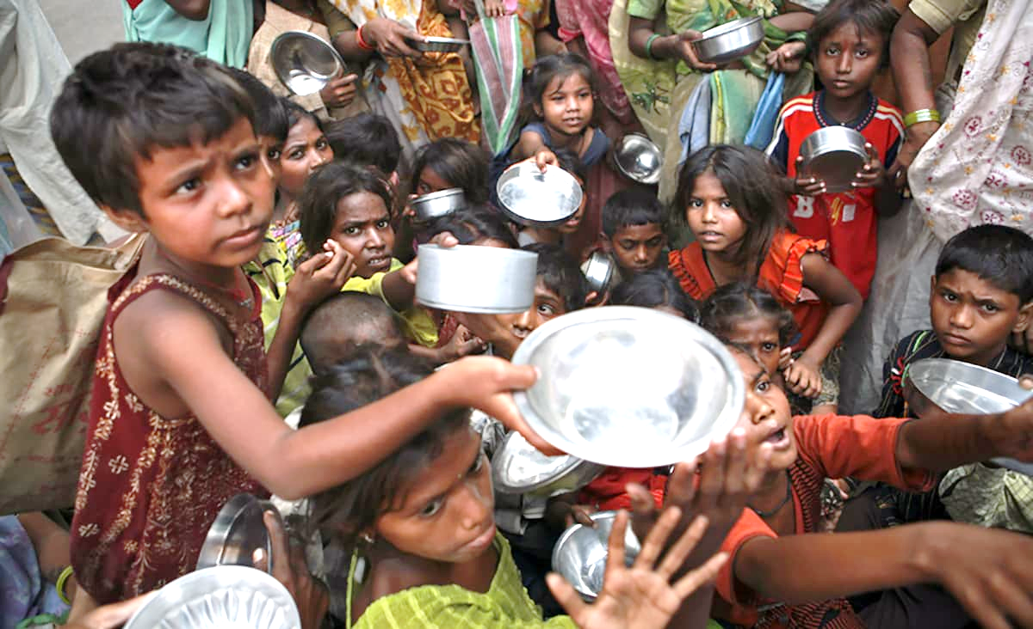
Practice
“Wealth is distributed around the world very unfairly, and many people starve.”
Verbs
Distributed, starve
Nominalised
Distribution, starvation
Rephrase sentence
The unfair distribution of wealth around the world leads to starvation.
Notes:
Pause before you click next. Get the class to look at the sentence, ask what are the verbs? Get them to have a go at turning them into nouns. Get them to have a go at rephrasing the sentence verbally.

Slide 14
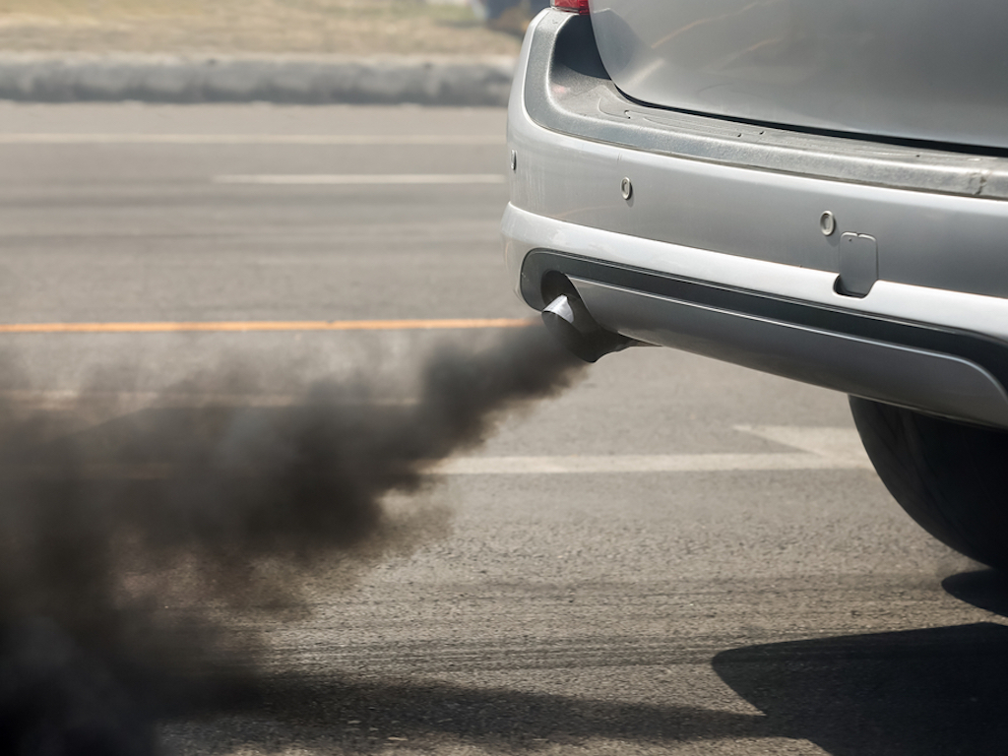
Practice
“When cars emit toxic gasses into the atmosphere, they pollute the air.”
Verbs
Emit, pollute
Nominalised
Emission, pollution
Rephrase sentence
The emission of toxic gasses into the atmosphere causes air pollution.
Notes:
Pause before you click next. Get the class to look at the sentence, ask what are the verbs? Get them to have a go at turning them into nouns. Get them to have a go at rephrasing the sentence.

