Slide 1
Idioms
Year 8 Vocab – Term 2, Week 3

Slide 2
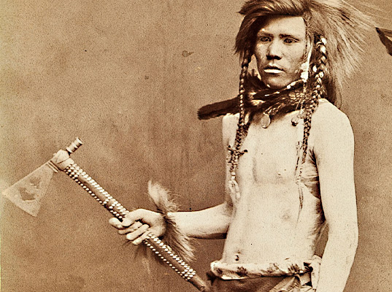
Bury the hatchet
“Harry and Ben have finally agreed to bury the hatchet and cooperate.”
Meaning: to settle an argument
Origin: Native Americans used to have a ceremony at the end of a war. To show it was over, they would bury their weapons in the dirt.

Slide 3


Carrying on like a pork chop
“Mate, calm down. You’re carrying on like a pork chop.”
Meaning: talking too much, behaving in a silly way, or making a fuss.
Origin: The full expression was originally ‘carry on like a pork chop in a synagogue’. Pork is a forbidden food to Jewish people, so a pork chop would be very much out of place in a synagogue.

Slide 4
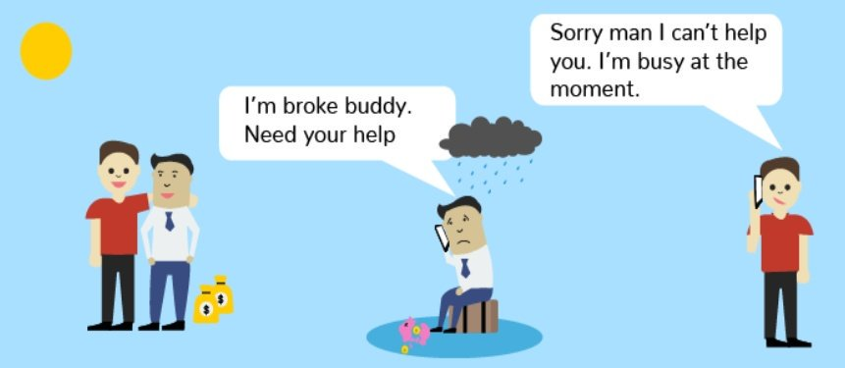
Fair-weather friend
“You can’t count on Penny when you’re in trouble, she’s such a fair-weather friend.”
Meaning: a person who is only friends with you when things are going well. They desert you when times are difficult.
Origin: Life usually feels better when the weather is sunny with blue skies. A friend who ditches you when times are bad, or “foul weather,” is not a very good friend.

Slide 5

Pull the wool over your eyes
“Don’t let that insurance company pull the wool over your eyes.”
Meaning: to trick or deceive someone
Origin: This expression comes from a time when people used to wear powdered wigs (often made of wool). If this was pushed down over their eyes, they wouldn’t be able to see.

Slide 6
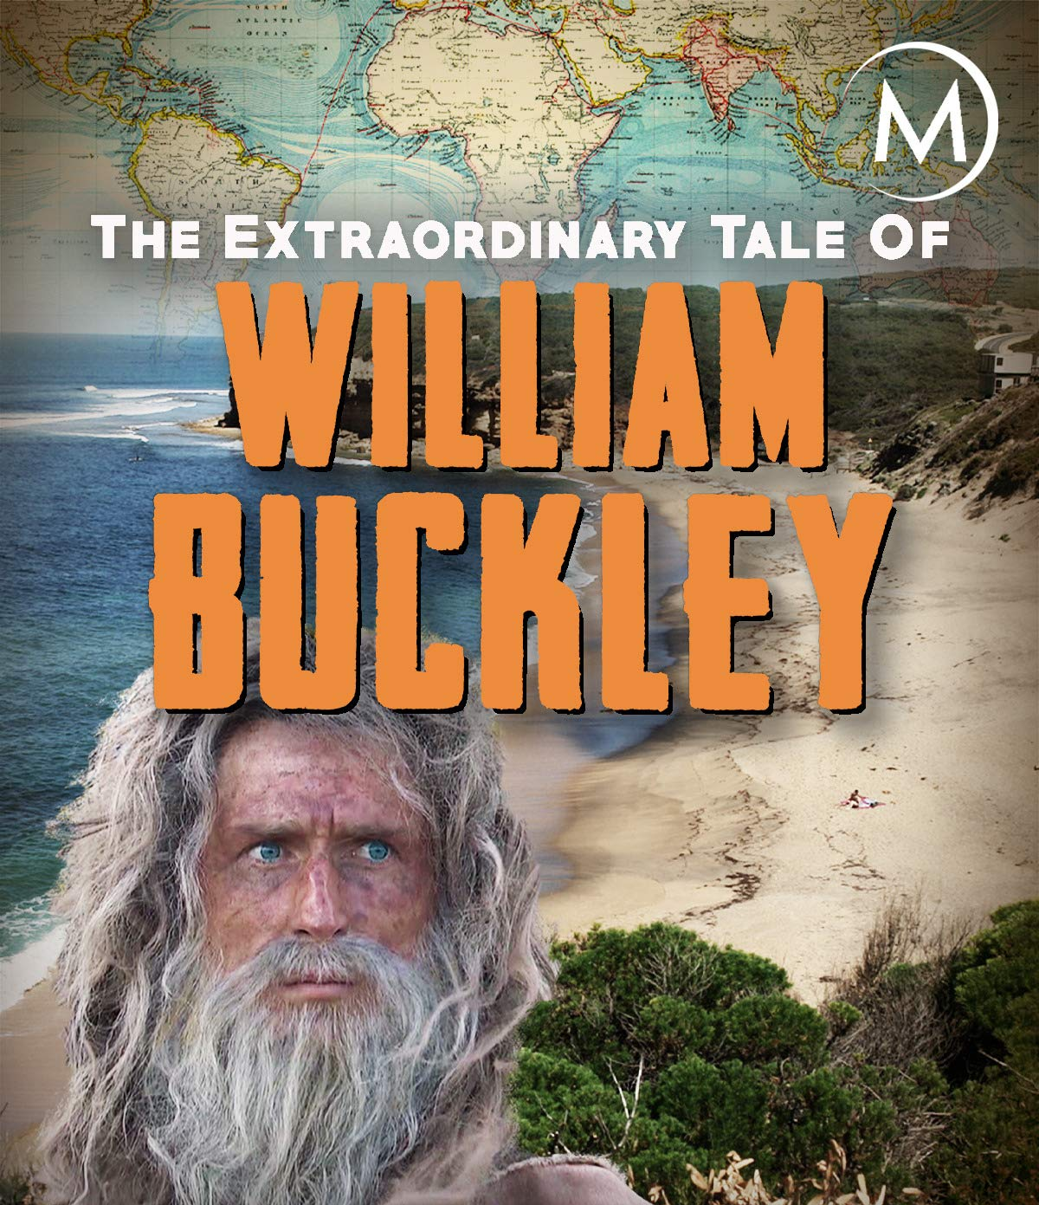
Buckley’s chance or
“Two chances, Buckley’s or none”
“You’ve got Buckley’s chance of finding your lost ring in that huge paddock.”
Meaning: no chance at all
Origin: William Buckley was a convict who escaped. The British officers thought he had no chance of surviving in the bush, so the saying: “he’s got Buckley’s chance” (i.e. no chance) was born.
Ironically, Buckley did survive! He lived with the Indigenous people for 32 years before returning to the colonies. He became famous for telling his story.

