Slide 1
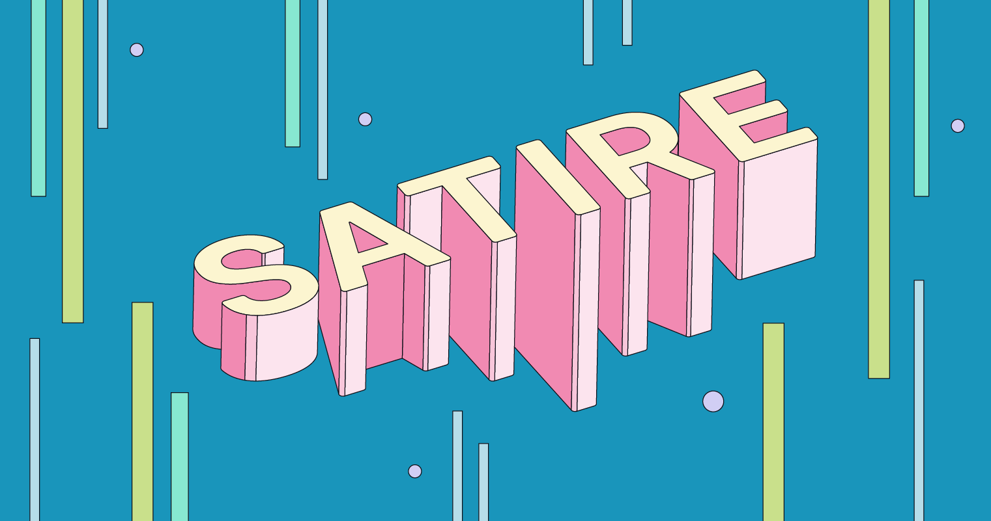

Slide 2
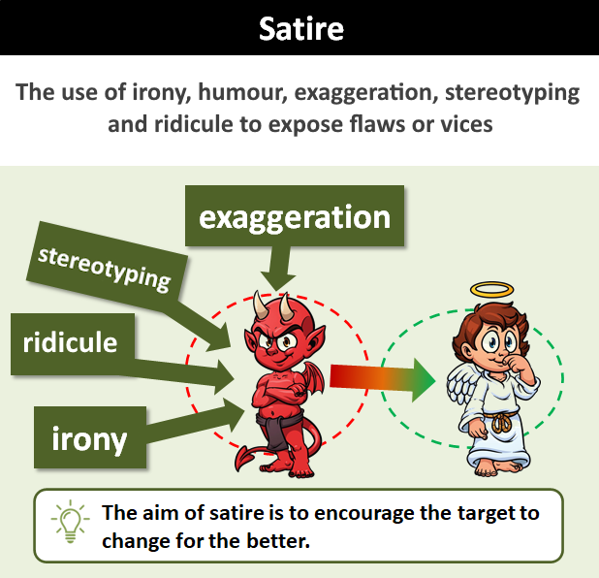
What is Satire?
The use of irony, humour, exaggeration, stereotyping and ridicule to expose and criticise people’s stupidity or vices, particularly in the context of politics and other current issues.
The aim of satire is to encourage people to examine any problematic views or behaviours they might have. Hopefully, to make them see it’s wrong, and change for the better!

Slide 3
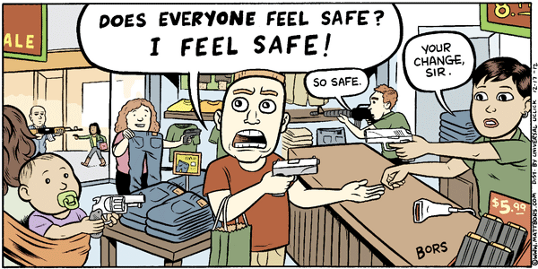
Purpose of Satire
Satire has two main purposes:
To entertain and make people laugh
To make people think/reflect
It’s true, this IS ridiculous!
Perhaps I need to change my views
Perhaps I need to change my behaviour
Satire is a form of social commentary. It is often used to highlight or draw attention to flaws or problems in institutions, people, or ideas. It points out behaviour or attitudes that are wrong or bad and need to change.

Slide 4
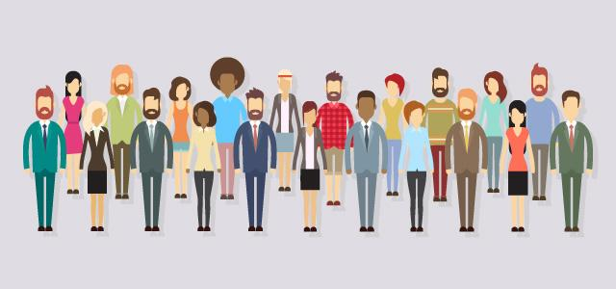
Stereotypes

Slide 5
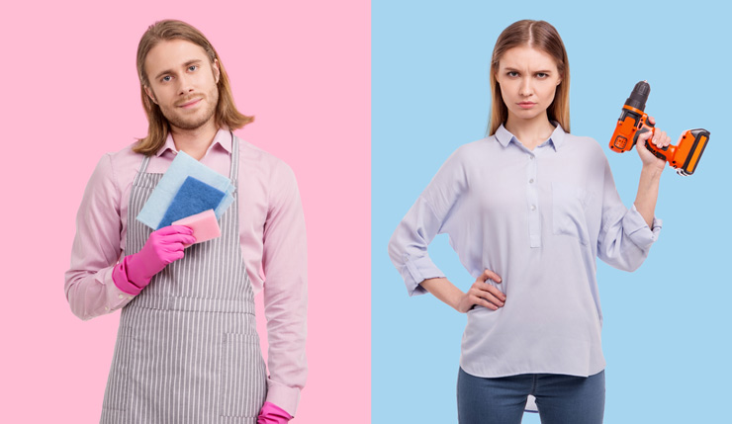
Stereotypes
Stereotypes are beliefs or assumptions about a particular group of people. They can involve various aspects such as race, ethnicity, gender, religion, nationality, age, occupation, or social class. Stereotypes can be both positive and negative.
Examples:
Elderly people are wise and experienced
Blondes are dumb
Women are nurturing and caring
Muslims are terrorists
Asians are good at maths

Slide 6
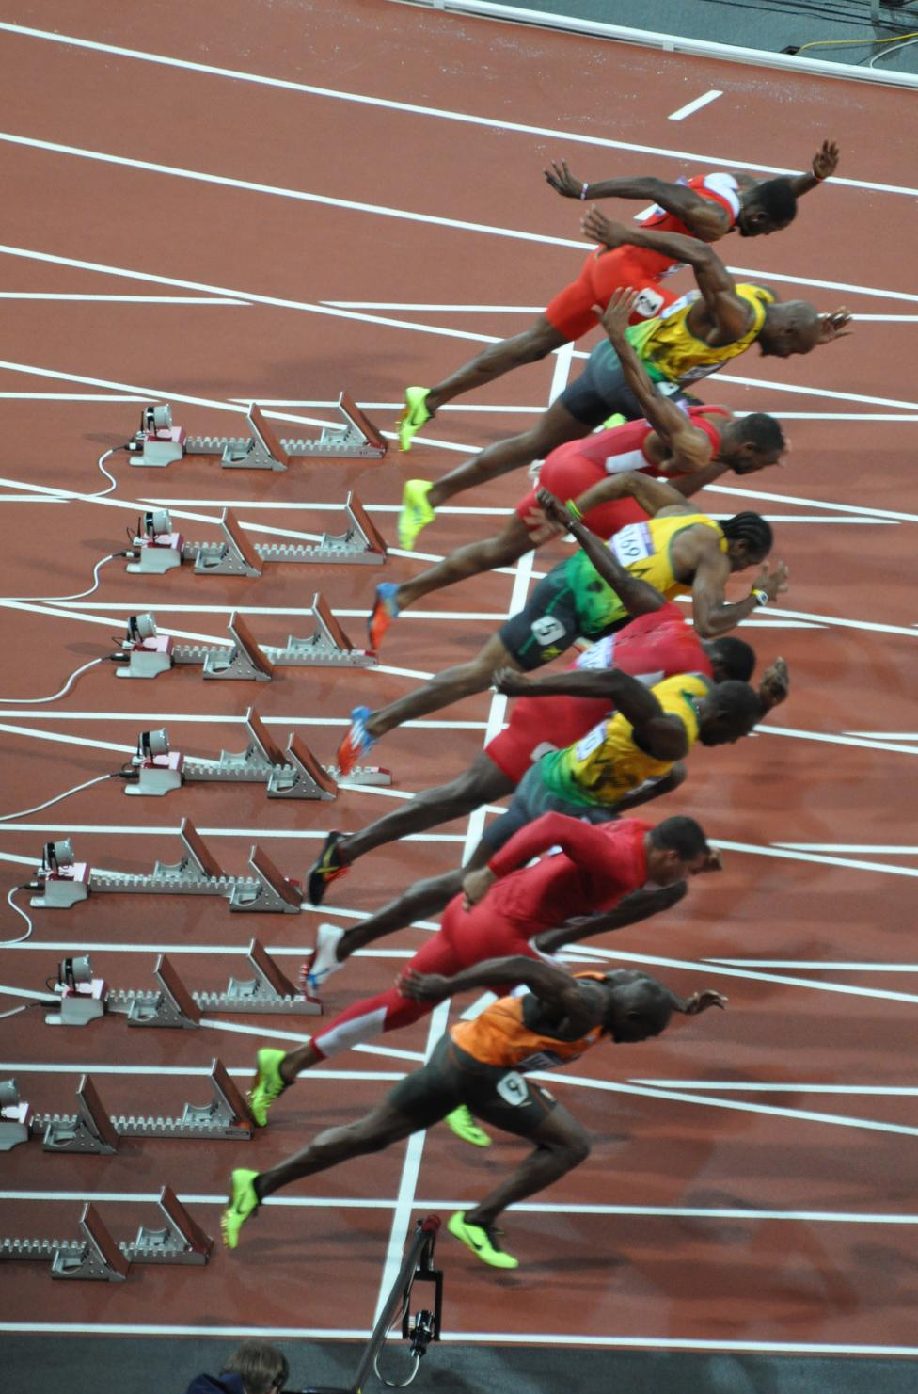
Why do stereotypes exist?
Some generalisations exist because data shows a majority occurs within a group. Humans like to generalise and lump things into simplified categories for easy reference.
Statistically speaking…
Most terrorists are male
Most social media users are teenagers
Most Italians are Catholic
Most Olympic sprinters are black
Despite this, it’s important to remember that generalising everyone based on the majority isn’t always useful or true.
Statistically speaking, women are better drivers. However, this doesn’t mean…
ALL women are good drivers & ALL men are bad drivers
A man can’t be a good driver and a woman can’t be a bad driver
Any random guy you meet is probably a bad driver
Etc

Slide 7
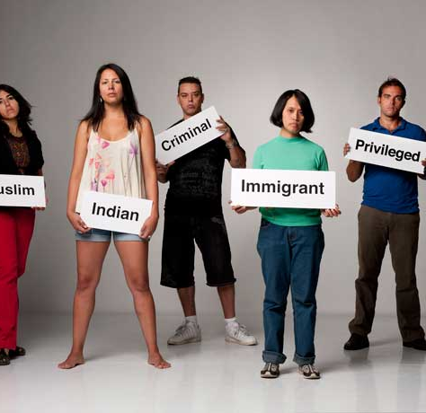
Harmful Stereotypes
Stereotypes don’t accurately represent the diversity and individuality that exists inside a group
People often base stereotypes on limited data. A single personal experience with one or two individuals can shape their idea of an entire country
Stereotyping can lead prejudice, discrimination, and unfair treatment of individuals based on their perceived group characteristics rather than their individual merits or qualities.
Even positive stereotypes can cause incorrect assumptions.

Slide 8
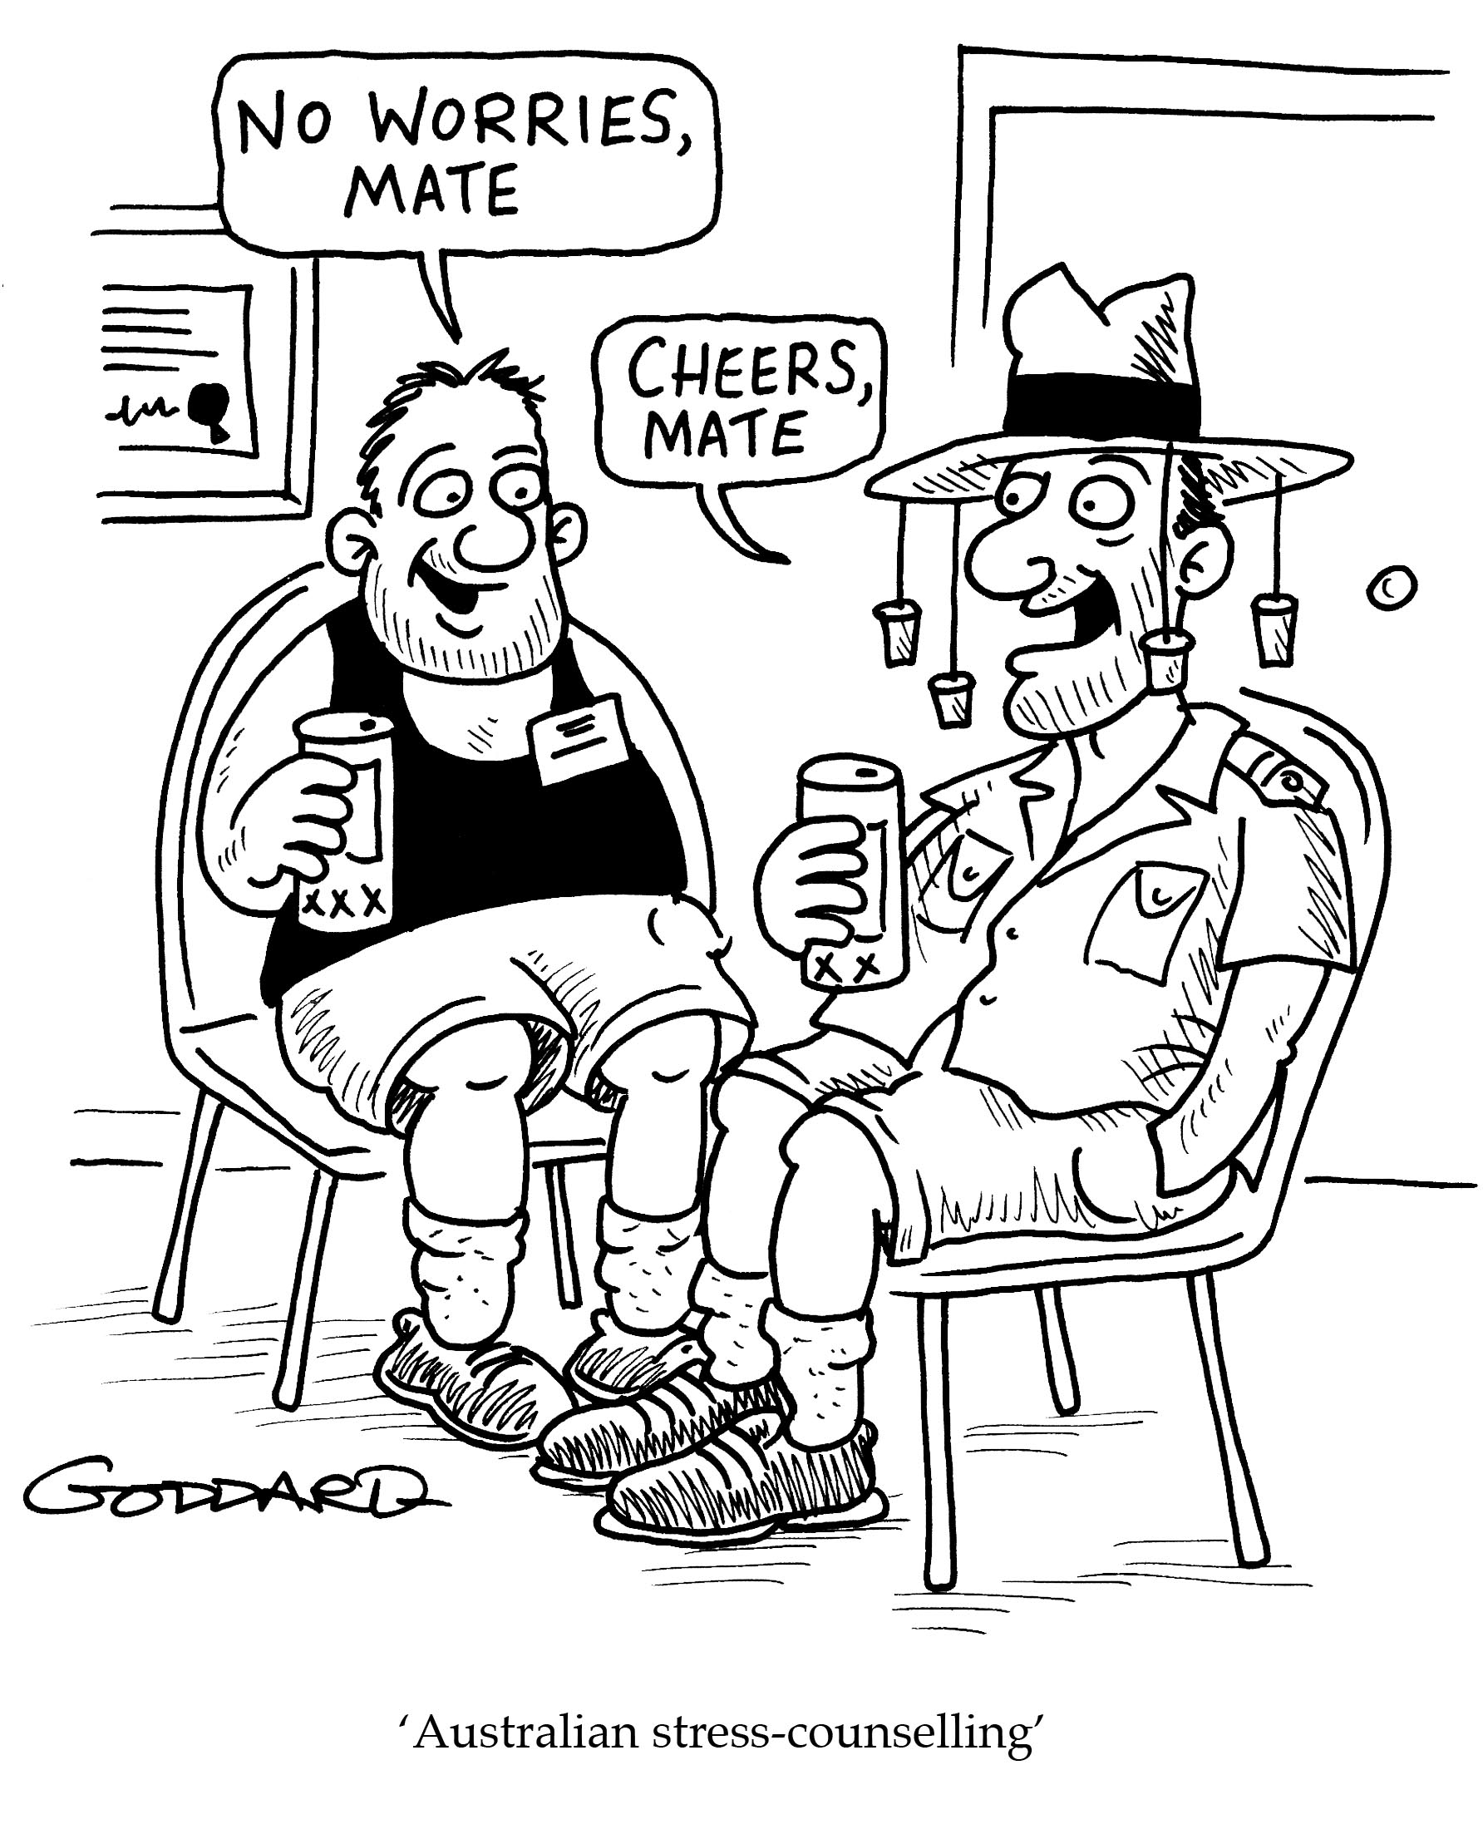
Stereotypes in Satire
Stereotypes can be used in satire as a tool to criticize or mock societal attitudes, prejudices, and assumptions.
Satire often uses exaggeration or subversion of stereotypes to expose the absurdity or flaws in them
Exaggeration – taking the stereotype to extremes to show why it’s ridiculous
E.g. an alarm goes off every 3 minutes in a British workplace to remind them all to drink another cup of tea
This challenges the stereotype that British people drink tea constantly
Subversion – reverse the stereotype to challenge people’s expectations.
E.g. the creator of an app that went viral and is making billions is revealed to be an old granny.
This challenges the stereotype that old people know nothing about technology

Slide 9
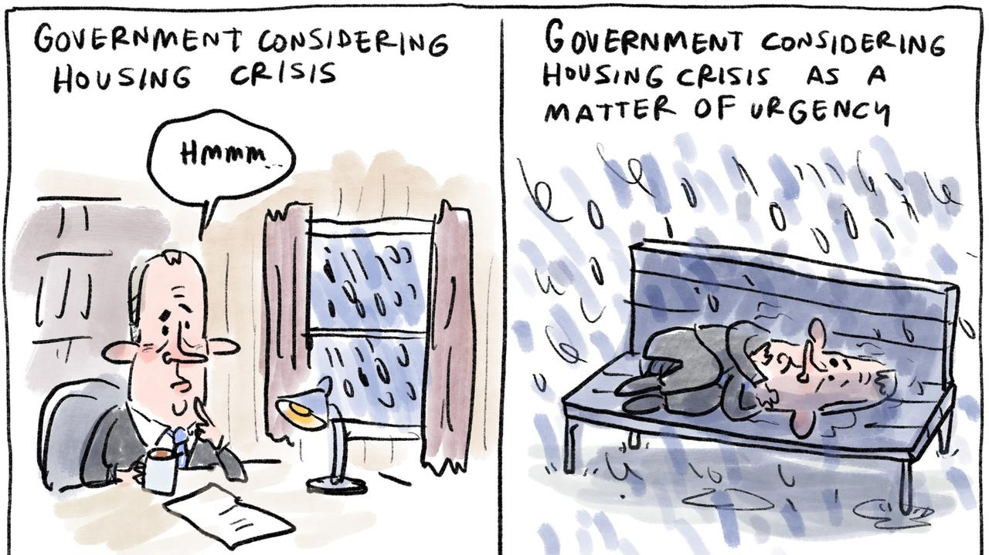
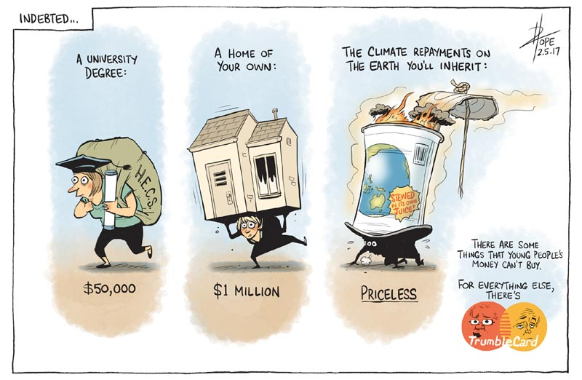
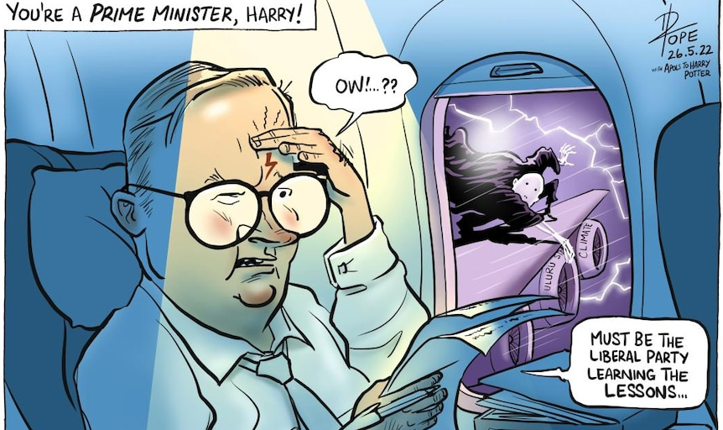
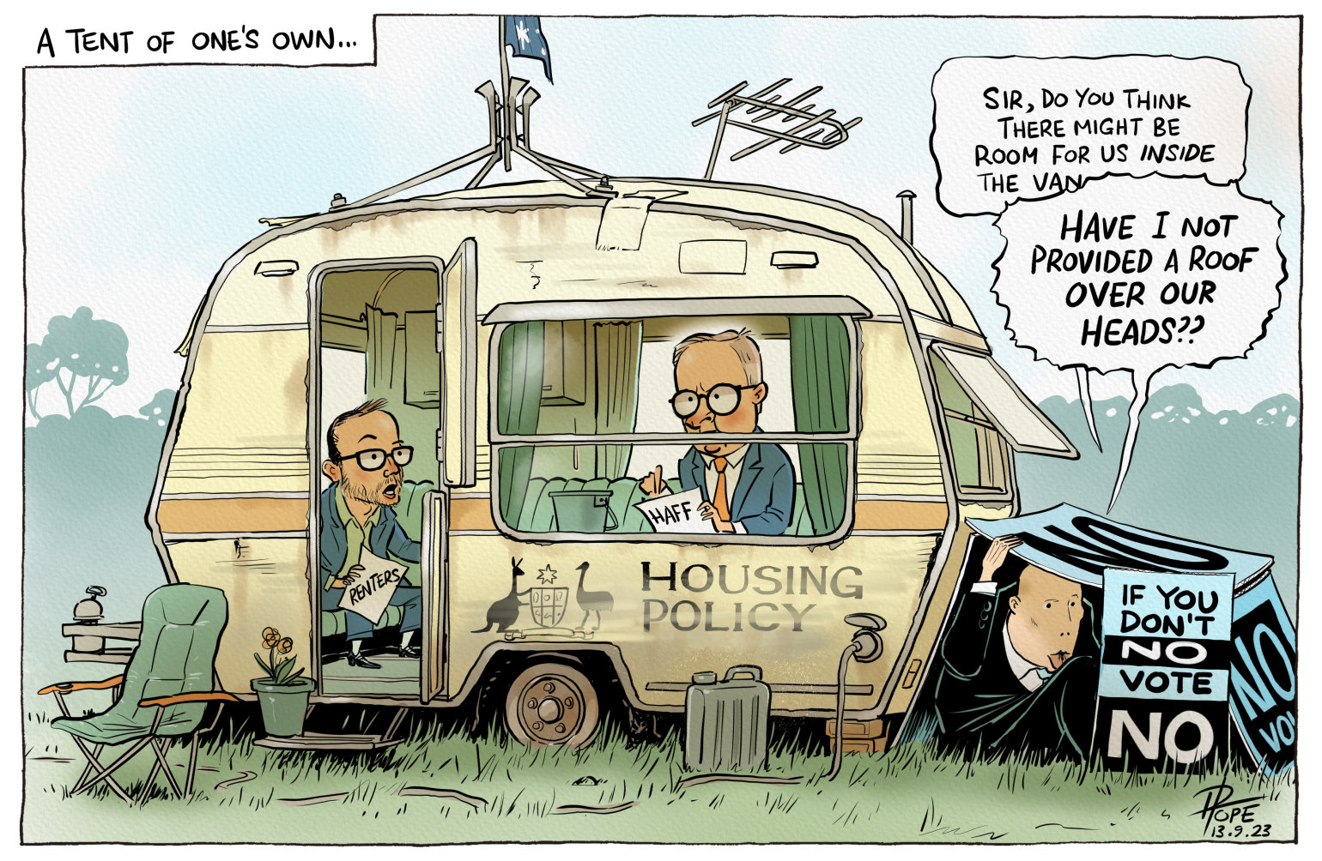
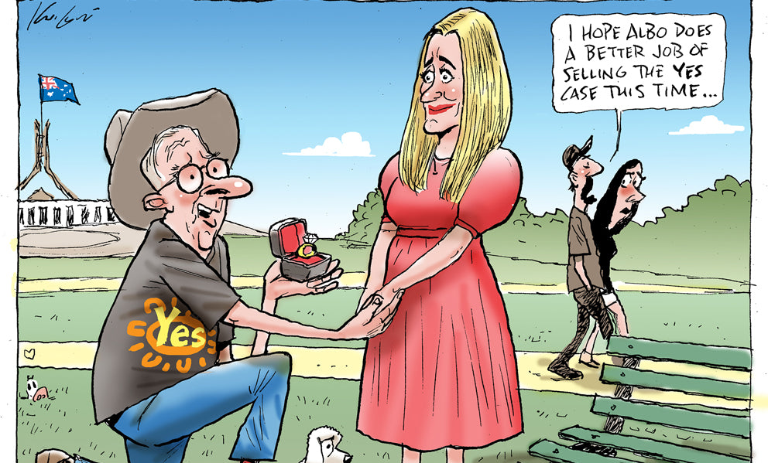
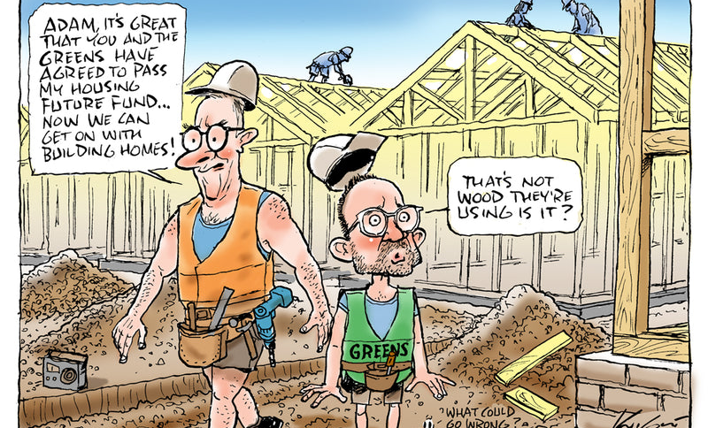
Satirical Cartoons
Political cartoons use satire (irony, stereotypes, ridicule & humour) to make a point about something that is wrong or silly and should change.

Slide 10
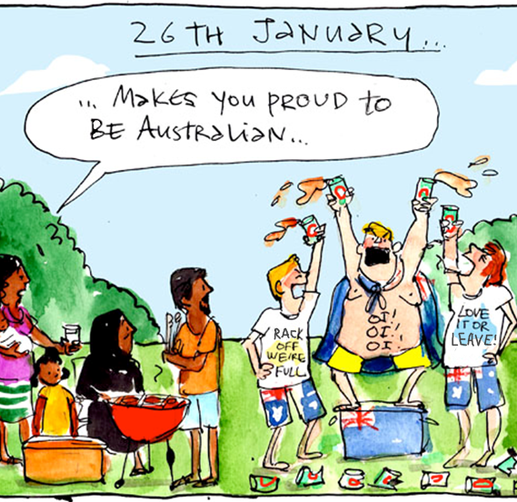
What are the issues being considered?
The way Australia Day is celebrated
The way immigrants are treated
What behaviour does the cartoonist think needs to change?
White Australians making immigrants feel unwelcome (perpetuating messages like the ones on their shirts).
Bad behaviour on Australia day under the guise of ‘patriotism’ e.g. drinking, rioting, littering
How does this comic use satire (irony, stereotypes, ridicule, humour)?
The T-shirt wearers are proud of being Australian and think it is an exclusive privilege or right that they don’t want anyone else to share. However, ironically, their own behaviour suggests that Australians aren’t very nice people.
The comic uses ridicule to contrast the toxic behaviour of the T-shirt wearers to the behaviour of the migrant family, suggesting that perhaps THEY are not the ones who should be unwelcome.

Slide 11
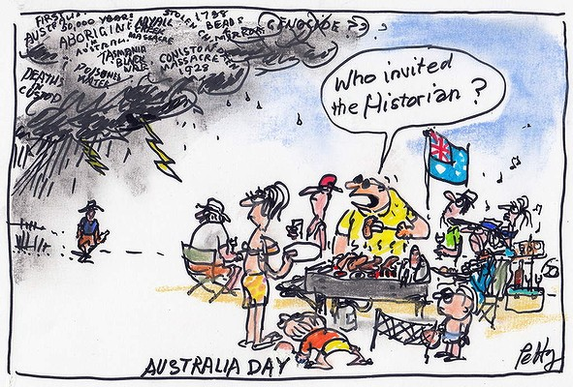
What are the issues being considered?
Australia Day & Indigenous Australians
Many Indigenous Australians consider it disrespectful to celebrate this date with parties & BBQs. For them, this date involved slaughtering their people & taking over their homeland.
What behaviour does the cartoonist think needs to change?
People who celebrate Australia Day should at least be willing to consider the historical associations of the date for Indigenous Australians
The people in the cartoon don’t want to be reminded of the past. They would rather ignore it and enjoy themselves. This shows a lack of respect.
How does this comic use satire (irony, stereotypes, ridicule, humour)?
The comic uses a stereotypical Australia Day BBQ, and exaggeration of the big looming black cloud of Indigenous problems. It ridicules the comment “who invited the historian?” which implies Australians are wilfully ignorant and deliberately sticking their heads in the sand.

Slide 12
Activity
Do the worksheet – questions on stereotypes & satire
Can discuss answers in groups, but must submit answers individually in your own words.
Put your answers on a word doc & email it to me when finished
This activity IS for marks

