Slide 1
One Duck Two Duck
By Dr.Sus
Aaron, hunter, Harley

Slide 2
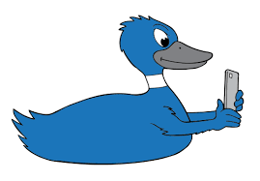
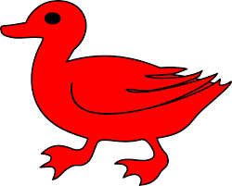
One duck, two duck, red duck, blue duck new duck, old duck, black duck, white duck

Slide 3
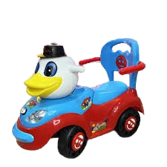
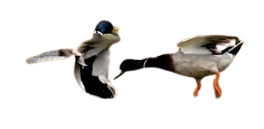
this duck’s drinking at a bar and this one has a little car, oh my what a lot of ducks there are. Some are sad, and some are mad, but most these ducks are glad. This ones very very bad, why are all these ducks sad and mad and glad, how the hell should I know, go and ask your dad.

Slide 4
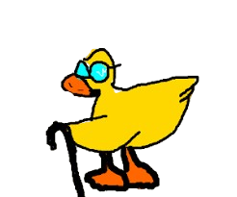
Some are thin and some are thick This thick one is looking very slick From here to there, from there to here, silly ducks are everywhere

Slide 5
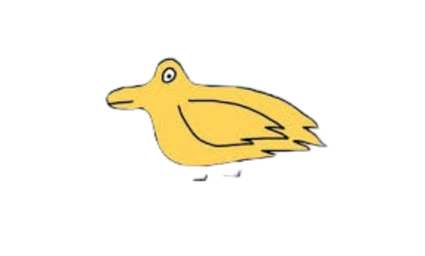
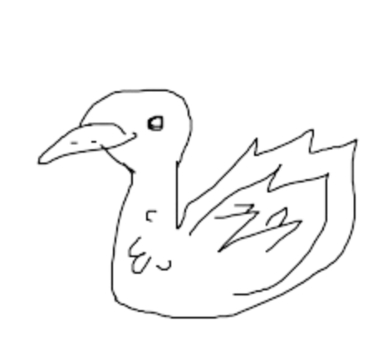
Some ducks have two feet, and some have four, some have eight feet and some have more. Where do they all come from? I can not say but I bet they’ve come from far far away

Slide 6
Oh my, oh my what a bunch of silly ducks go by
we see them come we see them go
Some are fast, and some are slow, some are high, and some are in Bordeaux (board-dough).

Slide 7
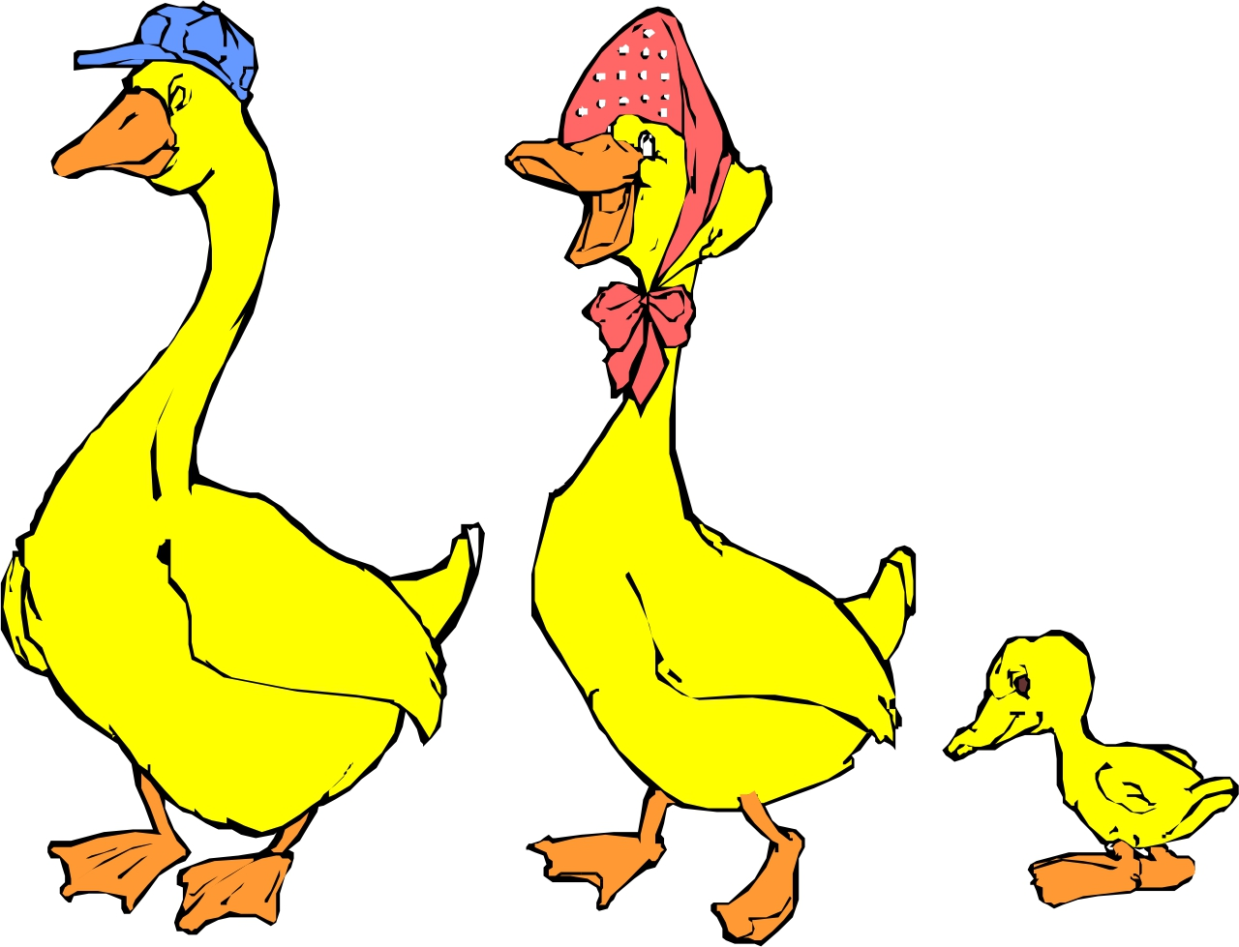
Not one of them is like another
wanna know why
Don’t ask us why
go ask your mother

Slide 8
Thump!
Thump! Thump!
Do you want to ride on the sklump?
We have a sklump
With just one hump
But we know a man
Called Mr Trump
Mr. Trump has a seven humped sklump.
So…
If you like to go bump bump
Just jump on the hump of the sklump belonging to Trump

Slide 9
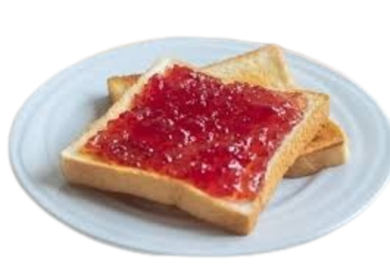
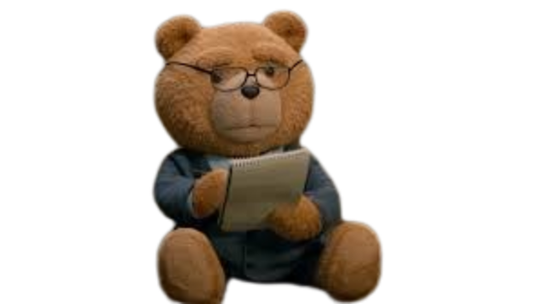
Who’s this
His name is ted
ted does not like his bread
This is no good
this is not right
Ted couldn’t spread his jam on his bread
And when ted doesn’t spread
oh dear
teds bread tastes dead

Slide 10
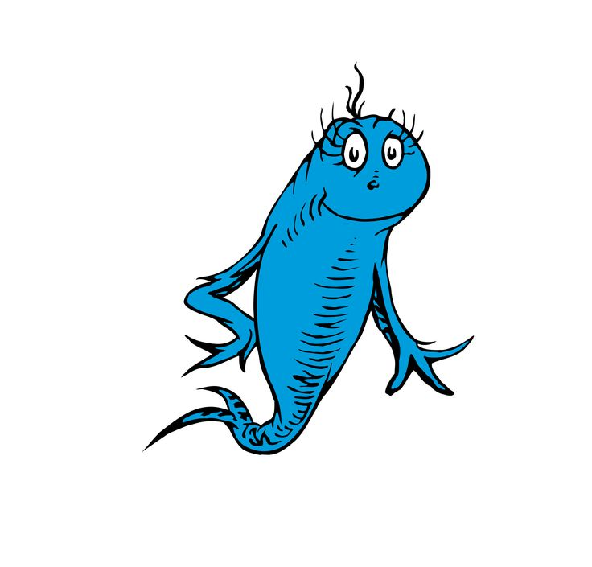
Oh dear, oh dear
I cannot hear
will you please come over here
can you please take a peek in my ear
I think there's a puppeteer in my ear
say look
a nerd was in your ear
but he is out so have no fear
Again your ear can hear, my dear.

Slide 11
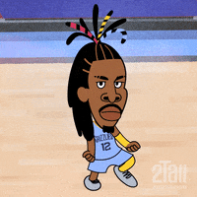
bill is bold
Ja Morants grill is gold
he has a teddy
that he likes to hold
my shoe is off
my foot is cold
and now my story is all told

Slide 12
We took a look
we saw captain cook
on his head he had a hook
he rode around on his little tuktuk
We took a look and saw captain cook trying to cook in his tuktuk
Now captain cook could not cook for he forgot to read the cook book
so captain cook, he took a sook and ran away
Far from here with nothing to say

Slide 13
This guys called drake, he has a snake and Drake’s snake lives in a lake
The snake wanted to make Drake a lovely steak
After Drake finished his steak
his stomach started to ache
Drake loved his snake
so Drake named his snake Jake.

