Slide 1
Paraphrasing, Summarising & Quoting

Slide 2
Quotation
Example:
Evidence suggests that the Australian landscape was “skilfully managed and shaped” (Reynolds, 2000) by the Aboriginal people through the use of fire.
Exactly the same as the original. Matches the source word for word
Short – max 100 words
Use quotation marks to show they’re someone else’s words
Must be referenced
Date & author name in brackets immediately afterwards
Source listed in bibliography
Quotation marks around the words that are exactly the same
Author last name, year & page number (if there is one), in brackets straight after
Quotation

Slide 3
Paraphrase
Example:
Reynolds (2000) suggests that the Australian landscape was carefully controlled by the Aboriginal people through the use of fire.
In your own words – should NOT use any of the exact same phrases or the exact same words
Contains most or all of the same information
STILL should be referenced
Date in brackets after author name
Source listed in bibliography
Last name of person whose ideas you are explaining
Year & page number (if there is one), in brackets straight after

Slide 4
Summary
Example:
The Aboriginal people managed the landscape (Reynolds 2000).
In your own words – should NOT use any of the exact same phrases or the exact same words
Contains only the key points of the source information
Usually much shorter than original
STILL should be referenced
Date in brackets after author name
Source listed in bibliography
Last name of person whose ideas you are explaining
Year & page number (if there is one), in brackets straight after

Slide 5
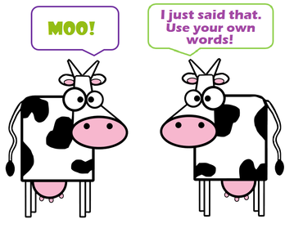
Putting it Into your Own Words
Paraphrasing & Summarising:
how to

Slide 6
Step 1: Understand
Read through the text a couple times
Look up any difficult words
If you can’t figure out what it means, it might be too complicated for this assignment – skip
Pay particular attention to the first sentences in paragraphs (often the ‘topic sentence’ that contains the main idea)

Slide 7
Step 2: Repeat from memory
Cover the text and verbally summarise it from memory.
Imagine you’re explaining to someone else what it means.
Think of the words YOU would use to describe it. It’s ok if these aren’t big words and it doesn’t sound as ‘academic’.

Slide 8
Step 3: Re-write
Write down your verbal explanation.
If possible, don’t look at the original while writing your version – will make it too similar

Slide 9
Step 4: Check & Compare
Check the original text again to make sure you have included the key points.
Make sure it’s not too similar.
Add quotation marks if you have used any key phrases or unique terms.

Slide 10
How to Summarise
Finding Key Points

Slide 11
Step 1: Understand
(This part is the same as paraphrasing)
Read through carefully
Look up any unfamiliar words
Ask for help if too complicated

Slide 12
Step 2: Find & List Key Points
Some paragraphs contain a topic sentence that expresses the main idea of that paragraph. This is often (but not always) the first sentence.
If there’s no clear topic sentence, identify the topic of the paragraph and ask ‘what is this paragraph saying about the topic?’
In longer texts, look for introduction & conclusion paragraphs, headings or subheadings
Highlight or list key points in dot point form

Slide 13
Example 1
Tea is an international drink. It was discovered in China in 2737 BC, and became popular in Japan about three thousand years later. In the 1600s, England tasted tea for the first time. Today, people in Russia, Saudi Arabia, South Africa and India all regularly consume tea. It is considered by some estimations to be the world's favourite beverage.
Is there a topic sentence?
Tea is an international drink.

Slide 14
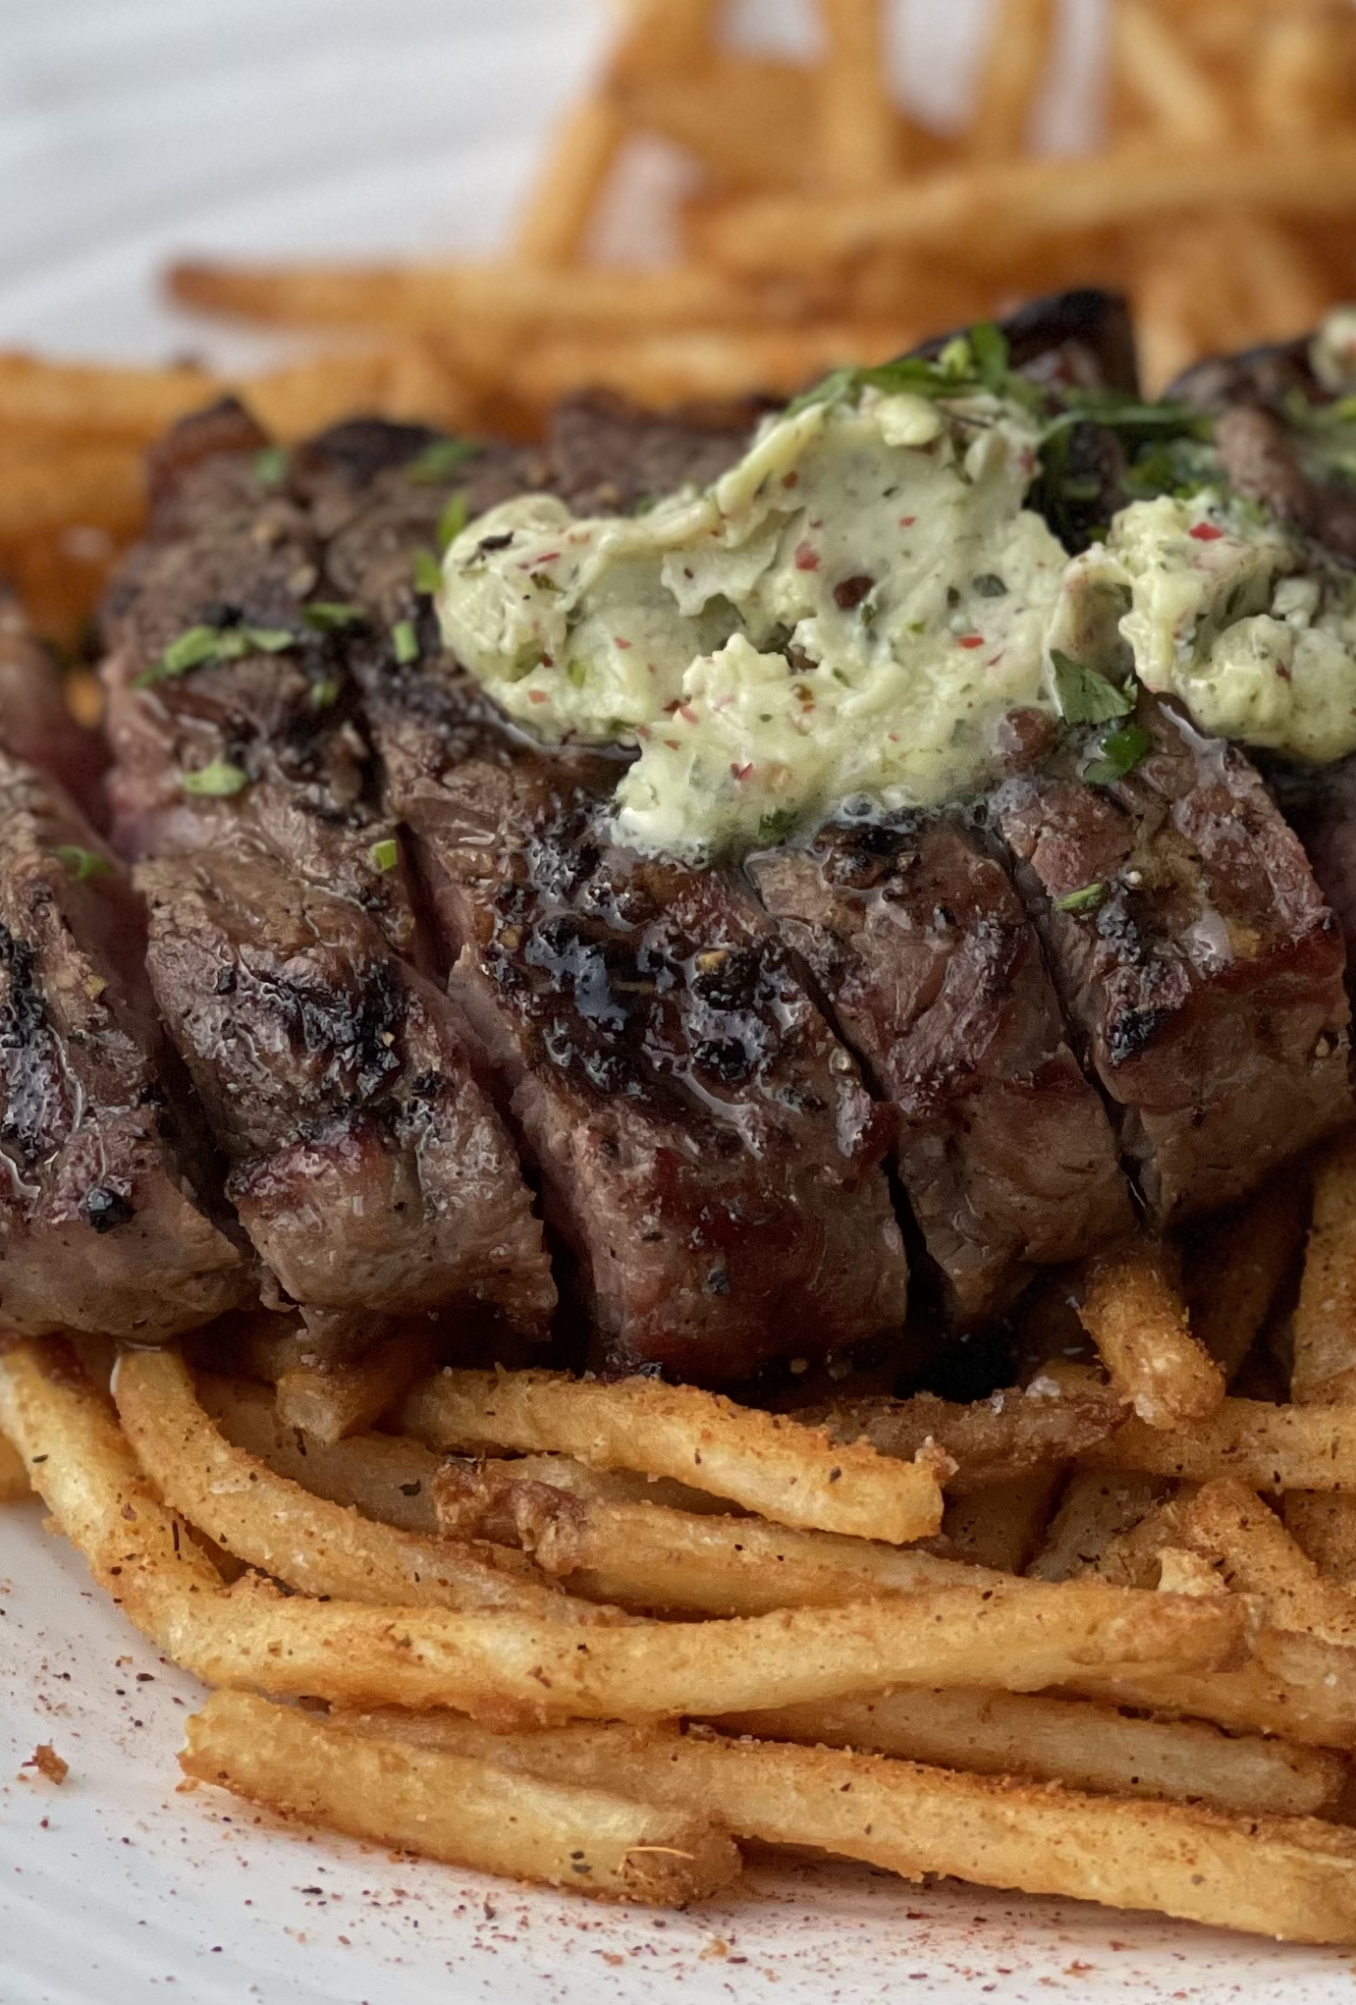
Example 2
For most Australians, meat is the main component of any meal. But research has consistently shown that the meat industry has a significant environmental impact. Cattle farming alone is responsible for a large proportion of greenhouse gas emissions. Producing a kilogram of beef emits 60 kilograms of greenhouse gases and requires over 900 gallons of water. While beef clearly has the most dramatic footprint, other animal products also have serious impacts in terms of emissions, water and land use.
Is there a topic sentence?
The meat industry has a significant environmental impact.

Slide 15
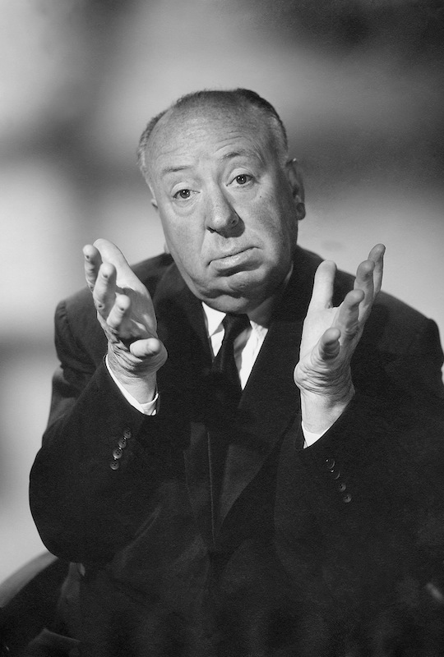
Example 3
Alfred Hitchcock was a man with a vivid imagination, strong creative skills and a passion for life. With his unique style and razor-sharp wit, he produced and directed some of the most thrilling films that had the audience almost swooning with fright and falling off their seats with laughter.
1. What is the topic?
Alfred Hitchcock
2. What is this paragraph saying about the topic?
He was a great film maker

Slide 16
Step 3: Ignore unnecessary information
Don’t include examples
Mineral ores like iron or copper can be mined with explosives such as dynamite
Don’t include anecdotes or background info
Mountain biking is a dangerous sport. Billy, aged 13, broke both his collarbone and jawbone, resulting in expensive dental work and permanent loss of movement.
Don’t include extra detail or description
Tea, whether of the Chinese or Indian variety, is well known to be high in antioxidants

Slide 17
Step 4: Re-write
From your dot points or notes, re-write the summary in full sentences
As with paraphrasing:
Use your own words, as though explaining to a friend
Keep language simple and straightforward
Don’t look at original to avoid sounding too similar
Don’t OVER summarize!
A three-word summary of a page of text is too short.
Needs to include the main points as well as just the overall topic

Slide 18
Step 5: Check and compare
Check the original text again to make sure you have included the key points.
Make sure it’s not too similar.
Add quotation marks if you have used any unique terms.
Record all source and author details for future reference.

