Slide 1
Essays A Quick Review
Structure, PEEL paragraphs, using evidence, academic language

Slide 2
Formal Academic Language
NO
YES
Contractions
don’t, can’t
Personal pronouns
I, me, you
Slang
really cool
Figurative language:
He finally saw the light
Opinions
I think this is bad
Waffle
as has already been discussed in the previous paragraph
“In this essay I will”
Wrong in TWO WAYS (waffle & pronouns)
Proofread
Billie Jo not billy joe
Correct terminology
In the novel… in the poem titled… the author’s… Hesse’s…
Specific
Another example is when Billie Jo says…
There are many other examples.
Dense & concise
Overcropping led to soil degradation.
When people planted too many crops, they degraded the quality of the soil.
Nominalise
her bravery not she was brave
Quotations
Hesse uses figurative language describe voices rising “like ghosts on the howling wind” (Hesse 1999, pg. 143)

Slide 3
Structure
INTRODUCTION:
Hook (get the reader’s attention),
background information about the topic generally,
thesis statement (brief summary of your 3 main points)
BODY:
3+ PEEL paragraphs
CONCLUSION:
Re-state your thesis (3 main points)
finish with a takeaway message, lesson for us, or final thought about the topic.

Slide 4
Introduction
(Optional) Hook:
Grab the reader’s attention with an interesting quote, statement or rhetorical question.
Background/Orientation:
Explain to the reader what you’re talking about – who, what, when, where, why?
For a novel essay, you should probably mention the title and author of the novel, perhaps when it’s set or when it was written, and sum up (BRIEFLY, 4-5 words) what happens in it
Thesis statement:
BRIEFLY outline your 3 main points – don’t go into too much detail or start explaining them
Make sure you’ve answered the essay question.
E.g. HOW does the relationship between Billie Jo and Arley Wanderdale change throughout the novel?
HOW does Arley treat Billie Jo BEFORE and AFTER her accident?
TO WHAT EXTENT was Mad Dog’s positive influence orchestrated by Arley?

Slide 5
Example Introduction Paragraph
Question: Examine the significance of music in Billie Jo's life. How do her feelings about playing the piano change over the course of the novel and how does music provide her with comfort and a sense of identity?
Hook: Music can be the difference between hope and despair.
Background: In Karen Hesse’s novel "Out of the Dust," the protagonist Billie Jo Kelby finds herself navigating personal tragedy during the environmental devastation of the Dust Bowl era.
Thesis Statement: Music, particularly playing the piano, is a lifeline to Billie Jo. Initially, it is a source of joy and family bonding, but when a terrible accident strikes, Billie Jo's relationship with music becomes complicated. As she navigates the depths of grief, she discovers resilience, and ultimately, reclaims her sense of self through music. Through her playing, Billie Jo finds a connection to her mother, which ultimately aids in her journey toward healing and self-discovery.

Slide 6
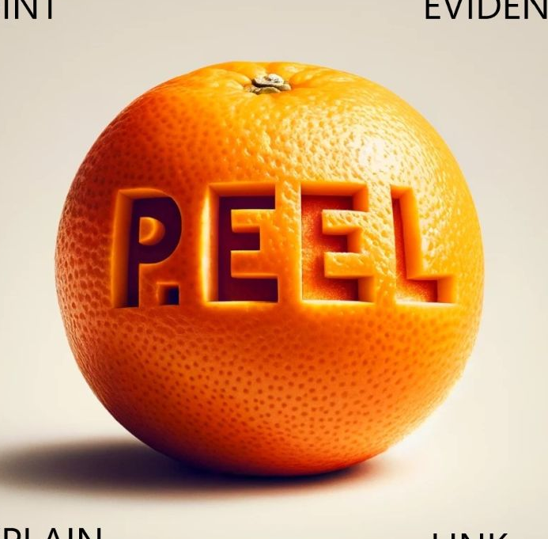
Body Paragraphs (PEEL)
POINT
one main point that answers the essay question.
EVIDENCE
a quote from the novel that is an example of this.
ELABORATE
what this means, how this proves your point.
(Optional) Extra EE
repeat step 2&3 – use another quote & explain what it means.
LINK
connect back to overall thesis OR lead on to next main point

Slide 7
Example Body Paragraph
Question: Examine the significance of music in Billie Jo's life. How do her feelings about playing the piano change over the course of the novel and how does music provide her with comfort and a sense of identity?
Point: Music offers Billie Jo a profound sense of comfort amidst the turmoil and grief she faces, particularly because it reconnects her with her mother.
Evidence: In the poem ‘The Dream’ in Summer 1935, Billie compares the piano to her mother: "Piano, my silent mother… willing to stay with me, talk to me. Uncomplaining." (Hesse 1999, pg. 193).
Explanation: This highlights the deep emotional connection Billie Jo has with the piano and, by extension, her mother. The piano symbolizes the bond she shared with her Ma, who taught her to play, and serves as a tangible reminder of happier times. By continuing to play despite the physical and emotional pain, Billie Jo seeks solace and a way to keep her mother's memory alive. The act of playing becomes a therapeutic outlet, allowing her to process her grief and find a measure of peace in the middle of her suffering.
Link: The connection that Billie Jo makes between her mother and the piano highlights the crucial role that the piano plays in her journey toward healing.

Slide 8
Conclusion
Re-state thesis
Briefly outline the 3 main points you’ve made, answering the essay question
Try and rephrase it – don’t use the exact same words as
Concluding Thought
Finish up with a takeaway message, lesson for us, or final thought about the topic.

Slide 9
Example Conclusion Paragraph
Question: Examine the significance of music in Billie Jo's life. How do her feelings about playing the piano change over the course of the novel and how does music provide her with comfort and a sense of identity?
Re-state thesis: Music and piano playing are crucial aspects of Billie Jo's life. Throughout the novel, her feelings about it change as she faces personal loss and grief as well as the hardships of the Dust Bowl era. Initially it is a source of joy and emotional release, but it becomes a bitter symbol of all she has lost when her burned hands make it painful and difficult to play. Eventually, she uses music as a tool for healing and self-reconstruction. The changing role of the piano in her life highlights its importance as both a source of comfort in times of need, and a foundation for her identity.
Concluding thought: Through its ability to heal, connect, and inspire, music serves as a powerful reminder of the resilience and enduring human spirit even in the face of adversity.

Slide 10
Using evidence from the novel
Keep quotes short – less than 100 words
Use the EXACT words, spelling, and punctuation from the original.
Use quotation marks around quoted sections. No need to use italics or indentations.
e.g. “It almost rained Saturday.” (Hesse 1999, pg. 88)
After a quote, put the following information in brackets: the author’s last name, the year this edition of the book was published, and the page number
e.g. “President Roosevelt tells us to plant trees.” (Hesse 1999, p. 75)
Use an ellipsis (3 dots) to indicate sections left out of a quotation:
“The price of wheat kept dropping… the drier things got” (Hesse 1999, p. 84)
Try and work quotations smoothly into your sentences.
Hesse uses figurative language to vividly describe a look “as foul as maggoty stew” (Hesse 1999, pg. 29) and voices rising “like ghosts on the howling wind” (pg. 143)

