Slide 1
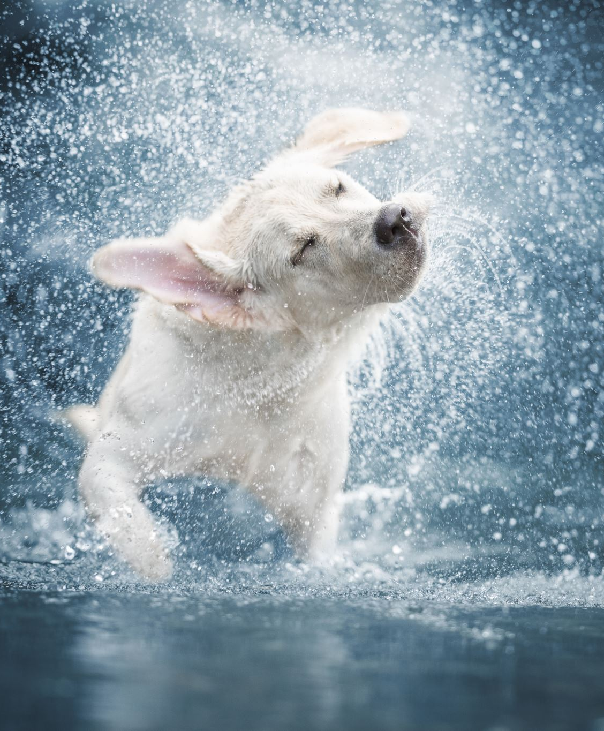
Year 9 Vocab
Term 1, Week 8

Slide 2
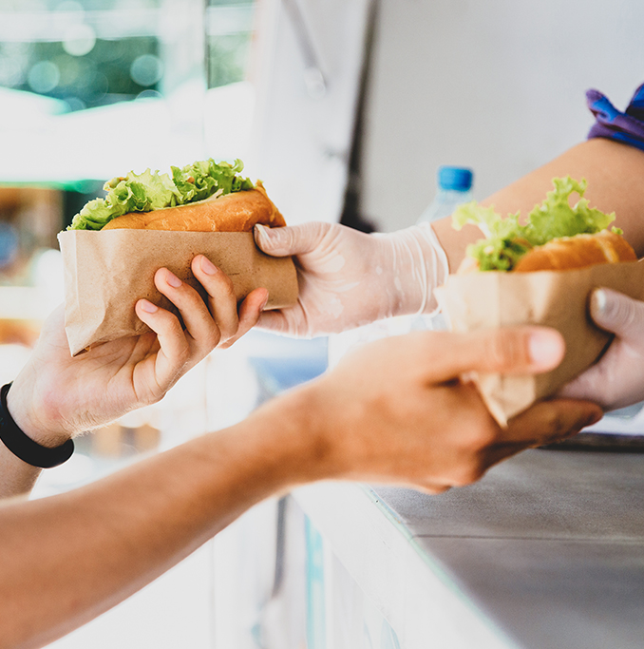
Acquiesce
Part of speech: verb
Meaning: to accept something reluctantly but without protest.
I don’t really want to go to that outing, but I might acquiesce if there’s free food.

Slide 3
Preposterous
Part of speech: adjective
Meaning: absurd or ridiculous; without reason or common sense
I know you’re a fast runner, but it’s preposterous to think you could catch that car on foot.

Slide 4
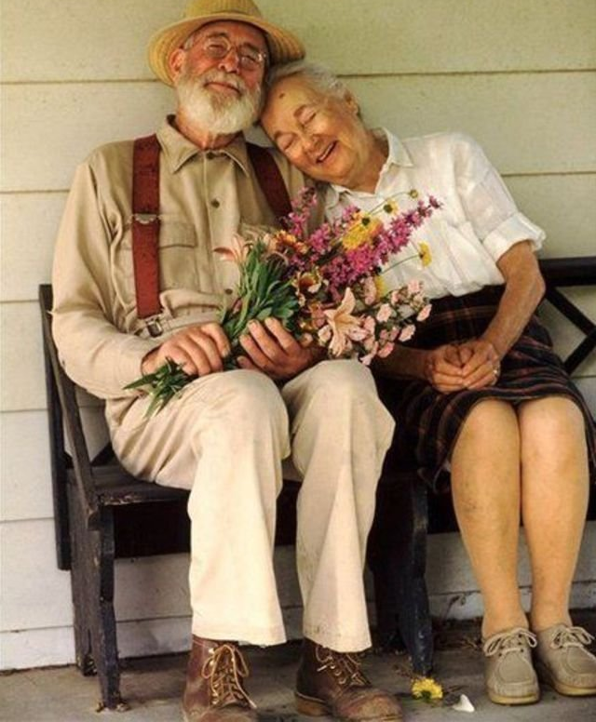
Amity
Part of speech: noun
Meaning: peace, harmony; friendship between people or countries
Fred had lived for 60 years in perfect amity with his wife.
The ambassador was able to negotiate a treaty of amity between the two nations.

Slide 5
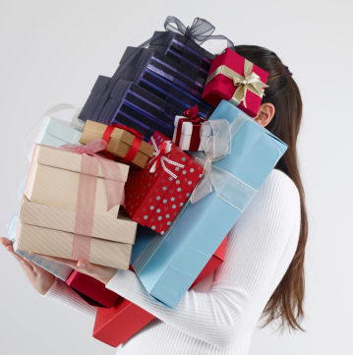
Inundate
Part of speech: verb
Meaning: to flood or overwhelm
On her birthday, she expected people to inundate her with gifts.
We’ve been inundated with complaints since we painted over that mural.

Slide 6
Arduous
Part of speech: adjective
Meaning: difficult and tiring
It was an arduous climb, but it was worth it for the view.

Slide 7
Incongruous
Part of speech: adjective
Meaning: out of place; strange or wrong in a particular situation
It seems incongruous to eat dessert before main course.
There’s one incongruous tile on our bathroom floor.

Slide 8
Trepidation
Part of speech: noun
Meaning: a feeling of fear or anxiety about something that may happen
The number of recent burglaries in my neighbourhood fills me with trepidation – our house could be next!

Slide 9
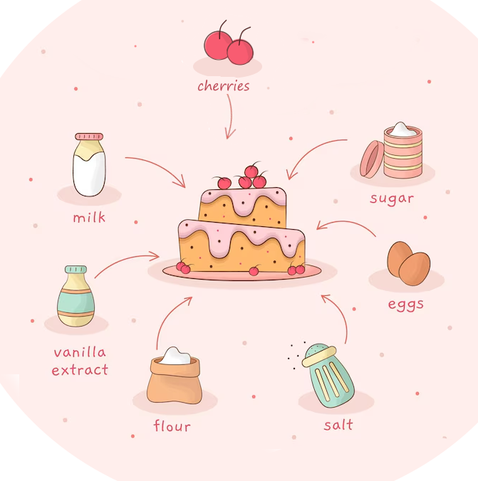
Synthesise
Part of speech: verb
Meaning: to combine ideas or information from different sources, including what you already know, to create a new idea.
Students should synthesise the data they have gathered in their report.
I was asked to synthesise the ideas from the meeting into a mission statement.

Slide 10
Voluble
Part of speech: adjective
Meaning: talking a lot, with confidence and enthusiasm
I thought he was quiet when I first met him, but he’s voluble when he’s with his friends.

Slide 11
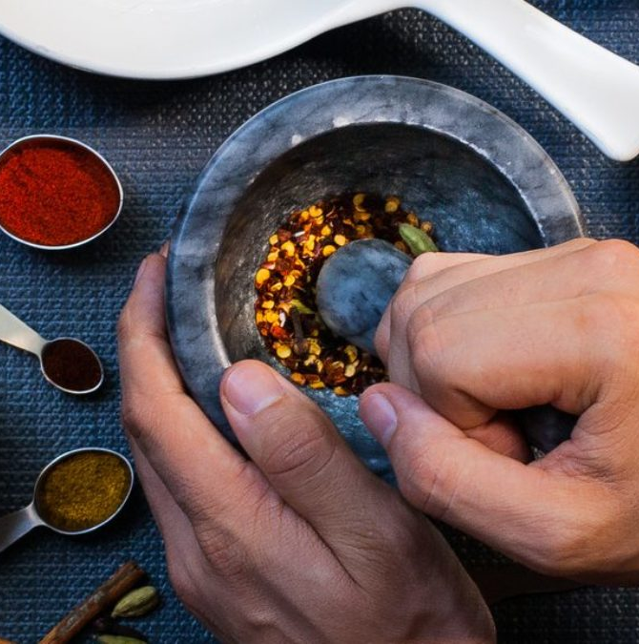
Pulverise
Part of speech: verb
Meaning: to grind into powder; to utterly defeat
I think the team will pulverise their opponents in the next match.
Using a pestle and mortar, pulverise the dried chilli flakes.

