Slide 1
Year 9 Vocab
Term 2, Week 4

Slide 2
Deposition
Part of speech: noun
Meaning: a statement or testimony made in court, under oath
The witness gave a deposition about what she had seen that night.

Slide 3
Laconic
Part of speech: adjective
Meaning: using a minimum of words; concise
When I ask Ben about his day, I usually get a laconic reply like “Fine.”

Slide 4
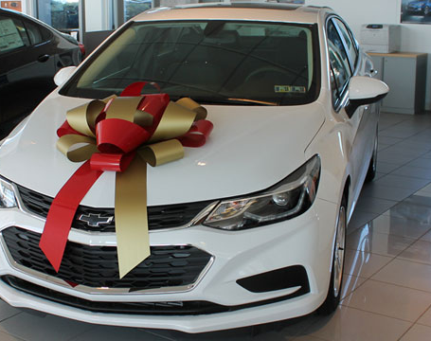
Depreciate
Part of speech: verb
Meaning: to decrease in price or value over time
A brand-new car starts to depreciate the moment you drive it away from the dealership.

Slide 5
Disdain
Part of speech: noun
Meaning: a feeling of scorn or contempt for something worthless
My dog gave me a look of disdain when I offered him some broccoli.

Slide 6
Discursive
Part of speech: adjective
Meaning: moving from topic to topic without any order; rambling
She has such a discursive way of speaking that I can never understand what she’s on about.

Slide 7
Wry
Part of speech: adjective
Meaning: showing mocking, grim, or sarcastic humour
When the marquee collapsed on the bride and groom, he gave a wry smile.

Slide 8
Oxymoron
Part of speech: noun
Meaning: a figure of speech that combines two opposite or contradicting ideas.
The phrase “a deafening silence” is an oxymoron.
You can’t say she made a deliberate mistake, that’s an oxymoron!

Slide 9
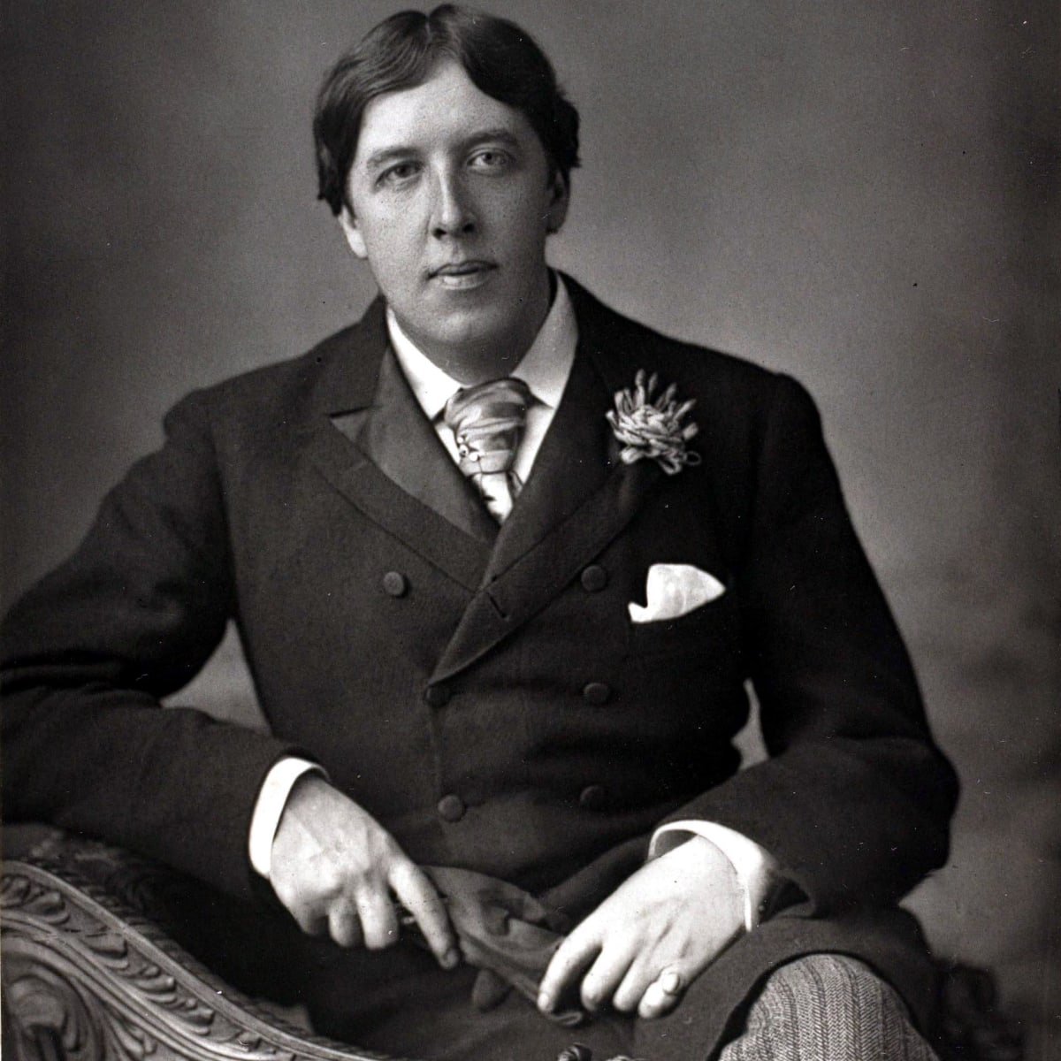
Epigram
Part of speech: noun
Meaning: a witty saying; an idea expressed in a clever or amusing way.
The writer Oscar Wilde was known for epigrams such as “I can resist everything except temptation.”

Slide 10
Redundant
Part of speech: adjective
Meaning: not needed or useful; unnecessary, surplus to requirements
ATM stands for Automatic Teller Machine, so calling it an “ATM machine” is redundant.
My dad was made redundant last week.

Slide 11
Veracity
Part of speech: noun
Meaning: truth or accuracy
The penguin doubted the veracity of the suspect’s claim.

