Slide 1


Idioms
Year 8 Vocab – Term 2, Week 6

Slide 2
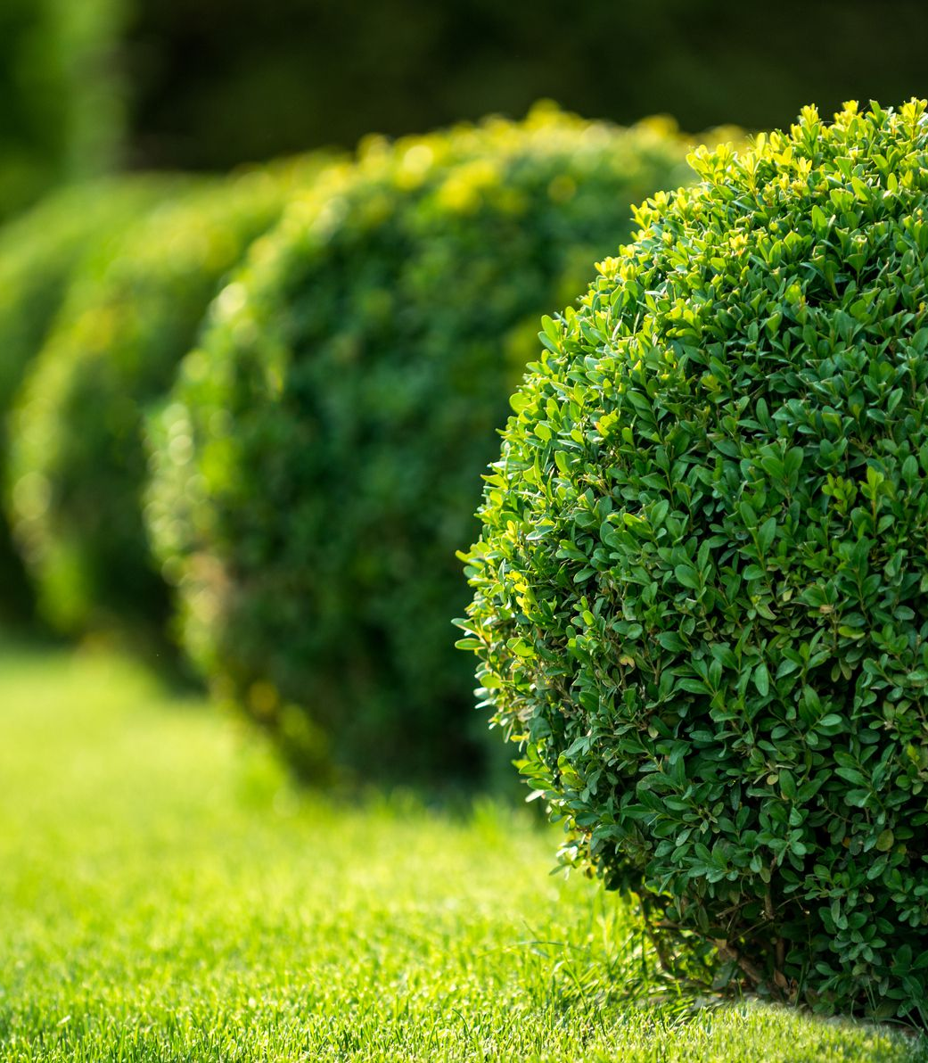

Beat around the bush
“Stop beating around the bush and tell me what’s really going on.”
Meaning: to avoid answering a question; approach something in a roundabout way
Origin: Medieval hunters would employ servants to scare prey (such as foxes or wild boar) out of the bushes with sticks. The servants had to be careful not to get too close, or the animals might attack them, so they would beat around the bushes instead of right on top of them.

Slide 3


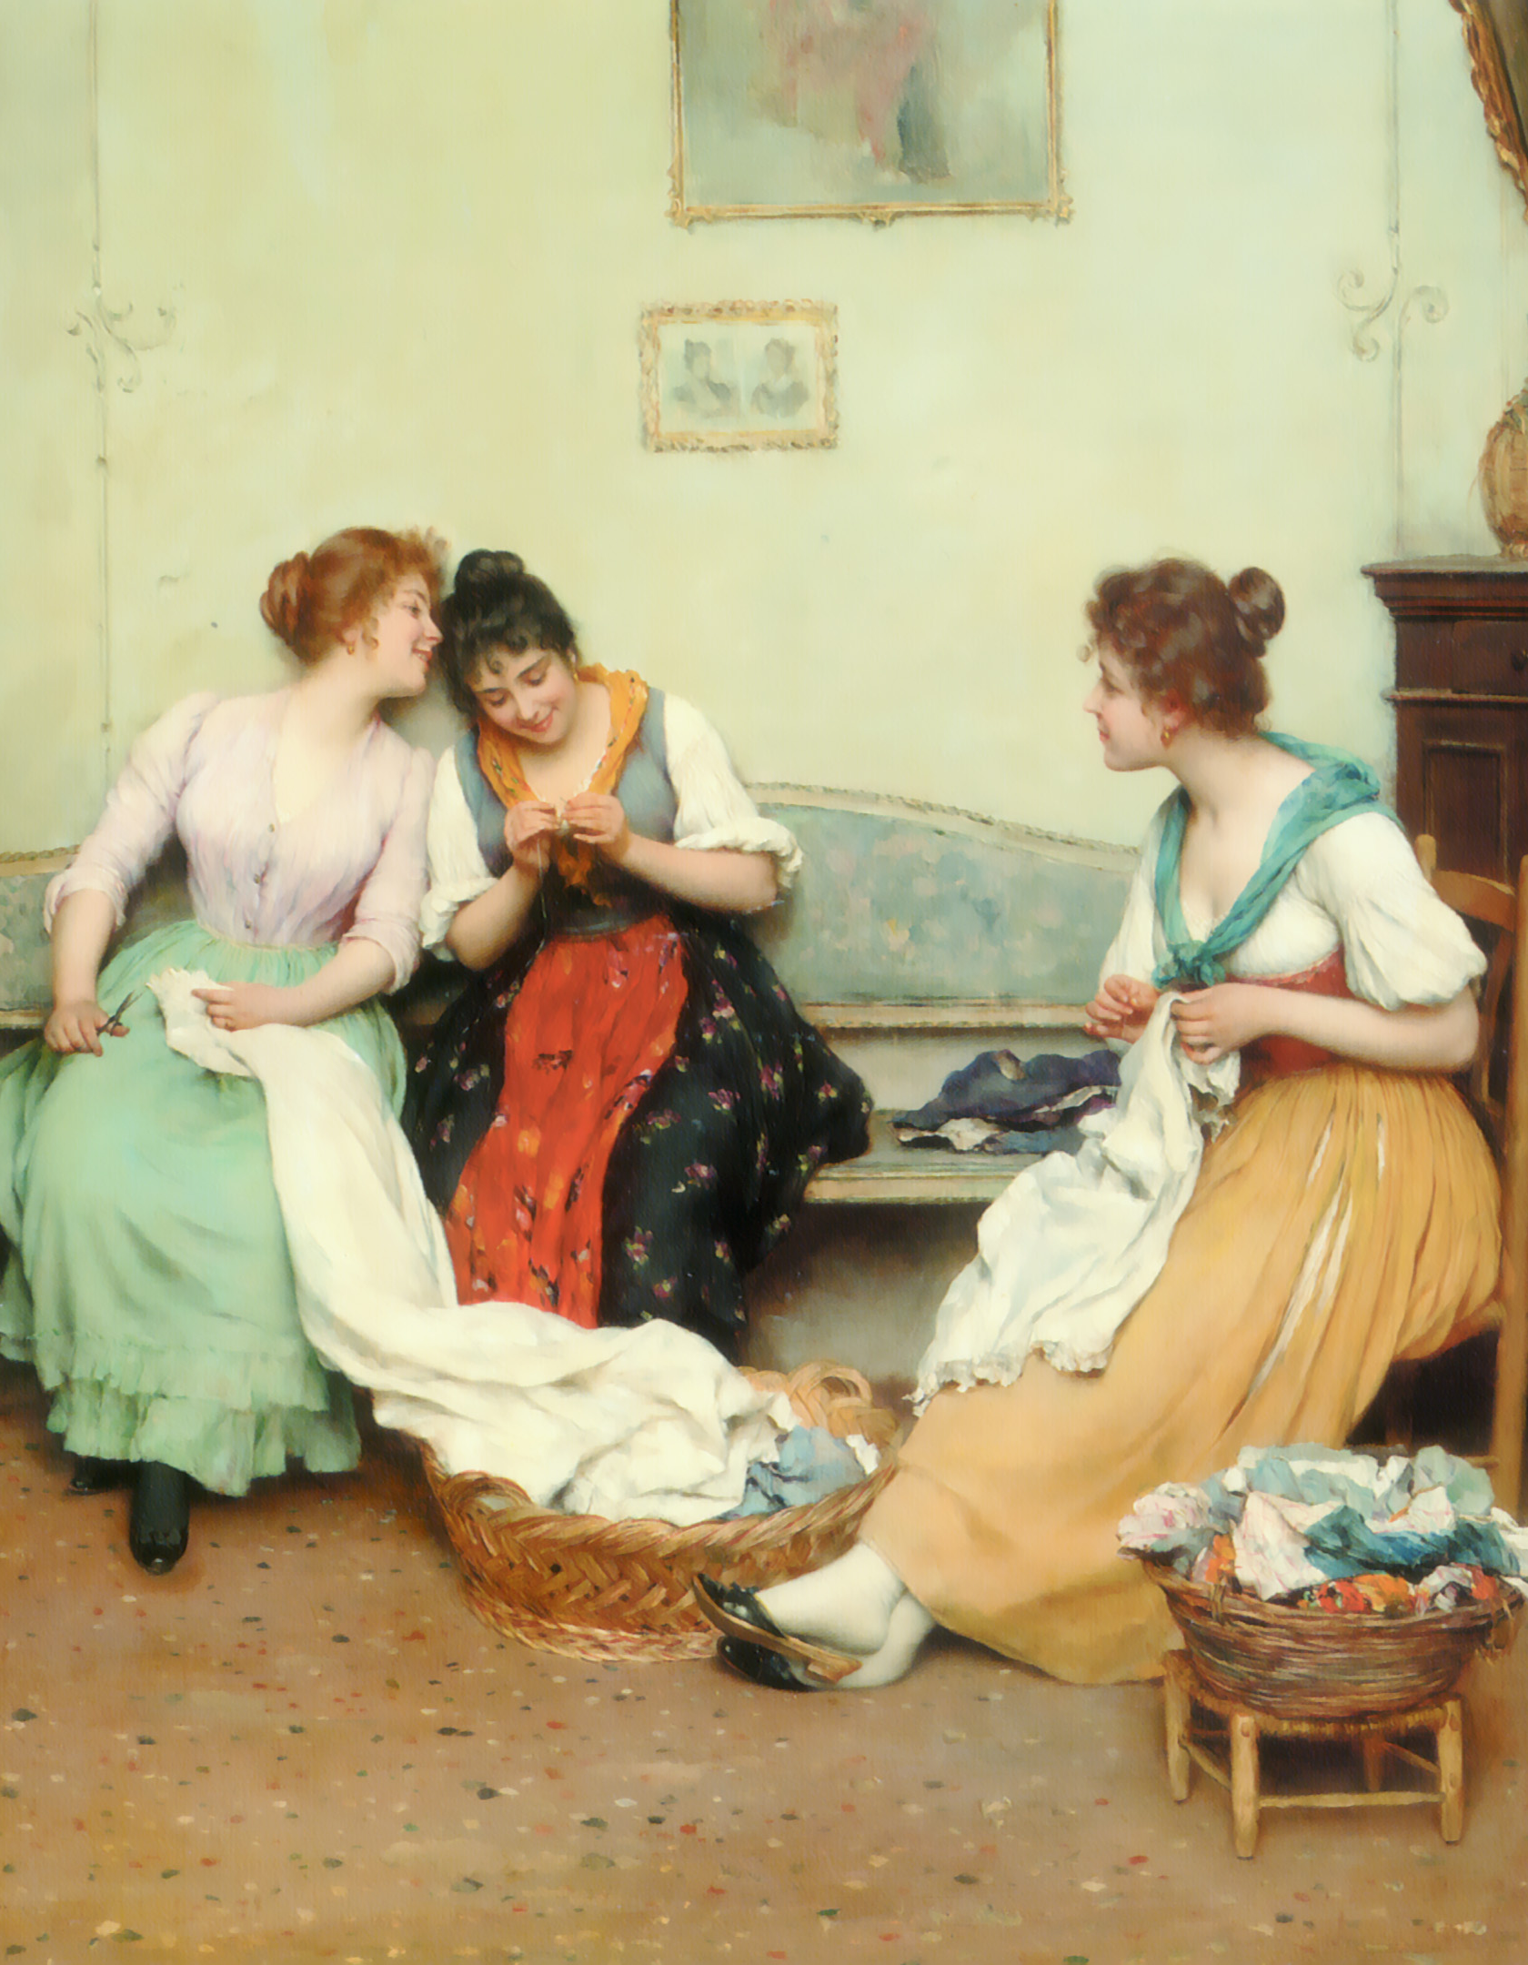
Chew the fat
“Jenny and I stayed up all night just chewing the fat.”
Meaning: chatting in a relaxed way
Origin: Sometimes the action of talking looks like chewing. If you have ever tried to chew a piece of fat, you know it takes a lot of chewing.

Slide 4
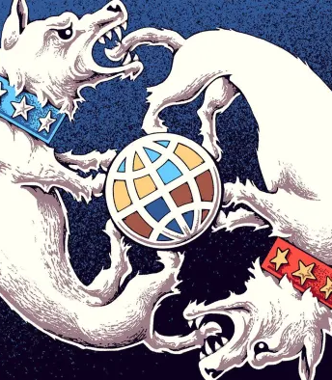
Dog-eat-dog world
“Rosie had no idea that when she left high school that it was such a dog-eat-dog world.”
Meaning: life is harsh and full of fierce competition. Everyone is out for their own personal gain.
Origin: An ancient Latin proverb stated “dog does not eat dog”. But in the early 1900s there was such brutal competition in the business world, with people willing to destroy others to get ahead, that people started using the proverb in reverse – “dog DOES eat dog” to express their shock.

Slide 5
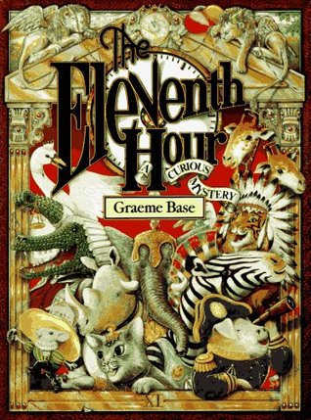
Eleventh hour
“Rocco waited until the eleventh hour to start working on his research paper.”
Meaning: at the latest possible time, right before the deadline
Origin: The day ends at midnight (the twelfth hour). If you procrastinate, you might wait till the day is just about over, or the eleventh hour.

Slide 6
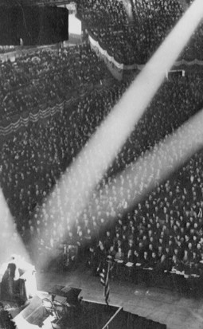
In the limelight
“Addie is always telling jokes because she loves to be in the limelight.”
Meaning: at the center of attention
Origin: In theaters in the 1800’s, the spotlight was created by heating lime (calcium oxide) until it produced a brilliant white light. A lens would direct the light onto the actors. The limelight is like a spotlight without electricity.

