Slide 1

Year 8 English Vocab
Term 3, Week 4

Slide 2
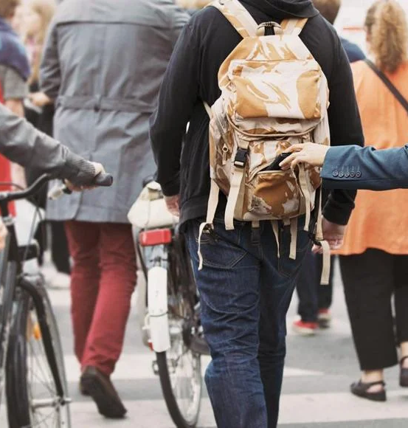
Notorious
Part of Speech: adjective
Meaning: famous for something bad
Tourists should avoid this area as it is notorious for crime and pickpocketing.

Slide 3
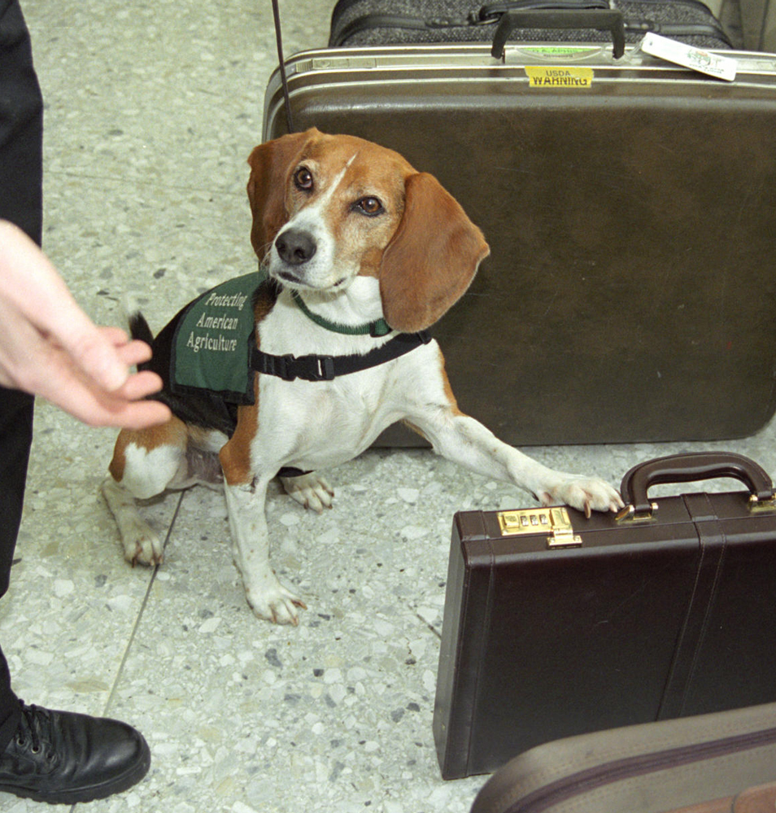
Contraband
Part of Speech: noun
Meaning: goods that have been taken between countries illegally
At the airport, bags are inspected for any contraband items.

Slide 4
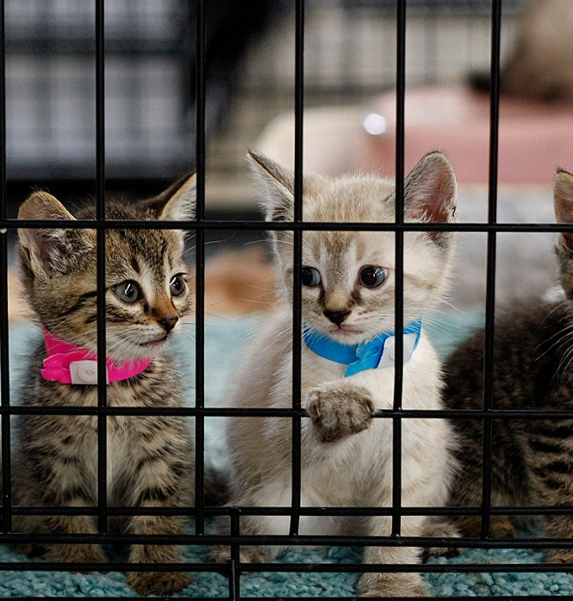
Defray
Part of Speech: verb
Meaning: to provide money to cover costs or expenses
Please donate to help defray the costs of running the animal shelter.

Slide 5

Covert
Part of Speech: adjective
Meaning: hidden or disguised; secret
The spy went hoped his enemies would not discover his covert plans.

Slide 6

Camaraderie
Part of Speech: noun
Meaning: friendly warmth or loyalty between people who spend a lot of time together
Camping trips are a great way to develop camaraderie.

Slide 7
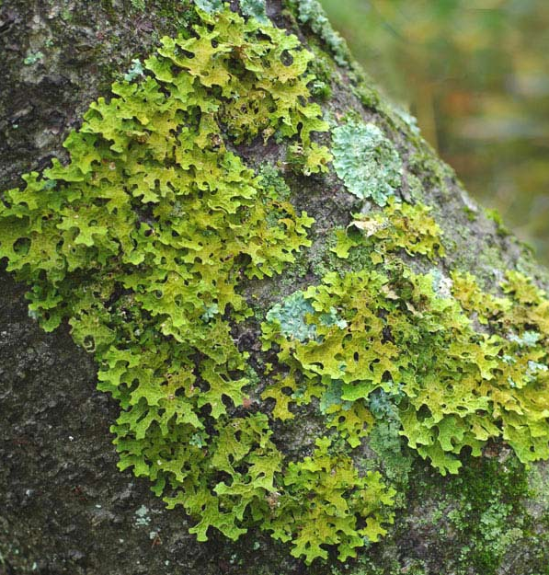
Lichen
Part of Speech: noun
Prounounced: LIE-kn
Meaning: a type of flat plant-like growth that spreads over rocks, walls and trees.
Lichen is not technically a plant or a fungus.

Slide 8

Placate
Part of Speech: verb
Meaning: to make someone less angry by doing or saying something to please them
The manager tried to placate the customer by giving her a full refund.

Slide 9
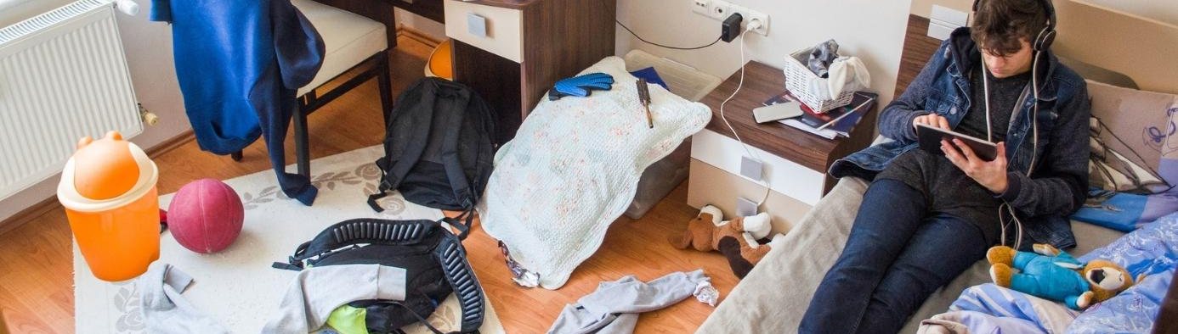
Incentive
Part of speech: noun
Meaning: a thing that motivates or encourages someone to do something.
If you want me to clean my room, you’d better offer me a good incentive.

Slide 10
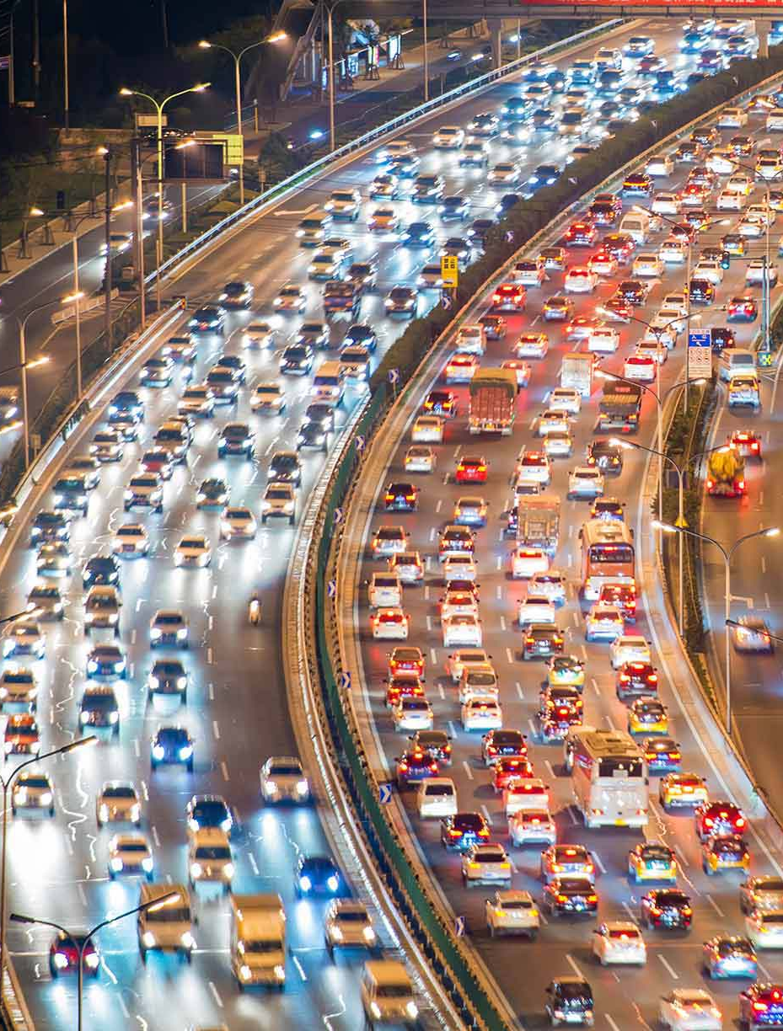
Endemic
Part of speech: adjective
Meaning: regularly occurring in a certain area or native to that place.
Kangaroos are endemic to Australia
Malaria is endemic in some tropical countries.
Traffic congestion is endemic in large cities.

Slide 11

Delineate
Part of speech: verb
Meaning: to describe, explain, or show something clearly and in detail
In his essay, he delineated the causes and effects of climate change.
The map needs to clearly delineate the borders between countries.

