Slide 1

Year 8 English: Vocab
Term 3, Week 5

Slide 2
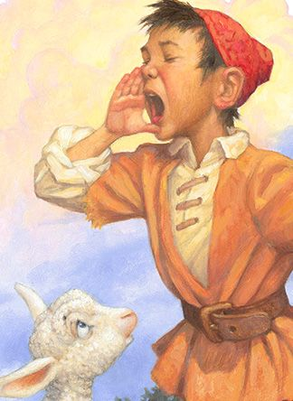
Credibility
Part of Speech: noun
Meaning: the quality of being believable, trustworthy, or convincing.
The boy lost all credibility when he cried ‘wolf’ for the third time.
The scientist gained a lot of credibility when his research was shown to be accurate.

Slide 3
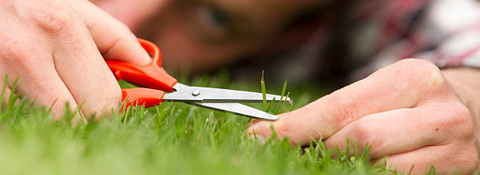
Scrupulous
Part of Speech: adjective
Meaning: careful, thorough and attentive to detail; being careful to be honest and correct
Dad has always been scrupulous about cutting the lawn.
After she received a formal warning, she tried to be scrupulous in her behaviour at work.

Slide 4

Remorse
Part of Speech: noun
Meaning: deep and painful regret
She was full of remorse after she lost her diamond ring at the beach.
He felt no remorse about being rude to the scam caller.

Slide 5
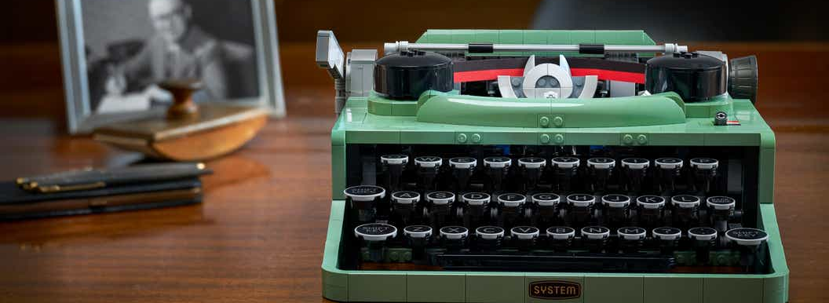
Defunct
Part of Speech: adjective
Meaning: no longer in use; not working or existing anymore
I found Granny’s defunct typewriter in the attic.

Slide 6

Inhibit
Part of speech: verb
Meaning: to hold back, to prevent. To slow or stop something from happening.
Fear of failure can inhibit people from trying new things.
This medication inhibits the growth of tumours.

Slide 7
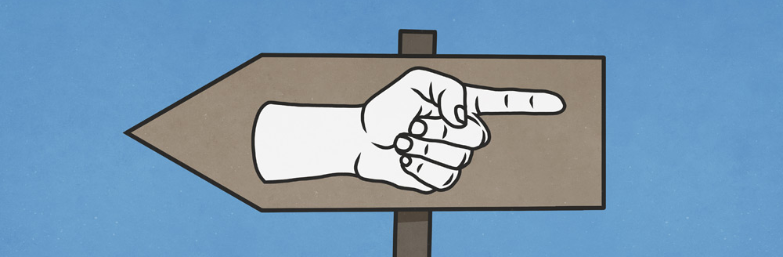
Ambiguous
Part of speech: adjective
Meaning: unclear, misleading, having more than one possible meaning.
That sign is ambiguous.

Slide 8
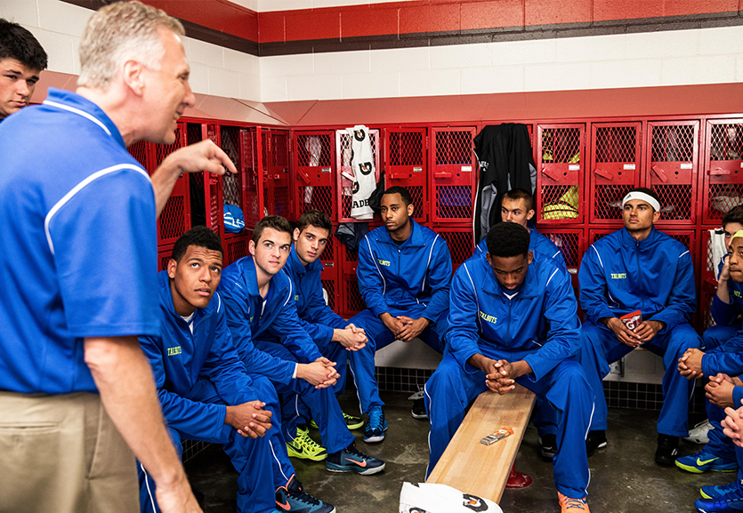
Diatribe
Part of speech: noun
Meaning: an angry speech or piece of writing that criticises something harshly.
The coach launched into a diatribe about the team’s poor effort in the game.
His article was more like a diatribe than a fair review.

Slide 9
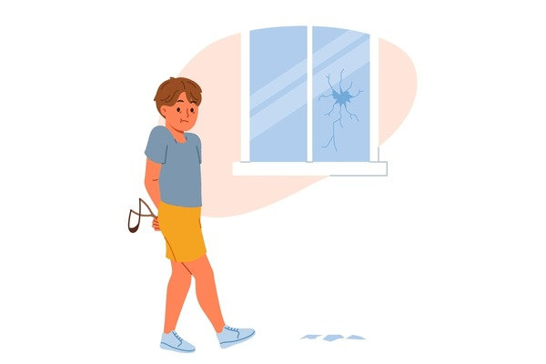
Fabricate
Part of speech: verb
Meaning: to create or invent something, or to make up a lie.
He tried to fabricate a story about how the window got broken.
Our company fabricates metal frames for buildings.

Slide 10

Antagonise
Part of speech: verb
Meaning: to make someone angry or upset, or to make them your enemy
She didn’t want to antagonise her parents, so she kept quiet instead of answering back.
The last thing we want is to antagonise the Chinese government.

Slide 11
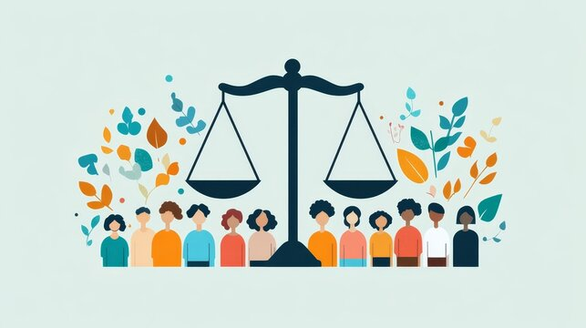
Egalitarian
Part of speech: adjective
Meaning: based on the principle that all people are equal and deserve the same rights and opportunities.
I think we should fight for a fairer, more egalitarian society.

