Slide 1



Year 9 English: Vocab
Term 3, Week 5

Slide 2

Conjecture
Part of speech: noun
Meaning: An opinion or guess made with incomplete information.
Without any proof to back you up, your theory is just a conjecture.
The media made a lot of conjectures about why the singer had cancelled the concert.

Slide 3
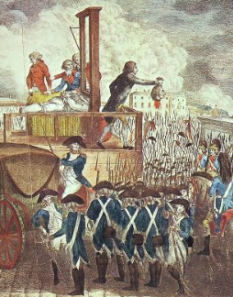
Legacy
Part of speech: noun
Meaning: the long-lasting impact of actions that took place in the past, or in a person’s life. Can also mean money or property left to you by someone who has died.
When Grandma died, she left me a small legacy of books and jewellery.
One of the key legacies of the French Revolution was the idea that people should have a say in how their country is run.

Slide 4
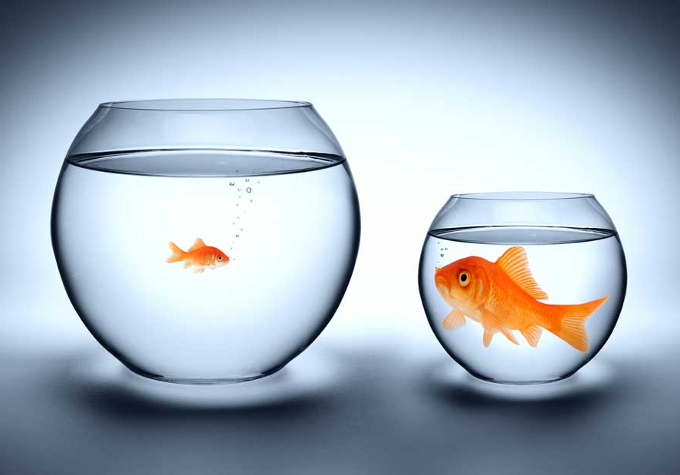
Invidious
Part of speech: adjective
Meaning: likely to cause jealousy, resentment or anger from being unfair
Being asked to chose the ‘employee of the month’ put her in an invidious position.
The coach’s invidious decision to make one player sit out for the whole game was called into question.

Slide 5
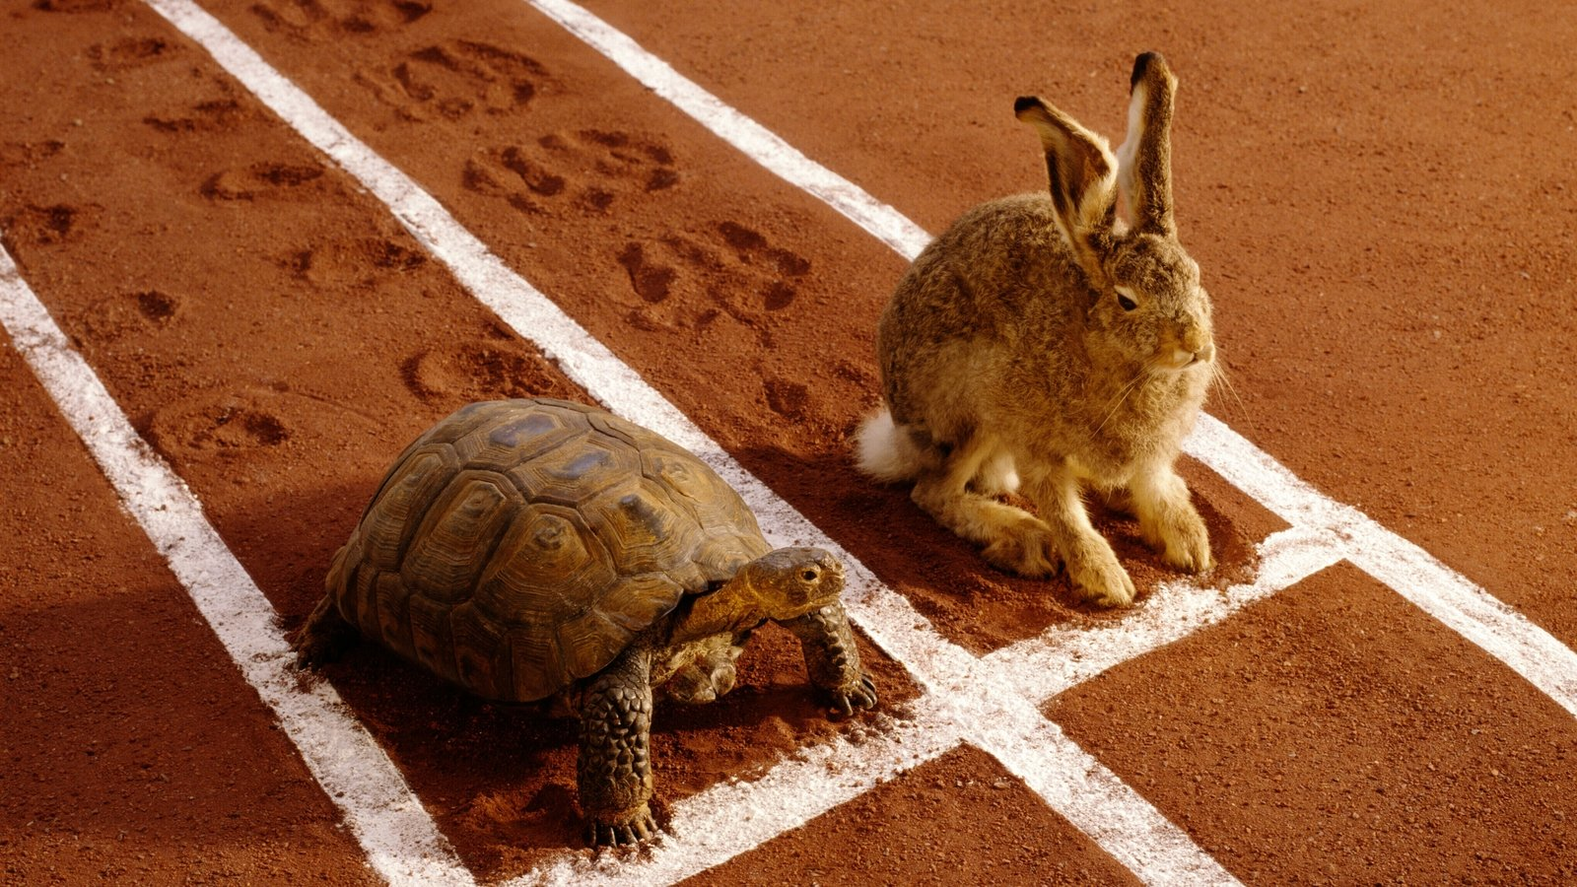
Allegory
Part of speech: noun
Meaning: a story, poem, artwork or film that has a deeper meaning, often teaching a moral or lesson
The tortoise and the hare is an allegory about how consistency is often better than speed.

Slide 6
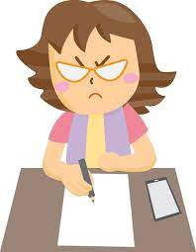
Convey
Part of speech: verb
Meaning: to show, to communicate, or to carry from one place to another
She wrote a strongly worded letter to try to convey her anger.
The film tries to convey the importance of family
The pipes will convey water from the river to the town.

Slide 7
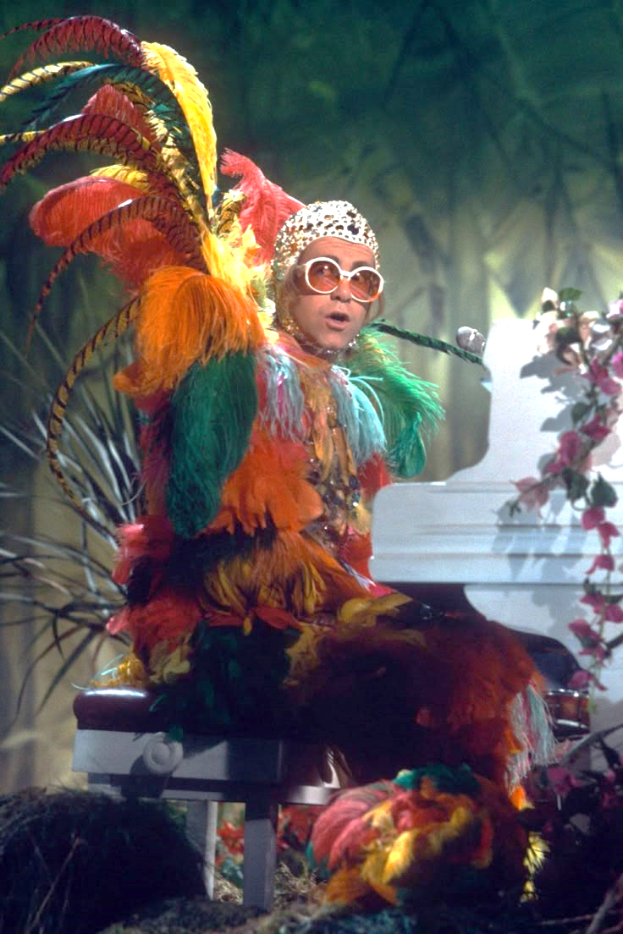
Extravagant
Part of speech: adjective
Meaning: wasteful. Spending far more time, money or resources than needed. Going over the top.
It would be extravagant to buy a brand-new phone every month.
His costumes for the show were rather extravagant.

Slide 8
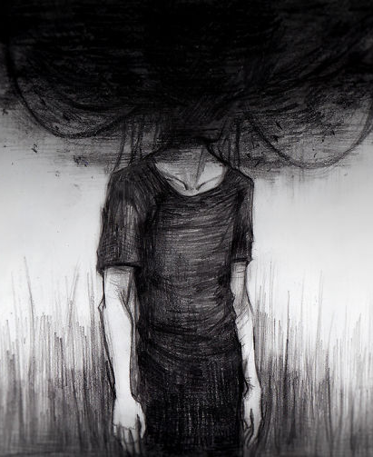
Nihilism
Part of speech: noun
Definition: The belief that nothing matters, all theories are false, and existence is pointless
The artist’s nihilism can be seen in his dark and depressing works.

Slide 9
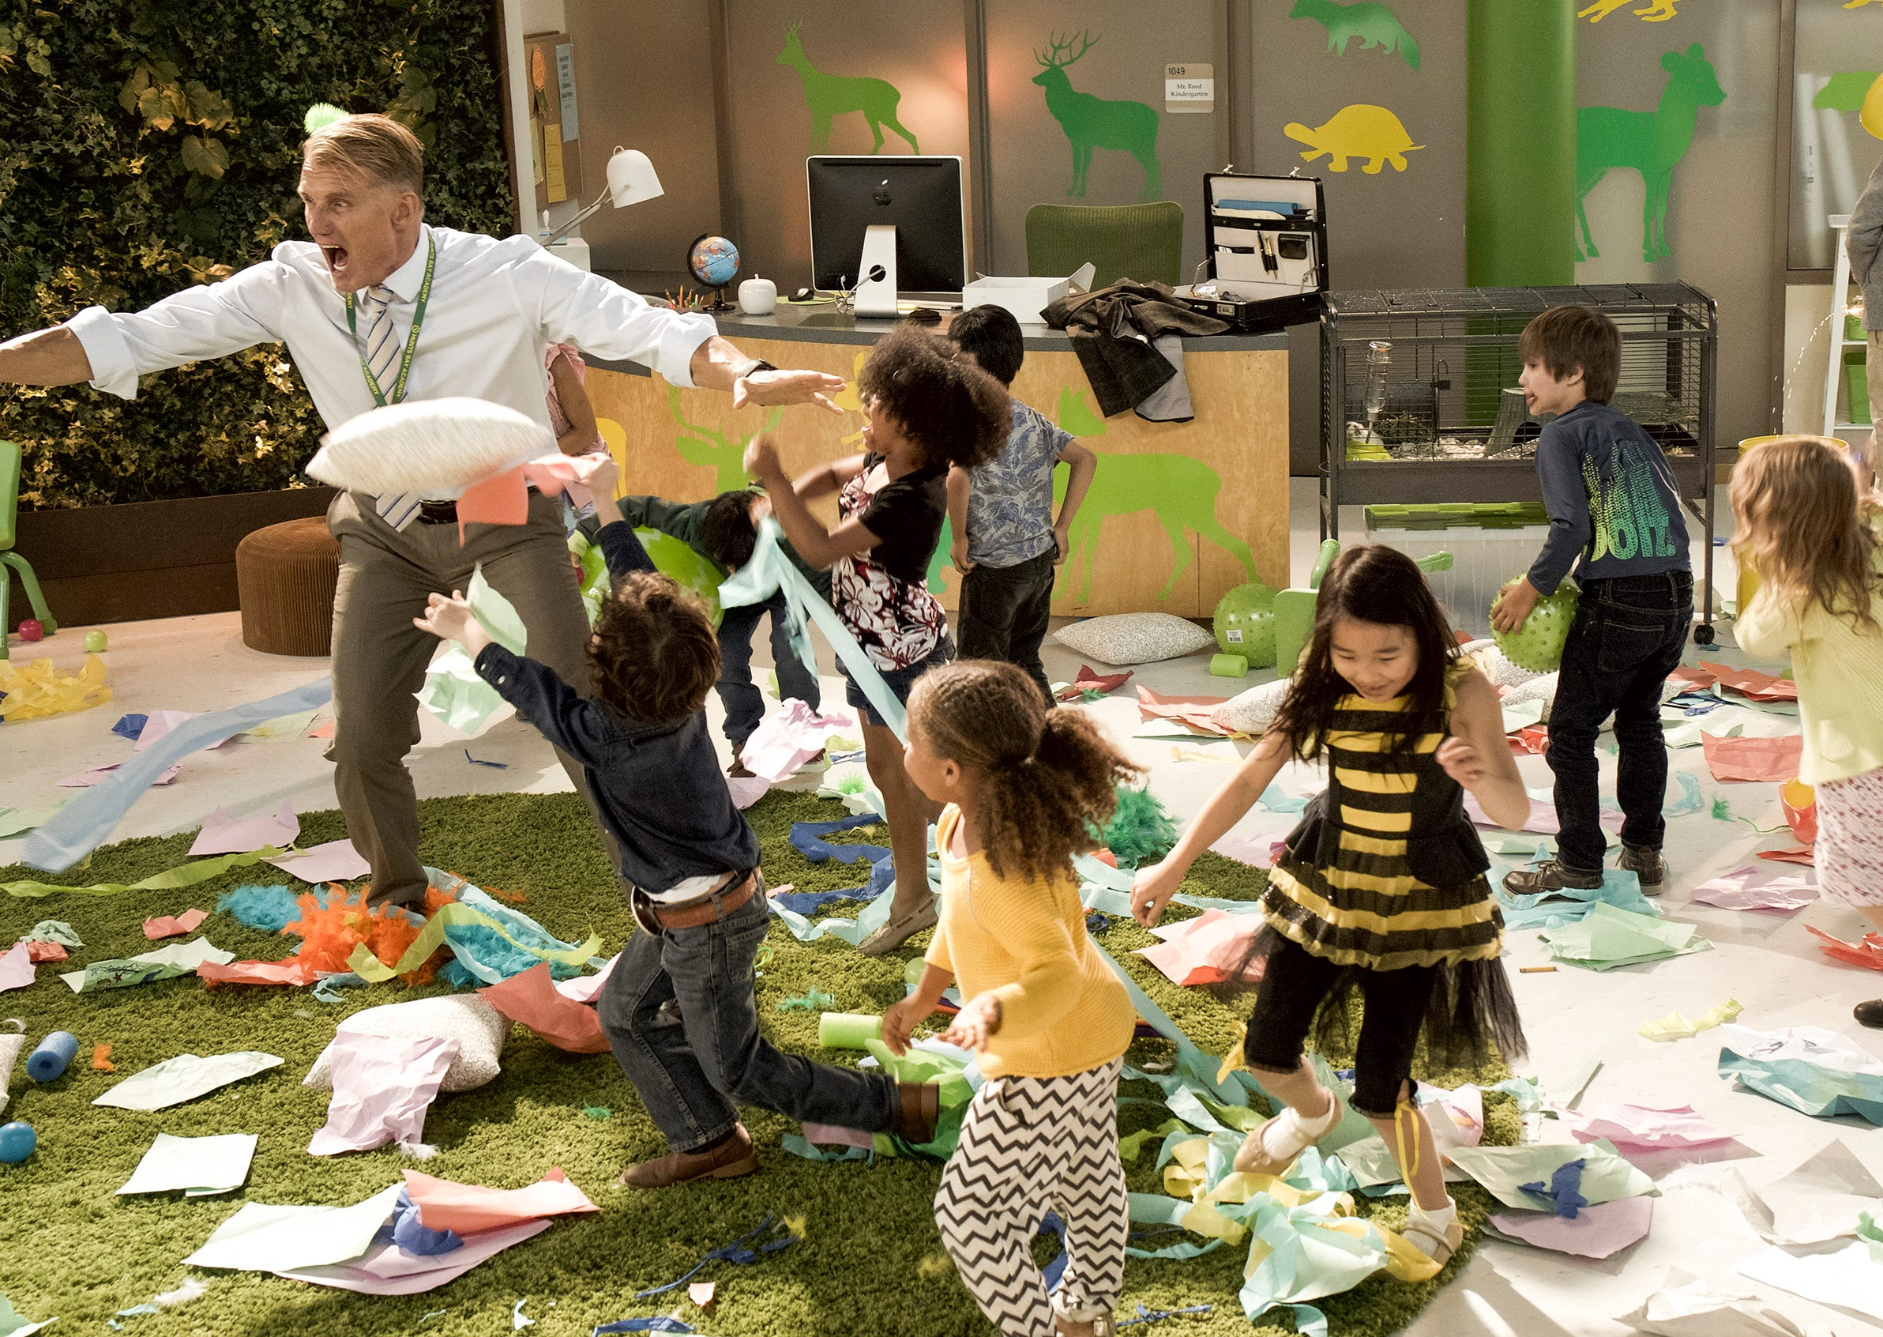
Obstreperous
Part of speech: adjective
Meaning: noisy and difficult to control
The Year 8 class was obstreperous, but the Year 9 class was always quiet and well behaved.
The crowd had become so obstreperous that the referee had to pause the game.

Slide 10
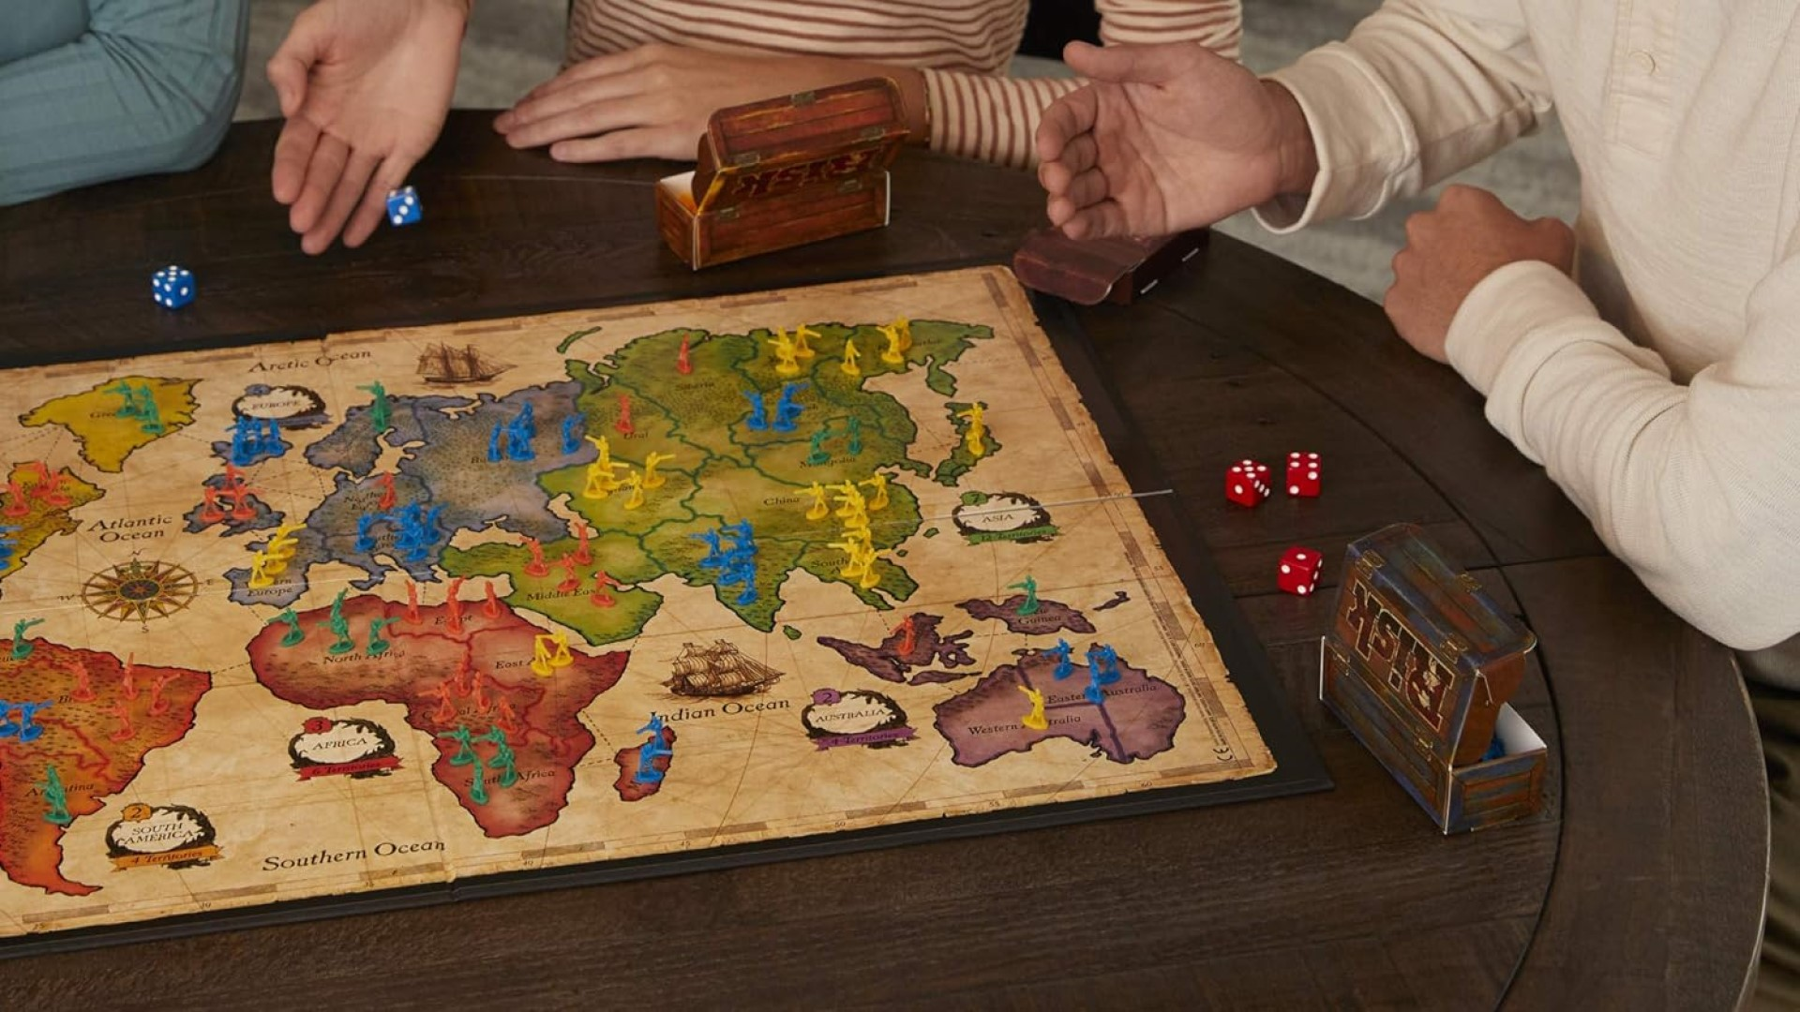
Subjugate
Part of speech: verb
Meaning: to bring someone or something under control by force.
Throughout history, powerful nations have often tried to subjugate weaker ones.

Slide 11

Belie
Part of speech: verb
Definition: to give a false impression or hide the truth
Harold hoped his smile would belie the pain he felt inside.

