Slide 1

Year 8 English: Vocab
Term 3, Week 6

Slide 2

Demeanour
Part of Speech: noun
Meaning: outward behaviour; way of looking or acting
Anne’s calm demeanour put me at ease.

Slide 3
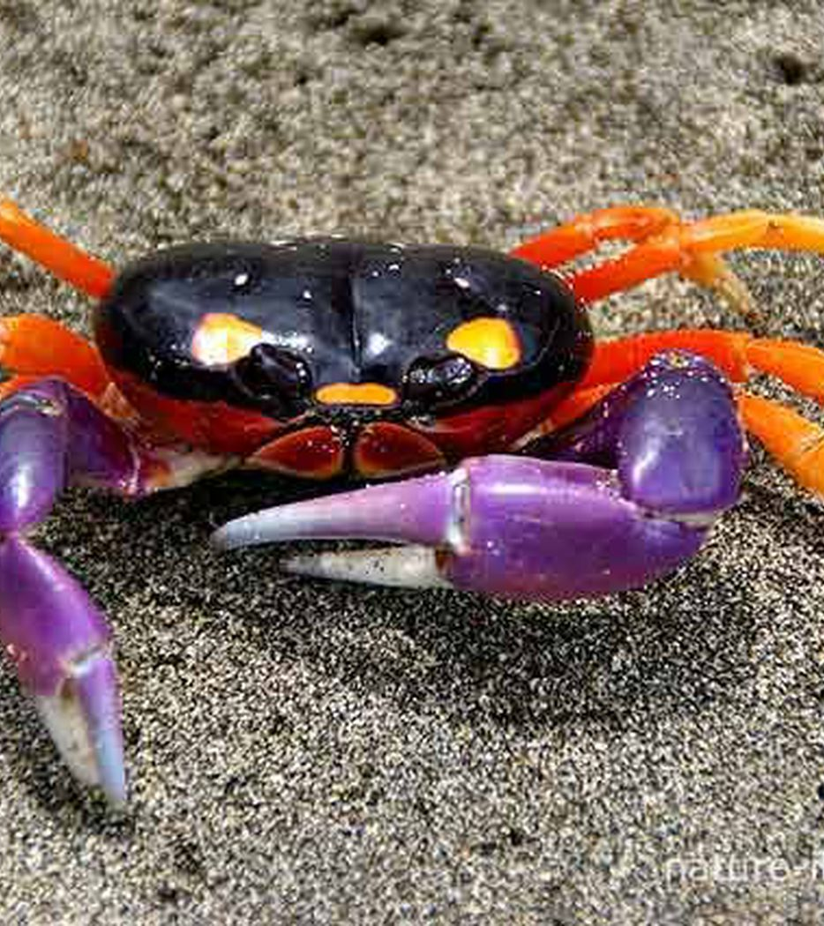
Scuttle
Part of Speech: verb
Meaning: to run with quick, hasty steps
The crab will scuttle away if I try to take a picture.

Slide 4
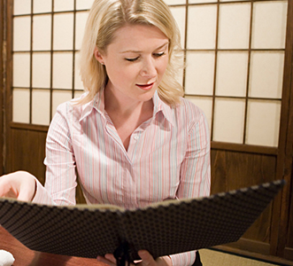
peruse
Part of Speech: verb
Meaning: to read or examine something in a relaxed way; to browse through
While we wait for a table, we should peruse the menu.

Slide 5
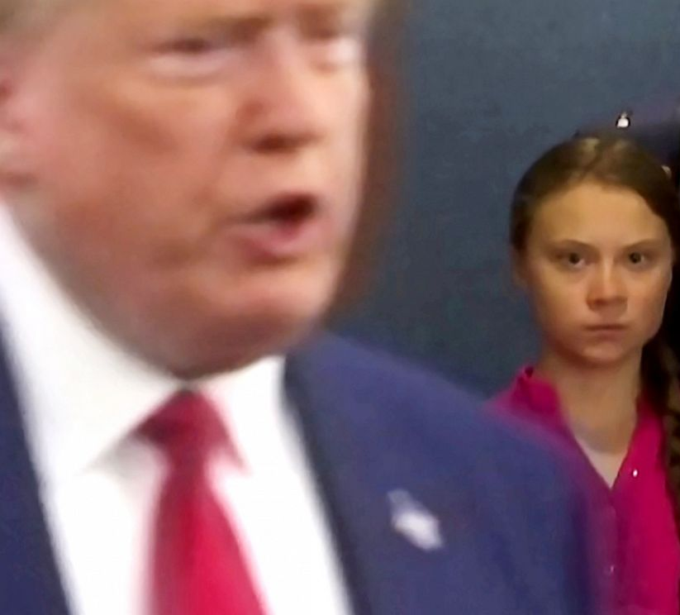
glower
Part of Speech: verb
Meaning: to stare angrily; to glare
Greta took the opportunity to glower at Donald Trump.

Slide 6
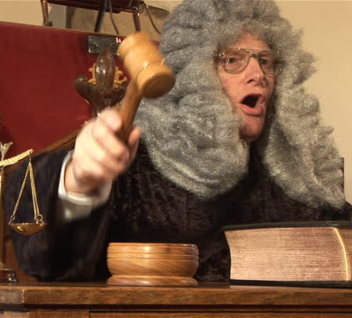
Acquit
Part of Speech: verb
Meaning: to free from legal charges; to declare not guilty
The judge’s decision to acquit the billionaire of all charges made many people suspect he had accepted a bribe.

Slide 7
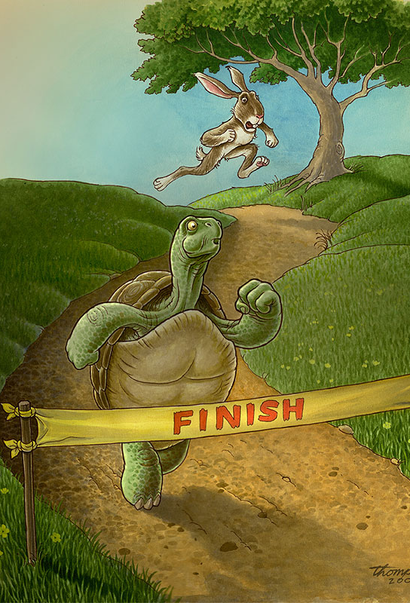
edification
Part of Speech: noun
Meaning: education or enlightenment; improvement, building up
Aesop’s fables were written for the edification of children.

Slide 8
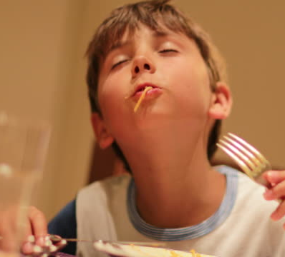
savour
Part of Speech: verb
Meaning: to taste or experience something slowly and thoroughly in order to enjoy it as much as possible
The spaghetti was so delicious that Lachlan wanted to savour every bite.

Slide 9
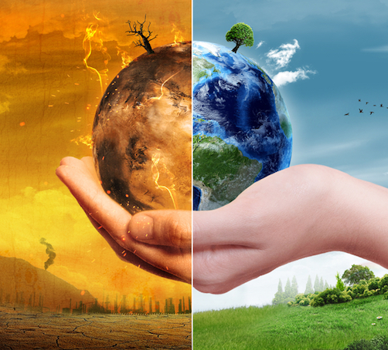
Consensus
Part of Speech: noun
Meaning: a general agreement; everyone in a group has the same opinion
The consensus among scientists is that climate change is worsening.
The committee could not reach a consensus about what to do.

Slide 10
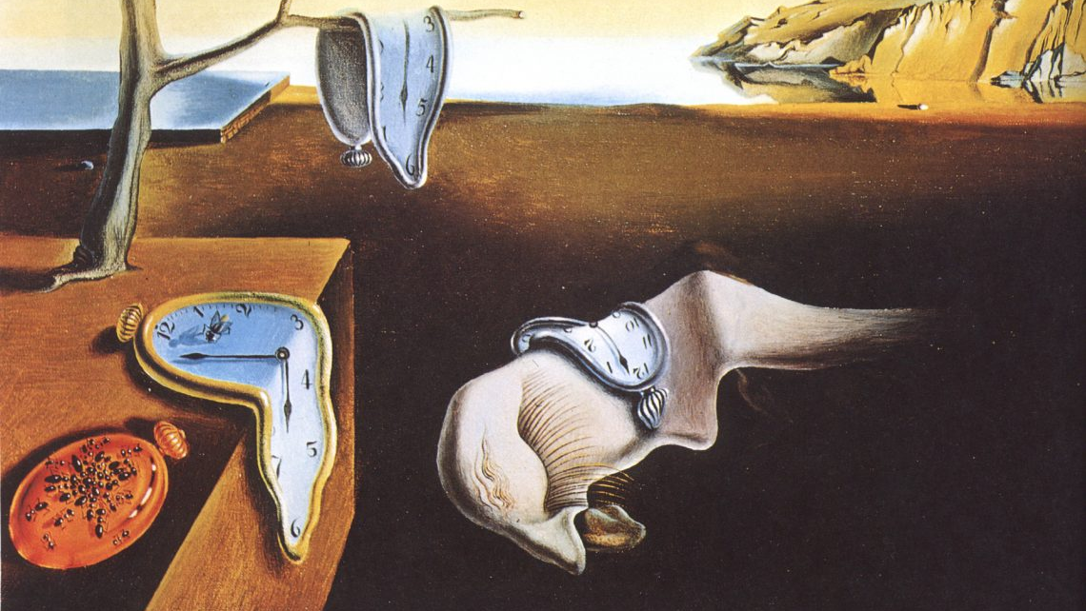
enigma
Part of Speech: noun
Meaning: something that is mysterious and impossible to understand
Many have pondered the enigma of Salvador Dali’s paintings.

Slide 11
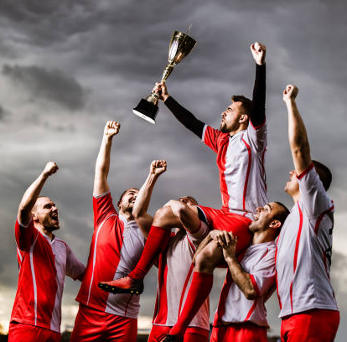
morale
Part of Speech: adjective
Meaning: The attitude, confidence and enthusiasm of a person or group at a particular time.
The team’s morale was high after their victory.
What can we do to boost her morale?

