Slide 1

Year 8 English: Vocab
Term 3, week 7

Slide 2
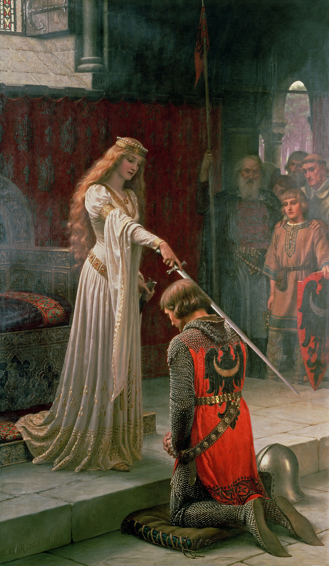
Accolade
Part of Speech: noun
Meaning: an award or privilege granted as a special honour
The soldier received an accolade for his bravery.

Slide 3

Renege
Part of Speech: verb
Meaning: to go back on your word or fail to keep a promise
The builder promised to be finished by July, but later tried to renege on his agreement.

Slide 4

Instigate
Part of Speech: verb
Meaning: to start or cause something, to make it happen
He always tries to instigate trouble by spreading rumours.
The new policy is likely to instigate some changes.

Slide 5
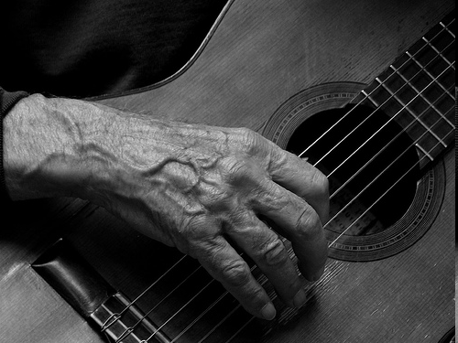
Gnarled
Part of Speech: adjective
Meaning: knobbly, rough or twisted, especially with age
The old man’s gnarled hands played the guitar with surprising speed and grace.

Slide 6

Unfettered
Part of Speech: adjective
Meaning: not controlled or restricted; free from
Danny has an unfettered imagination and comes up with the most amazing stories!

Slide 7
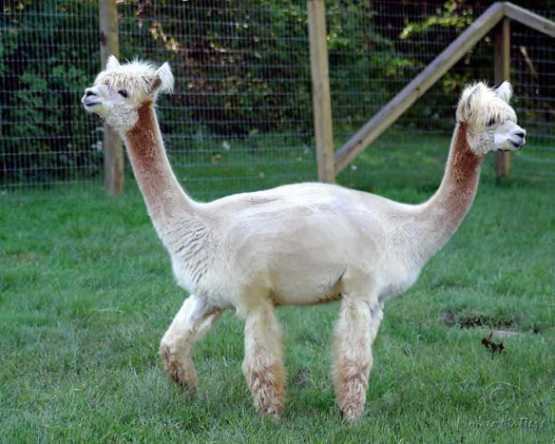
Preposterous
Part of Speech: adjective
Meaning: utterly absurd or ridiculous; outrageous
I do not believe a word of that preposterous story about a two-headed alpaca.

Slide 8

Covenant
Part of Speech: noun
Meaning: an agreement, promise or contract
God made a covenant with Abraham.
Marriage is a covenant between two people.

Slide 9
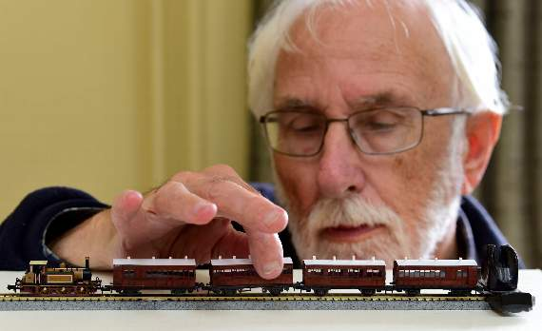
Scrutiny
Part of Speech: noun
Meaning: careful observation or examination
Jim looked over his model train with scrutiny, trying to figure out why it wouldn’t go.

Slide 10
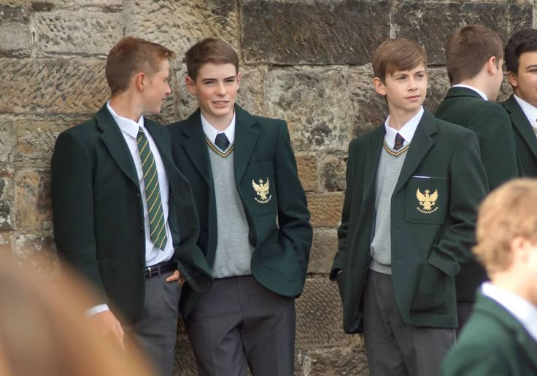
Abolish
Part of Speech: verb
Meaning: to formally put an end to something
Do you think we should abolish school uniforms?
Britain abolished slavery in 1832.

Slide 11
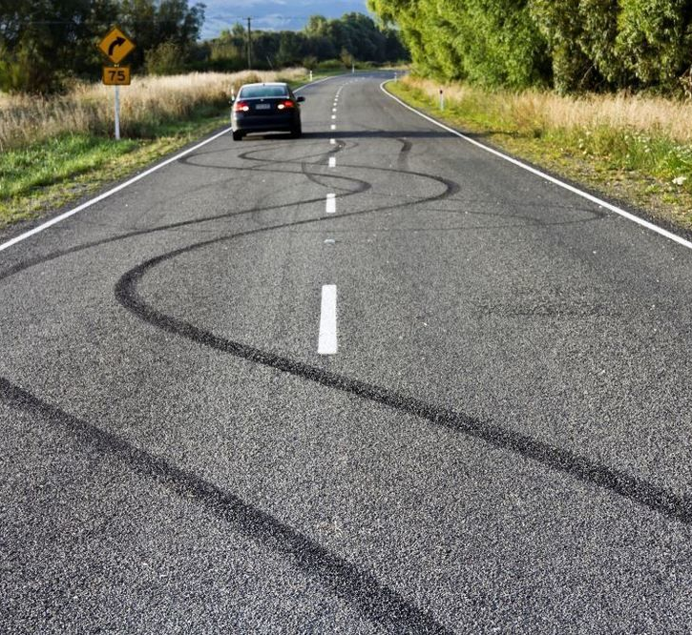
Erratic
Part of Speech: adjective
Meaning: unpredictable; uneven or irregular; strange
He has always been a very erratic driver.
Susan’s mood swings have been erratic lately.

