Slide 1
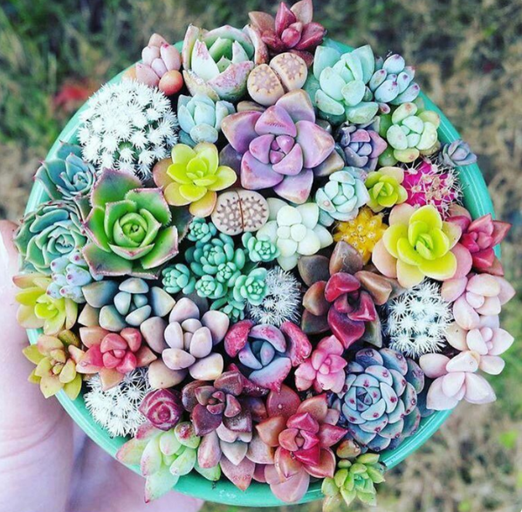
Year 8 English: Vocab
Term 3, Week 8

Slide 2
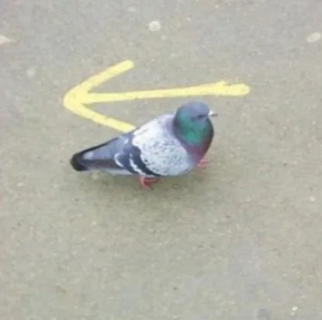
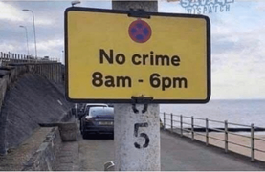
Prerogative
Part of Speech: noun
Meaning: a privilege; a right
Just because you’re rich, you don’t have the prerogative to break the law.

Slide 3
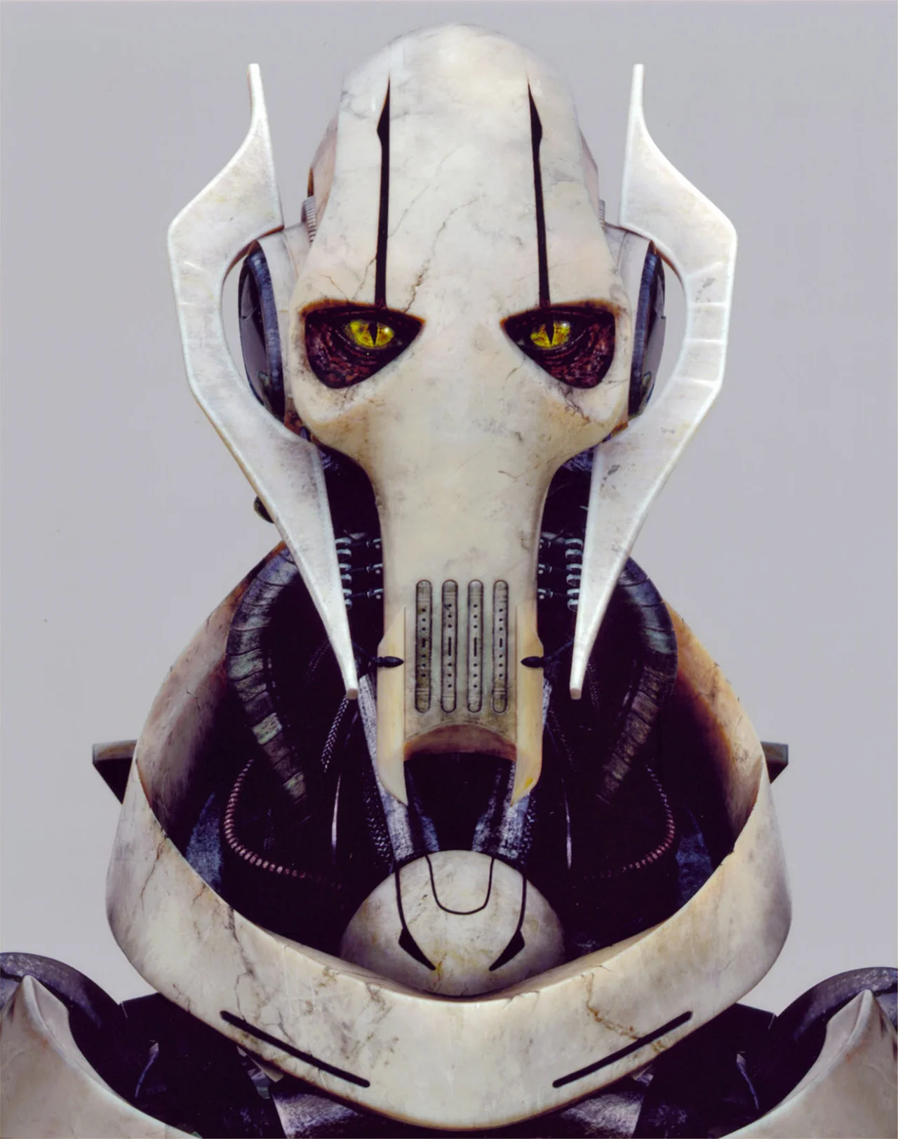
Grievous
Part of Speech: adjective
Meaning: very bad or serious; causing great sadness or pain
I was shocked when I heard the grievous news about the twin towers.
General Grievous lives up to his name.

Slide 4
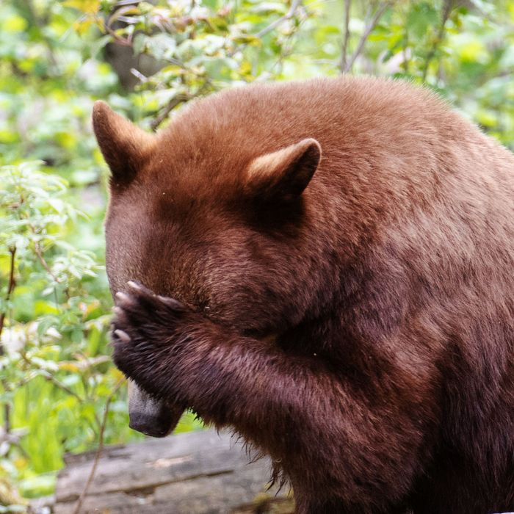
Expunge
Part of Speech: verb
Meaning: to wipe out or erase, to completely remove
It was years ago, but I can never expunge that incident from my memory.

Slide 5
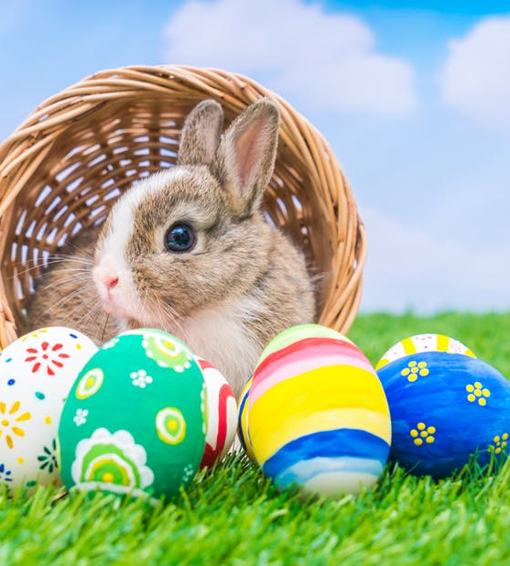
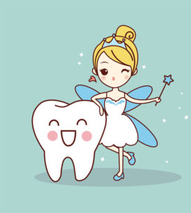
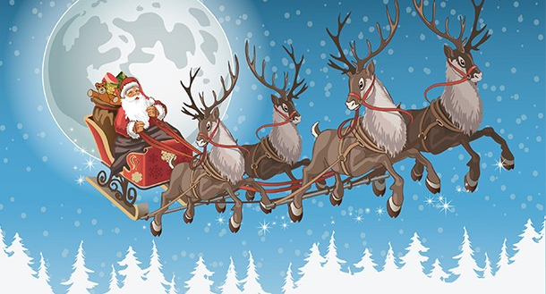
Credulous
Part of Speech: adjective
Meaning: trusting; believing
Children are so credulous, they believe any story you tell them.

Slide 6
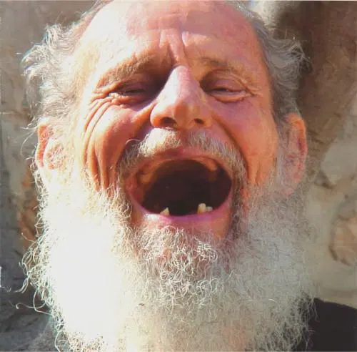
Guffaw
Part of Speech: noun
Meaning: a loud, unrestrained burst of laughter
The toothless old man let out a huge guffaw when I told a joke.

Slide 7
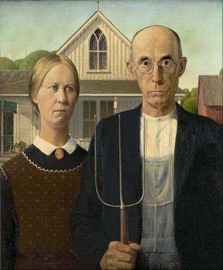
Austere
Part of Speech: adjective
Meaning: stern and severe
The portrait makes them look austere, but they’re fun when you get to know them.

Slide 8

Turmoil
Part of Speech: noun
Meaning: a state of confusion, disorder or uncertainty
Her mind was in turmoil over the difficult decision – the boring white shirt, or the boring grey jacket?

Slide 9

Utopia
Part of Speech: noun
Meaning: a perfect, idealised society free from fear or suffering
Science fiction movies often present the future as a peaceful utopia.

Slide 10

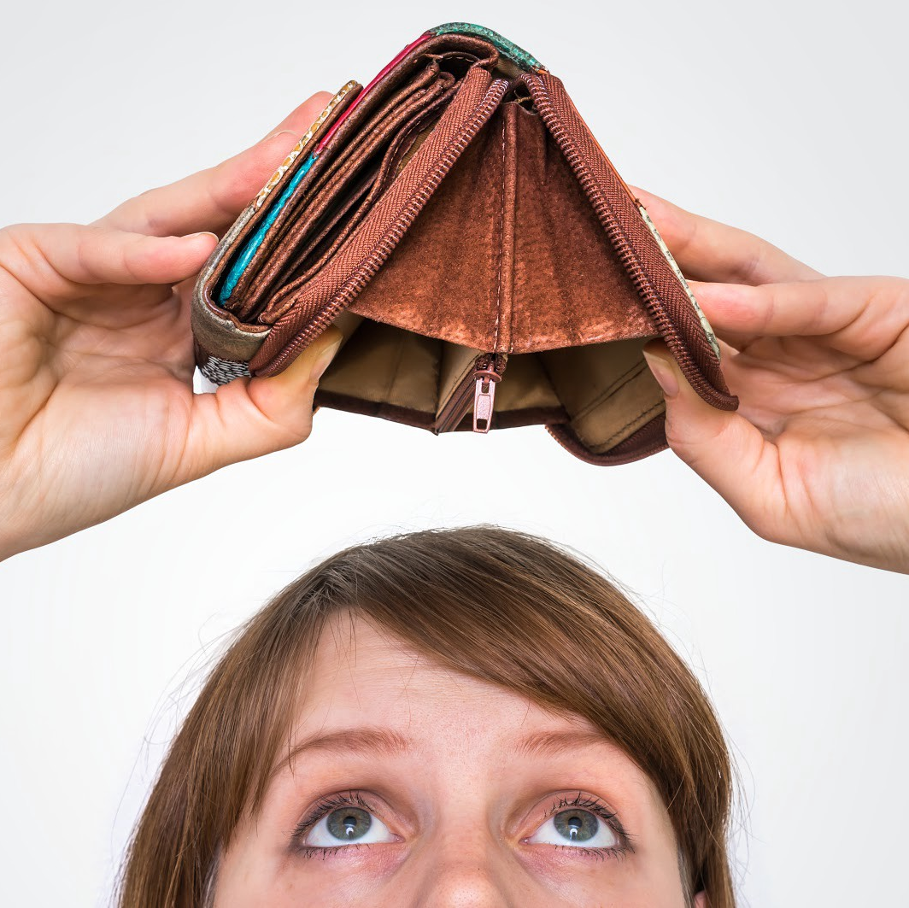
Heed
Part of Speech: verb
Meaning: to pay attention or take notice of
My sister is always broke, but she still refuses to heed my sensible financial advice.

Slide 11
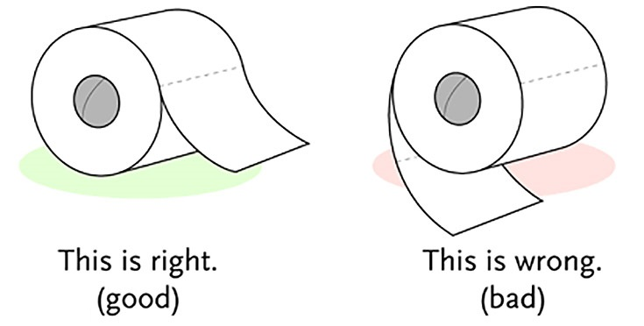
Controversy
Part of Speech: noun
Meaning: a public debate or disagreement that lots of people are talking about for a long time
There has always been controversy about which way the toilet paper roll should go.
The team’s unexpected win led to controversy between the fans.

