Slide 1

Year 9 English: vocab
Term 3, Week 8

Slide 2
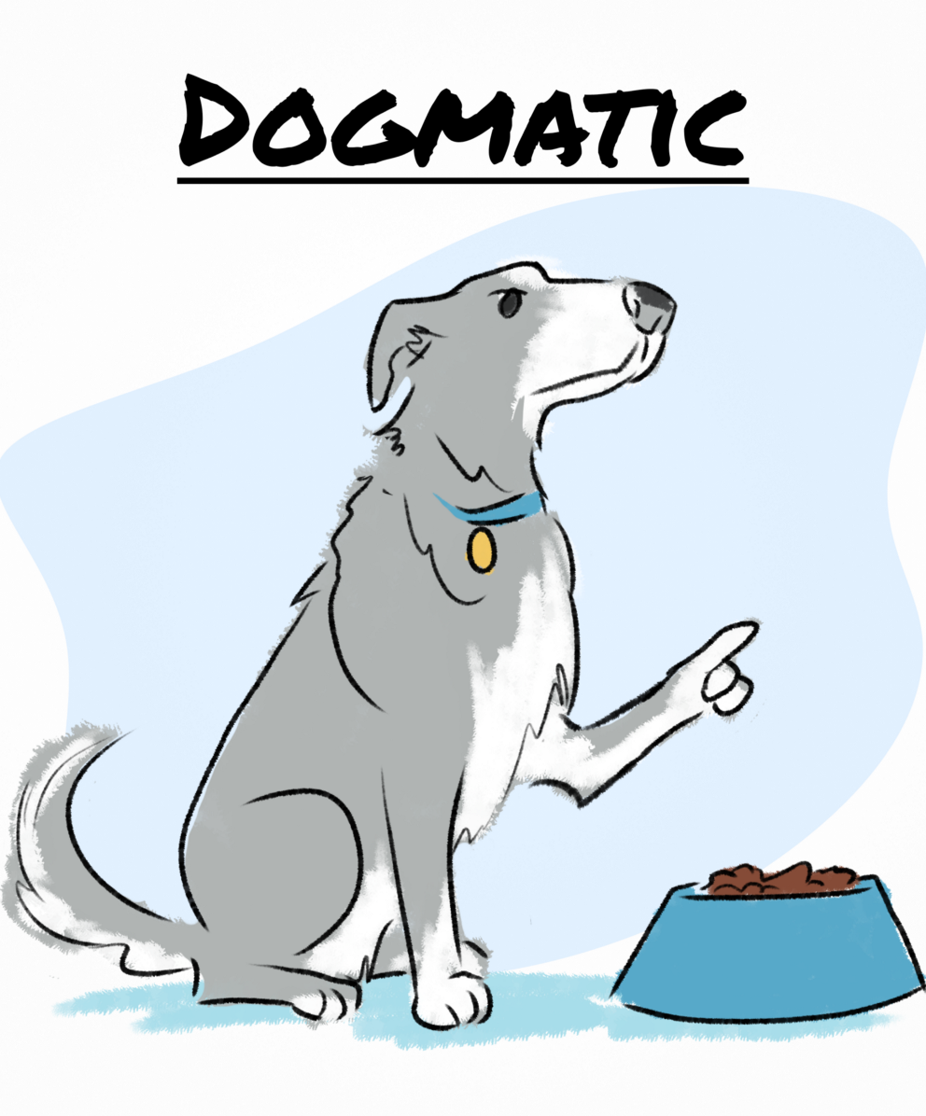
Dogmatic
Part of speech: adjective
Definition: having extremely strong beliefs; stating opinions as facts; being absolutely convinced you’re right
Fido was dogmatic when it came to mealtimes.

Slide 3
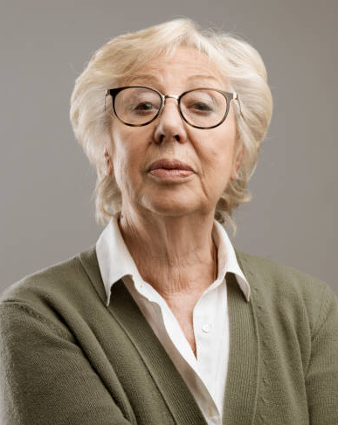
Haughty
Part of speech: adjective
Definition: proud; snobbish and unfriendly; looking down on others.
The woman gave us a haughty look when we knocked on her door collecting for charity.

Slide 4
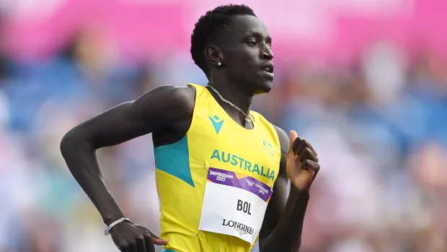
Pariah
Part of speech: noun
Definition: an outcast; someone who is disgraced or not accepted by society
The athlete became a pariah when he was caught using performance-enhancing drugs.

Slide 5
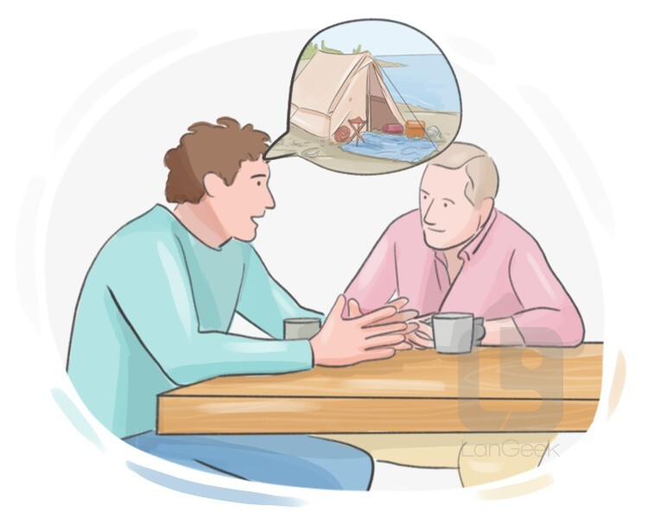
Depict
Part of speech: verb
Definition: to show or represent something in words or pictures
Your painting should depict a bowl of fruit.
The way he depicted it, camping sounded pretty fun.

Slide 6
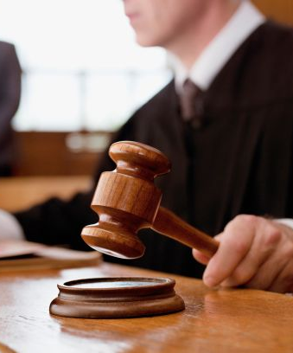
Egregious
Part of speech: adjective
Definition: outstandingly bad; shocking; offensive
The judge said it was the most egregious act of villainy he had ever seen.

Slide 7
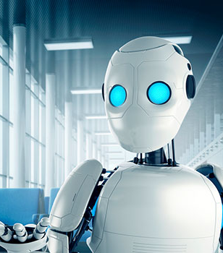
Supersede
Part of speech: verb
Definition: to replace something older or less effective
Do you think robots will ever supersede factory workers?

Slide 8

Monolithic
Part of speech: adjective
Definition: Massive or impressive; made from a single large block of stone
The statues at Easter Island are monolithic, but the ancient Polynesians somehow moved them for miles.

Slide 9

Unkempt
Part of speech: adjective
Definition: untidy, messy or scruffy; not well cared for
My hair looks unkempt if I don’t brush it.
The broken window, peeling paint, and overgrown garden made the house look very unkempt.

Slide 10
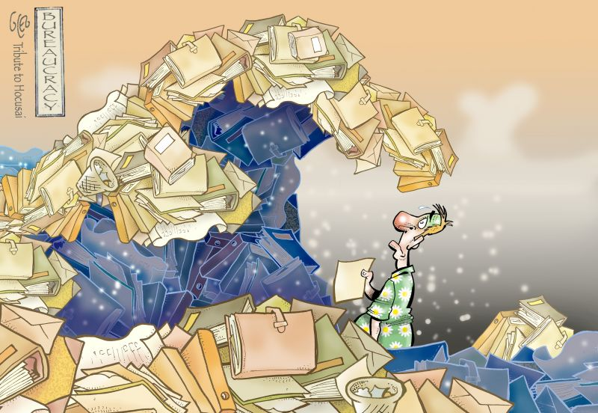
Bureaucratic
Part of speech: adjective
Definition: involving lots of unnecessary steps, admin or paperwork
The school had such bureaucratic rules that you practically had to submit a form and wait three weeks for approval just to use the oval.

Slide 11
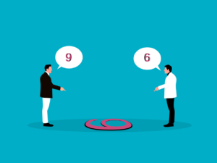
Perceive
Part of speech: verb
Definition: to notice, to become aware of something or understand it
Two people can perceive the same thing very differently.
Sir, I perceive that you are a prophet.

