Slide 1


Slide 2
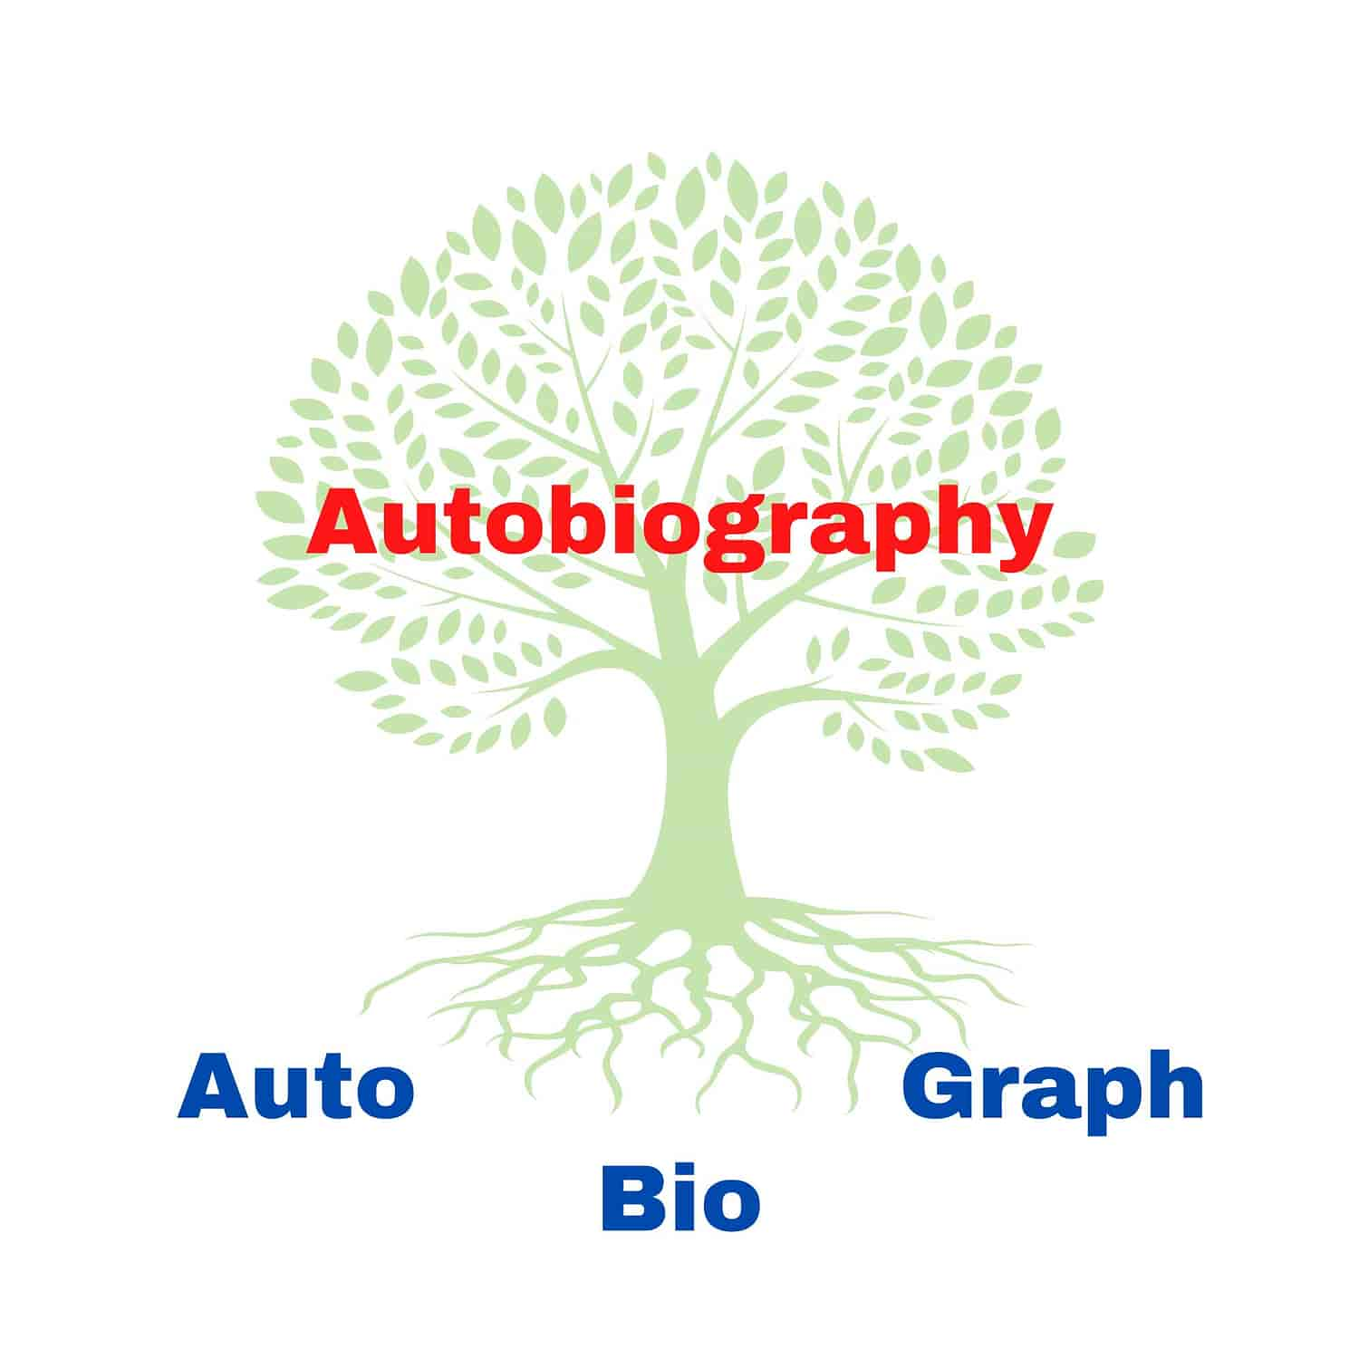
What are word roots?
Word roots are parts of words that tell you the core meaning. In English, they most often come from ancient Greek or Latin (Roman) words, showing the origins of our language
E.g. AUTOBIOGRAPHY is made up of three parts:
Prefix: ‘Auto’ = by itself
Root word: ‘Bio’ = life
Suffix: ‘Graph’ = to write
So an autobiography is the story of someone’s life that they have written themselves.

Slide 3
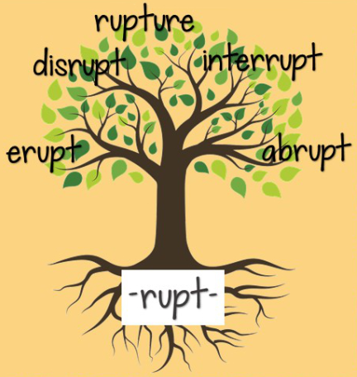
Why Study Root Words?
Over 60% of English words have Greek or Latin roots. Being aware of them helps you have a better understanding of our language and how its words work
Knowing common roots helps you figure out unfamiliar words.
  If you know what some parts of the word mean, you can make an educated guess about the rest
Efficiency! If you know the root word, you know (or can work out) the meaning of MULTIPLE words in the same word family

Slide 4

Root words & STEM
Words related to the STEM field (science, technology, engineering, maths) nearly always have Greek/Latin roots.
Knowledge of these increases understanding and fluency of terminology in this field.
  biology: (Greek ‘bio’ = life, ‘ology’ = study of)
  science: (Latin ‘scire’ = to know)
  mathematics: (Greek ‘mathema’ = learning, mental discipline)
  engineering: (Latin ‘ingeniare’ = to make or devise)

Slide 5

Disclaimers
Different roots can mean the same thing
  E.g. ‘hyrdo’ and ‘aqua’ both mean water
  ‘Hydro’ is the Greek word & ‘aqua’ is the Latin word
Some have many different versions/endings
  E.g. spic, spec, spect, scope, vid, vis – all mean ‘look/see’
  We borrowed words haphazardly over a long period of time, and English changes. For a long time there was no ‘correct’ spelling – words were spelled by sound
  Root languages sometimes also have synonyms
Sometimes words with the same sound don’t have the same root
  E.g. ‘confidence’ and ‘connect’ – both start with ‘con’
  ‘Con’ in confidence comes from ‘confidere’ = trust
  ‘Con’ in connect comes from ‘con’ = together

Slide 6

Year 9 Vocab
Term 4 Week 1
Common Greek & Latin Prefixes & Suffixes

Slide 7

Not, opposite of, against, without, reverse, away from
Anti- antibiotic, antisocial
A- abiotic, atheist, amoral
Ab- abnormal, absorb
De- destabilise, degrade
Dis- disrespect, dishonest, dislike
In- invalid, inaccessible
Im- impossible, immature
Il- illegal, illiterate
Ir- irregular, irresponsible
Non- nonviolent, nonfiction
Un- unsure, unholy

Slide 8
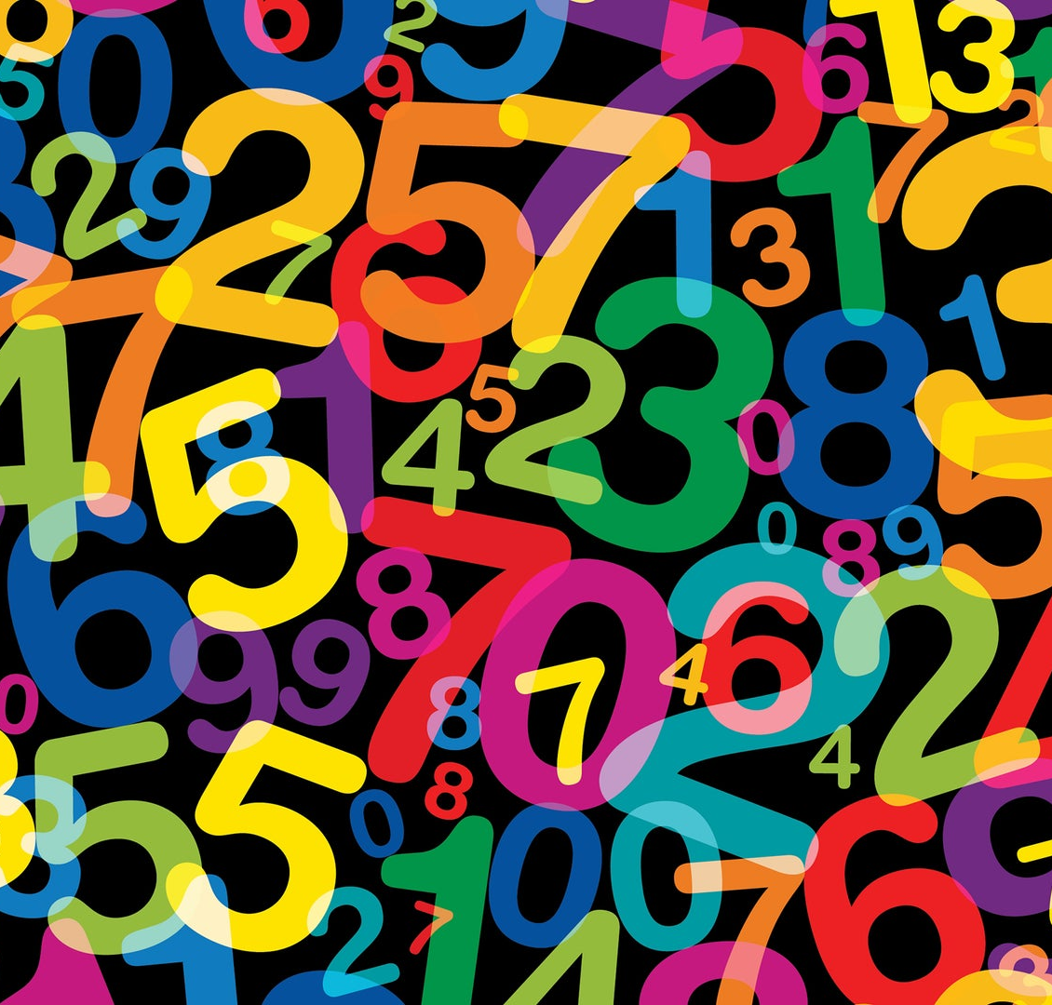
Numbers
1 = mono- uni- (e.g. monotheistic, unicycle)
2 = bi- du- deutero- diplo- (e.g. binoculars, duplicate, Deuteronomy, diploid)
3 = tri- (e.g. tricycle, tripod)
4 = quad- quar- tetra- (e.g. quadruplets, quarter, tetrahedron, Tetris)
5 = quint- pent- (e.g. pentagon, quintuplets)
8 = oct- (e.g. octopus, octagon)
10 = dec- (e.g. decimal, December, decathlon)
100 = cent- (e.g. century, centennial, centipede, centimeter)
1,000,000 = milli- (e.g. millipede, millimetre)

Slide 9
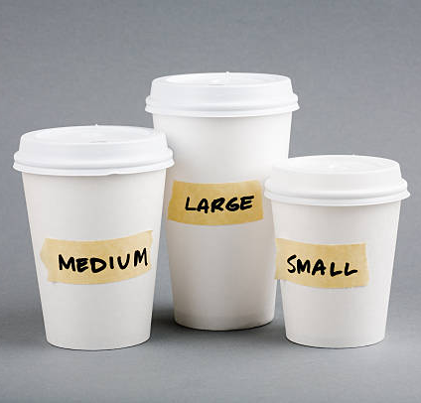
Amounts & Sizes
Many: multi- poly-
  multimedia, multigrain, polytheistic, polymer
Half, partial: semi- hemi-
  semicircle, hemisphere
Both: ambi- amphi-
  ambidextrous, amphibious
Above, more, excess: super- hyper- ultra-
  supermarket, hyperactive, ultraviolet
Under, less than, not enough: sub- hypo-
  subway, hypothermia
All: omni- pan-
  omnibus, pandemic
Large: macro- mega- magni-
  Macrocosm, megabyte, magnificent
Small: micro- mini- nano-
  microchip, minibus, nanobot

Slide 10
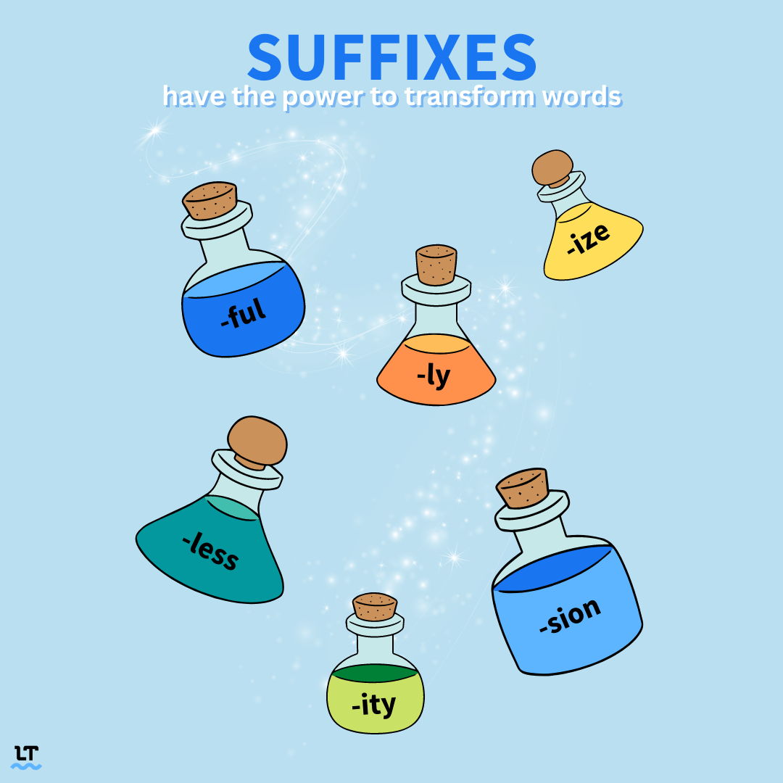
Suffixes
-ive = tending to, doing
  (e.g. talkative, creative, impulsive)
-tion, -ment, -ance = act or process, result
  (e.g. selection, improvement, performance)
-able, -ible = worthy of, capable of, able to be
  (e.g. sensible, affordable)
-ious, -eous, -ful, -y = full of
  (e.g. studious, courageous, helpful, muddy)
-ness, -ity = state of, quality
  (e.g. happiness, unity)
-er, -ist, -ant = person who does a thing
  (e.g. teacher, chemist, assistant)
-en = made of
  (e.g. golden, wooden)

