Slide 1
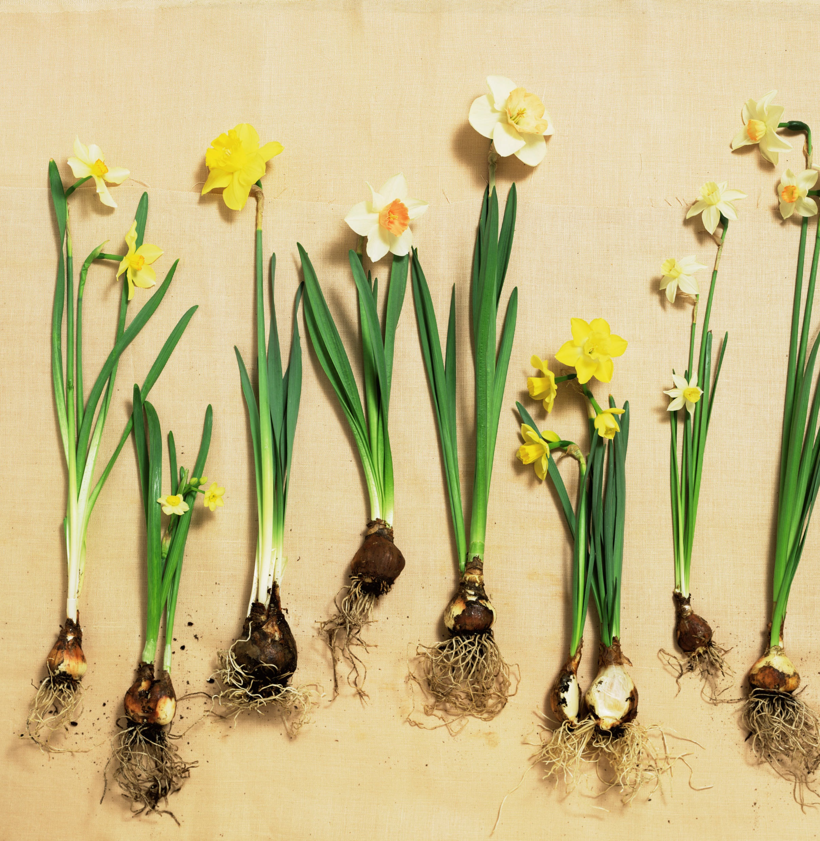
Year 9 Vocab
Term 4 Week 3

Slide 2

Auto
Meaning: self, by itself, on its own, spontaneous
Automobile
Autopilot
Autonomy
Automatic
Autograph
Autobiography

Slide 3

Tele
Meaning: far away, distant
Telegraph
Telescope
Television
Telepathy
Teleport

Slide 4
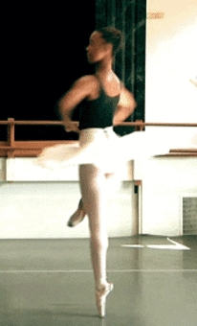
Vers, vert
Meaning: to turn, to spin
Vertigo
Reverse
Convert
Advertise
Revert

Slide 5

Cred, creed
Meaning: to believe
Incredible
Credentials
Credit
Accreditation

Slide 6

Circum
Meaning: around, full circle/ring, round about
Circumference
Circumnavigate
Circumstance
Circumspect

Slide 7
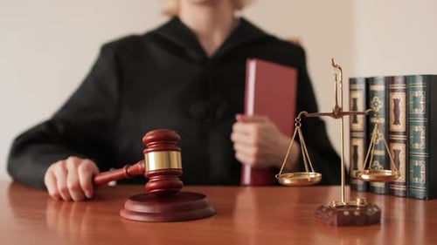
Jud, jur, jus
Meaning: law, decision, judgement, fairness
Adjudicate
Judicial
Jury
Perjury
Justify
Justice
Just

Slide 8
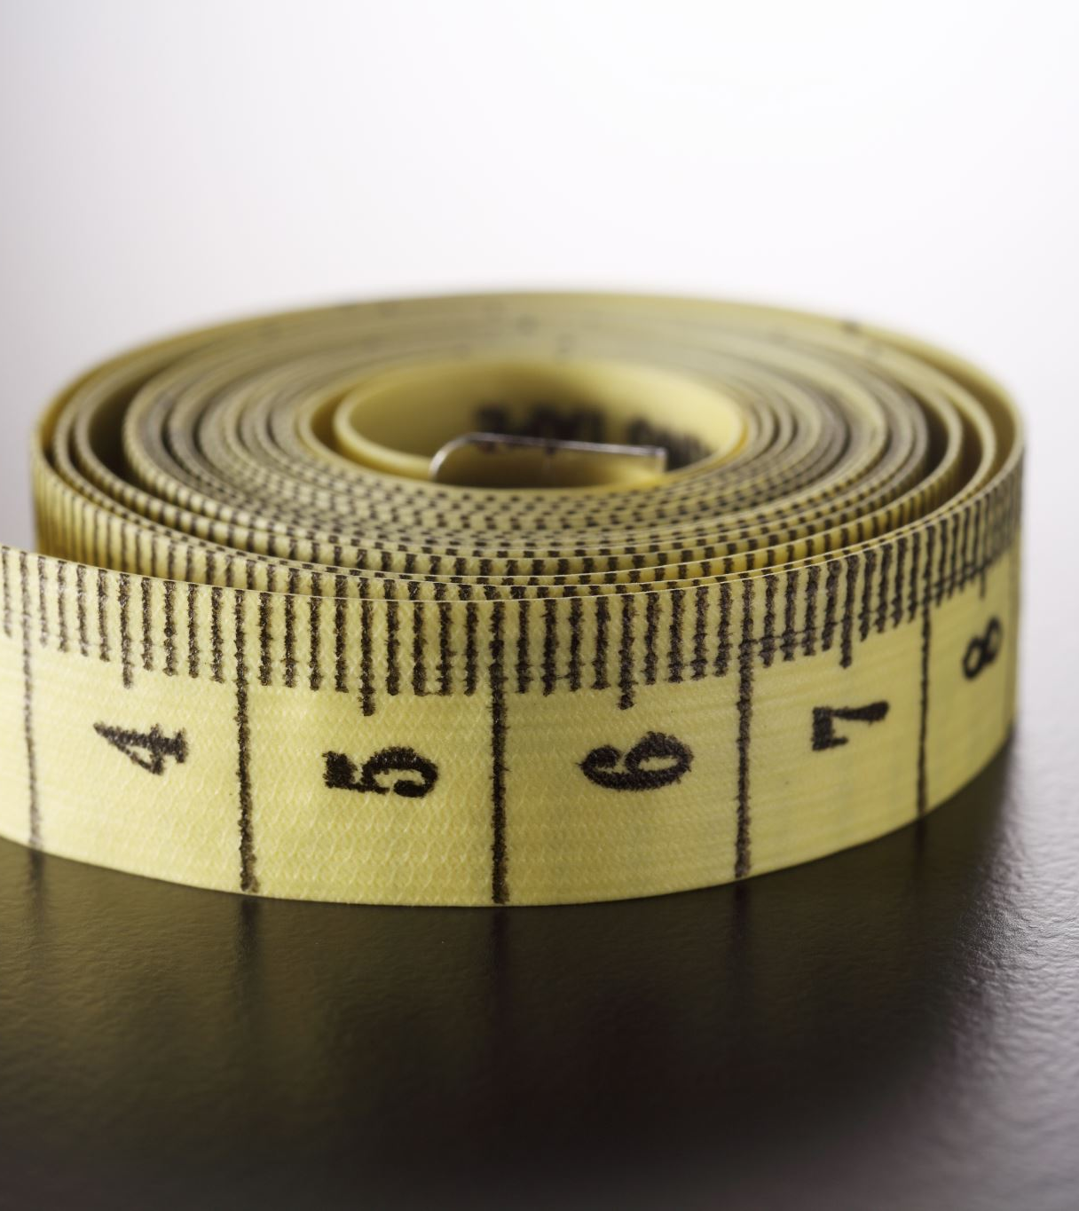
Meter, metr
Meaning: measure
Speedometer
Thermometer
Optometry
Symmetry

Slide 9

Bio
Meaning: life, alive, living things
Biology
Biography
Biodiversity
Symbiosis
Biome

Slide 10

Pre, pro, fore, ante
Meaning: in favour of, in front of, before, first
Prepare
Promote
Pregame
Progress
Foreshadowing
Forefront
Antechamber

Slide 11
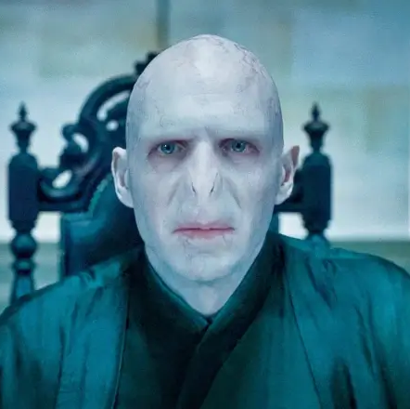
Mor, mort, necro
Meaning: death, corpse
Mortician
Mortal/immortal
Morbid
Voldemort
Necromancy
Necrosis

