Slide 1

Year 9 Vocab
Term 4, Week 6

Slide 2
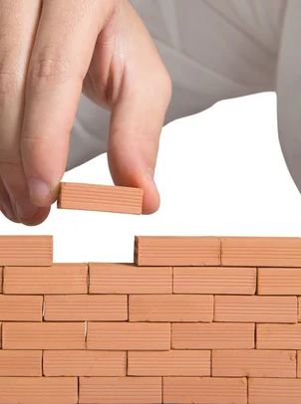
Pos, pon, posit
Meaning: to put, to place, to set down
Position
Postpone
Composition
Proposal
Expose

Slide 3

Helio, sol
Meaning: sun
Solar
Parasol
Solstice
Heliosphere
Helium
Heliotrope
Heliocentric

Slide 4

Contra, Counter
Meaning: opposite, against
Examples:
Contradict
Counterclockwise
Contrast
Counteract
Contrary

Slide 5

Voc, vok, dict
Meaning: voice, say, speak, call, declare
Vocal
Vocabulary
Provoke
Dictionary
Dictator
Contradict
Predict
Dictate

Slide 6
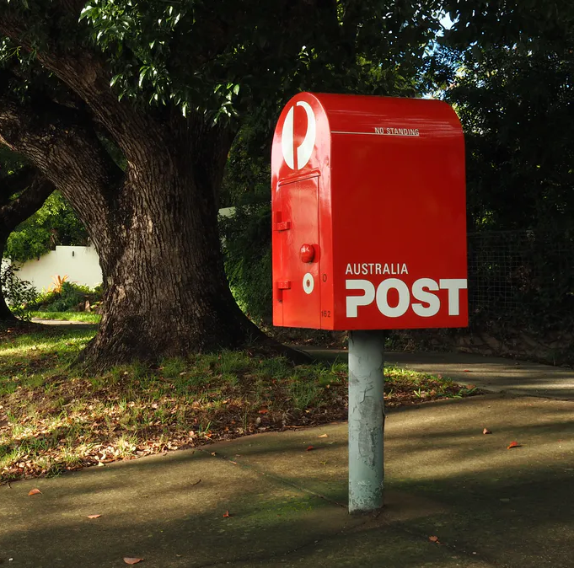
Mit, miss
Meaning: to send
Emit
Dismiss
Mission
Submit
Admit

Slide 7

Phile, phil, am, amor
Meaning: love, lover of, friend, enthusiast, tendency towards
Philosophy
Philanthropy
Bibliophile
Amity
Enamour
Haemophiliac
Amateur

Slide 8

Geo, terr, terra
Meaning: earth, land, ground
Geography
Geology
Geothermal
Extraterrestrial
Terrain
Mediterranean
Subterranean

Slide 9

Psych, anim
Meaning: mind, soul, spirit, life, breath
Psychology
Psychopath
Psychic
Unanimous
Animated
Animal

Slide 10

Struct
Meaning: build, assemble
Construct
Structure
Instruct
Destruction
Obstruct

Slide 11
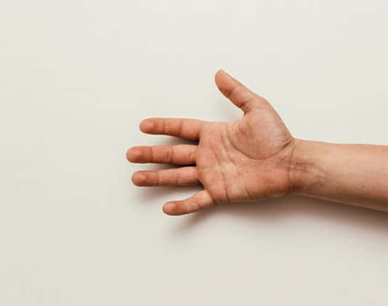
Man, manu
Meaning: hand, by hand
Manuscript
Manual
Manufacture
Manacle
Manipulate
Manoeuvre

