Slide 1

Year 9 Vocab
Term 4 Week 2

Slide 2
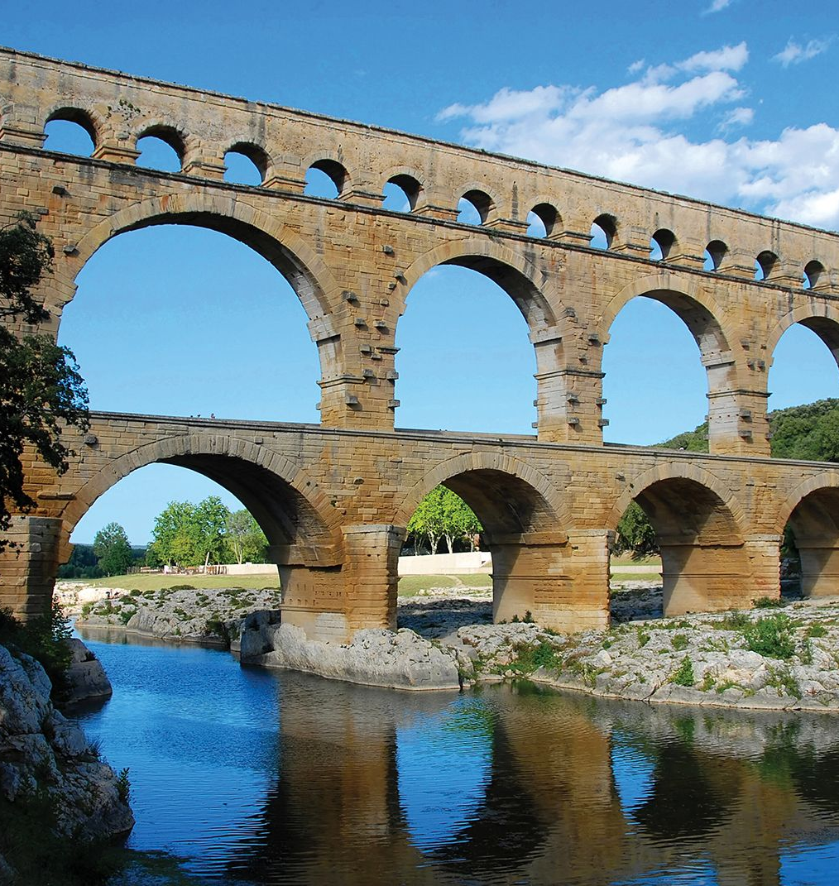
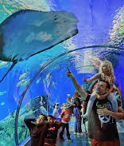
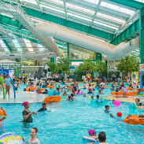

Aqua, hydr, hydro
Meaning: Water
  Aquarium
  Aquatic
  Hydration
  Dehydrate
  Hydrotherapy
  Hydrant

Slide 3
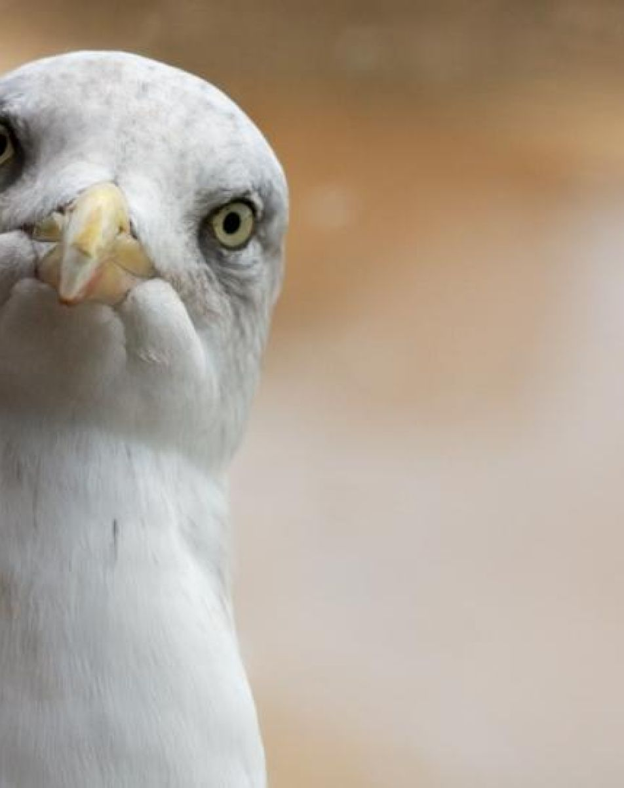
Spect, spic, scope, vid, vis
Meaning: to look, to watch, to see
Spect – inspect, spectator, perspective
Spic – conspicuous, suspicion, auspicious
Scope - microscope, telescope
Vis - visible, invisible, vision, supervise
Vid – video, evidence

Slide 4

For, fort
Meaning: strong, strengthen
Fort, fortress
Force, forceful
Reinforce
Forte, fortissimo
Comfort
Effort

Slide 5

Pend, pens
Meaning: to hang or weigh
Suspense
Pending
Expensive
Pendulum
Dependent

Slide 6

Duct, Duce
Meaning: to lead, to draw along
Conduct
Aqueduct
Deduce/deduction
Introduce
Reduction

Slide 7

Cap, cip, cept
Meaning: to seize, to take, to grab hold of
Captive
Deceptive
Concept
Capacity
Encapsulate

Slide 8

Mal, Mis, Dis, Dys
Meaning: bad, wrong, hate, difficult, unlucky, abnormal
Mal- malnutrition, malfunction
Mis- mistake, misunderstanding, misogyny
Dis- dismay, disappoint
Dys- dysfunctional, dyslexic, dystopia

Slide 9

Con, Com, Col, Co, Syn, Sym
Meaning: together, with
Con – connect
Com – community, communicate
Col – collaborate, collect
Co – coworker, copilot
Syn – synchronised, synonym
Sym – sympathy, symphony

Slide 10

Photo, phos, lumin
Meaning: light
Photograph
Photosynthesis
Phosphorescence
Illuminate
Luminous
Bioluminescence

Slide 11

En, em, endo, intra, inter, intro
Meaning: in, into, inside, between
En – encode, enclose, endocrine
Em – empower, embrace
Intra – intravenous, intranet
Inter – intervene, intercept
Intro – introvert, introduction

