Slide 1



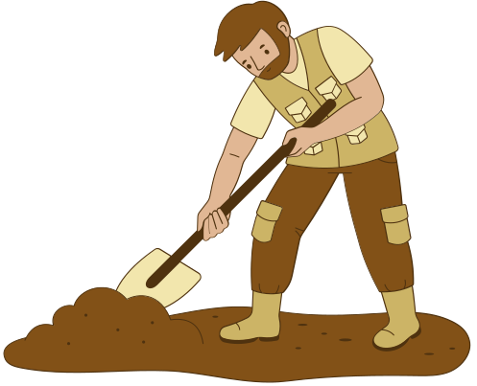
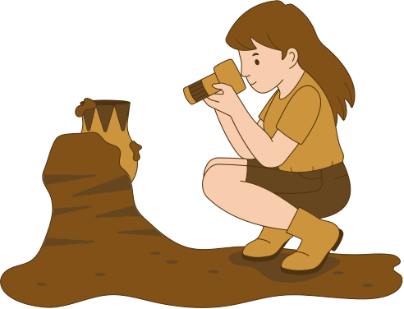
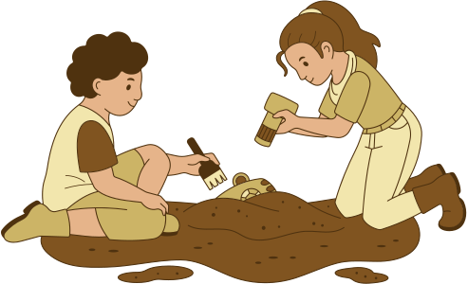


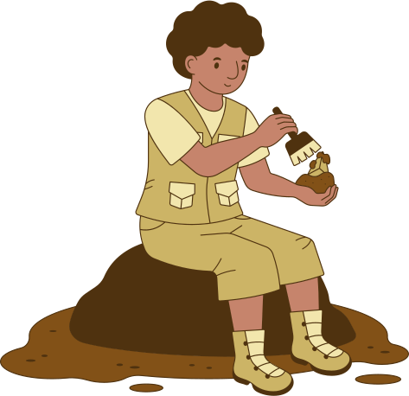



PREACH!
Archaeology
Reasons we can believe the Bible to be true

Slide 2


What is Archaeology?
Archaeology is the study of the human past using material remains. These remains can be any objects that people created, modified, or used.
Portable remains are usually called artifacts. Artifacts include tools, clothing, and decorations. Non-portable remains, such as pyramids or post-holes, are called features.
Archaeologists use artifacts and features to learn how people lived in specific times and places. They want to know what these people’s daily lives were like, how they were governed, how they lived.

Slide 3

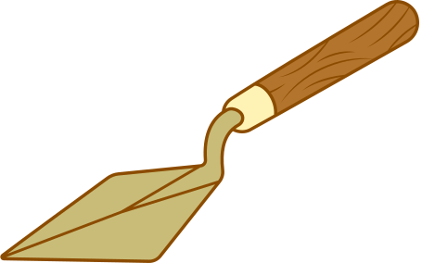
Biblical artifacts found by Archaeologists
Moabite Stone
Evidence of Omri, King of Israel
2 Kings 3:4-5
Ahab’s Ivory Palace
1 Kings 22:39
The Black Obelisk of Assyria
Evidence found supporting Jehu, King of Israel offering tribute to Shalmaneser

Slide 4
Biblical artifacts found by Archaeologists
Hezekiah’s Tunnel
Pool of Siloam inscription
2 Kings 2:20
Taylor’s Prism
Sennacherib’s Invasion of Judah in Hezekiah’s time
2 Kings 18
Nabonidas Inscription
Proof of the reign of Belshazzar
Daniel 5

Slide 5
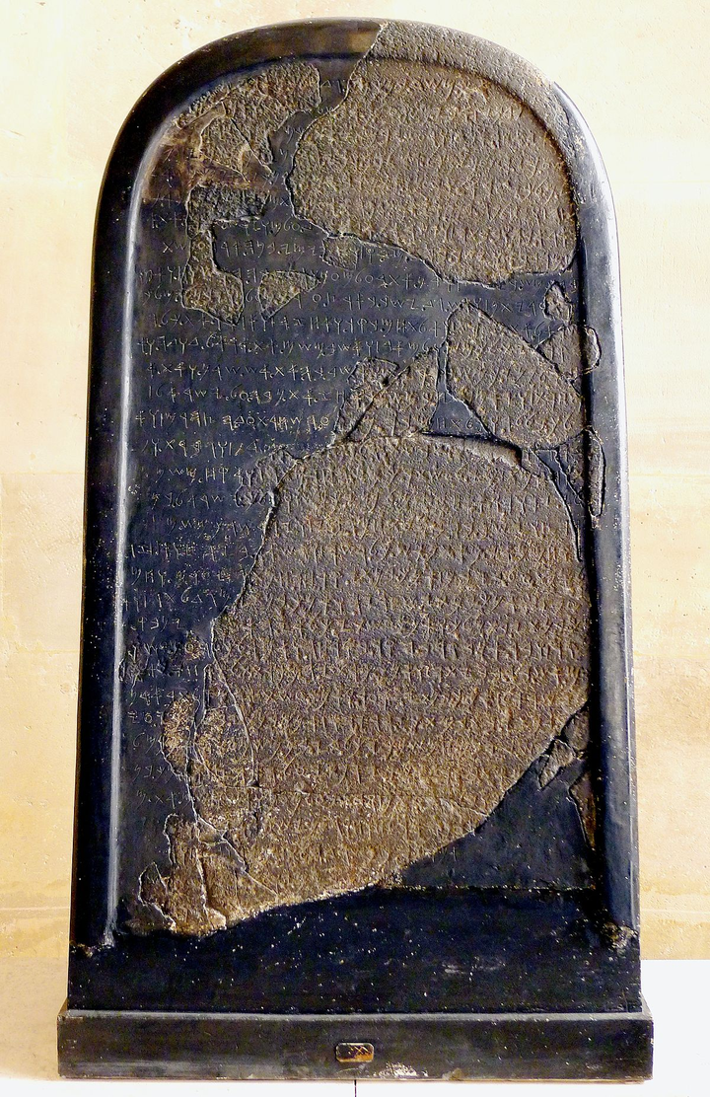


The Moabite Stone
Read 2 Kings 3:4, 7-27
Which King was paying tribute to Israel?
What happened?
The Stone
Found in August 1868 in what is now Jordan.
Most extensive reference to the Kingdom of Israel outside the BIble.
Now housed in the Louvre in Paris.
Tells the story from the Moabite perspective.

Slide 6

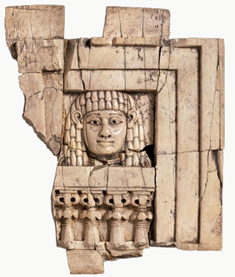
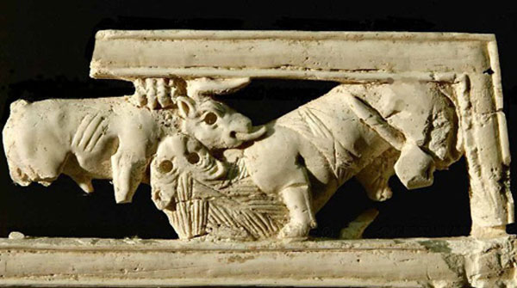
Ahab’s Ivory Palace
Read 1 Kings 22:39
Many Bible critics thought ivory was not used as a furniture or building material that far back in history. Despite in 1 Kings 10 Solomon had brought ivory to Jerusalem.
What they found?
Over 500 fragments of ivory in the ruins of ancient Samaria- more than 200 were carved. Dated to around 860 BCE

Slide 7
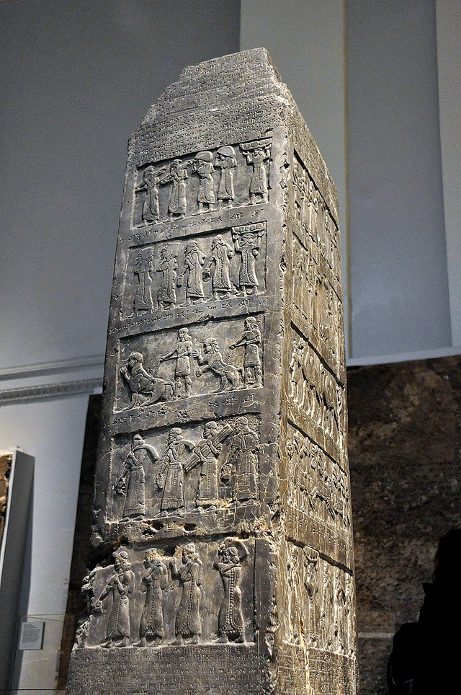
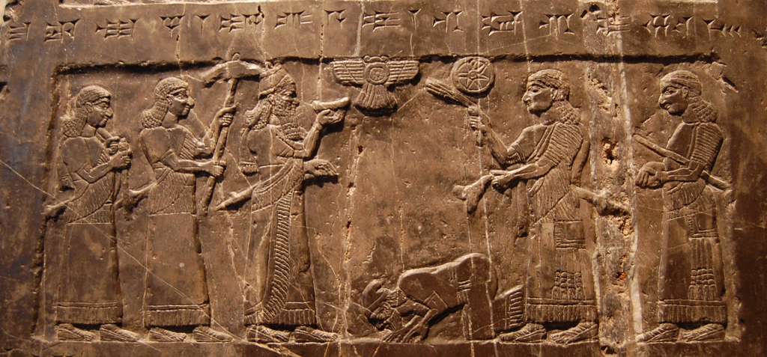
The Black Obelisk of Assyria
King Shalmaneser
The Obelisk shows Jehu bowing in submission to Shalmaneser and other Israelites paying tribute.
Also includes images of Ahab fighting agasint Shalmaneser at the battle of Karkar.
Not in the Bible?
Both the events on the Obelisk aren’t mentioned in the Bible- but it provides proof that these people existed.

Slide 8
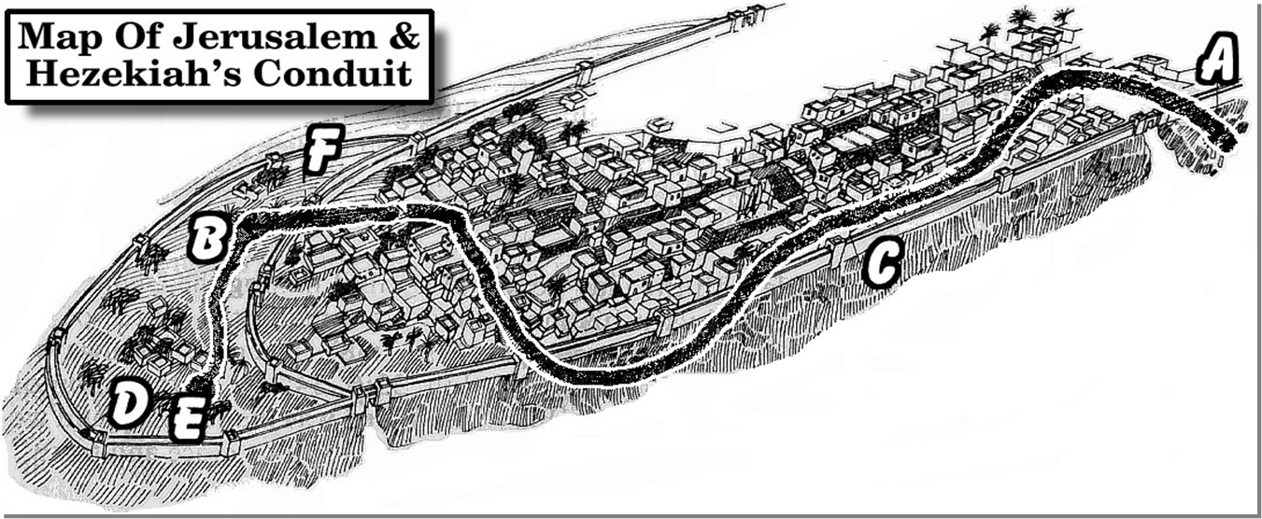
Hezekiah’s Tunnel
Read 2 Chronicles 32:30 and 1 Kings 20:20
Before 1880 there was no physical evidence to support the pool or the tunnel.
What they found?
An inscription near the water level of the pool of siloam

Slide 9

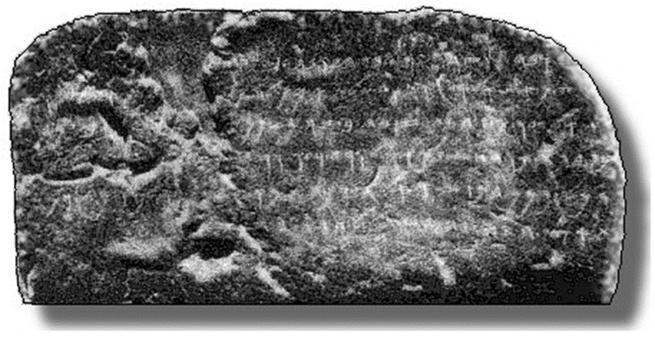

Pool of Siloam inscription
Behold the excavation! Now this is the history of the excavation. While the excavators were still lifting up the pick, each towards his neighbour; and while there were yet three cubits to excavate, there was heard the voice of one man calling to his neighbour; for there was an excess in the rock on the right hand and on the left. and after that on the day of excavating, the excavators had struck pick against pick, one against the other; the waters flowed from the spring to the pool for a distance of 1200 cubits. and part of a cubit was the height of the rock over the head of the excavators.

Slide 10
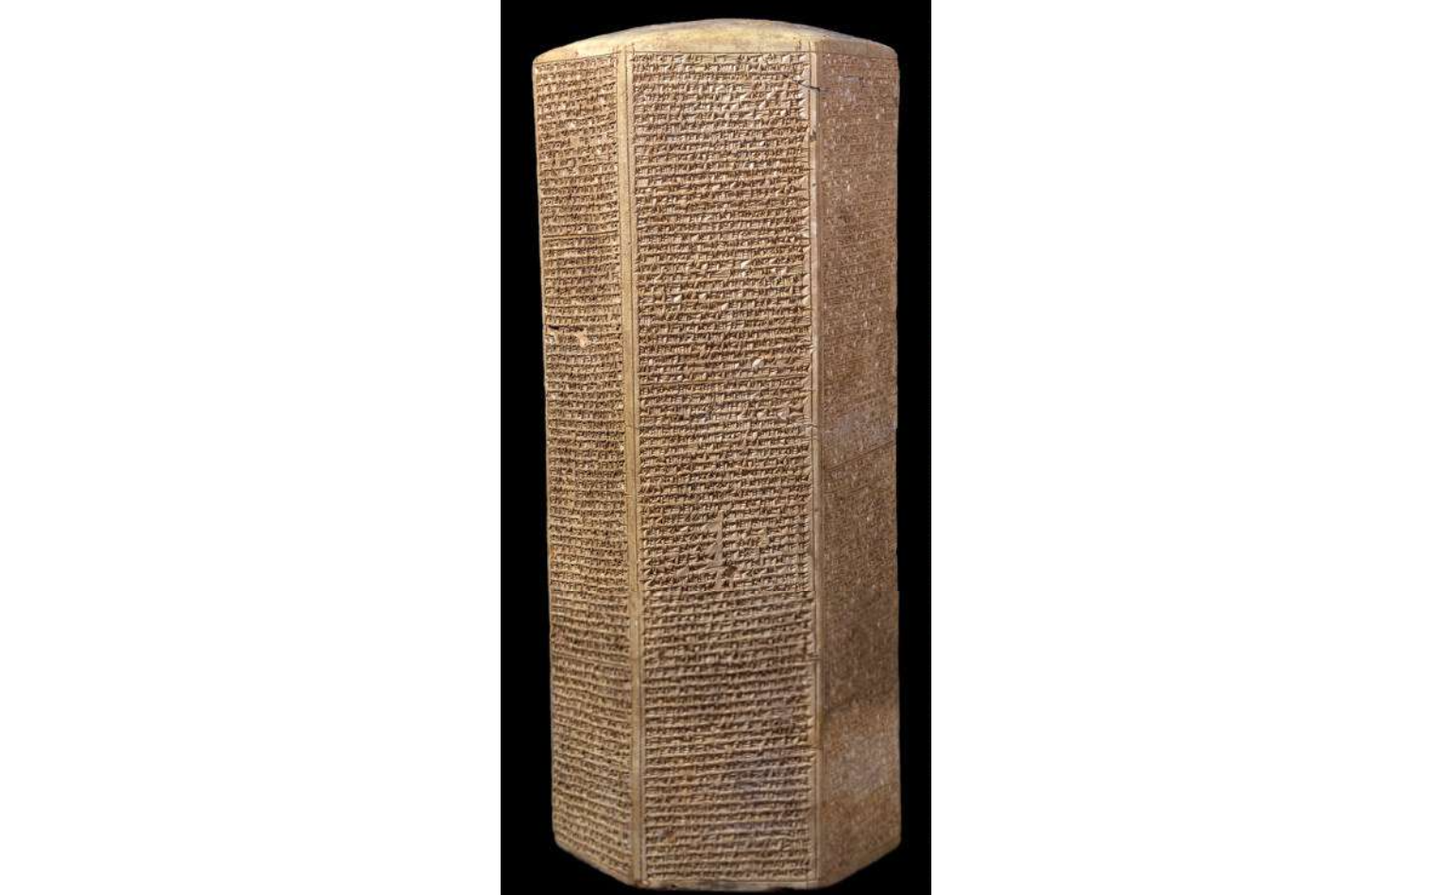
Taylor’s Prism
2.505
Read 2 Kings 18, Isaiah 36-37, 2 Chronicles 32
Prism was found by an archaeologist named Taylor.
Records the event from the Assyrian point of view- interestingly doesn’t talk about losing the 185,000 - but doesn’t say he succeeded either.

Slide 11
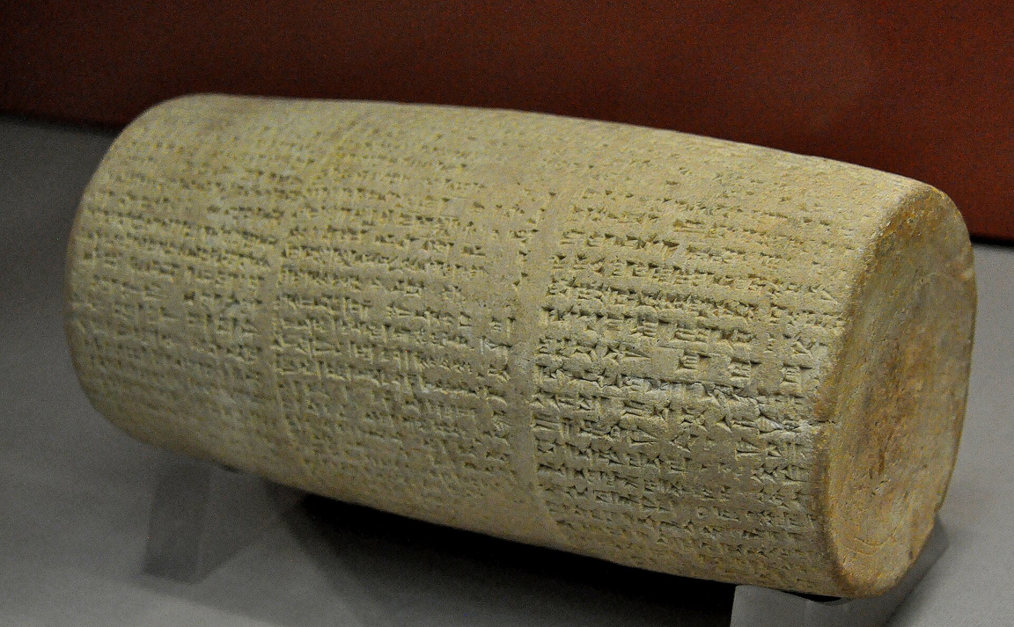
The Nabonidas Inscription
Look at Daniel 5
Who was the ruler when Babylon was overthrown?
Prior to 1854
There was no physical evidence of Belshazzar. Until Dr. Henry Rawlinson found the clay cylinder.

Slide 12
Nabonidas inscription
As for me, Nabonidus, king of Babylon, save me from sinning against your great godhead and grant me as a present a life long of days, and as for Belshazzar, the eldest son -my offspring- instill reverence for your great godhead in his heart and may he not commit any cultic mistake, may he be sated with a life of plenitude

Slide 13
And wait... there’s more
Key Takeaways:
  Many people were critical of Biblical events until physical evidence appeared
  Archaeology is not always correct, we are trying to piece together things from ages ago- faith is still required.
  No archaeologic find has contradicted the Bible
The Archaeological record support the Bible’s truth!

